Slide 1
UK National Report
Sarah North & Steve Bond
PMO 5 – Chile – July 2015

Slide 2
UK VOS Fleet - VOS Classes
 | July 2015
Selected | 51 <
Selected (AWS) | 0
VOSClim | 205 >
VOSClim (AWS) | 1
Auxiliary | 0
Auxiliary (AWS) | 0
Supplementary | 0
Supplementary (AWS) | 44 >
[ =301 ]
We also receive third party data from >110 automated offshore installations
© Crown copyright Met Office

Slide 3
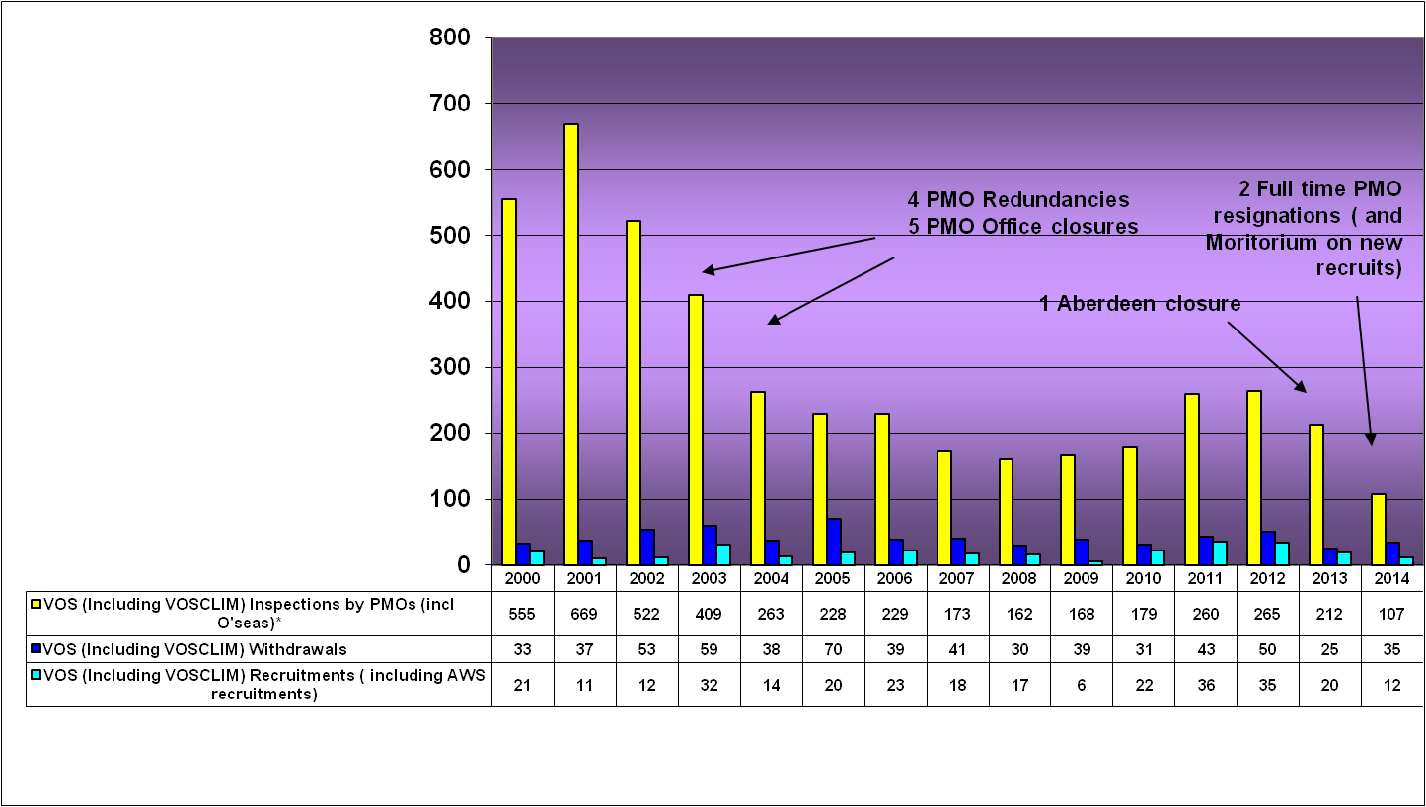
PMO Activity – since 2000

Slide 4
UK VOS – Fleet 1992 - 2014
© Crown copyright Met Office

Slide 5
UK VOS Fleet - Observations Trend 2006 - 2015
© Crown copyright Met Office

Slide 6
Selected – v – VOSClim Observations
© Crown copyright Met Office

Slide 7
Observations in 2014
88296 – real time observations from manually reporting UK VOS & VOSClim ships (81311 within HH+120 minutes)
262541 –real time observations from shipborne AWS installed
>800000– real time observations from third party offshore rigs and platforms.

Slide 8
Met Office – v- Third Party Obs 2009-15 (excluding moored buoys)
© Crown copyright Met Office
Notes:
8

Slide 9
VOSClim Activity 2010 -15
We are moving to a core UK fleet of ~200 active manually reporting VOS Climate standard ships
© Crown copyright Met Office

Slide 10
Status Report UK s Ccommunication Costs – Inmarsat 2002 -2014
Increased use of E-mail for sending Obs
Goonhilly Closure and transfer of ASAP TEMP messages
© Crown copyright Met Office

Slide 11
Data Quality – RMS Pressure
2011-2015 (AWS & Manned VOS)
© Crown copyright Met Office

Slide 12
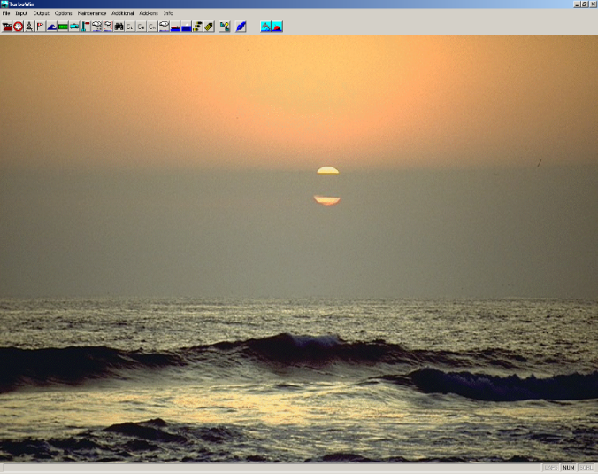
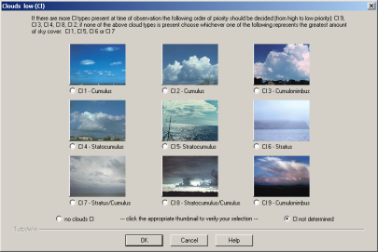
Electronic Logbook Versions
TurboWin
5.0+ – 176 ships
4.0+ – 65 ships
TurboWeb
15 ships
© Crown copyright Met Office
Notes:
12

Slide 13
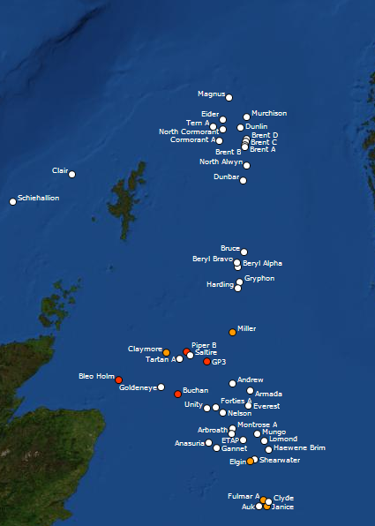
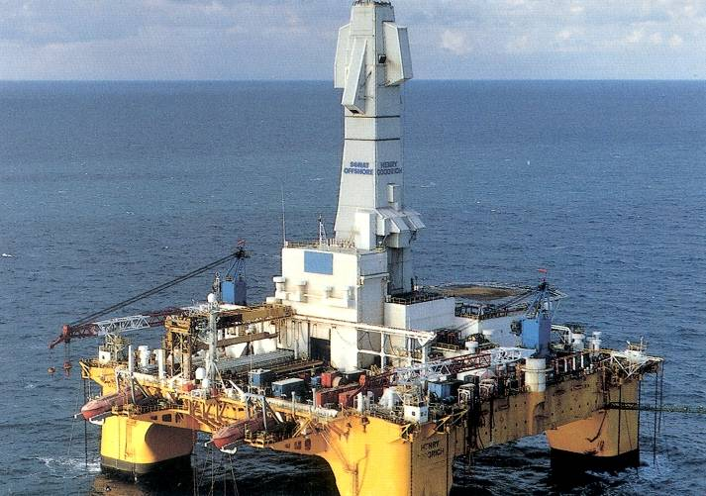
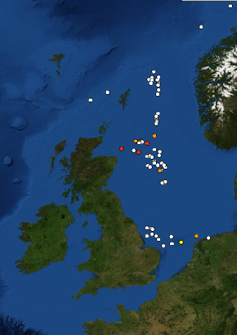
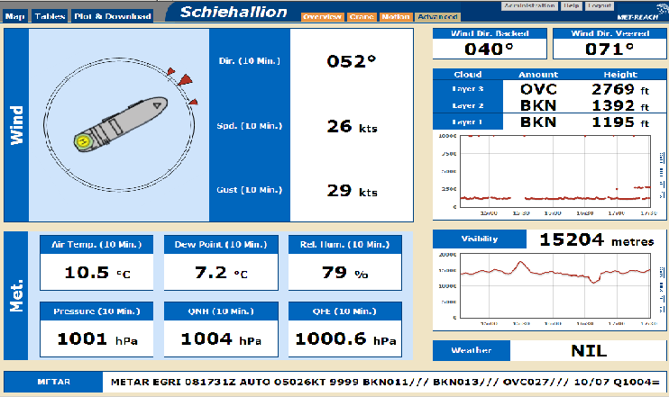
Third Party Offshore Platforms & Rigs
>110 installations contributing ~ 800k observations
© Crown copyright Met Office

Slide 14
VOS Automation
Integrated AWS Systems
1 BATOS system - installed on fishery protection vessel
Autonomous AWS Systems
41 AMOS AWS systems installed mainly on ferries operating out of the UK, but also on a few ships and research ships operating in data sparse areas
3 MINOS systems on ferries operating out of the UK
Notes:
14

Slide 15
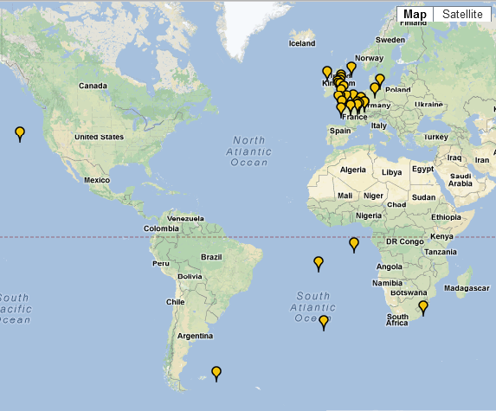
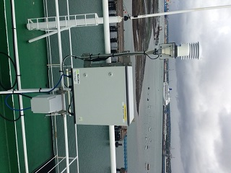
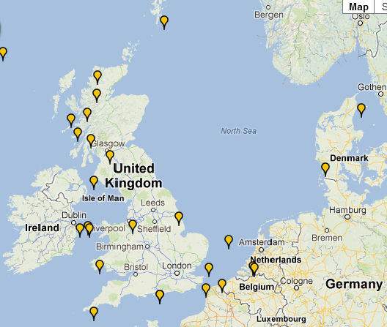
Recent AMOS locations
41 AMOS systems currently active on ferries, coastal ships, research ships and container ships
© Crown copyright Met Office

Slide 16
AMOS Plans
Plan to install a further 15 systems in this Financial Year
Agree future iridium supplier
Finish rolling out new data format
Concentrate on 24 v systems if possible
Start developing a Mk2 variant
AMOS Display development on bridge
New data gateway to allow BUFR data to the GTS and with ability to block poor data

Slide 17
Future VOS Plans
Aim for 100 AMOS systems (rolling out ~15 new AMOS this FY)
Replace all existng ship AWS systems with AMOS this year
Aim for 200 ‘Active’ manually reporting VOSClim ships
Operational Acceptance for AMOS
Phasing out use of mercury thermometry ( use of digital systems)
Roll out of TurboWeb to suitable ships
Roll out of TurboWin V5.5 using E-Surfmar data format
Further roll out of Vaisala 330 barometers to replace PAB’s
Concentrate on key shipowner’s with increased ‘buy-in’
Development of new marine data gateway to permit BUFR quality data to GTS
© Crown copyright Met Office

Slide 18
Questions
Perfect World
Real World

