Slide 1
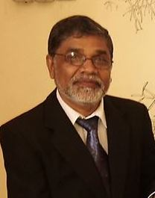
“Fifth International Port Meteorological Officers (PMO) Workshop”, Vina del Mar, Chile, 20-24 July 2015.
Asoka Premaratne Piyadi Gamage
from Sri-Lanka
Email; asokapre@gmail.com
Tele Phone +94711693441
+94766266057
Facebook; Piyadi Gamage Asoka Premaratne
Linkedin Asoka Premaratne

Slide 2
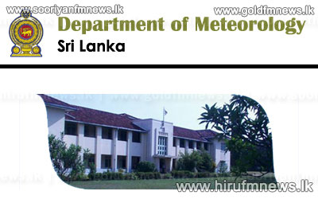
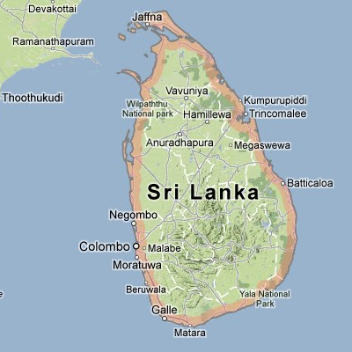
SRI-LANKA
7.0000° N, 81.0000° E

Slide 3
Country in Asia
Sri Lanka (formerly Ceylon), a tiny island nation south of India in the Indian Ocean,
Capitals: Sri Jayawardenepura Kotte,Colombo
Population: 20.48 million (2013) World Bank
Continent: Asia
President: Maithripala Sirisena
Official languages: Sinhala, Tamil

Slide 4
Department of meteorology, 383,bauddaloka mawatha, Colombo-7, sri-lanka. WWw.meteo.slt.lk +94112694846-7
started in 1867 under British governors
the Survey Department was later continued by as the Colombo Observatory after 1909.
The Colombo Observatory became an independent government department – Department of Meteorology in 1948
Now it is under the purview of the Ministry of Disaster Management.

Slide 5
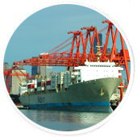
Functions
The following major functions are accomplished by the department
1. Observing weather elements in conformity with international standards
2. Provision of weather and climatological services as the national authority
3. Provision of early warning information/advisories on bad weather and tsunami
4. Provision of meteorological services to national and international aviation
5. Maintaining climatological databases
6. Encouraging study and research in Meteorology and allied subjects
7. Organizing and contributing to public awareness programs
8. Provision of limited astronomical and terrestrial magnetism related services.
9.Issuing fleet forecast for Ships and navel personals and issuing bad weather warnings for fisherman via the relevant authorities.

Slide 6
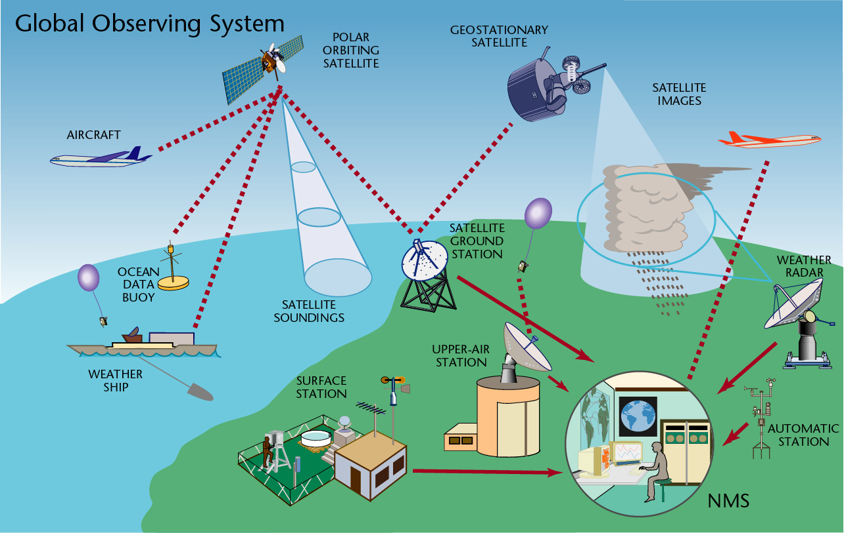
Meteorological Data Network Meteorological Observations
Meteorological data observed at the observation networks of the Department of Meteorology can be broadly categorized surface meteorological data and upper atmospheric meteorological data

Slide 7
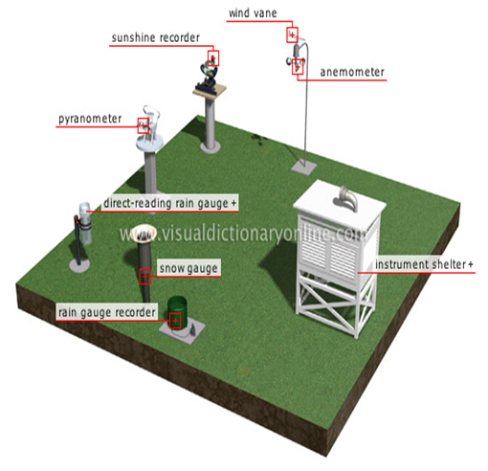
Surface Observations Synoptic Meteorological Information
Surface synoptic meteorological observations are made at the regional meteorological stations at 3 hourly intervals.
observations on rainfall, pressure, temperature, humidity, wind, visibility, weather and clouds have been made at the surface meteorological network stations of the Department of Meteorology.
In addition to manual observations, self-recording instruments are also used at meteorological stations to record major weather parameters.

Slide 8
Rainfall Information
Rainfall measuring stations were established since 1867
Nowadays there are 521 rainfall stations functioning under the Department.

Slide 9
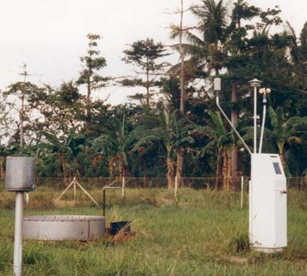
Agro Meteorological Information
Agro Meteorological stations established since 1973.
38 agro Meteorological stations functioning under the department.

Slide 10
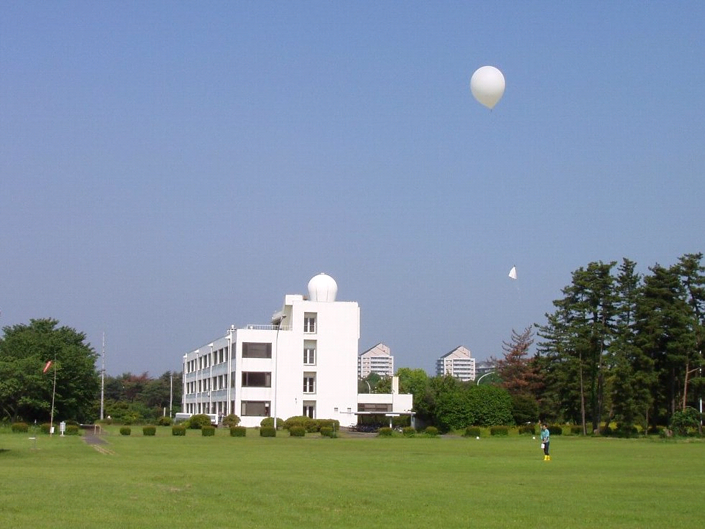
Upper Atmospheric Information
In Colombo, upper air observations are made thrice a week at 0600 hours UTC using the radiosonde equipment up to a height of approximately 20 km from the surface.
The total number of radiosonde observations made during the year 2014 was 148.
pilot balloon observations are made at Mannar, Hambantota, and Trincomalee and Colombo stations.

Slide 11
Weather Reports
Following additional inquiries have been responded by the National Meteorological Centre during the year 2014.
Inquiries on weather by Police, Hotels, and Mercantile establishments – 2238
Inquiries on weather by fishing community - 780
Interviews on weather by Media - 120
Certified weather reports - 134

Slide 12
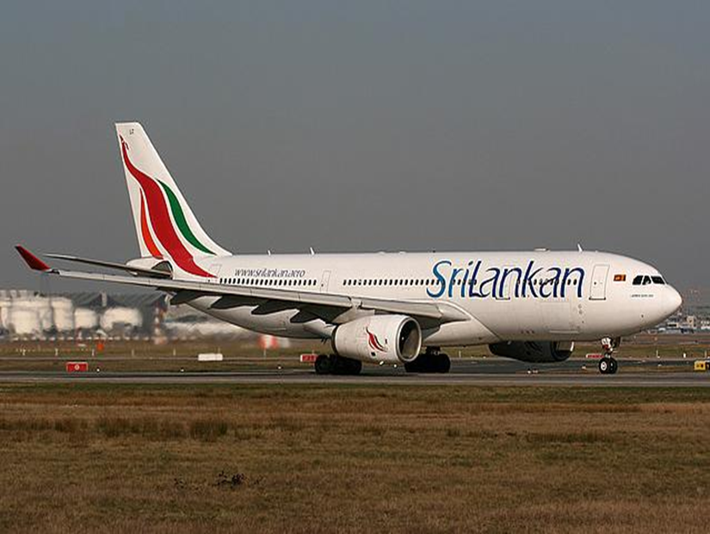
Katunayake International Airport
Meteorological station at Katunayake International Airport has provided the following service to flights that fly through its Flight Information Region during the year 2014:
Terminal Aerodrome Forecasts (TAF) 1,460
Meteorological Aerodrome Reports (METAR) 17,028
Special Observations (SPECI) 628
Weather Warnings (SIGMET) 154
Aerodrome Warnings 28
Flight Folders 25,134
Area Forecasts 5,945
Route Forecasts 4,678

Slide 13
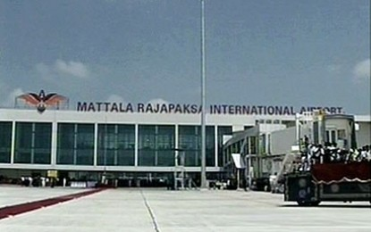
Mattala International Airport
Details of information provided to aviation community by the Mattala International Airport are briefly given below:
Terminal Aerodrome Forecast (TAF) 1,460
Meteorological Aerodrome Reports (METAR) 14,384
Special Observations (SPECI) 263 9

Slide 14
Ratmalana Airport
Major task accomplished by this station is to provide meteorological information required for domestic flights and for Sri Lanka Air Force flight operations. Details of the services provided during the year 2014 are stated below:
Meteorological Aerodrome Reports (METAR) 4,760
Special Observations (SPECI) 347
Provision of Surface Pressure to aircrafts 130

Slide 15
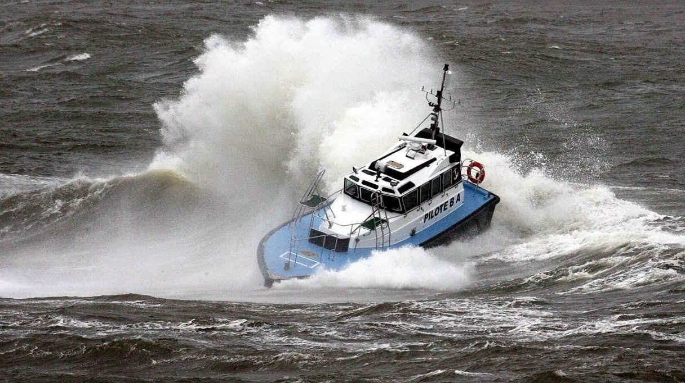
Provision of Meteorological Services for Marine Activities Shipping Report
Shipping reports on meteorological condition of the sea area around Sri Lanka are issued everyday at 10.00 am and 04.00 pm. The total number of shipping reports issued during the year 2014 was 730.

Slide 16
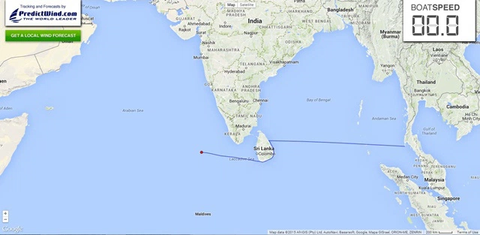
Fleet Forecast
Fleet forecasts are issued at 06.00am and 04.30pm and contains the weather, sea state and wind conditions of the sea area given in figure below. The total number of Fleet Forecasts issued during 2014 was 730.

Slide 17
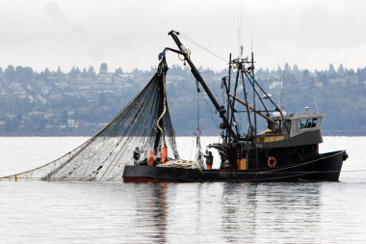
Forecast for Multi-Day Fishing Vessels
Weather forecast for the sea area of the Southern Indian Ocean, Bay of Bengal and the Arabian Sea is issued for the benefit of multi-day fishing vessels on daily basis. These forecasts are issued with a validity period of 72 hours and are disseminated through Sri Lanka Navy and Fisheries Department. As the issue of this forecast commenced from 01st October 2014 only 92 such reports have been issued by 31st December 2014.

Slide 18
Shipping
Sri Lanka is strategically located in the Indian Ocean coming on the way of major sea routes. Shipping lines linking Europe, America, Far East, Middle East and Asia pass through the ports of Colombo, Galle and Trincomalee. Sri Lanka is a major and convenient link on these routes.

Slide 19
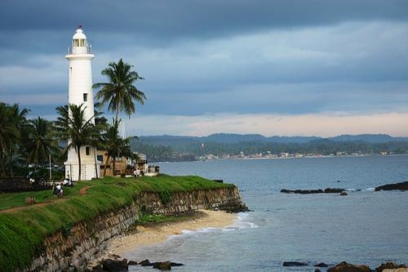
The Seaports
Colombo JAYE Container Terminal of Colombo is fully equipped modern seaport. The 632meters long port has the draught of up to 13 meters making it capable of handling modern container vessels. The terminal facilities are equipped with modern cargo handling equipment. All kind of cargo can be stuffed and destuffed here. Queen Elizabeth Quay Container Terminal is 425 meters long with the maximum draught of 12 meters. Dry dock and bulk handling facilities are available Colombo airports.
Trincomalee
Trincomalee is considered among the finest natural harbours in the world. It is naturally equipped with unlimited draught and is capable of accommodating even the largest vessels. Galle Galle port can handle two vessels at along-side berths. The port has the facilities of road and rail access. It has well equipped transit sheds.

Slide 20
Thank you thank you very much
Port Meteorological stations are not established under our department due to lack of staff and lack of funds In Sri-lanka
Future plans to improve them accordingly to other countries
I suppose this International Port Meteorological workshop will help for it.
In the mean time
I may take this opportunity to thanks to The WMO
And the whole staff engage with WMO
The Chilean government
And the whole staff who engaged with this event in Chile and the staff of embassies
Sri Lankan government and the Disaster Ministry and DoM Chilean console and the whole staff each and every authorities.

