Slide 1
National Report
Compiled and Presented by: Mardené de Villiers
South African Weather Service

Slide 2
Index
Background
VOS fleet
ASAP
Buoy Deployment
In Process

Slide 3
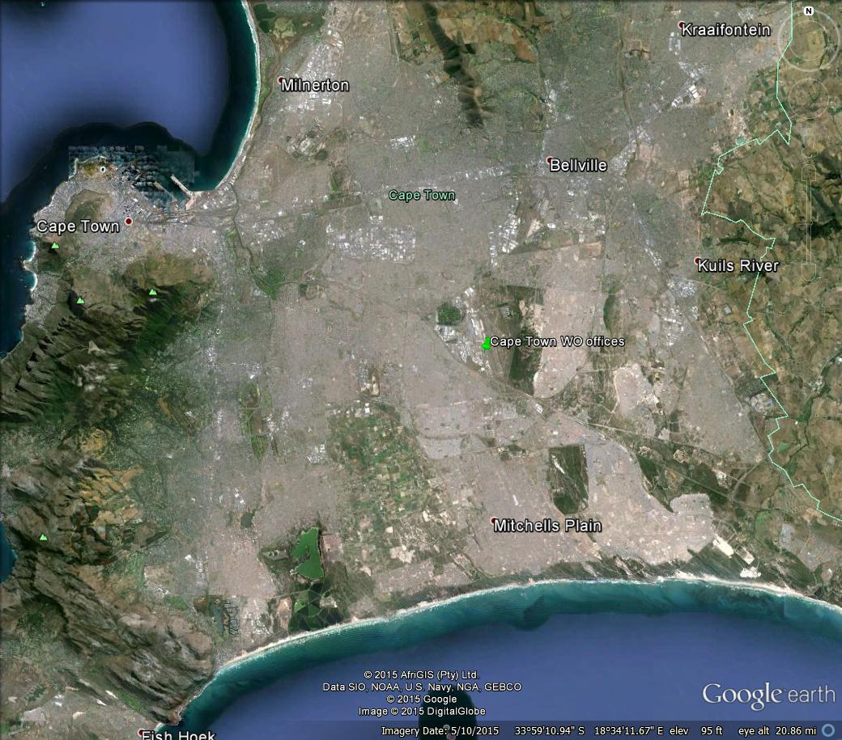
Background
Head office
PMO offices
Marine office

Slide 4
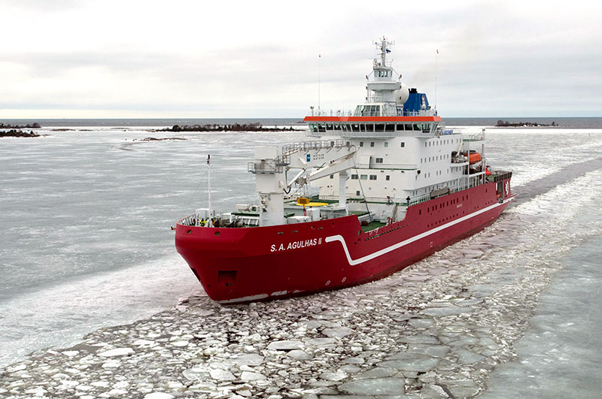
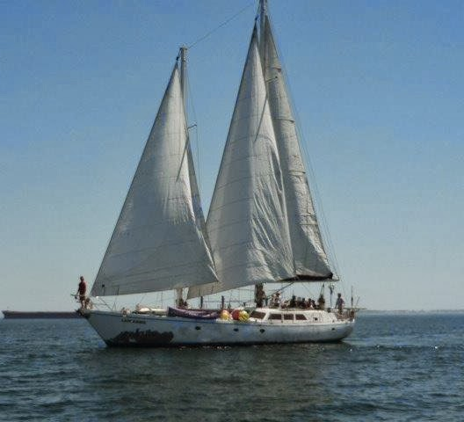
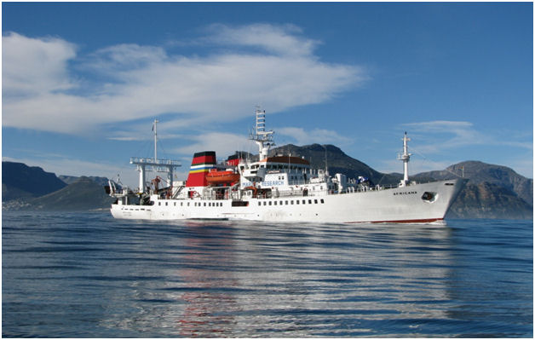
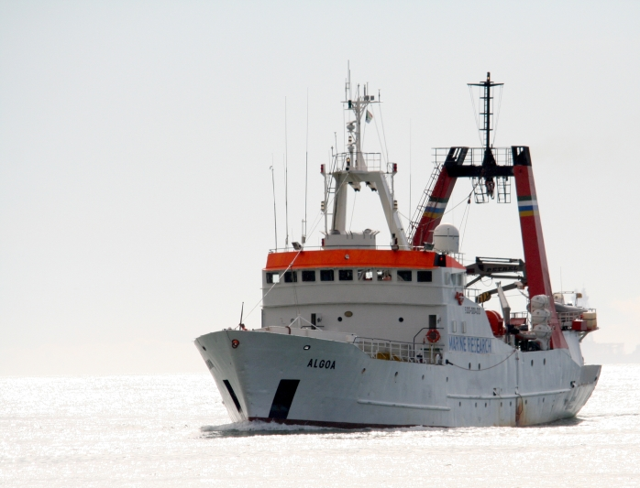
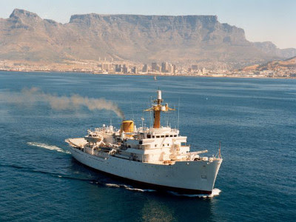
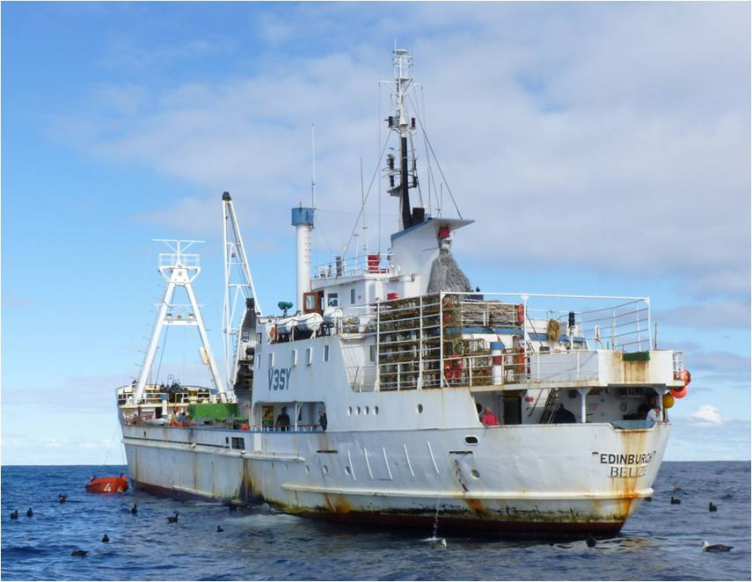
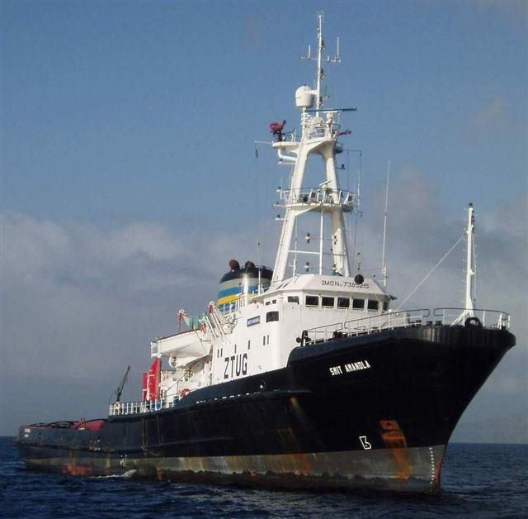
VOS fleet
SA Agulhas II
Lady Amber
Afrikana
Algoa
SA Agulhas I
SAS Protea
Edinburgh
Smit Amandla

Slide 5
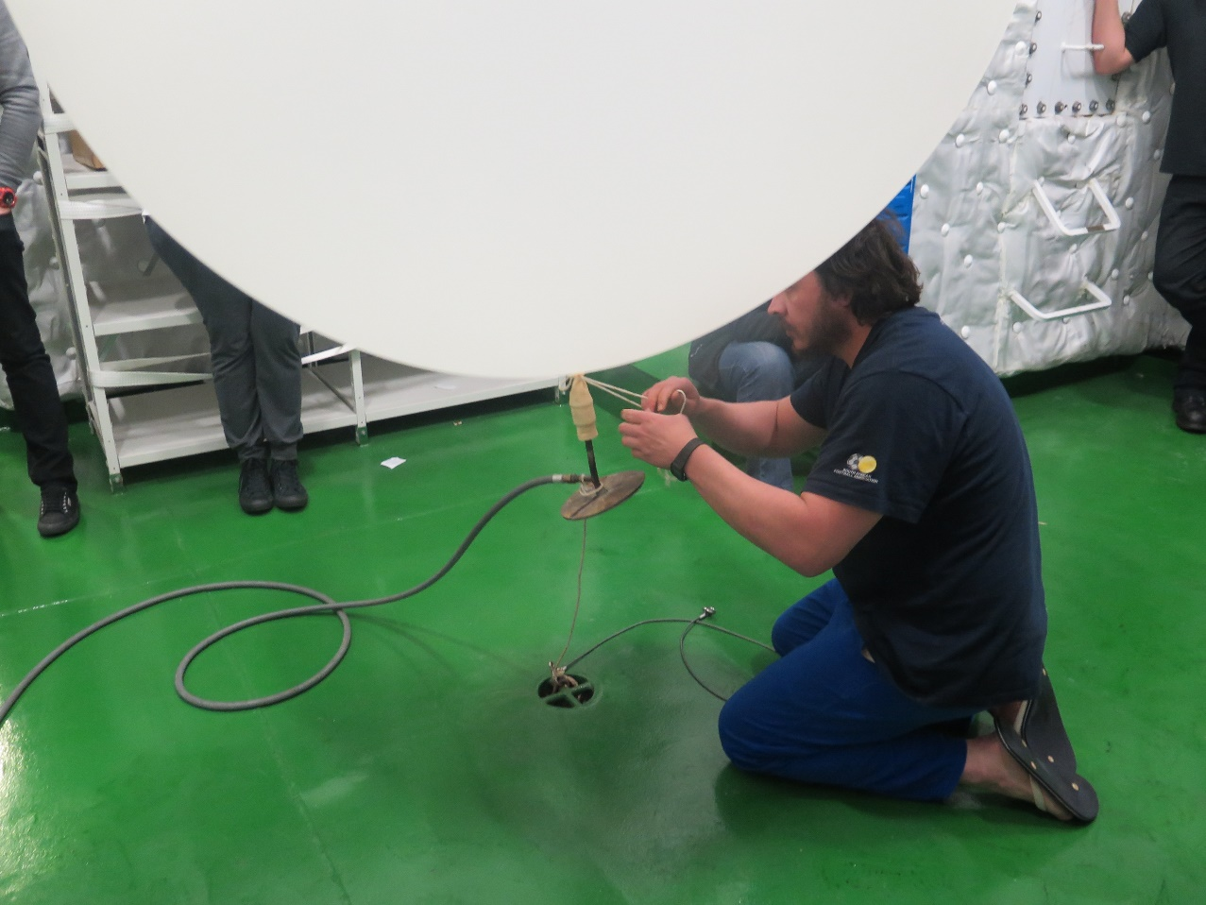
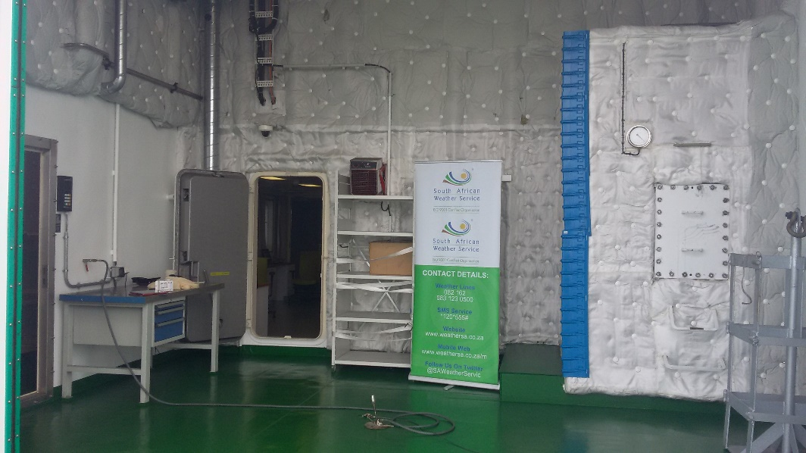
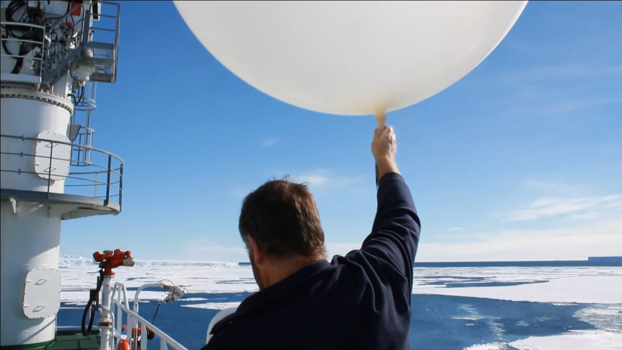
ASAP

Slide 6
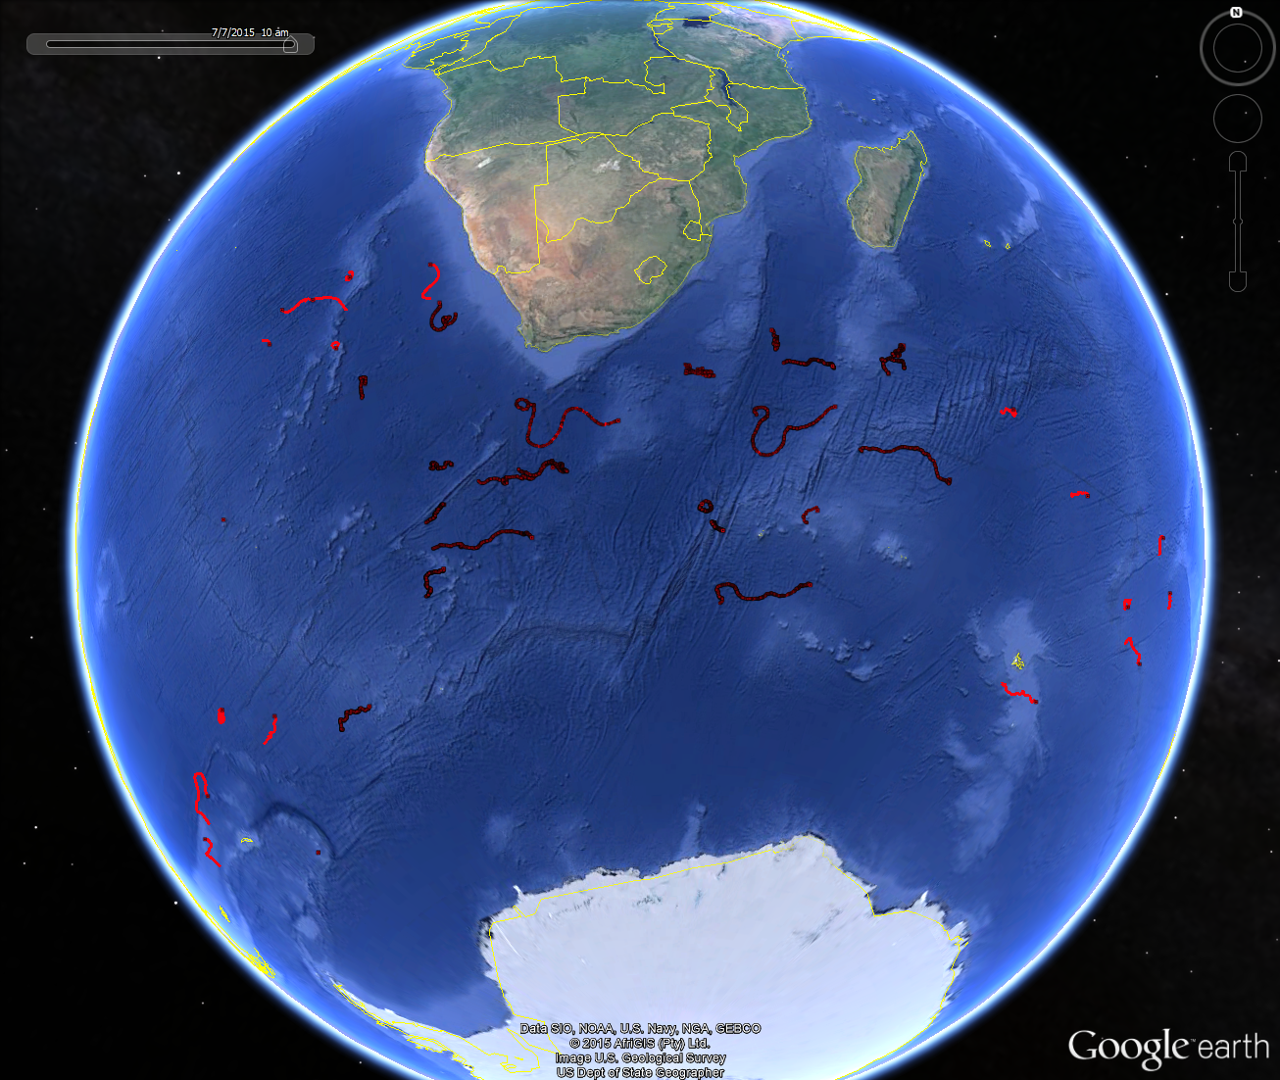
Buoy Deployment
Cape Town
Gough
Marion
SANAE

Slide 7
In Process
Algoa (Aug 2015) – VOSclim
Improve quality and availability of data
Discussions of recruiting another VOSclim ship

