Slide 1
REPORT OF RESPONSIBLE MEMBERS – HONG KONG, CHINA
Expert Team on Marine Climatology
5th Session
Geneva, Switzerland,
22-25 June 2015

Slide 2
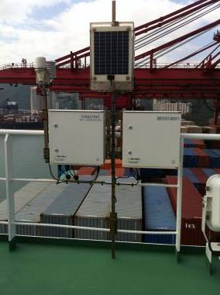
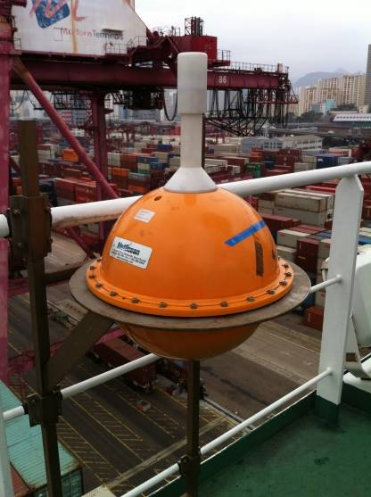
Activities of Hong kong, china as MCSS Contributing Member (CM)
In 1949 under the Voluntary Observing Ships' Scheme of the World Meteorological Organization, Hong Kong Observatory began to recruit a fleet of locally based voluntary weather observing ships to report weather conditions at sea.
Total Number of HKVOS ( 8 June 2015) : 61
- 52 Selected
- 8 VOSClim
- 1 supplementary
2 Selected ships were installed with AWS
- AMOS (UKMet Office)
- Drifter buoy (MetOcean Surface Velocity Program (SVP))
Notes:
A Selected ship is equipped with sufficient certified meteorological instruments for making observations, transmits regular weather reports and enters the observations in meteorological logbooks. It should have at least a barometer, a thermometer for sea-surface temperature, a psychrometer and a barograph. Most of the VOS are selected ships.
A VOSClim ship is a mobile ship station equipped with sufficient certified meteorological instruments for making observations, transmits regular and timely weather reports, enters the observations in an International Maritime Meteorological Tape (IMMT) compliant electronic logbook including the extra VOSClim delayed-mode groups, and has a proven record of providing high quality observations. A VOSClim ship should have at least a barometer, a thermometer to measure SST, a psychrometer (for air temperature and humidity), a barograph and possibly an anemometer. The full range of metadata must be maintained in WMO No. 47, the full suite of digital images, sketches and drawings must be available, and the delayed-mode IMMT data must be submitted to the Global Collecting Centres (GCCs) according to recommended WMO procedures. It is highly desirable for a VOSClim ship to be inspected at less than six monthly intervals.
A Supplementary ship is a mobile ship station equipped with a limited number of certified meteorological instruments for making observations. It transmits regular weather reports and enters the observations in a meteorological logbook.

Slide 3
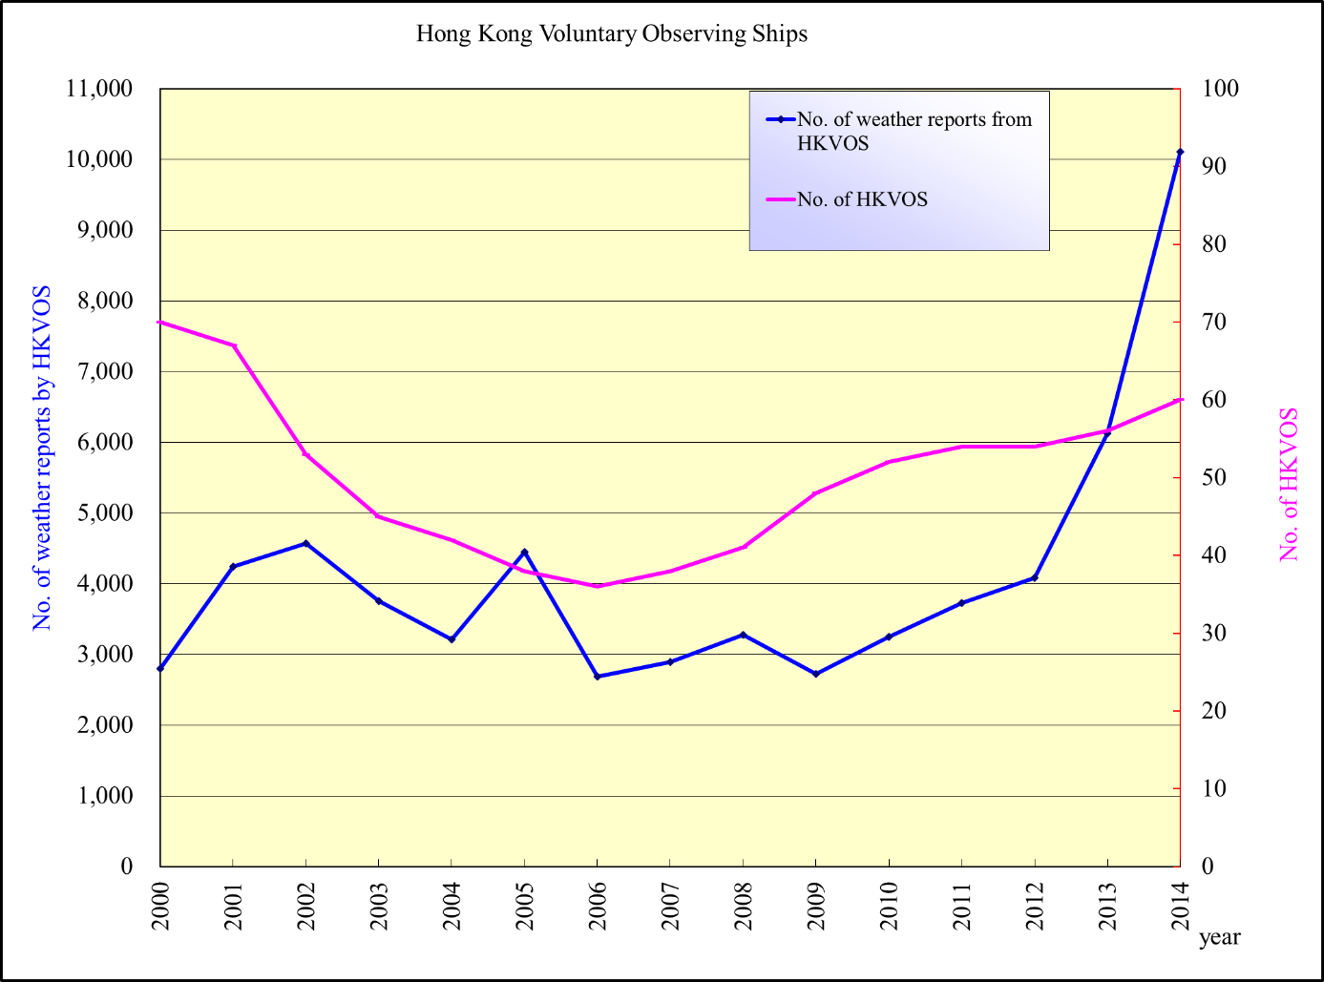
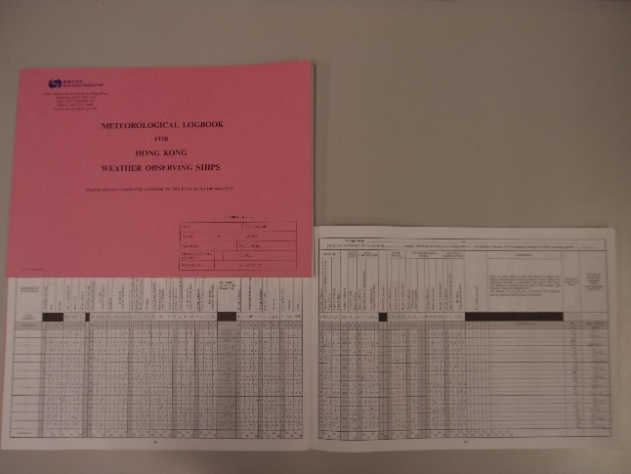
Delay mode data sent to Global Collecting Centres:
2012 (2033), 2013 (2199) and 2014 (3887)
Number of real-time weather reports transmitted through GTS

Slide 4
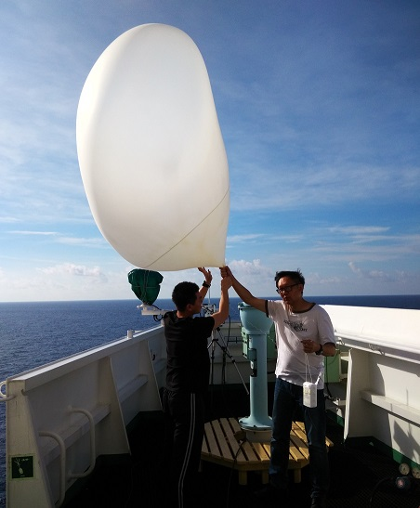
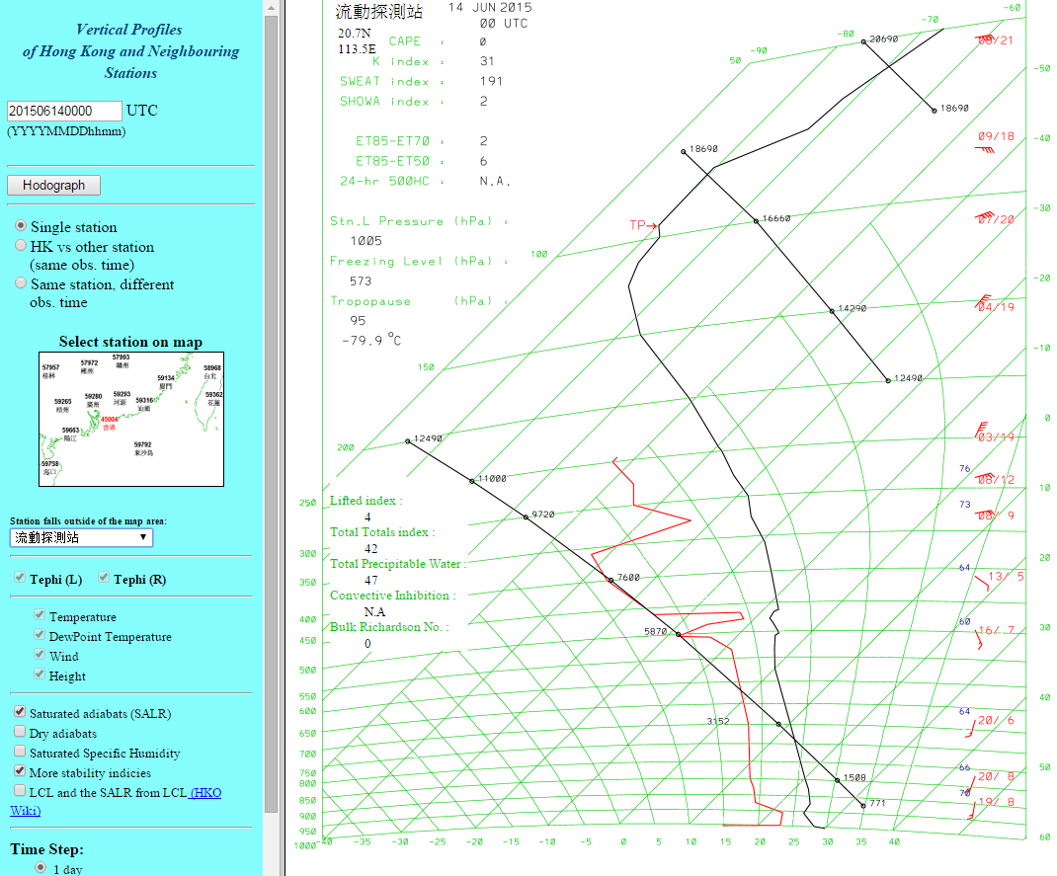
Experimental launch of radiosonde on board VOS in the South China Sea

Slide 5
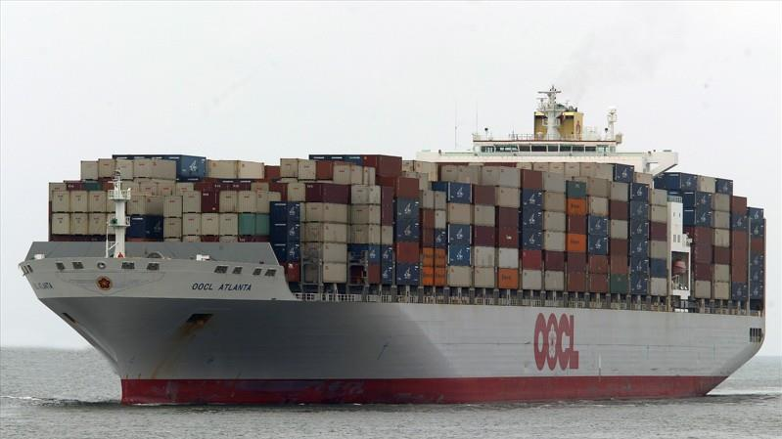
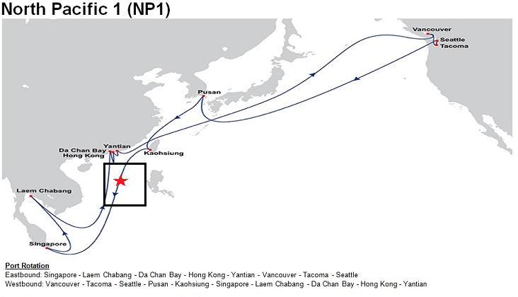
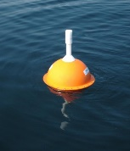
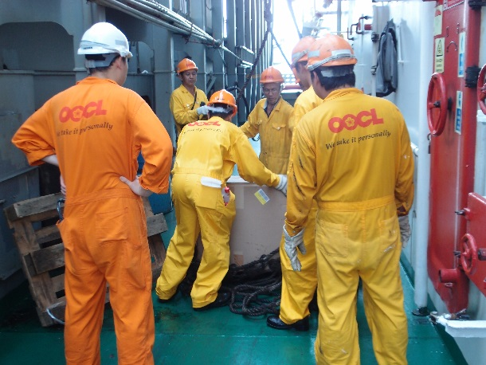
Deployment of drifter buoy in the South China Sea

Slide 6
Data processing and data exchange frequency are summarized in the table below:
Frequency of data exchange with GCC | Quarterly
Data format | International Maritime Meteorological Tape-5 (IMMT-V)
Quality control | GCC minimum quality control software MQC version 5 Minimum Quality Control Standards version 7 (MQCS-7)
Frequency of submitting metadata to WMO | Quarterly
Metadata format | WMO Pub 47 version 04 (Document Revision 4.0)

Slide 7
ACTIVITIES OF HONG KONG, CHINA AS MCSS RESPONSIBLE MEMBER (RM)
Data processing: data exchange frequency and details on delayed mode data submitted quarterly to the GCCs in 2012, 2013 and 2014 are 2033, 2199 and 3887 respectively.
MCSS: Besides 1961-70, 1971-80, and 1981-90, decadal MCSS have also been compiled for 1991-2000. Web version of the MCSS from 1961 to 2000 is being generated.

Slide 8
Archives
For the delayed mode data observed within Hong Kong’s Area of Responsibility, the numbers of observation
reports taken in the past five years that have been digitized in the GCC archive are
2010 | 2011 | 2012 | 2013 | 2014 | Total
12223 | 14270 | 21389 | 18742 | 10396 | 77020
Since 1949, the total number of delayed mode data stored in HKO’s database is 2,229,424

Slide 9
National perspective with regard to the developing MCDS
Hong Kong, China would like to play the role of Data Acquisition Centre (DAC) to continue to collect marine climate data and would also like to explore the feasibility to play the role of Global Data Assembly Centre (GDAC) in the new Marine Climate Data System (MCDS).

Slide 10
Thank you

