Slide 1
Sea ice climatology
Doc. 7.5
Dr Vasily Smolyanitsky
ETSI chair
Arctic and Antarctic Research Institute (AARI)
St.Petersburg, Russia
Expert Team on Marine Climatology) fifth session Geneva, Switzerland, 22-25 June 2015

Slide 2
Background
(1) Majority of activities for sea-ice climatology within the WMO is traditionally carried out by the SFSPA Expert Team on Sea Ice. That includes:
support for terminology, symbology, coding (main document WMO Sea-Ice Nomenclature, volumes I, II and III)
support for data exchange and archival formats (main documents SIGRID-3 -“Sea Ice Georeferenced Information and Data”, “Ice Objects Catalogue” etc.)
historical sea-ice data archival and processing
(2, 3) Prior to 2001 most of the activities were kept under review by the GDSIDB project initiated by the WMO former CMM in 1989 to support WCRP
Since 2001 the ETSI is coordinating the GDSIDB activity.
Since 1999 the International Ice Charting Working Group (IICWG) serves as an active and vital advisory body to the Team, meeting annually

Slide 3
Sea ice / <ETSI && IICWG> activities concept schema
GMDSS polar components
GFCS
CryoNet
WIS
SaftyNet NAVTEX text
RFx transmission
Ice charting
Ice obs
Docs
Integrated
Ice Services
Charting, Obs
SAR/Vis/IR imagery
Ice forecasts
MetOcean
Docs
Training
ENC/ECDIS

Slide 4
ETSI-5 outcomes
(4) ETSI intersessional activities till JCOMM-V were agreed in March 2014 by its 5th session. Major outcomes of the Meeting included
agreement on ETSI status and ToRs,
revision and proposal for standards for Marine Safety Information related to sea ice (WMO 558)
revision of status and plans for sea ice climatology (during the GDSIDB-13 session),
adoption of the new WMO sea ice guidance material (SIGRID-3 ver. 3, “Ice Objects Catalogue” v 5.2, “Ice in ECDIS” S-411 specification, additions to Sea ice nomenclature”, etc.),
adoption of plans for sea ice training ( IAW-4 and COMET),
agreement on collaboration and partnership (EC-PORS, GCW)
agreement on ETSI WP / projects till JCOMM-5 (2017).

Slide 5
ETSI-5 WP for 2014-2017
(5, 6) Following 3 project in the Team’s WP are directly related to sea-ice climatology:
#27 Support and enhance ENC/Electronic chart Display Information System (ECDIS) for ice navigation
Wide usage on ships of ice charts
Capability at National Ice Services to produce ice in S-10x and S-57
#28 Maintain and update sea ice technical documentation
Harmonization and updates to WMO ice documentation following progress in ice in ECDIS standards
Updates to WMO ice standards in parts of river/lake ice/point/linear/gridded objects
Documentation on ice observations and best practices
#29 Support for Sea ice climatology and ice information systems
Updated semicentennial and longer sea ice ‘blended’ climatology and uncertainties
Availability of sea ice operational and historical metadata and material in WIS, Cryonet, CMOC framework and other information systems and as geoservices
Identification/referencing datasets by assigning DOI
Actions related to sea-ice climatology are given as App.2 to Doc. 7.5

Slide 6
Support for terminology, symbology and coding related to sea ice climatology (1)
(7) The WMO Sea Ice Nomenclature (WMO-No. 259, vol.I-III) is a top level WMO sea-ice standard, regulating the descriptive (nomenclature and glossaries), coding and presentation procedures for sea ice cover
By March 2014 Volume I contains 220 terms and definition in 13 sections in 4 WMO languages (EN/FR/RU/ES).
Volume III, the International System of Sea-Ice Symbols is a 14-pages document containing coding and presentation rules for sea-ice variables. As the new ice charting and ice coding standards (“SIGRID-3”, “Colour Standard for Ice Charts”, “Ice Objects Catalogue”, S-411) are now on hand, the document will further contain static versions of the rules.
All three Volumes of the publication are formally managed as electronic database with content and interface available in EN/FR/RU/ES http://www.aari.ru/gdsidb/XML/wmo_259.php
Included into WMO Meteoterm, GCW glossaries

Slide 7
Support for terminology, symbology and coding related to sea ice climatology (2)
(8) Sea-ice terminology includes
basic terms (floating ice, sea ice, fast ice, drift ice, ice of land origin, lake ice, river ice) used both for sea ice analysis, observations, historical data
specific terms used only in connection with sea ice climate (ice cover or ice extent, ice limit, mean ice edge, median ice edge).
(8) The Team accepted approach for further developing the “Sea Ice Nomenclature” is that it should support:
observational, operational and research communities
all kinds of floating ice – sea, lake and river ice
with all kinds of topology (point, linear, area, grid)
thus answering requirements from the Services, WMO GCW / GCW Cryonet as well as the NWP community
.

Slide 8
Support for data exchange and archival formats (1)
Sea ice transport standards may be divided into:
(9) Ice analysis standards (observations, charting) for ice services:
"SIGRID-3: -“Sea Ice Georeferenced ”Information and Data" (WMO/TD-No. 1214, revision 3 May 2014)
geometry based on shapefile format
supports all types of sea ice objects: polygones (areas), lines, points
“Ice chart colour standard” (WMO/TD-No. 1215, revision 1 May 2014) is a presentation standard for ice chart
SIGRID (WMO-716, CMM-X, Rec.11) and SIGRID-2 are older raster formats for historical collections:
geometry based on 0.25x0.25 geographic grid
(10) Standards for ice (sea, fresh-water) display on Electronic Chart Display and Information Systems (ECDIS):
Ice Object Catalogue (version 5.2, May 2014) is a standard sea ice content for ENC.
Ice Information Product Specification Edition 1.1.0, June 2014 Special Publication JCOMM S-411

Slide 9
Support for data exchange and archival formats (2)
SIGRID, SIGRID-2 | SIGRID-3 (WMO TD 1214) | Ice Objects Catalogue (JCOMM TR 80) | S-411 (JCOMM TR 81)
Contains all ice parameters needed in ice chart Raster based Do not contain recommendations for observations not supported by OGS | Contains all ice parameters needed in ice chart, analysis, observations Vector-based “shape files” (polygons, lines, points) Contains metrics(units) for sea-ice variables Does not contain portrayal OGS supported WIS friendly | Basic building block of S-411 Describes ice classes (polygon, linear, point) and attributes equivalent to codes of SIGRID-3 Contains metrics(units) for sea-ice variables Defines what ice information can be used in S-411 | Defines how ice information is displayed on an ECDIS Ice information exchange standard of the S-100 family Basic structure the same as S-57 Includes a Portrayal Standard which defines the appearance of an ice object OGS supported WIS friendly

Slide 10
Example of metrics for sea-ice variables in SIGRID-3
Table A-2: Polygon Field Enumeration References
Field or Column Name | Data Type | Length (bytes) | Code Table Reference | Field Definition
…
POLY_TYPE | Text | 1 | SIGRID Table 4 | Type of polygon feature
ICEACT | Text | 2 | IOC Code 30300 | Total Concentration
ICEAPC | Text | 6 | IOC Code 30301 | Partial Concentration
ICESOD | Text | 10 | IOC Code 30302 | Ice Stage of Development
ICEDSP | Floating Point | 4 | IOC Code 30318 | Speed of an ice mass in knots (floating point)
ICETCK | Integer | 2 | IOC Code 30319 | Ice Average Thickness (integer number of cm)
…
(12) A special paragraph in SIGRID-3 prescribes using the format for coding ice observations regardless of their geometry (polygon, line or point) with a field name T1 (RECDAT) to define date and time of observation.”
(13) All sea-ice documentation in the latest version is available at JCOMM web-site publication section (http://jcomm.info).

Slide 11
Historical sea-ice data archival and processing (1)
(14) Since 1989 the Team’s activity for the sea-ice climatology collection and archival is concentrated within the WMO GDSIDB project, initiated by the WMO to support WCRP
Most of the ice services including BSIS, Canada, Japan, Russia, USA, are contributing to the project.
Ice charting data prior to 2000s are stored in a 0.25°x0.25° raster SIGRID and SIGRID-2 (WMO, 1989 and 1994) or Ease-grid formats,
After 2000s the data is stored in a more flexible vector SIGRID-3 format (WMO, 2004-2014).
(15) The sea ice charting collections for the period of instrumental ice observation (i.e. ~1933 till present moment) is available
either via the GDSIDB centers at AARI (http://wdc.aari.ru/datasets), supported by the WDC Sea Ice (WDCSI) or NSIDC (http://nsidc.org)
dedicated web geo-portals at USA NIC (http://www.natice.noaa.gov) or AARI (http://gisa.aari.ru)..

Slide 12
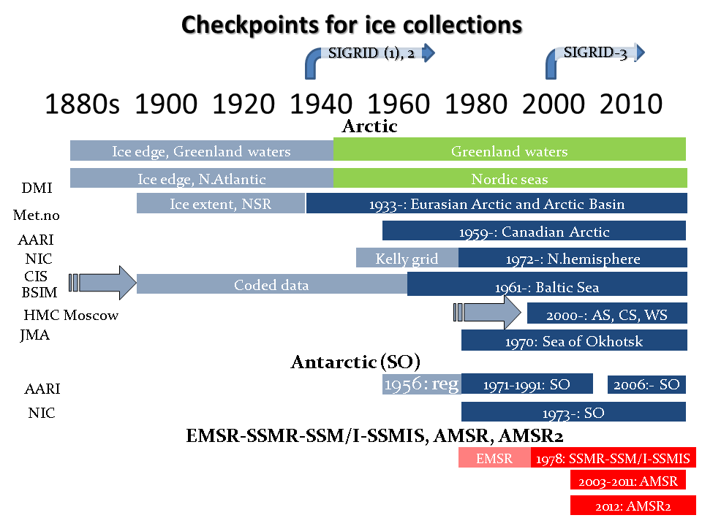
GDSIDB center at the Arctic and Antarctic Research Institute (2)
(15) The major sea ice collections at AARI GDSIDB/WDCSI by May 2015 include more than 27000 ice charts in WMO exchange raster and vector standards.

Slide 13
GDSIDB center at National Snow and Ice Data Center (3)
(17) NOAA@NSIDC (http://nsidc.org/noaa/) is the program under which GDSIDB data sets at NSIDC are maintained. NOAA@NSIDC is affiliated with the NOAA National Geophysical Data Center (NGDC).
Simultaneously access to sea ice collections at NSIDC is supported via the NASA Distributed Active Archive Center (DAAC).
Besides to historical collections from the national ice service, NASA has supported development of outreach and information products like Arctic Sea Ice News and Analysis (http://nsidc.org/arcticseaicenews/) and Satellite Observations of Arctic Change (http://nsidc.org/soac). Sea ice thickness estimates from IceBridge (http://nsidc.org/data/icebridge/) can be used to provide a crosscheck with estimates of ice thickness from operational sources.
(18) The National Ice Center Arctic Sea Ice Charts and Climatologies in Gridded Format continues to have high usage statistics, although it has not been updated since 2007..

Slide 14
Practices of sea ice historical data processing (4)
(20) The most requested derivatives from the GDSIDB collections include
Long-term estimates of the ice extent (close to centennial interval for several areas of the Arctic Ocean, or close to pan-Arctic from late 1960s)
Sea ice total concentration grids for the period of instrumental observations (for several areas since 1933, or close to pan-Arctic from late 1960s)
estimates of the stages of ice development/mean weighted thickness of level ice, including old ice boundary (for several areas since 1933, or close to pan-Arctic from late 1960s)
(21) One of the useful approaches is the ‘blending’ of sea ice information from different collections into a single one on a same grid and periodicity.
The latest developed under a joint project AARI-IARC spanning period up from the beginning of ice charting (early XX century) to present moment.
Resulting blended dataset contains gridded CT values (monthly means, minimums, maximums, medians) and supplementary information (number of cases, origin) on a hemispheric (90°N…45°N 0°….360°) geographical 0.25°by 0.25° grid with monthly interval.

Slide 15
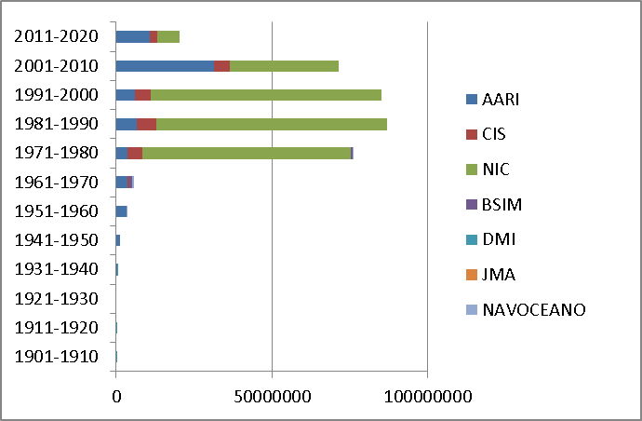
Practices of sea ice historical data processing (5)
Summary number of points by decades by originating centers for 1901 – 2013
Northern hemisphere sea ice total concentration statistics for the periods of maximum (March) and minimum (September) ice extent based on blended ice charting for 1901-2013

Slide 16
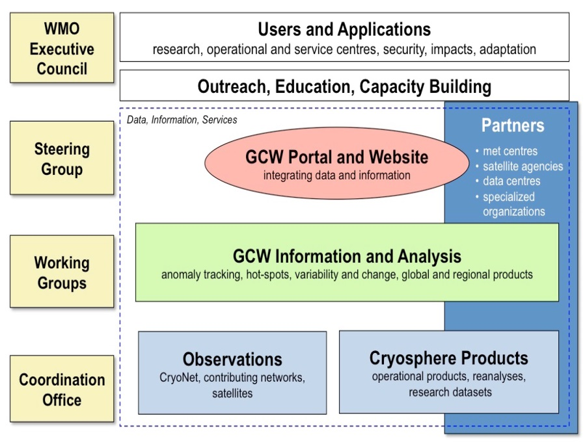
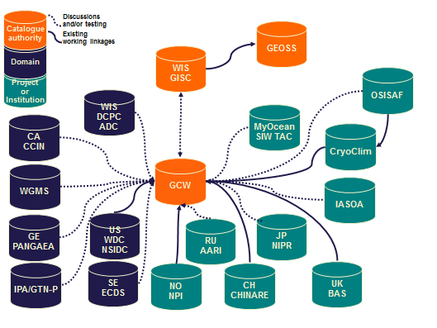
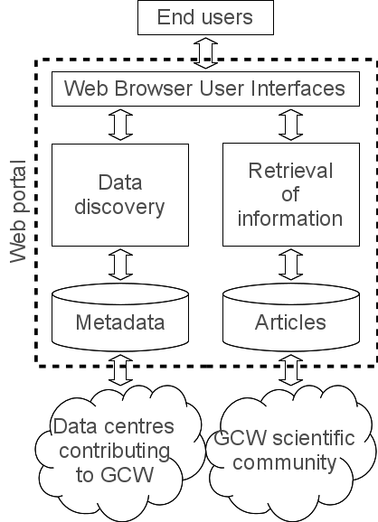
Sea ice material in GCW

Slide 17
Proposals for actions
(22) As a part of SFSPA the ETSI will proceed with development of the WMO sea ice technical documentation as well as continue to supervise extension of the GDSIDB collections.
However, there is definitely a need for joint actions by ETMC and ETSI to ensure harmonization of the WMO standards for the world ocean and availability of historical sea ice collections. That may include at least:
Reinforcement of gdsidb by integration with the JCOMM-IODE MCDS (agreed by ETSI-5)
Cross-harmonization of the marine climatology transport formats with sea ice transport formats
Cross-harmonization of the manuals (WMO 558 and 259, SIGRID-3, etc)

