Slide 1
Review of GOOS and GCOS Requirements for Climatological Data Sets
David I. Berry
ETMC-V, 22 – 25 June 2015

Slide 2
Requirements setting process
Observation requirements collected and summarised in the WMO Observing Requirements database and published via OSCAR
Requirements specified by application area (e.g. Climate-AOPC)
4 stage process
Review of requirements
Review of observing system capabilities and planned observing systems
Critical review of extent to which capabilities (ii) meet the requirements (i)
Statement of guidance based on (iii)
Requirements setting responsibility remains with programme / application area

Slide 3
Interpretation of ETMCs role

Slide 4
Requirements
Requirements specified by number of criteria at three different levels
Threshold, Breakthrough, Goal
Uncertainty, Stability, Horizontal Resolution, Vertical Resolution, Observing Cycle, Timeliness, Coverage
Marine requirements for GCOS defined by two application areas
Climate – AOPC
Climate – OOPC
GOOS requirements defined by the Ocean Applications area
Requirements listed in report for this meeting - not going through them in detail now

Slide 5
Example GCOS requirements (SST)
Application area | Confidence level | Uncertainty | Horizontal resolution | Observing cycle | Timeliness | Coverage
Climate-AOPC | Goal | 0.25 K | 10 km | 3h | 3h | Global ocean
 | Breakthrough | 0.4 K | 50 km | 6h | 6h | Global ocean
 | Threshold | 1 K | 500 km | 24h | 12h | Global ocean
Climate-OOPC | Goal | 0.1 K | 1 km | 60 min | 3h | Global ocean
 | Breakthrough | 0.126K | 8 km | 3 h | 5h | Global ocean
 | Threshold | 0.2 K | 500 km | 24 h | 12 h | Global ocean

Slide 6
Scientific justification
Unclear that the GOOS / GCOS requirements are properly defined within OSCAR – may be definition of technology specific requirements
Example: SST goal of 0.1K on 1km grid every hour – is this really needed for climate applications or is this the input data (technology dependent) to meet some other definition of the requirements
However, requirements are currently under review (e.g. variable and network specification sheets)
Linking to these and other scientific justifications from within OSCAR would be very helpful
Notes:
Dig out OOPC document from 2014? Or 2015 meeting and use that as example

Slide 7
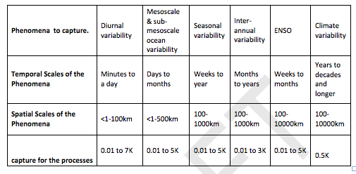
Table of example phenomena and related scales / size of signal from draft GCOS / OOPC EOV Specification for SST

Slide 8
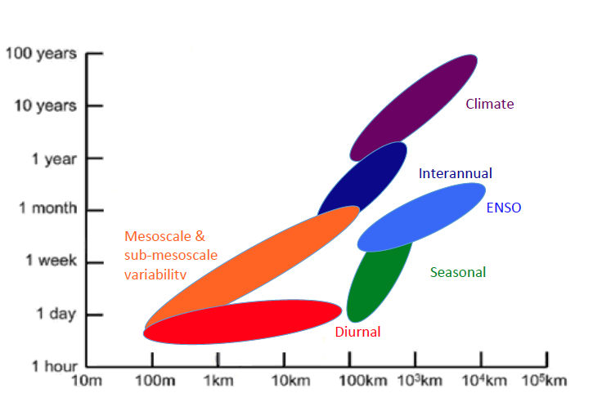
Scales of phenomena related to sea-surface temperature (from draft GCOS/OOPC EOV Template for SST)

Slide 9
Observing system capabilities and critical review
In the past these have been covered by the GCOS Progress reports and implementation plans
However, these have been very basic in there approach and lacked the critical review component
Descriptive assessment of network components without relating to broader ECV requirements
Again, improvements being made via variable and network specifications (example shortly)

Slide 10
Statement of guidance
This should be provided by GCOS / GOOS implementation plan
Progress report currently being written, due 2015
Implementation plan due 2016
Similar activities within GOOS
Premature to make too make comments

Slide 11
Previously commented on assessments and proposed methods for making quantitative assessments (e.g. at ETMC-IV and SOT-VII)
However, any metric or assessment needs to be simple
Equivalent buoy density of Reynolds et al 2005 is a good example (see report for full reference)
This can be expanded and made more generic in terms of standard observations – described in report
Standard uncertainty (for a single observation) defined, allowing number of “standard observations” to meet uncertainty requirement to be determined
These can then be related to the different components of the observing network and metrics / targets determined for the different components

Slide 12
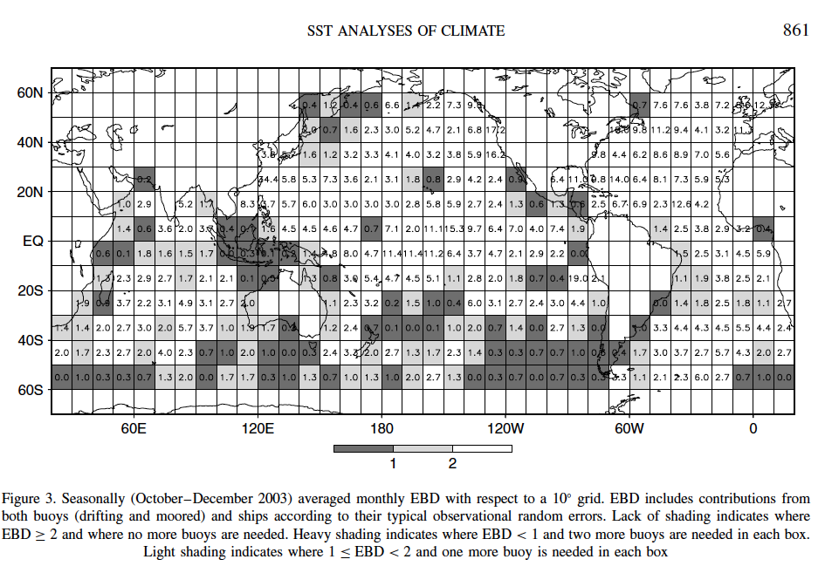
Equivalent buoy density map from Reynolds et al 2005

Slide 13
Final thoughts
There has been a large amount of progress since last ETMC within GCOS / GOOS
For example, from the GCOS Programme Review
GCOS should elaborate the ECV concept to specify its key deliverable and outputs, continuing the process of emphasizing fields and products and de-emphasizing individual platforms
Recommend ETMC to endorse this approach
Recommend GCOS to explore the use of the equivalent buoy density / equivalent standard observation density when assessing adequacy

