Slide 1
2015 REPORT OF RESPONSIBLE MEMBER GERMANY
Lydia Gates and H. Otten-Balaccanu
DWD

Slide 2
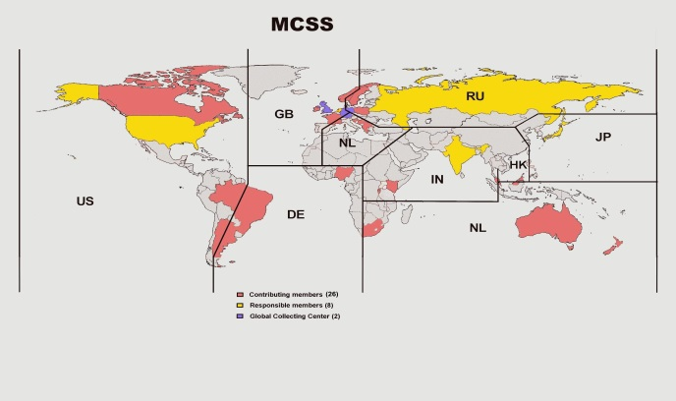
Germany is one of eight responsible members of the Marine Climatological Summaries Scheme (MCSS) and is responsible for the South Atlantic Ocean between 20°N and 90°S and from 80°W to 20°E.

Slide 3
 | 2012 |  | 2013 |  | 2014
 | No. of Ships | No. of Obs. | No. of Ships | No. of Obs. | No. of Ships | No. of Obs.
Unknown |  |  | 17 | 1.430 | 19 | 1.577
Selected Ships | 423 | 101.413 | 460 | 124.784 | 304 | 61.922
Supplementary Ships | 1 | 397 | 1 | 3 | 1 | 1
Auxiliary Ships | 2 | 639 | 3 | 997 | 2 | 643
Automated Stations | 2 | 3.280
Registered VOSClim Ship |  |  | 36 | 10.671 | 50 | 16.249
Total | 428 | 105.729 | 517 | 137.885 | 376 | 80.392

Slide 4
German VOS fleet, active ships
Year | No. of active ships in GTS
2012 | 684
2013 | 627
2014 | 552
2015 (until May) | 438

Slide 5
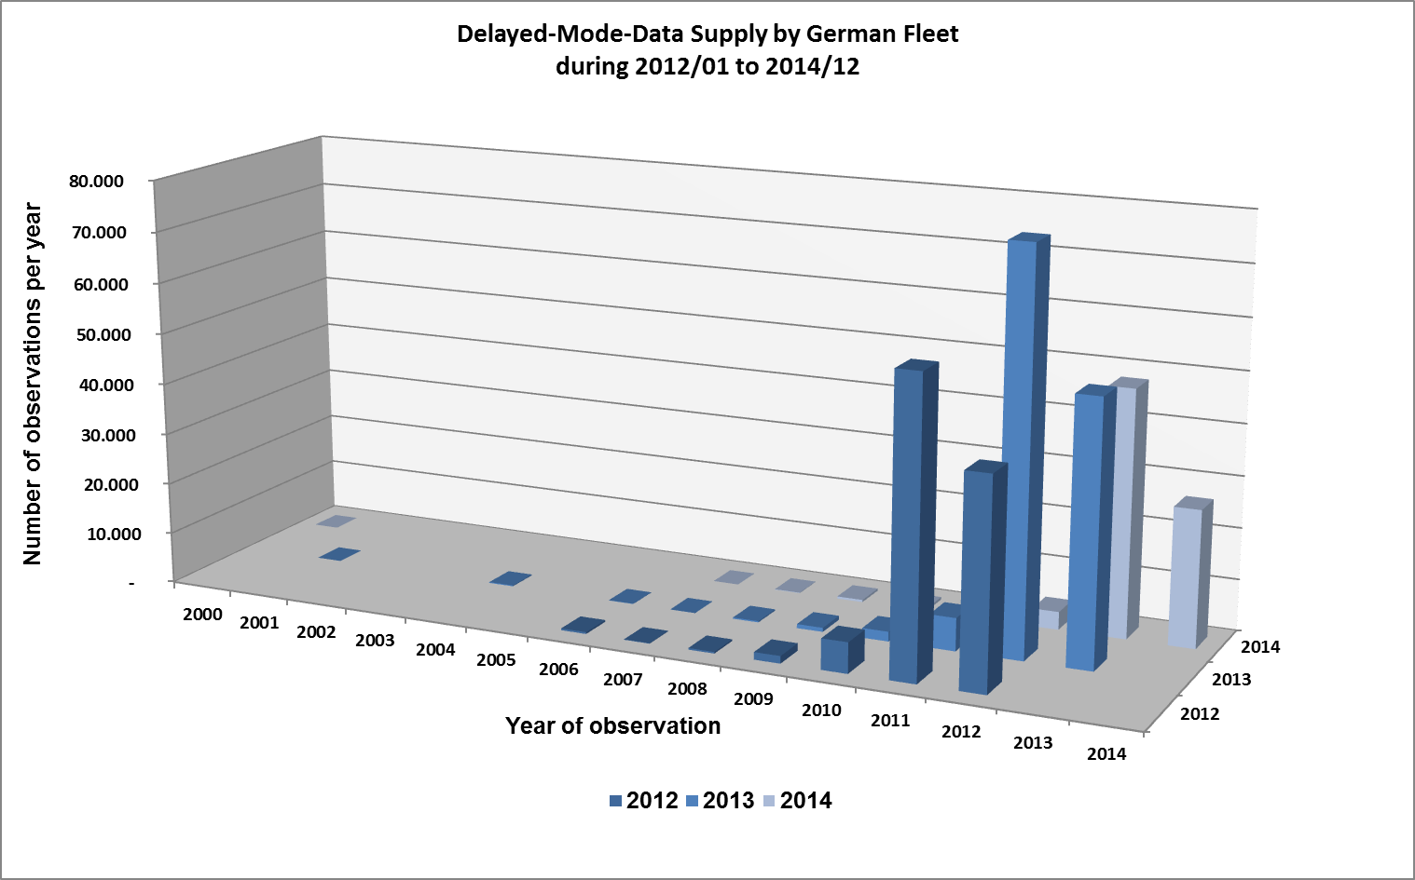

Slide 6
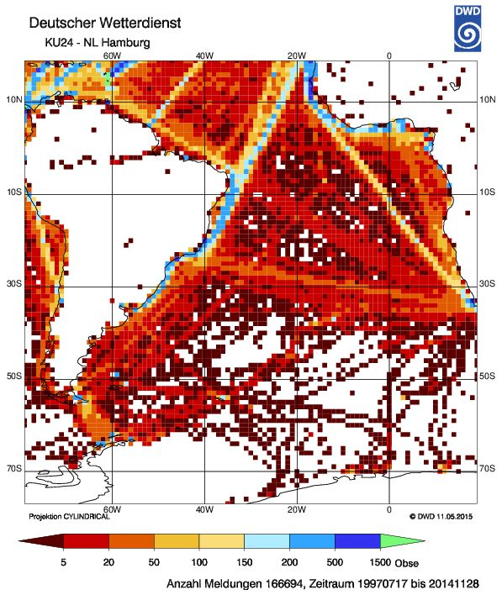
Total number of observations: 166,694
17th July 1997 to 28th November 2014

Slide 7
At the end of 2014 there were 7.166.124 observations in the delayed-mode archive of the German area of responsibility.

Slide 8
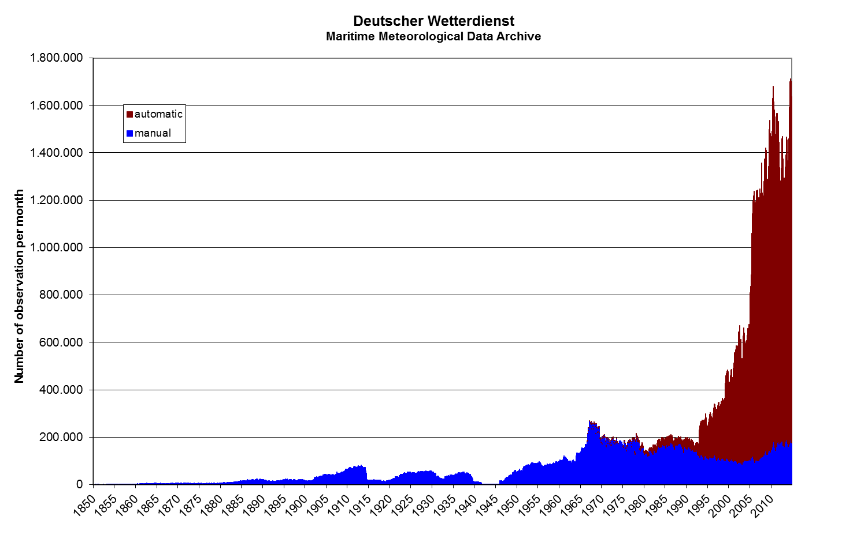

Slide 9
Future Role of Germany in the MCDS:
DAC
GDAC (DCPC in GISC DWD and DWD-CDC)
CMOC-DWD
Product development
High quality historical data set: rescuing the existing data of the archives of Deutsche Seewarte
High quality observation data from the German fleet
Development of high quality checking applications
Processing of data
Dissemination of high quality data and products for interdisciplinary use
Mirroring facility of ICOADS data holdings contingent on the development of a CMOC-ICOADS.

