Slide 1
HQCS High Quality Control Standard
Developed by DWD, basis for a software package for automatic quality checks
Integrated land-sea-mask, accuracy of 0.01°
Course and speed check
Climatology check based on background fields using the ERA-Interim-Reanalysis 1981-2010
Time-sequence check
Inconsistency check
Spatial check

Slide 2
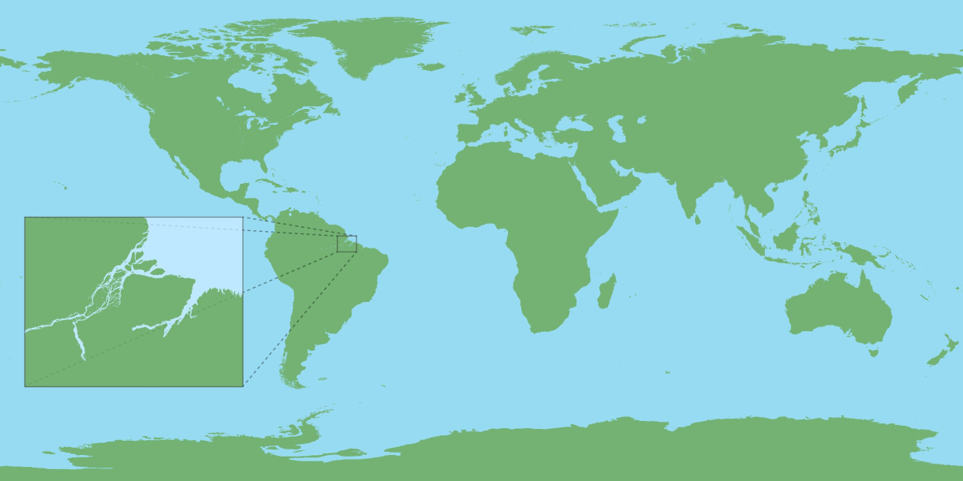
HQCS High Quality Control Standard Land-Sea Mask

Slide 3
HQCS High Quality Control Standard

Slide 4
HQCS High Quality Control Standard Sequence of Checks

