Slide 1
Activities of the GCCs
ETMC-5 22nd – 25thJune 2015, Geneva, Switzerland

Slide 2
MCSS Marine Climatological Summaries Scheme
27 Contributing Members (CMs)
2 Global Collecting Centres (GCCs) for delayed mode VOS data
8 Responsible Members (RMs)
GCC @DWD makes data available on WIS DCPC GISC for individual download
Notes:
das GCC seit 1994 erhalten hat, sind auf dem deutschen WIS DCPC (Data Collection and Production Centre) GISC (Global Information System Centre) gespeichert und stehen zur Verfügung. Jeder kann sich hier selbst die Daten herunterladen.

Slide 3
MCSS, the GCCs and their purpose
MCSS
GCC
JCOMM’s Marine Climatological Summaries Scheme
JCOMM’s Global Collecting Centres (for delayed mode VOS data)
Gather quality data – from 27 CMs in IMMT format
Perform quality control – using MQCS (v7)
Store data & allow data access – by 8 RMs and DCPC

Slide 4
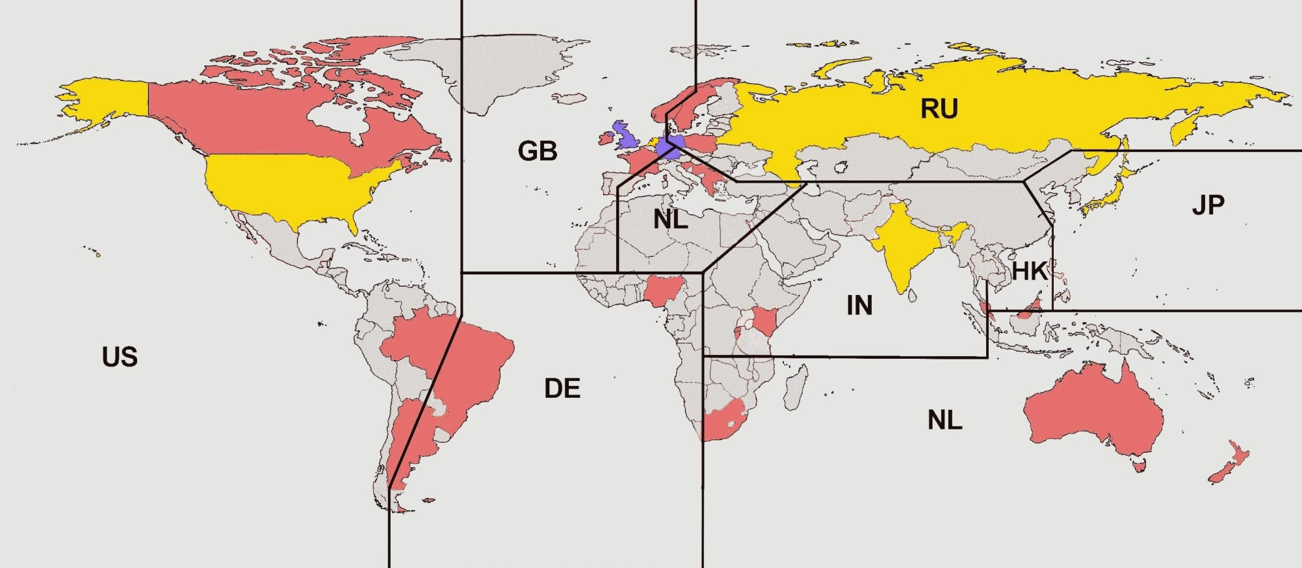
Registered CMs
27 countries still run a VOS fleet and are willing to contribute data to the MCSS
MCSS
Contributing members
Responsible members
Global Collecting Centre
23 of the 27 countries have contributed in the last 3 years!

Slide 5
The Number of CMs and the Fluctuation of Total Obs received by the GCCs over the last 3 Years
VOS Data Volumes

Slide 6
GCC Data
23 CMs submitted in 2012, 2013 and 2014
High number of observations 2012 was due to large volumes of backlogged data
Large data files were contributed by Canada, France, Norway, United Kingdom and Germany
Fluctuation results from CM issues including software, staff and technical problems

Slide 7
Distribution of data received 2012 - 2014

Slide 8
Data Problems
found by MQCS
duplicate observations
invalid dates
wrong positions
Most of those rejected records were corrected or deleted after consultation with the appropriate CM

Slide 9
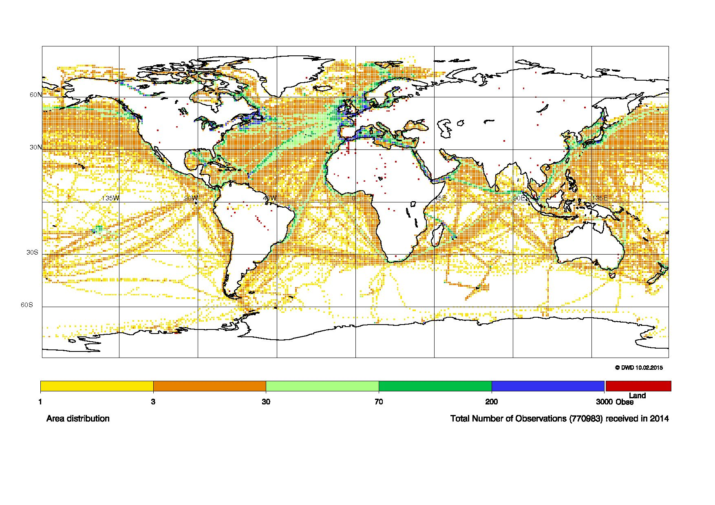
Distribution of Observations 2014
Only 174 of 770,983 observations with on-land positions in 2014

Slide 10
Formats & Coding
IMMT coding 2013:
5% in IMMT - 1 / 2
28% in IMMT- 3
65% in IMMT- 4
2% in IMMT- 5
IMMT coding 2014:
1% in IMMT- 1 / 2
22% in IMMT- 3
72% in IMMT- 4
4% in IMMT- 5
The revised IMMT-4 version with the new and clarified codes for the source of observation, were in effect from 1st January 2011
IMMT-5 with minor updates of wording were in effect from 1st June 2012

Slide 11
VOSClim Input 2012 - 2014

Slide 12
VOSClim Input 2012 - 2014

Slide 13
VOSClim Input 2014
358 registered VOSClim ships provided reports in 2014
France and Japan are the only CMs to provide 100% of VOSClim elements in the VOSClim reports

Slide 14
Developments MCDS Marine Climate Data System
MCDS shall replace MCSS
Update of the MCDS implementation plan for Data Acquisition Centres (DACs) and Global Data Assembly Centres (GDACs) at CLIMAR-4 by members of ETMC and the Task Team of MCDS (TT-MCDS)
TT-MCDS teleconferences were held and it was decided to rewrite relevant sections of WMO No 471 and 558

Slide 15
Developments MCDS Marine Climate Data System
Modernization of the MCSS
New sources of historical marine-meteorological and oceanographic data
State of the art data management techniques
Goal: to develop a standardized international data management system across JCOMM
Collection, rescue, quality control, formatting, archiving, exchange and access for all marine data and metadata

Slide 16
Developments DACs Data Acquisition Centres
Receive data/metadata from single platform type (e.g. Buoy, ship)
Both in near real-time and delayed mode
Apply Minimum Quality Control (MQC)
Forward data to the GDACs in agreed formats

Slide 17
Developments GDACs Global Data Assembly Centres
Combine all data streams
Establish a unique complete dataset
Perform agreed quality checks including High Quality Control (HQC)
Forward the original and quality controlled data and metadata with flags to the CMOCs
Ensure that delayed-mode and real-time data streams are compared and linked
Feedback to DACs

Slide 18
Developments CMOCs WMO-IOC Centres for Marine-Meteorological and Oceanographic Climate Data
Act as a network of data centres
Collect data from GDACs and other sources
Undertake data rescue
Apply bias correction
Make integrated datasets and products available to the user interface and advise member states when appropriate
Ensure storage of data and metadata with defined standards

Slide 19
CMOC WMO-IOC Centre for Marine-Meteorological and Oceanographic Climate Data
CMOC in Tianjin, China
was successfully evaluated against the CMOC evaluation criteria proposed by the ETMC and Data Management Coordination Group (DMCG)and a draft Resolution establishing CMOC/China has been submitted to the WMO 17th Congress for its adoption
focus on the integration of global drifting buoy observations and metadata, in cooperation with NOAA/AOML and GDACs.
will also have a focus on historical metadata and data rescue in the Asian-Pacific region, as well as on capacity building in this region

Slide 20
MCDS Data Flow

Slide 21
Developments HQCS High Quality Control Standard
Developed by DWD
Basis for a software package for automatic quality checks
Integrated land-sea-mask, accuracy of 0,01°
Climatology check based on background fields using the ERA-Interim-Reanalysis 1981-2010
Time-Sequence check
Inconsistency check
Spatial check

Slide 22
More details of GCC activities
➔ www.wmo.int/pages/prog/amp/mmop/gcc-reports.html
or contact by email
gcc@metoffice.gov.uk gcc@dwd.de

