Slide 1
WIGOS Metadata Standard A global standard for all observational metadata
Workshop (… 2016)
WIGOS Project Office
WMO; OBS/WIGOS

Slide 2
Contents
The WIGOS Metadata Standard (WMDS)
Scope and purpose
The WMDS structure and main features
Current status and future developments
Final remarks

Slide 3
WIGOS Metadata Standard (WMDS) Scope and background
The WIGOS Metadata Standard (WMDS) is a semantic standard, defining a common set of requirements for observational metadata and describing the elements to be recorded/reported:
Its practical implementation will be done through OSCAR
It is applicable to all observing systems:
In-situ, remote, fixed, mobile, on land, on sea, on ice, on rivers, etc
It is meant to be used by all application areas:
Climate, NWP, Oceans, Atmospheric Composition, Hydrology, Agriculture, etc
The official WMO Application Areas are described here: http://www.wmo.int/pages/prog/www/OSY/GOS-RRR.html

Slide 4
WIGOS Metadata Standard (WMDS) Description
WIGOS metadata is observational or description metadata – enables data values to be interpreted;
It is not discovery metadata – that facilitates data discovery, access and retrieval, which is part of WIS (WMO Information System)
The practical implementation of the WMDS is done through the OSCAR tool (Observing Systems Capability Analysis and Review)
What Members will have to do to comply with the Tech.Regulations (WMO-No. 49, Volume I, Part I – WIGOS and Manual on WIGOS):
Keep records of WIGOS metadata
For those observations that are exchanged internationally:
Exchange also the associated WIGOS metadata
For surface observations:
Review the information in OSCAR/Surface
Keep entries in OSCAR/Surface up to date

Slide 5
WIGOS Metadata Standard (WMDS) Background and milestones
The WMDS was developed by WMO:
through the Inter-Commission Coordination Group on the WMO Integrated Global Observing System (ICG-WIGOS) Task Team on WIGOS Metadata (TT-WMD)
The 1st version of WMDS was approved by the 17th World Meteorological Congress as part of the Manual on WIGOS:
http://www.wmo.int/pages/prog/www/wigos/documents/WIGOS-RM/1160_en.pdf#page=49
It has entered into force for WMO Members on 1 July 2016
OSCAR/Surface (the web-based inventory of all surface-based observing stations) was launched operationally on 2 May 2016
The implementation of WIGOS metadata exchange will be done using an XML schema, which format is being tested/finalized
Guidance is being developed to assist Members with the WMDS:
The first (online) edition is planned to be available in June 2016

Slide 6
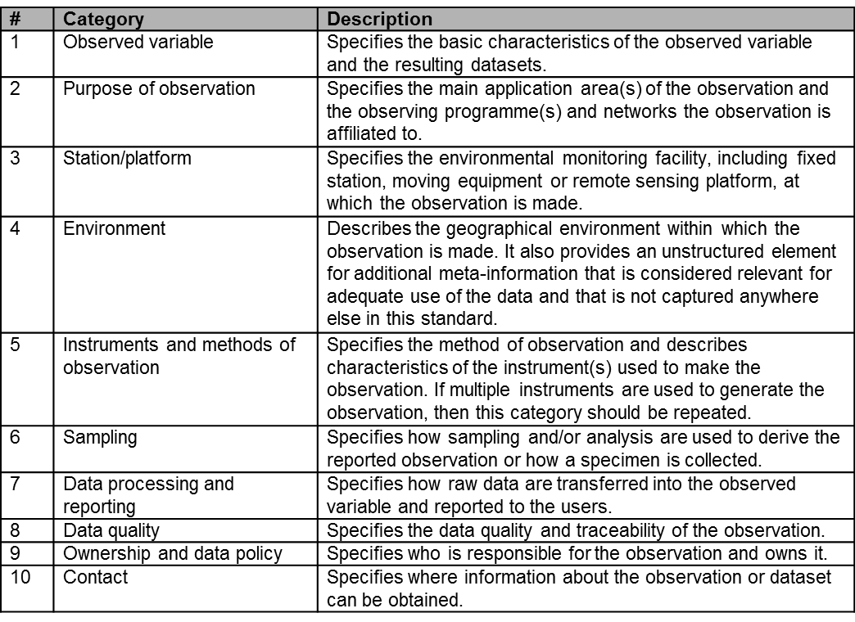
WIGOS Metadata Standard (WMDS) Structure (1)
It is organized in 10 categories
Each category consists of 1 or more elements: 65 in total (+2 new)

Slide 7
WIGOS Metadata Standard (WMDS) Structure (2)
There are 3 levels of MD reporting:
Mandatory - Required for all WIGOS observing systems/platforms
Conditional - Required if applicable
(e.g. instrument calibration is not applicable to a human observer)
Optional – Desirable/useful, but non-compulsory
The WMDS includes 45 Code Tables – Example of a Code table:

Slide 8
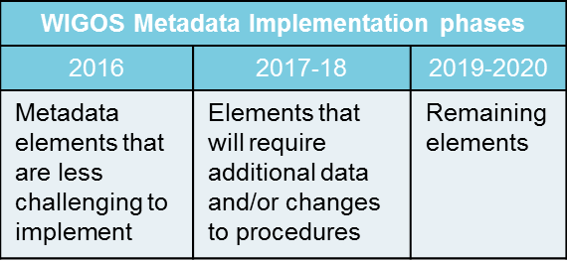
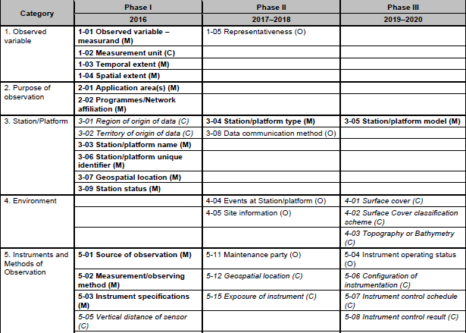
WIGOS Metadata Standard (WMDS) Implementation Phases
Extract of the WMDS elements per Implementation Phases

Slide 9
FINAL REMARKS
Collaboration with various communities to the further development of the WMDS has been, and will continue to be, essential;
Feedback on the current version of WMDS and OSCAR/Surface will help improve the next edition which is expected to be submitted to Cg-18 (2019)
All groups dealing with observational metadata are encouraged to use OSCAR/Surface at: http://oscar.wmo.int/surface
Some changes to version 1.0 of the WMDS will be submitted to the 16th Session of CBS (November 2016)

Slide 10
Thank you for your attention Acknowledgments: TT-WMD members
http://www.wmo.int/wigos
lfnunes@wmo.int

