Slide 1
WIGOS Workshop for Regional Association VI (RA-VI)
with Focus on Marine Meteorological and
Oceanographic Observing Requirements
(Split, Croatia, 5-7 September 2016)
Observational user requirements for
marine meteorological and oceanographic
observations according to the
Rolling Review of Requirements (RRR)
Etienne Charpentier
Chief, WMO Observing Systems Division

Slide 2
WMO Application Areas
Global Numerical Weather Prediction
High Resolution Numerical Weather Prediction
Nowcasting and Very Short Range Forecasting
Sub-seasonal to longer predictions
Aeronautical Meteorology
Forecasting Atmospheric Composition
Monitoring Atmospheric Composition
Providing Atmospheric Composition information to support services in urban and populated areas
Ocean Applications
Agricultural Meteorology
Hydrology
Climate Monitoring (GCOS)
Climate Applications (Other aspects, addressed by the Commission for Climatology)
Space Weather
Cross cutting:
Global Cryosphere Watch (GCW)
Global Framework for Climate Services (GFCS)

Slide 3
Statement of Guidance for Global Numerical Weather Prediction (GNWP)
Key variables: 3D wind, 3D temp, 3D humidity, 2D SLP
Also important: surface boundary variables: SST, soil moisture, vegetation, ice & snow cover
SLP over the oceans: ships & buoys provide good frequency & accuracy. Coverage marginal or absent in some areas in the tropics & Arctic. SLP not observed by satellites
SST over the oceans: ships & buoys provide good frequency & accuracy. Coverage has enhanced considerably. Satellite data available. Resolving the diurnal cycle is becoming important

Slide 4
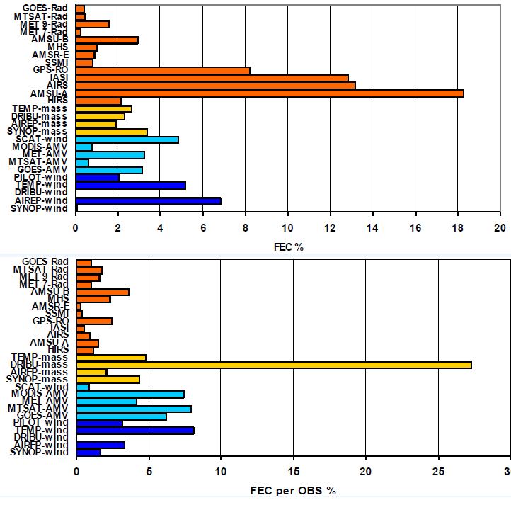
Forecast Error (FEC) distribution for observing systems (24H forecast) (top: summed up; bottom: normalized per observation)
ECMWF 2012 study

Slide 5
Statement of Guidance for Ocean Applications (link)
Wide range of applications: analysis, forecasts & warnings for shipping, fishing, coastal & offshore activities
Depends on NWP, Sub-Seasonal to longer prediction, Metocean Forecasts and Services (MOFS), incl. marine services and ocean mesoscale forecasting
Statement of Guidance focusing on MOFS (waves, storm surges, sea-ice, ocean current …)
Sustained funding of key observing systems needed (tropical moorings, Argo, drifters, altimeters, scatterometers, microwave SST, sea-ice from satellite)
Need to improve geographical coverage (studies needed)
Critical variables: sea surface height anomaly & sea-level, waves, surface pressure, visibility
in situ metocean data and observations are poor for marine services (in particular, for monitoring and warning marine-related hazards) and marginal for assimilation into ocean models, including wave models.
Satellites: Ensure (i) a combination of infra-red & microwave measurements for SST; (ii) improved observations in coastal regions (altimetry, SST); (iii) a minimum of 2 interleaved operational satellites providing SSHA observations to support ocean forecasting applications, and (iv) development of satellite SSS on an operational basis

Slide 6
Requirements for ocean observations 1/6 (gaps in yellow)
Variable | OCEAN | GNWP | HRNWP | NVSRF | SSLRP | GCOS
1D Frequency spectral wave energy density | X
2D Frequency spectral wave energy density | X
Accumulated precipitation (over 24 h) |  | X | X |  |  | X
Air pressure (at surface) | X | X | X | X |  | X
Air specific humidity (at surface) | X | X | X | X |  | X
Air temperature (at surface) | X | X | X | X |  | X
Atmospheric temperature |  | X | X | X |  | X
Bathymetry | X
Coastal sea level (tide) |  |  |  |  |  | X
Colour Dissolved Organic Matter (CDOM) | X |  |  |  | X
Dissolved inorganic carbon (DIC) |  |  |  |  |  | X

Slide 7
Requirements for ocean observations 2/6 (gaps in yellow)
Variable | OCEAN | GNWP | HRNWP | NVSRF | SSLRP | GCOS
Dominant wave direction | X | X | X |  |  | X
Dominant wave period | X | X | X |  |  | X
Downward solar irradiance at Earth’s surface |  | X |  |  |  | X
Earth’s surface albedo |  |  | X |  |  | X
Earth’s surface SW bidirectional reflectance distribution function (BRDF) |  | X |  |  |  | X
Fraction of Absorbed PAR (FAPAR) | X | X | X |  | X
Geoid |  |  |  |  | X
Long-wave Earth surface emissivity |  | X | X
Ocean chlorophyll concentration | X |  |  |  | X | X
Ocean dynamic topography, seal level | X |  |  |  | X | X
Ocean salinity | X | X |  |  | X | X
Ocean surface currents (vector) | X |  |  | X | X | X

Slide 8
Requirements for ocean observations 3/6 (gaps in yellow)
Variable | OCEAN | GNWP | HRNWP | NVSRF | SSLRP | GCOS
Ocean suspended sediments concentration |  |  |  |  | X
Ocean temperature | X | X |  |  | X | X
Ocean velocity | X |  |  |  |  | X
pCO2 |  |  |  |  |  | X
Precipitation rate at surface (liquid or solid) | X | X | X | X | X | X
Precipitation rate at surface (solid) | X | X | X | X | X | X

Slide 9
Requirements for ocean observations 4/6 (gaps in yellow)
Variable | OCEAN | GNWP | HRNWP | NVSRF | SSLRP | GCOS
Sea-ice concentration | X
Sea-ice cover | X | X | X | X |  | X
Sea-ice leads/polynyas | X
Sea-ice melt onset, duration of melt | X
Sea-ice motion | X
Sea-ice stage of development | X
Sea-ice surface characteristics | X
Sea-ice surface temperature |  | X | X
Sea-ice thickness | X | X | X |  | X | X
Sea-ice type |  | X
Sea-ice volume/mass flux | X

Slide 10
Requirements for ocean observations 5/6 (gaps in yellow)
Variable | OCEAN | GNWP | HRNWP | NVSRF | SSLRP | GCOS
Sea surface heat flux | X |  |  |  | X
Sea surface height anomaly | X
Sea surface mass flux | X
Sea surface salinity | X | X |  |  | X | X
Sea surface temperature | X | X | X | X | X | X
Significant wave height | X | X | X |  |  | X
Snow cover |  | X | X | X | X | X
Snow depth | X
Snow water equivalent |  | X | X | X | X | X
Specific humidity | X | X | X | X |  | X
Specific humidity (Total Column) |  | X | X | X |  | X
Visibility | X |  |  | X

Slide 11
Requirements for ocean observations 6/6 (gaps in yellow)
Variable | OCEAN | GNWP | HRNWP | NVSRF | SSLRP | GCOS
Wave period | X
Wind (horizontal) | X | X | X | X |  | X
Wind (vertical) |  | X | X | X
Wind speed over the surface (horizontal) | X | X | X | X |  | X
Wind stress | X |  |  |  | X

Slide 12
“Ocean” Variables gaps
Atmospheric profiles (Wind, T, U)
Surface met. (SLP, T, U, Precip., Visibility)
Surface Currents
Snow
Ice thickness
Sea level
Surface heat fluxes
Sea Surface Salinity
Waves / Sea State

Slide 13
Ocean related actions of the Implementation Plan for the Evolution of Global Observing Systems (EGOS-IP) (1/2)
C5 Sustained funding for the key marine/ocean observing systems (e.g. TIP, Argo, surface drifters with barometers, altimeter, scatterometer, SST from microwave radiometry, sea ice measurements from research satellite missions)
C8 Continued adherence to WMO data sharing principles irrespective of origin of data, including data provided by commercial entities
C13 Establish capacity building strategies for observing systems in developing countries
G1 Traceability of meteorological observations and measurements to SI or WMO standards
G2 Global exchange of hourly data which are used in global applications
G3 Global exchange of sub-hourly data in support of relevant application areas
G4 Exchange of observations according to the WIGOS standards

Slide 14
Ocean related actions of the Implementation Plan for the Evolution of Global Observing Systems (EGOS-IP) (2/2)
G49 Maintain & optimize ASAP network (N. Atlantic & beyond)
G50 Use state-of-art technologies to improve accuracy for all measurements made at sea stations. Develop visibility measurement capabilities over the ocean.
G51 Improve quality of ship observations (use NWP monitoring, check instruments)
G52 Support DBCP in its mission (1250 drifters, 400 MBs) for SST, surface velocity, air T & wind
G53 Install barometer on all newly deployed drifting buoys
G54 Extend RAMA to similar coverage as TAO & PIRATA
G55 Increase ice buoy data coverage on the northern polar cap
G56 Global availability of in situ sea level data (tide gauges, Tsunameters).
G57 For ocean & weather forecasting purposes, transition Argo to sustained status & ensure timely distribution of HR data (T&S)
G58 Improve timeliness & vertical resolution of sub-surface data

Slide 15
Thank You!

