Slide 1

WIGOS Workshop for Regional Association VI (RA-VI) with Focus on Marine Meteorological and Oceanographic Observing Requirements
(Split, Croatia, 5-7 September 2016)
The WMO Rolling Review of Requirements
Etienne Charpentier
Chief, WMO Observing Systems Division

Slide 2
The WMO Rolling Review of Requirements (RRR)
Addressing the requirements for all WMO applications
Initiated through the WMO Space Programme in cooperation with CEOS
Regulated in the WIGOS Manual (WMO No. 1160, para 2.2.4 and Appendix 2.3), and GOS Manual (WMO No. 588)
Members, both directly and through the participation of their experts in the activities of regional associations and technical commissions, shall contribute to the RRR process and assist the designated Points of Contact for each application area in performing their roles in the RRR
Commission for Basic Systems (CBS) in charge of RRR
  Inter Programme Expert Team on Observing System Design and Evolution (IPET-OSDE)
    Chairperson, John Eyre, UK Metoffice

Slide 3
WMO Application Areas
Definition: an activity involving primary use of observations, in a chain of activities which allow NMHSs or other organizations to render services contributing to public safety, socio-economic well-being and development in their respective countries, in a specific domain related to weather, climate and water. The concept of a WMO Application Area is used in the framework of the WMO Rolling Review of Requirements (RRR) and describes a homogeneous activity for which it is possible to compile a consistent set of observational user requirements agreed by community experts working operationally in this area.
Global Numerical Weather Prediction
High Resolution Numerical Weather Prediction
Nowcasting and Very Short Range Forecasting
Sub-seasonal to longer predictions
Aeronautical Meteorology
Forecasting Atmospheric Composition
Monitoring Atmospheric Composition
Providing Atmospheric Composition information to support services in urban and populated areas
Ocean Applications
Agricultural Meteorology
Hydrology
Climate Monitoring (GCOS)
Climate Applications (Other aspects, addressed by the Commission for Climatology)
Space Weather
Cross cutting:
Global Cryosphere Watch (GCW)
Global Framework for Climate Services (GFCS)

Slide 4
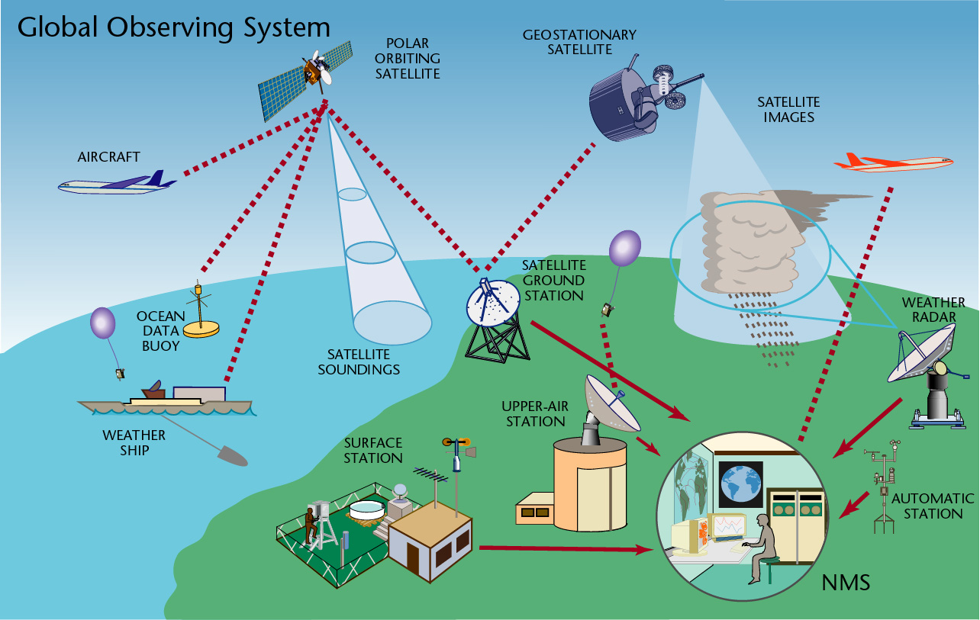
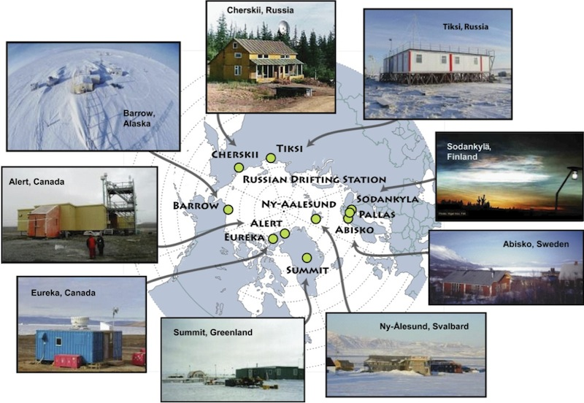
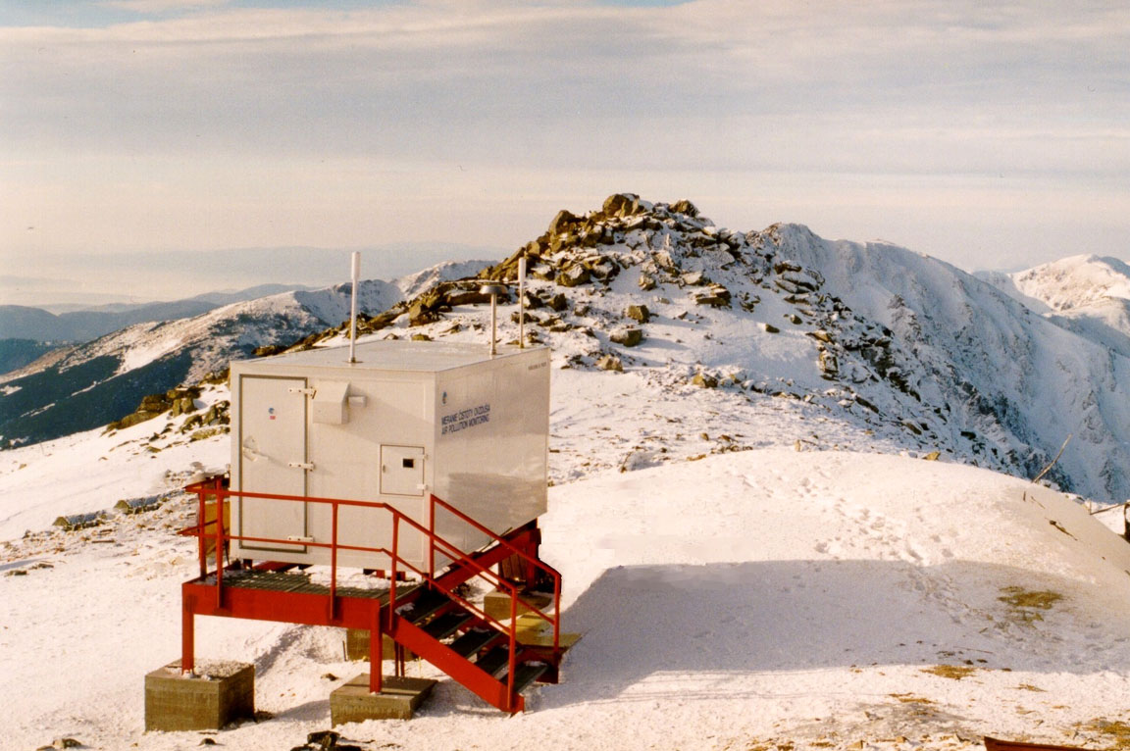
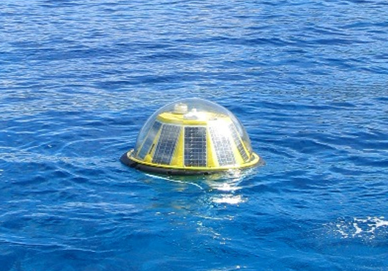
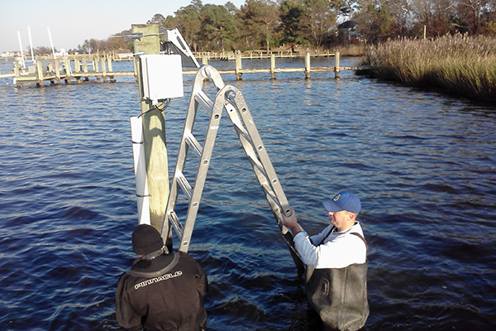
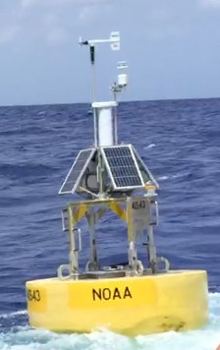
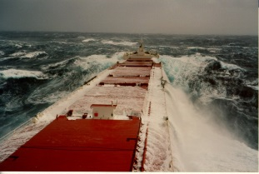
Observing systems contributing to WIGOS
Space-based
  Geostationary
  Polar orbiting LEO
  Eliptical orbit, ....
Surface-based
  Surface stations (RBSN, RBCN, AWS ..)
  Climate stations (GSN)
  Upper air soundings (incl. GUAN, GRUAN)
  Wind profilers
  Weather radars
  Lightning detection systems
  Aircrafts (e.g. AMDAR)
  Aeronautical stations
  Hydrological stations (WHOS)
  Atmospheric composition, air quality monitoring (GAW)
  Cryosphere observations (GCW)
  Marine observations (drifters, floats, moorings, tide gauges, ships, gliders …)
  Terrestrial observations (GTOS)
  Surface-based space weather observations
  GNSS radio-occultation
  …

Slide 5
Rolling Review of Requirements (RRR) and
Evolution of Global Observing Systems
Long term vision of global observing systems
Application
Areas
Critical
review
User
requirements
Statements of
Guidance
(gap analysis)
Impact
Studies
(e.g. NWP5)
Priorities,
cost
effectiveness
Observing
Systems
Capabilities
(Space & Surface)
(OSCAR)
Members’ and
Space Agencies
Observation
Programmes
Implementation Plan
(EGOS-IP)
Notes:
5

Slide 6
RRR process
WMO Database (OSCAR – oscar.wmo.int)
  Observational User Requirements (“technology free”)
  Capabilities of surface-based observing systems
  Capabilities of space-based observing systems
Critical review
  OSCAR/Analysis component will be developed
  Impact studies
    Observing System Experiments (OSEs)
    Observing System Simulation Experiments (OSSEs)
    Other tools, e.g. Forecast Error Contribution (FEC), Forecast Sensitivity to Observations (FSO), …
  Analysed by Experts to produce Statement of Guidance (SoG), i.e. gap analysis
SoGs reviewed by CBS IPET-OSDE
Feeds into the Implementation Plan for the Evolution of Global Observing Systems (EGOS-IP), and vision of the GOS
  Current EGOS-IP responding to the Vision for the GOS in 2025
  Vision for WIGOS Component Observing Systems in 2040 in development

Slide 7
How user requirements are specified
For each application & each geophysical variable
  Horizontal resolution
  Vertical resolution
  Accuracy
  Observing cycle
  Timeliness (Delay)
  Long term stability
For each parameter
  “min” (or threshold)
    value below which observations are worthless
  “max” (or goal)
    value beyond which improvement gives no additional value
  “breakthrough” (or optimum)
    proposed target for significant progress
    optimal cost/benefit

Slide 8
Performance-benefit curve for an observing system

Slide 9
Statements of Guidance
(gap analysis)
The Statement of Guidance interprets the output of the critical review as a gap analysis and identifies priorities for action: the most feasible, beneficial and affordable initiatives to deal with the identified gaps or shortcomings in WMO observing systems for an application area. This draws on the subjective judgement and experience of the Points of Contact, the experts and other stakeholders they consult within their application area.
This stage of the RRR requires the Points of Contact to coordinate with their application area community and stakeholders, as needed, in order to produce, review and revise the Statement of Guidance for the application area.

Slide 10
Implementation Plan for the Evolution of Global Observing Systems (EGOS-IP)
A result of the RRR process taking into account gap analyses for all WMO Application Areas, cost-effectiveness of observing systems, and the priorities of the Organization
A key document providing Members with clear and focused guidelines and recommended actions in order to stimulate cost-effective evolution of the observing systems to address in an integrated way the requirements of WMO programmes and co-sponsored programmes
115 actions, incl. 13 cross-cutting, 59 surface-based, 35 space-based, and 8 space weather.
Available on WMO website in 5 languages
http://www.wmo.int/pages/prog/www/OSY/gos-vision.html#egos-ip

Slide 11

Thank You!

