Slide 1
WIGOS Identifiers WIGOS Workshop for RA-VI with Focus on Marine Meteorological and Oceanographic Observing Requirements
Technical Coordinator - Data Buoy Cooperation Panel
Champika Gallage

Slide 2
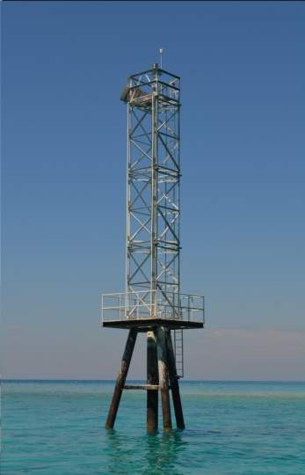
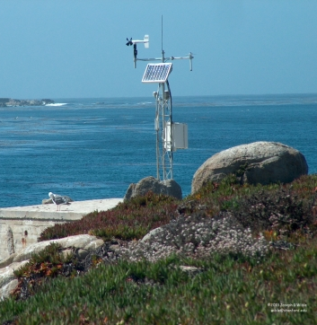
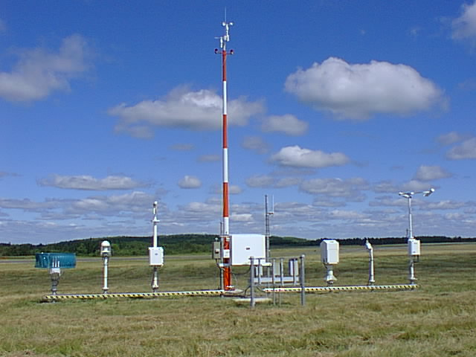
Purpose
WIGOS station identifiers ;
provide a link between observations and the metadata associated with the conditions under which the observations were made.
Facilitate to exclude the transfer of station metadata with observed values.

Slide 3
Introduction
WIGOS station identifiers ;
only be associated with one station or platform (called an “observing facility” in WIGOS metadata terminology)
single observing facility can be associated with more than one WIGOS station identifier in order to maintain a link with historic station identifiers
stations that had already been allocated an identifier under a previous scheme (e.g.WMO ID) should not create additional WIGOS station identifiers
Provisions are in place to map existing station identifiers to WIGOS identifiers

Slide 4
Structure of WIGOS Identifier
Example:
This would be written as : 0-191-326-4400150
WIGOS Identifier Series (number) | Issuer of Identifier (number) | Issue Number (number) | Local Identifier (characters)
0 -14 | 0-65534 | 0-65534 | 16 characters
WIGOS Identifier series 0 | Issuer of Identifier 191 | Issue Number 326 | Local Identifier 4400150
Notes:
Dash in between the sections.

Slide 5
Structure of WIGOS Identifier
WIGOS Identifier Series (number) | Issuer of Identifier (number) | Issue Number (number) | Local Identifier (characters)
0 -14 | 0-65534 | 0-65534 | 16 characters
WIGOS Identifier Series:
Only WIGOS Identifier Series 0 has been defined. This series is used to identify observing stations.
This is used to distinguish between different systems for allocating identifiers. It allows future expansion of the system so that entities do not have to be issued with new identifiers if the structure of the WIGOS identifiers proves unable to meet future requirements.
Different values of the WIGOS Identifier Series may correspond to different structures of the WIGOS identifier. Initial permitted range: 0-14
Notes:
0-14 is allocated for this particular structure.

Slide 6
Structure of WIGOS Identifier
WIGOS Identifier Series (number) | Issuer of Identifier (number) | Issue Number (number) | Local Identifier (characters)
0 -14 | 0-65534 | 0-65534 | 16 characters
Issuer of Identifier :
A number that is used to distinguish between identifiers issued by different organizations.
It is allocated by WMO to ensure that only one organization can create a given WIGOS station identifier.

Slide 7
Structure of WIGOS Identifier
WIGOS Identifier Series (number) | Issuer of Identifier (number) | Issue Number (number) | Local Identifier (characters)
0 -14 | 0-65534 | 0-65534 | 16 characters
Issue Number:
An identifier that an organization responsible for issuing an identifier may use to ensure global uniqueness of its identifiers.
For example, allocating one issue number for hydrological stations and another for voluntary climate observing stations would enable the managers of the two networks to issue Local Identifiers independently without needing to check with each other that they were not duplicating identifiers.

Slide 8
Structure of WIGOS Identifier
WIGOS Identifier Series (number) | Issuer of Identifier (number) | Issue Number (number) | Local Identifier (characters)
0 -14 | 0-65534 | 0-65534 | 16 characters
Local Identifier :
This is the individual identifier issued for each station/platform/observing facility.
An organization issuing identifiers must ensure that the combination of Issue Number and Local Identifier is unique; This will guarantee the global uniqueness of numbers.

Slide 9
Issuer of Identifier for station identifiers associated with WMO Programmes
Range of Issuer of Identifier | Category of issuer | Method of allocating | Procedures for issuing Issue Number and Local Identifier
0 | Reserved for internal use by OSCAR | OSCAR allocates the value | Determined by OSCAR
1-9999 | Member state or territory for which there is an ISO 3166-1 numeric country code | ISO 3166-1 three digit numeric country code (by convention leading zeroes are not shown in WIGOS Identifiers). See *ISO web site for more details | Issuer identifies its own procedures. Further guidance is available in the section **"Guidance on recommended practices for the allocation of 'issue number' and 'local identifier' for Member states and territories that have an 'issuer of identifier' allocated to them".
10000-11999 | Member state or territory for which there is no ISO 3166-1 numeric country code | WMO Secretariat allocates an available number on request | Issuer identifies its own procedures. Further guidance is available in the section "Guidance on recommended practices for the allocation of 'issue number' and 'local identifier' for Member states and territories that have an 'issuer of identifier' allocated to them".
12000-19999 | Reserved for future use. | To be determined. | To be determined.
* https://www.iso.org/obp/ui/#search
** https://wiswiki.wmo.int/tiki-index.php?page=WIGOS-Id-WMOProg
Notes:
ISO 3166-1 three digit numeric country code (by convention leading zeroes are not shown in WIGOS Identifiers). See ISO web site and click on "Officially assigned codes" (on the left of the screen)

Slide 10
Issuer of Identifier for station identifiers associated with WMO Programmes ctd.
Range of Issuer of Identifier | Category of issuer | Method of allocating | Procedures for issuing Issue Number and Local Identifier
Identifiers in the ranges 20000-21999 and 22000-39999 are intended only to be used to allocate WIGOS identifiers for observing facilities that had one or more pre-existing identifiers.
20000-21999 | WMO Secretariat for identifiers associated with WMO Programmes. | Details are provided in the section ***"Allocation of 'issuer of identifier' for station identifiers associated with WMO Programmes" | Details are provided in the section ***"Allocation of 'issuer of identifier' for station identifiers associated with WMO Programmes"
22000-39999 | WMO Secretariat for identifiers associated with programmes of Partner organizations. | Details are provided in the section ***"Allocation of 'issuer of identifier' for station identifiers associated with WMO co-sponsored programmes". | Details are provided in the section ***"Allocation of 'issuer of identifier' for station identifiers associated with WMO co-sponsored programmes".
40000-65534 | Reserved for future use. | To be determined. | To be determined.
65535 | Missing value (reserved value in Table Driven Code Forms).
*** https://wiswiki.wmo.int/tiki-index.php?page=WIGOS-Id-Country

Slide 11
‘Issuer of identifier' for station identifiers associated with WMO Programmes
Issuer of Ident. | Category of station identifier | Method of allocating Issue Number | Method of allocating Local Identifier
20000 | WWW land station with sub-index number (SI) = 0 | 0: station defined in WMO-No. 9 Volume A on 1 July 2016. Any other positive number: to distinguish between different observing facilities that used the station identifier in the past. | Use the block number (II) and the station number (iii) as a single five digit number IIiii (with leading zeroes). Example: station 60351 would be represented by 0-20000-0-60351
20001 | WWW land station with sub-index number (SI) = 1 | 0: station defined in WMO-No. 9 Volume A on 1 July 2016. Any other positive number: to distinguish between different observing facilities that used the station identifier in the past. | Use the block number (II) and the station number (iii) as a single five digit number IIiii (with leading zeroes). Example: upper air station 57816 would be represented by 0-20001-0-57816
20002 | WWW Marine Platform (moored or drifting buoy, platform, etc.) | 0 - platform for which the identifier was in use on 1 July 2016. Any other positive number - to distinguish between different platforms that used the same identifier at different times. | Use the region/platform number combination A1bwnbnbnb Examples: the data buoy 59091 would be represented by 0-20002-0-59091. The WWW list of data buoys lists two buoys with identifier 13001. The buoy most recently used at the time WIGOS station identifiers were introduced is allocated 0-20002-0-13001 and the second is issued identifier 0-20002-1-13001 (note - the Issue Number is different from that for the first buoy).
https://wiswiki.wmo.int/tiki-index.php?page=WIGOS-Id-WMOProg
Notes:
The table defines the value of Issuer of identifier in the range 20000-21999 to be used for WIGOS station identifiers.
This range is used to ensure that observing facilities that had pre-existing station identifiers can be allocated a WIGOS station identifier in a way that retains an association with the pre-existing identifier.
Any new observing facility will be given an identifier within the range allocated to the Member operating the observing facility outside this range.
The following observing programmes did not have a pre-existing international system for assigning station identifiers and have not been allocated Issuer of Identifiers. Members operating the stations supporting these observing programmes should allocate WIGOS identifiers using their national system. Sea level network. In the past, station identifiers have been issued according to national conventions. In cases where the identifier of another WMO Programme has been used (for example a land station identifier), the WIGOS identifier corresponding to that identifier should be used. Tsunamometer network. In the past, station identifiers have been issued according to national conventions. In cases where the identifier of another WMO Programme has been used (for example a land station identifier), the WIGOS identifier corresponding to that identifier should be used.

Slide 12
Principles to guide allocation of station identifiers
Issuers of identifiers are responsible for not to share the same station identifier on two observing facilities .
Issuers of identifiers can allocate different Issue Numbers to the organizations delegated to allocate "Local Identifiers" for their observing facilities.
The issuer of identifiers should maintain records on Issue Numbers and organizations responsible for managing Local Identifiers.
An organization issuing a Local Identifier must ensure that no two observing facilities share a WIGOS station identifier.
An organization responsible for allocating Issue Numbers and Local Identifiers must ensure that no two observing facilities have the same combination of Issue Number and Local Identifier. If the organization is only allocating Local Identifiers then it is sufficient for that organization to ensure that it does not issue the same Local Identifier to the more than one observing facility.
The organization must maintain a record of the Local Identifiers (and Issue Numbers) that it has issued (it may choose to use OSCAR for this).
An organization issuing a Local Identifier may choose to use an existing national identifier for the observing facility as the Local Identifier.
Historically, re-used station IDs can be retain with different Issue Numbers to maintain the link. (Example: 0-20002-0-4400123 and new allocation is 0-20002-1-4400123)
Notes:
Issuers of identifiers are responsible for guaranteeing that no two observing facilities share the same station identifier. Note that the structure of WIGOS station identifiers guarantees that issuers of identifiers cannot create station identifiers that have already been allocated by another issuer of identifier.
Issuers of identifiers may choose to use the Issue Number to allow them to delegate the allocation of Local Identifier to other organizations responsible for managing individual observing networks. Issuing each organization with a different Issue Number will allow those organizations to allocate "Local Identifiers" for their observing facilities.
The issuer of identifiers has to record which Issue Numbers have ever been allocated, and which organization is responsible for managing Local Identifiers for each.
An organization issuing a Local Identifier must ensure that no two observing facilities share a WIGOS station identifier.
An organization that is responsible for allocating both Issue Numbers and Local Identifiers must ensure that no two observing facilities have the same combination of Issue Number and Local Identifier. If the organization is only responsible for allocating Local Identifiers then it is sufficient for that organization to ensure that it does not issue the same Local Identifier to the more than one observing facility.
The organization must maintain a record of the Local Identifiers (and Issue Numbers) that it has issued (it may choose to use OSCAR for this).
The body may choose to use an existing national identifier for the observing facility as the Local Identifier. Doing so in a systematic way may decrease the administrative load for the body.
Historically, station identifiers may have been re-used when observing facilities closed and new ones opened. If the organization has been allocated a range of Issue Numbers, the organization may wish to consider using different Issue Numbers to distinguish between the different locations, allowing the Local Identifier to retain the link to the identifier that was used while the observing facility was open at a location. (Ex. 0-20002-0-4400123 and new allocation is 0-20002-1-4400123)

Slide 13
Principles to guide allocation of station identifiers ctd.
WIGOS station identifier must not be issued to more than one observing facility; though it is permitted for a station to have more than one WIGOS station identifier associated with it.
The WIGOS station identifier for a closed observing facility must not be re-used unless the observing facility reopens.
Stations may have more than one WIGOS station identifier. In this case, the organization issuing the Local Identifier should associate all these identifiers with the same WIGOS metadata record.
The organization must use meteorological judgement in deciding to use the same WIGOS ID for a station which moves its location.
Search Oscar/surface for the proposed WIGOS station identifier before issuing the identifier to make sure that it has not already been allocated.
Organizations are strongly advised to document their procedures for allocating WIGOS station identifiers in their Quality Management System.
Notes:
Although a single WIGOS station identifier must not be issued to more than one observing facility, it is permitted for a station to have more than one WIGOS station identifier associated with it. For example, although all observing facilities with pre-existing WWW station identifiers have a WIGOS station identifier based on the WWW identifier, the organization may wish to create a new identifier that is linked to a national numbering scheme.
The WIGOS station identifier for a closed observing facility must not be re-used unless the observing facility reopens.
The organization responsible for allocating the WIGOS station identifier should ensure that the operator of the observing facility has committed to providing and maintaining WIGOS metadata for that observing facility.
Stations may have more than one WIGOS station identifier. In this case, the organization issuing the Local Identifier should associate all these identifiers with the same WIGOS metadata record so that only one WIGOS metadata record needs to be maintained. OSCAR will provide tools to document this linkage.

Slide 14
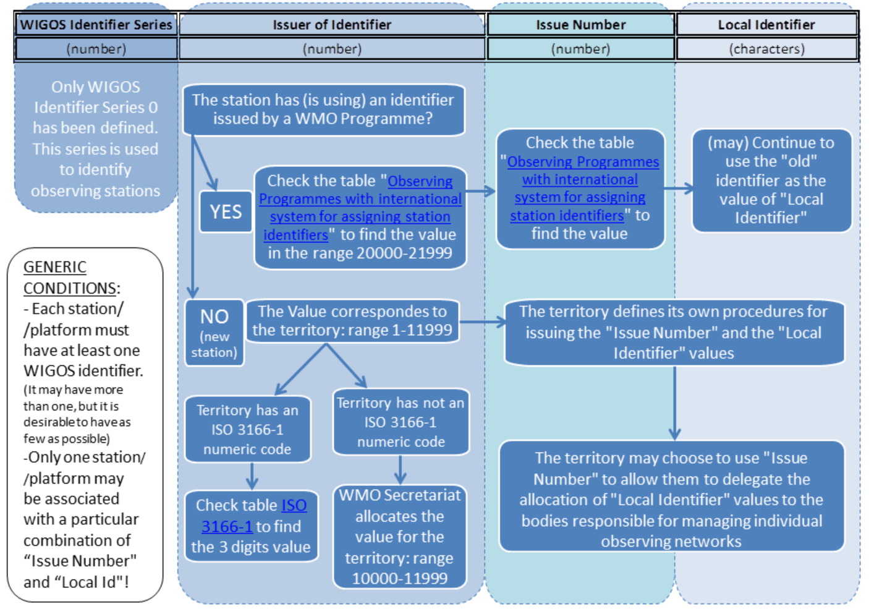
Assigning WIGOS Identifiers to observing stations

Slide 15
Advice for users of WIGOS Identifiers
WIGOS Identifiers do not have meaning in themselves. Users must not interpret any patterns they see in WIGOS Identifiers.
Metadata associated with WIGOS identifiers are available through OSCAR at
https://oscar.wmo.int/surface/index.html#/
WIGOS station identifiers cannot be represented in the Traditional Alphanumeric Code forms such as FM-12 SYNOP / FM-13 SHIP / FM-18 Buoy / FM-35 TEMP.
WIGOS station identifiers can be included in Table Driven Code Form equivalents (FM-94 BUFR or FM-95 CREX, or, in the future, model driven code forms. Information available on http://wis.wmo.int/page=WIGOS-ID-BUFR).
Centers unable to process Table Driven Code Form will not be able to access the reports from stations that only have WIGOS station identifiers.

Slide 16
Discussion
Who shoud be the issuer of identifiers?
Depend on the station Category?
WMO programmes of Partner organizations?
Regional center ?
National Organisation ?
Some or all of above ?
How to handle third party operated stations who are currently not providing data to the GTS?
Third party operators having agreements/MOU with NMHS?
Third party operators without existing agreement/MOU with NMHS?

Slide 17
For questions contact the Secretariat at
wigos-help@wmo.int
Thank you

