Slide 1
DWD
Activities in marine
meteorological observations

Slide 2
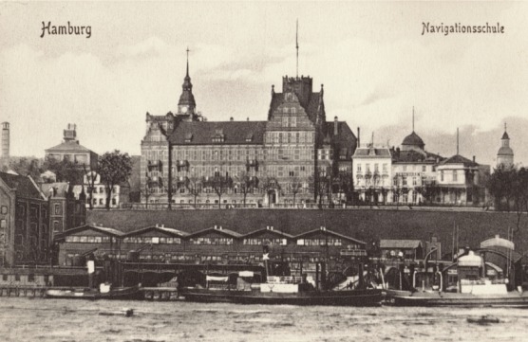
History (in Hamburg)
1.1.1868 Foundation of "Norddeutsche Seewarte"
1.1.1872 Reorganization into "Deutsche Seewarte" (Georg v. Neumayer)
1.1.1946 Reorganization into Meteorological Agency for North-West-Germany and Germany Hydrographic Institute
1947 Relocation into former School for Navigation (built 1905)
1952 Foundation of DWD

Slide 3
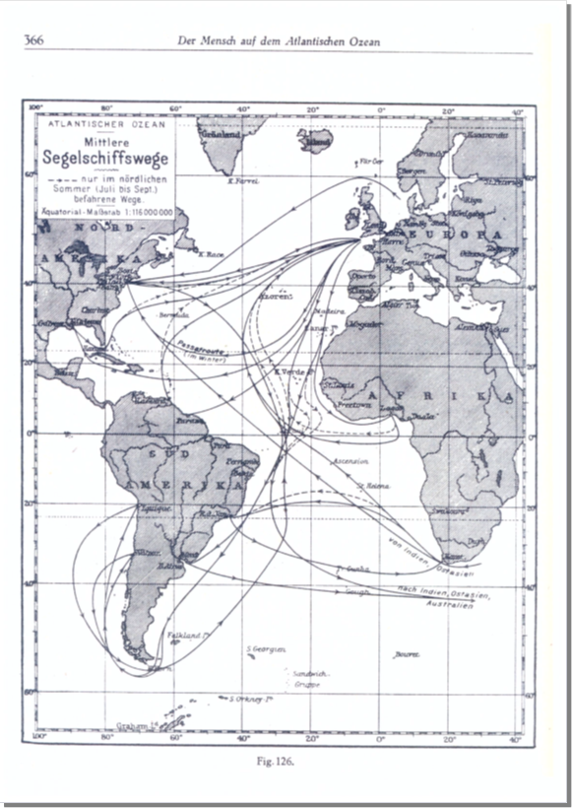
Historical tasks
issuance of special meteorological logbooks by "Deutsche Seewarte"
analysis of data at Seewarte:
acquisition of wind, currents, temperatures…
derivation of optimized shipping routes
release of sailing instructions and maps

Slide 4
Available data 1828 - 1945

Slide 5
International programmes and activities
europe
EUMETNET Observations Programme
E-SURFMAR
E-ASAP
global
JCOMM (Joint WMO-IOC Technical Commission for Oceanography and Marine Meteorology)
SOT (Ship Observations Team)
VOS Panel (Voluntary Observing Ship)

Slide 6
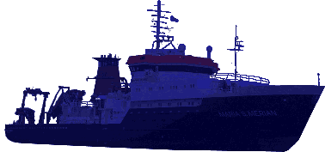
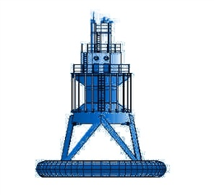
DWD VOS fleet (12/2015)
conventional 540 ( + 25 / - 73 )
automated 20 ( + 0 / - 0 )
other 5

Slide 7
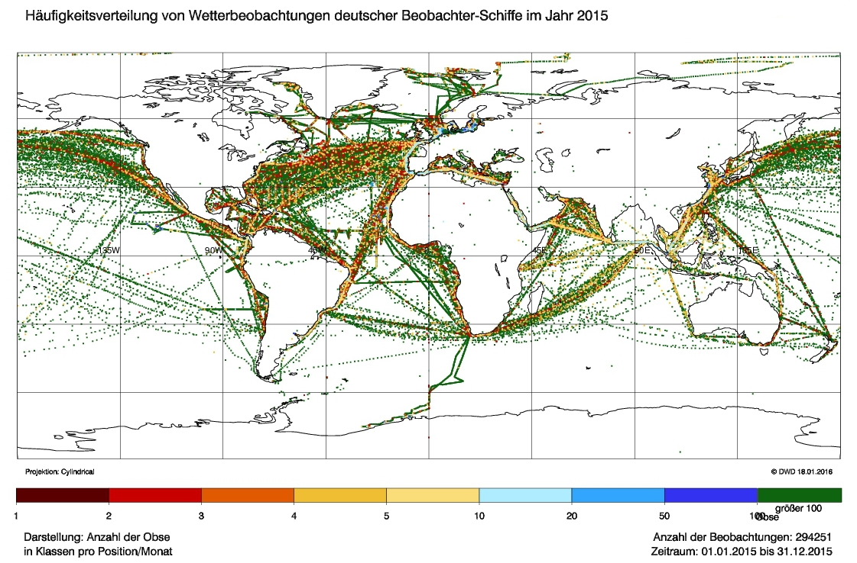

Slide 8
Data transmission
Conventional VOS
Inmarsat (SAC 41)
eMail
future plan: half-compressed, eMail or Inmarsat (SAC 449) for VOS
S-AWS
DCP (Eumetsat)
eMail
future plan: Iridium SBD (EUCAWS)
Inmarsat Fleetbroadband for fixed stations

Slide 9
QC
PMOs
Instrument checks onboard
Online tools (blacklists, counters, comparison to model output, …)
MQC on IMMT for GCC
GCC
course / speed check of received data
HQC (autmatic and manual)
Instruments
Calibration within DWD (applied to become RIC) accredited according to DIN EN ISO/IEC 17025:2005 for pressure, wind, temp, humidity and precipitation
Maintenance database within DWD

Slide 10
Metadata
DWD
HafDi
Metadata database (contacts, instruments, visits, rewards,…)
WaPiTi
Maintenance database (visits, instruments, calibration data,…)
Mirakel
Central database / archive of all observations
E-Surfmar
VOS metadata database
monthly manual feed of Pub47 from HafDi

Slide 11
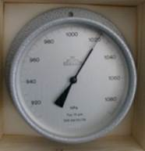
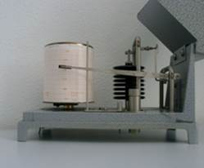
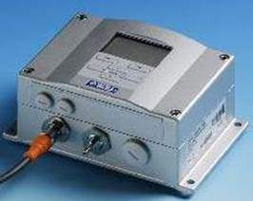
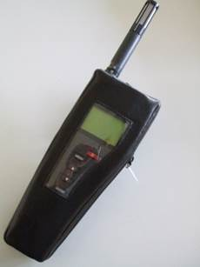
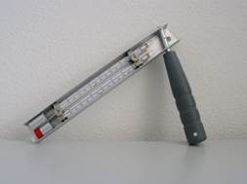
"Digitizing" of conventional fleet
+

Slide 12
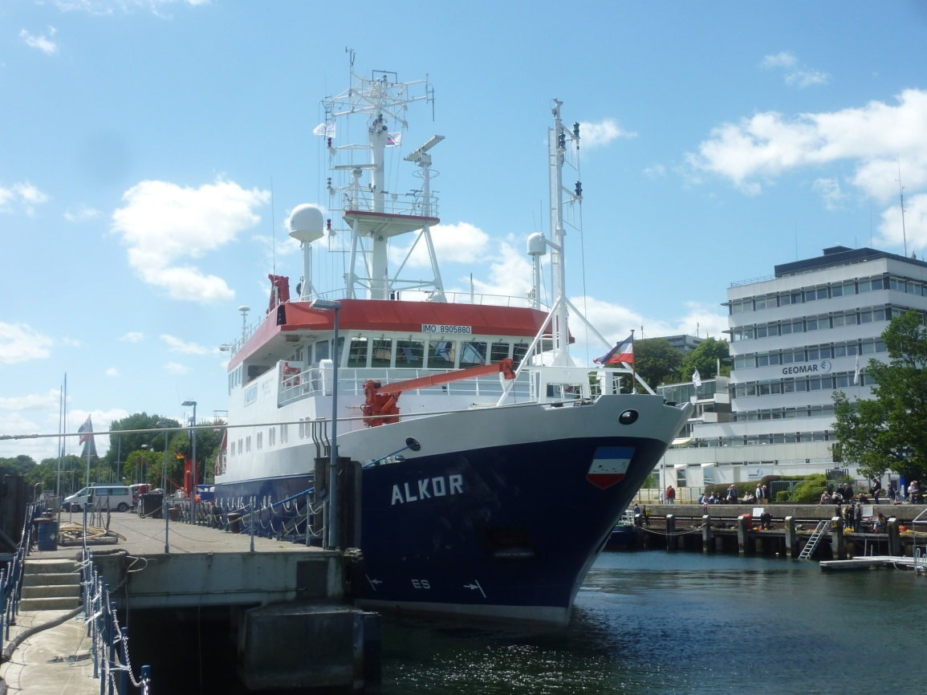
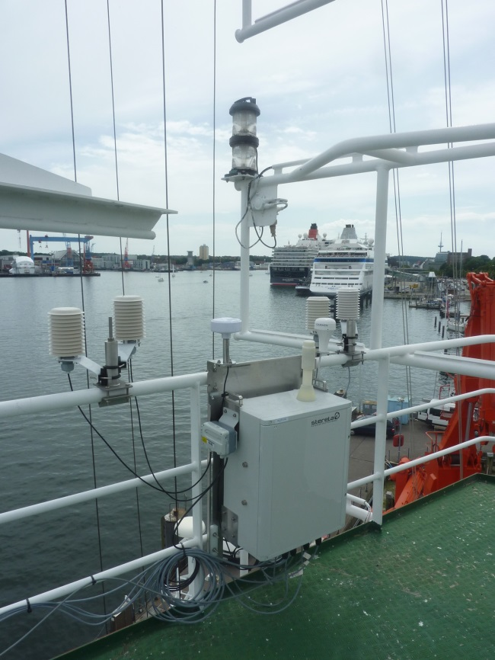
EUCAWS – the common european S-AWS

Slide 13
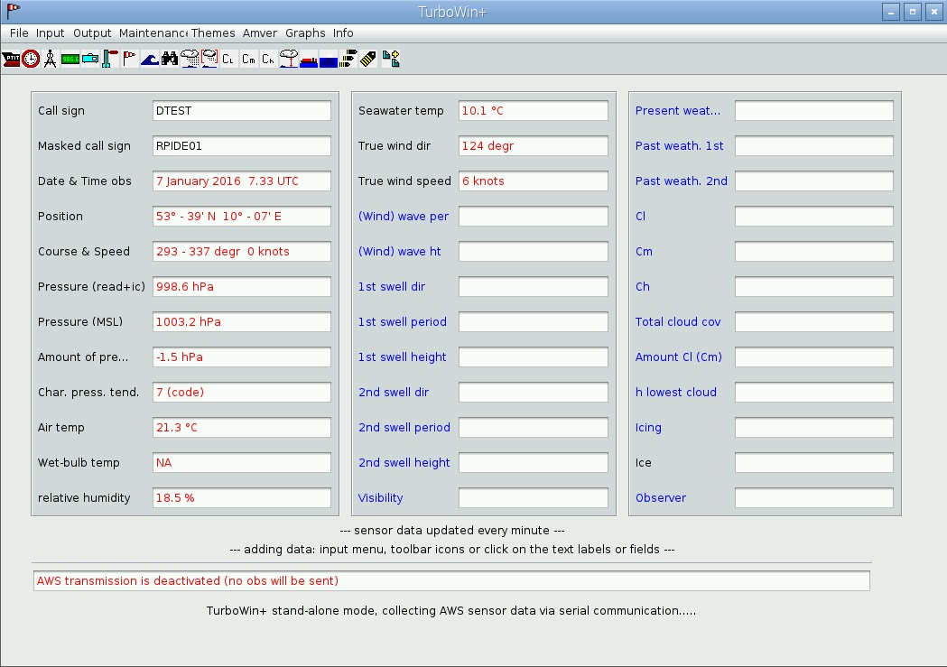
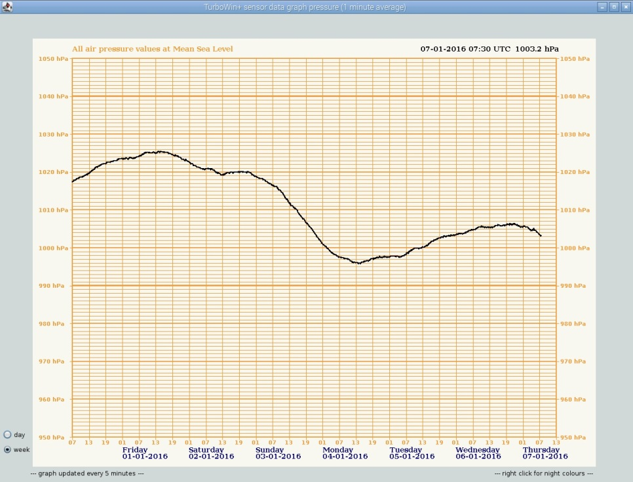
EUCAWS – TurboWin+
display of data and acquisition of visual observations
global standard software, provided by KNMI
runs on PC and i.e. RaspberryPi (TurboPi by DWD)

Slide 14
EUCAWS – planned fleet
DWD: 209
100 in basic setup – only pressure
90 in complex setup – pressure, temp (air and sea), humidity, wind
19 backup / spare
Météo France: 40 + 10 for E-Surfmar
KNMI: 50
met.ie: 5
SMHI: 5

Slide 15
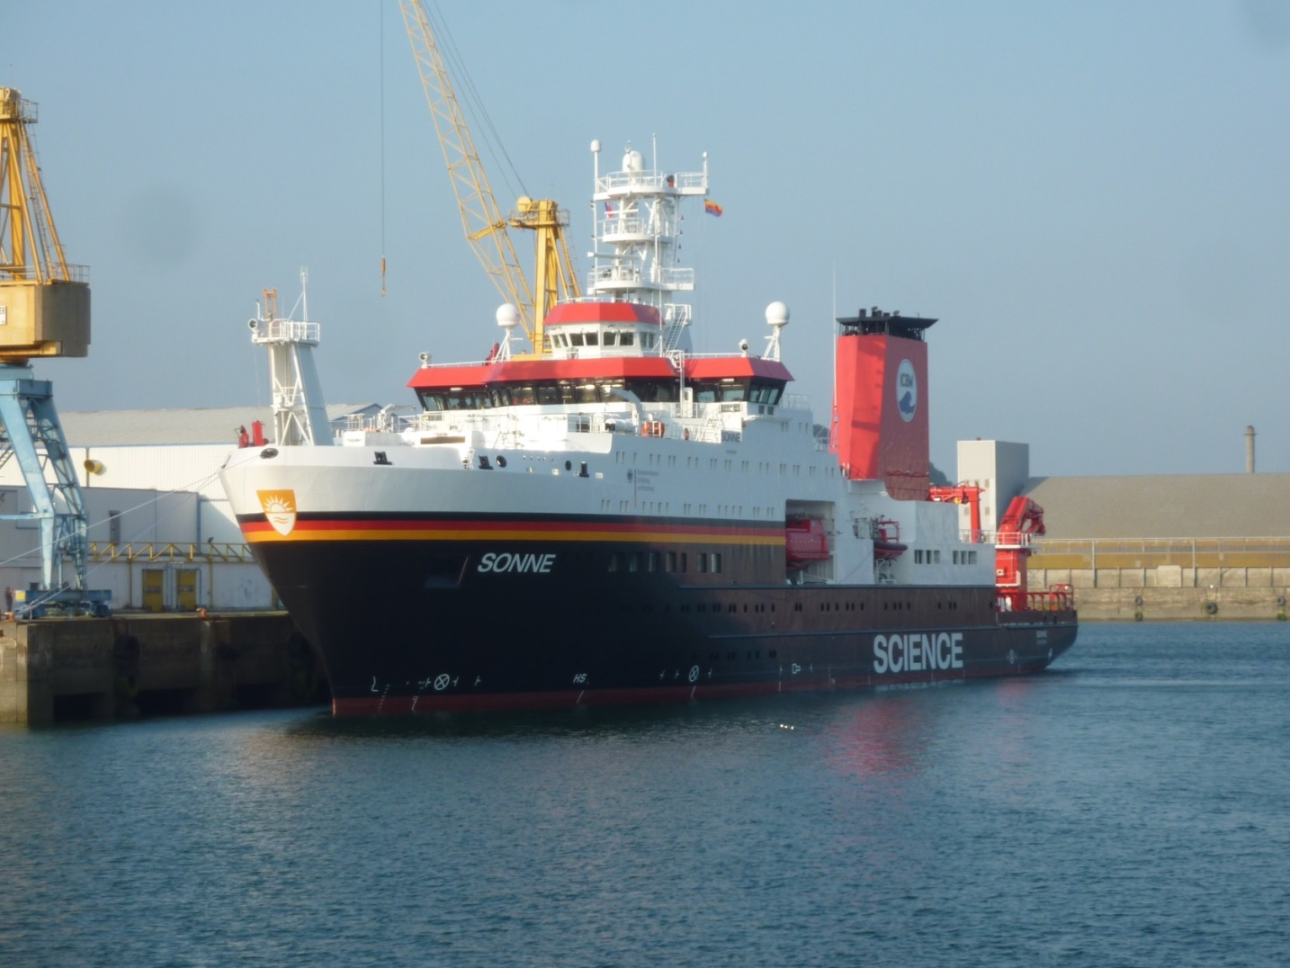
Super VOS (DBBE + TBWDE01)

Slide 16
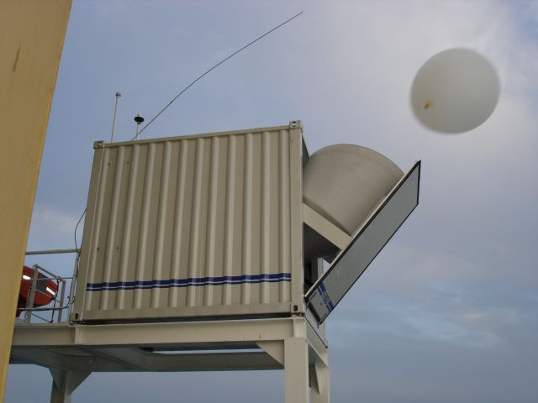
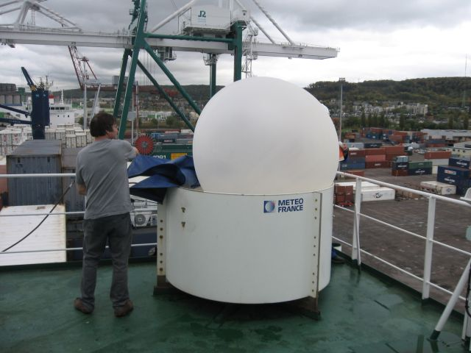
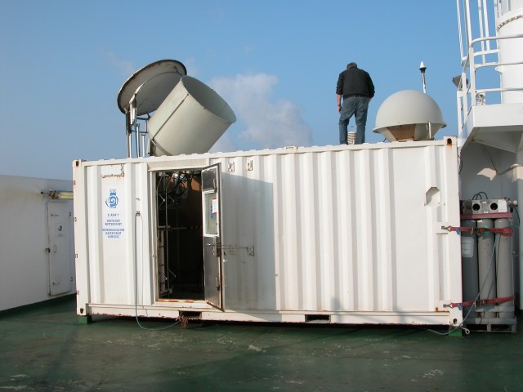
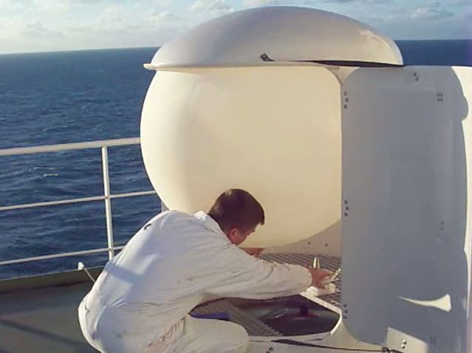
E-ASAP (Automated Shipborne Aerological Programme)

Slide 17
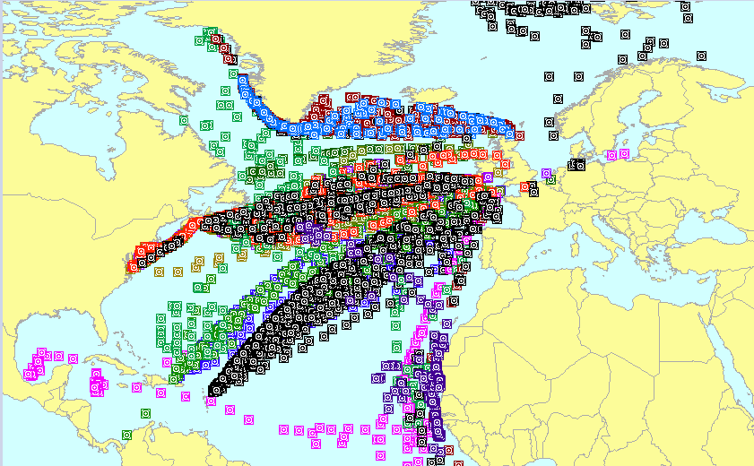
E-ASAP (2015)
4317 soundings (18 systems)

Slide 18
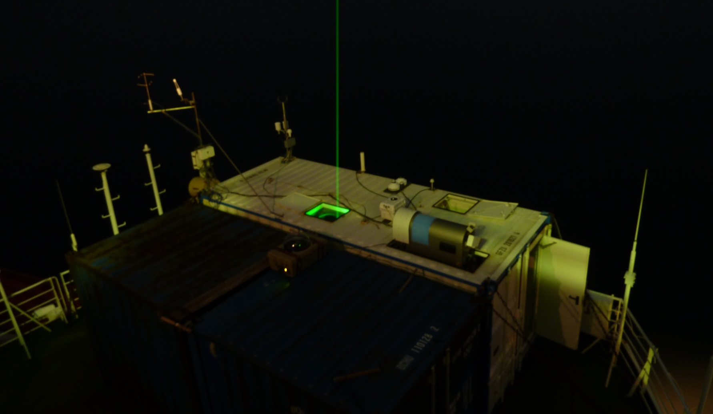
Support to scientific institutions

