Slide 1

EuroGOOS
facilitating sharing of oceanographic observations via EMODnet Physics
Patrick Gorringe

Slide 2


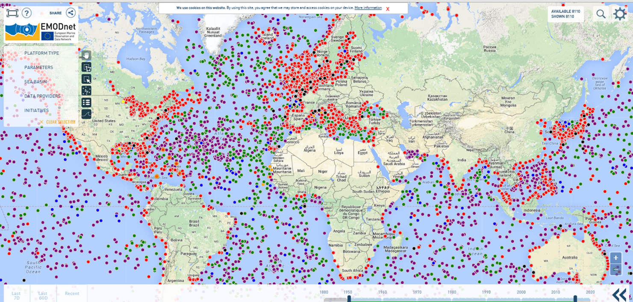
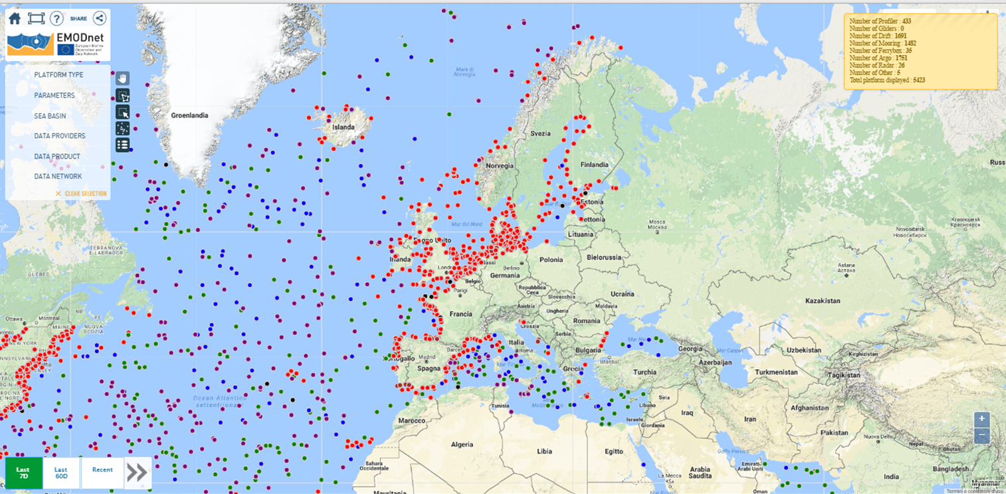
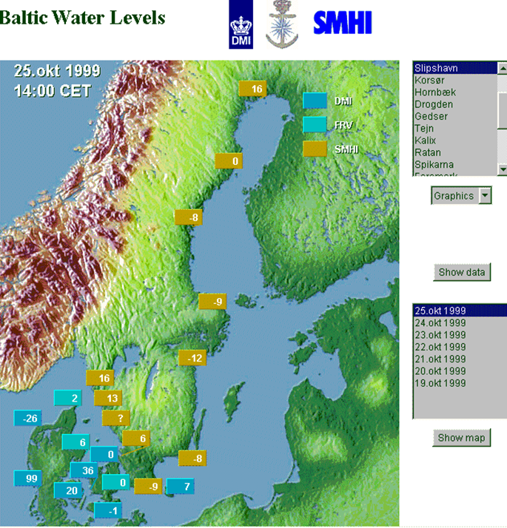
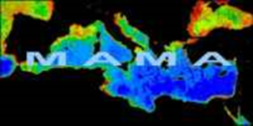
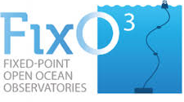
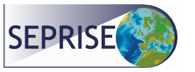



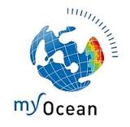
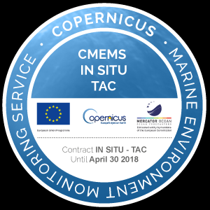


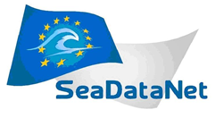
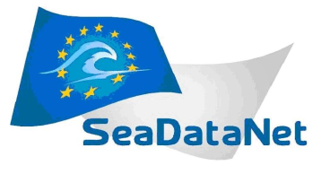
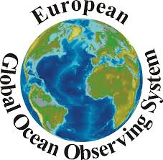

1999
2004
2006
2016
0

Slide 3
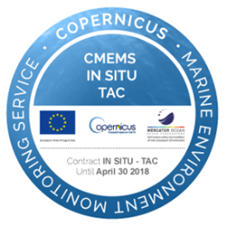
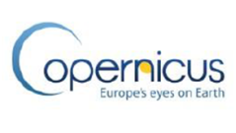

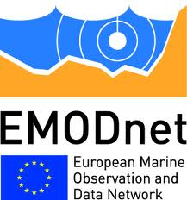
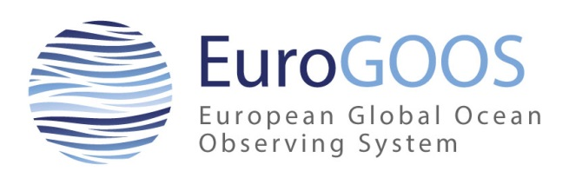
Three initiatives for marine information
DG
GROWTH
Copernicus
INSTAC
www.copernicus.eu
DG
RESEARCH & INNOVATION
SeaDataNet
www.seadatanet.org
DG
MARITIME AFFAIRS
& FISHERIES
EMODnet
Physics
www.emodnet-physics.eu
EuroGOOS
Operational oceanography community
EuroGOOS has the cross cutting role in these initiatives

Slide 4
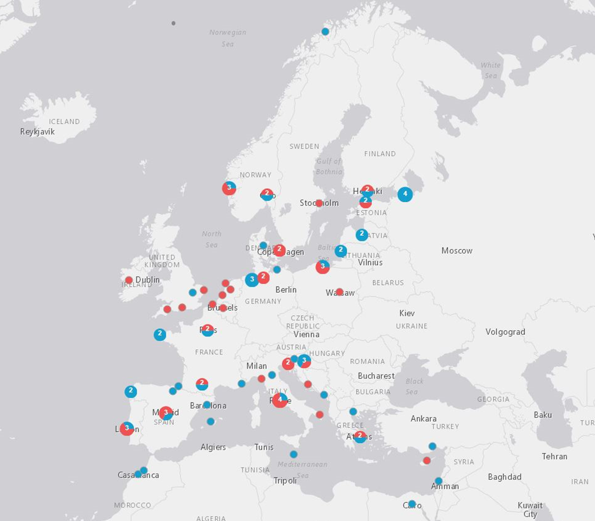
EuroGOOS is an international association of 40 national agencies (+ 60 ROOS members), institutes and research organizations in 19 European countries promoting and implementing Operational Oceanography (including 6 Meteorological institutes). Founded in 1994, EuroGOOS operates in the framework of the Global Ocean Observing System (GOOS) of UNESCO/IOC.
http://eurogoos.eu

Slide 5

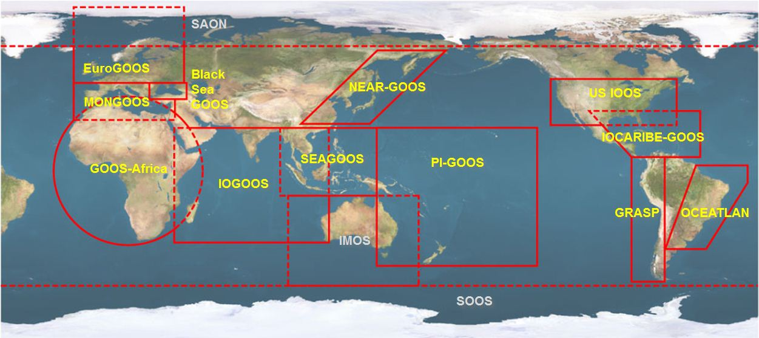

Part of the global effort
EuroGOOS is one of the thirteen GOOS Regional Alliances (GRAs) that develop the system in different parts of the World Ocean.
GOOS establishes a permanent global system for observations, modelling and analysis of marine and ocean variables to support operational ocean services worldwide
GOOS is a platform for:
International cooperation for sustained observations of the oceans
Generation of oceanographic products and services
Interaction between research, operational, and user communities

Slide 6
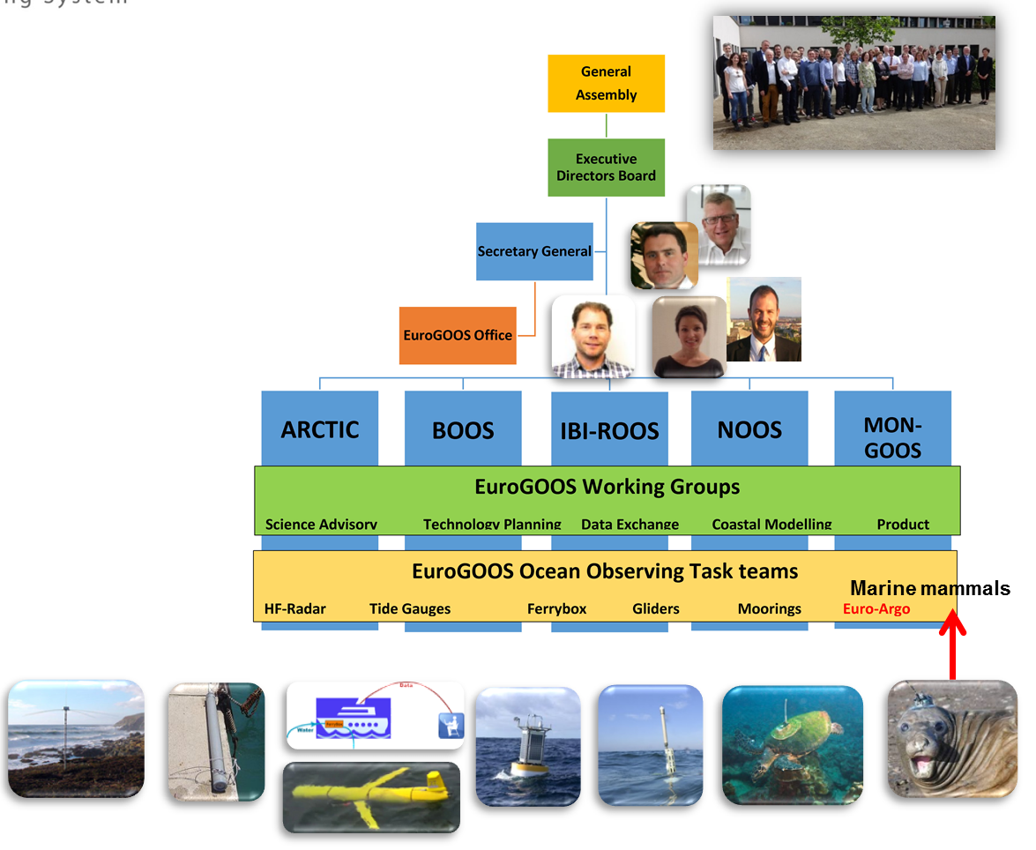
Structure

Slide 7
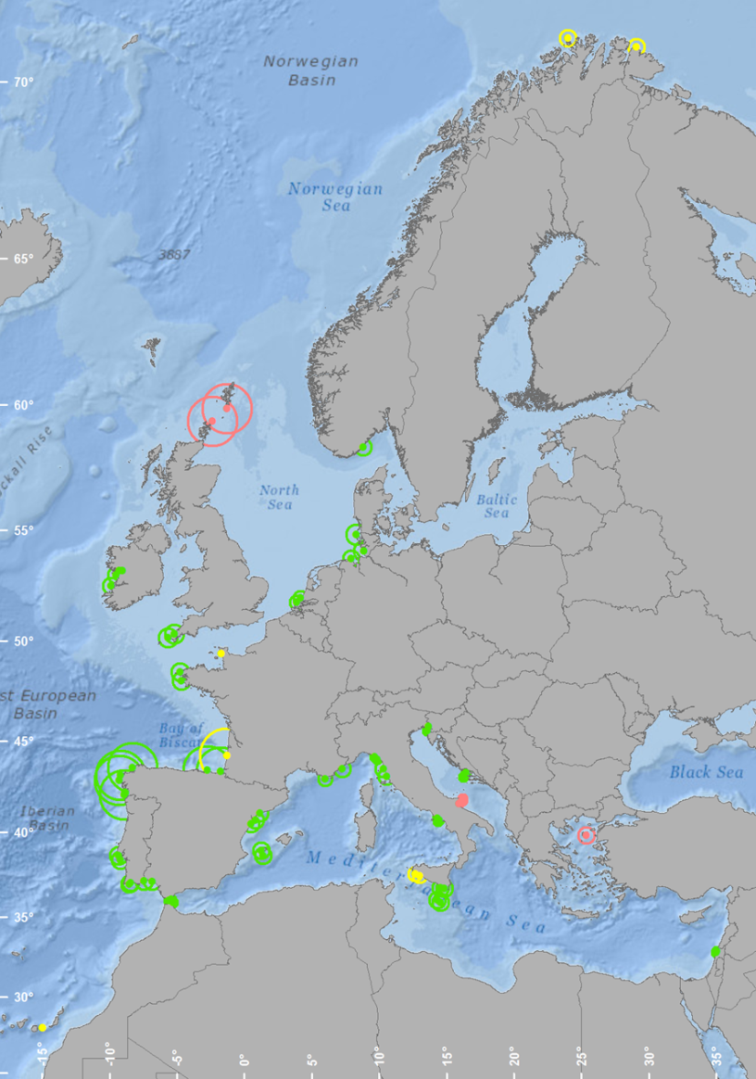
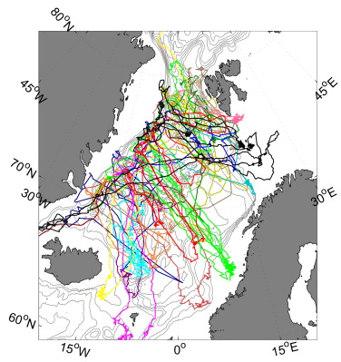
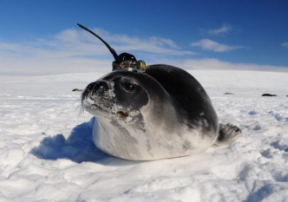
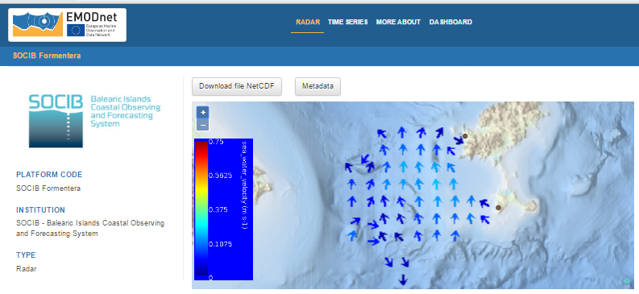
Tracks of seals in the North Sea from mid-July 2008 to end of November 2008 collecting 61112 CTD profiles (Isachsen et al. 2014).
72 HFR European sites

Slide 8

The ROOSs - Regional Operational Oceanographic Systems are the operational arm(s) of EuroGOOS
About 60 additional partners in ROOSs
The ROOSs cooperation focus on improved national and regional services and products
ROOSs coordinate the observations and the data transfer for internal use and to other users
Regional data portals in every ROOS simplifying the data transfer and enable interoperability and act as “data translators”

Slide 9
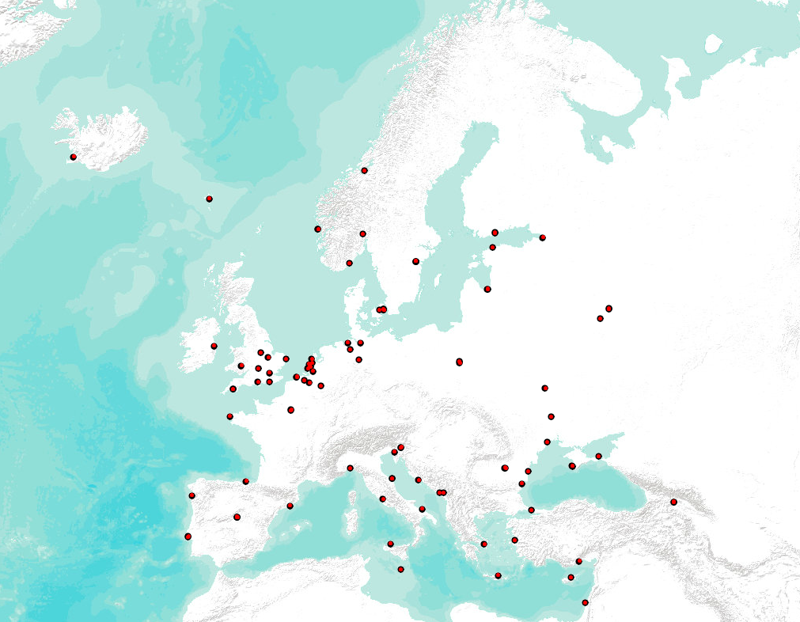

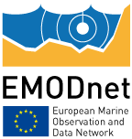
What is EMODnet?
A network of people and technology that work together to compile and distribute data, metadata and products on European coastal and ocean waters
Provide access to data
easily accessible,
free of restrictions on use and
Interoperable
→ Collected stored & managed by MS and/or regional aggregators
Create data products of common interest
Developed, stored and made available by EMODnet
Notes:
EMODnet = the long term marine data initiative at the core of Marine Knowledge 2020 Strategy – aim is to allow users to more easily find and retrieve data and products which are stored in datasystems scattered around Europe
It is a network of 110 Organisations at this point – involved in assembling marine data, metadata & data products from diverse sources within Europe in a uniform
→ Brings added value to already existing efforts: it makes available data already collected/stored somewhere - builds on existing efforts where data communities have already organised themselves and only develops new initiatives where necessary to actively fill gaps and breakdown barriers
Key Principles
Collect data once; use many times -> reduce costs
Sustainable funding at a European level to maximise benefit from the efforts of individual Member States
Free and unrestricted access to data and data products
Build on existing efforts where data communities have already organised themselves - develop new initiatives where necessary to actively fill gaps and breakdown barriers
Put the user first when developing priorities and taking decisions
Develop data standards across disciplines as well as within them
Process and validate data at different scales: regional, basin and pan-European
Provide statements on data ownership, accuracy and precision

Slide 10
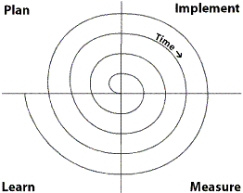
How?
2009 | 2010 | 2011 | 2012 | 2013 | 2014 | 2015 | 2016 | 2017 | 2018 | 2019 | 2020
Phase 1 – limited sea basins
 |  |  |  | Phase 2 - low resolution all basins
 |  |  |  |  |  | Phase 3 - multi-resolution
Central Portal
7 thematic portals
6 Regional checkpoints
Secretariat
Notes:
2009: Start EMODnet phase 1: 59 Institutes - Budget €6.45M
2013: Start EMODnet phase 2: 120 Institutes - Budget €16.3M
NOW: 7 thematic portals + 2 regional checkpoints (6 - soon) + EMODnet Central Portal + Secretariat
2015: EMODnet phase 3: towards a seamless multi-resolution digital seabed map of European waters by 2020.[budget ↑↑↑]
Central Portal - Acts as a gateway to the other thematic and regional EMODnet portals
Also develops own data services/products combining data from at least 2 thematic data portals
The approach in phases/steps allows users to assess and improve products by trying it out.
EMODnet is a long term marine data initiative developed through a step-wise approach. Currently, available data are being used to create medium-resolution maps of all Europe’s seas and oceans, spanning all seven disciplinary themes - these are expected to be complete in 2015. The next phase of EMODnet will involve the development of multi-resolution sea basin maps, commencing in 2015 to be completed by 2020.
Budget gradually increased based on the needs: from 6M in phase one to 16M in phase to to ??? 15M per year in phase 3?
A seamless multi-resolution digital seabed map of European waters by 2020.
Highest resolution possible in areas that have been surveyed;
Free of restrictions on use;
Topography, geology, habitats and ecosystems;
Accompanied by timely information on
Physical, chemical and biological state of the overlying water column
Oceanographic forecasts;
Together with a process that helps Member States maximise the potential of their marine observation programmes

Slide 11
EMODnet Physics objectives and commitments:
  Provides a single point of free and open access to marine real-time and archived data on physical* conditions of all European Seas as monitored by fixed platforms, ferry boxes, ARGO, gliders, mammals, HF Radars,….
  Make available monthly averages, sea level trends, ice info, etc.
  Facilitate down- and up-stream integration and interoperability (WMS, WFS, WebService, etc)
  Attract new data, new data providers, new platforms
  Collects data in a number of formats, makes available in one common format
    Built in cooperation and coordination with EuroGOOS and its ROOSs and other existing European integrator infrastructures, CMEMS and SeaDataNet
* Temperature (ocean, air), salinity, sea level, wind, waves, currents, light attenuation, river and underwater sound

Slide 12


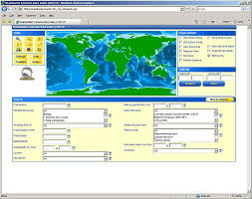
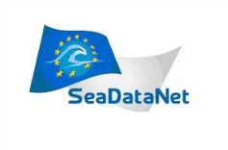


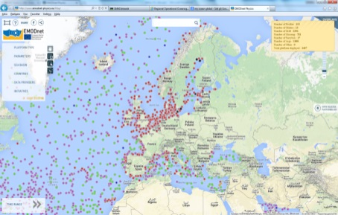


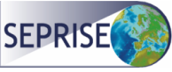

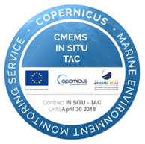

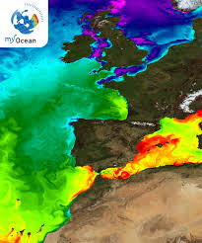
End Users
EuroGOOS and data
Network of NODC
Data Discovery, archiving, standards and distribution via NODCs
Unlocking new data, Data discovery, view, download, interoperability layers
Data Integration, Assessment and distribution for Operational use and Research, RT QC, products i.e. running
the operational service
Data collection, processing, platform network

Slide 13

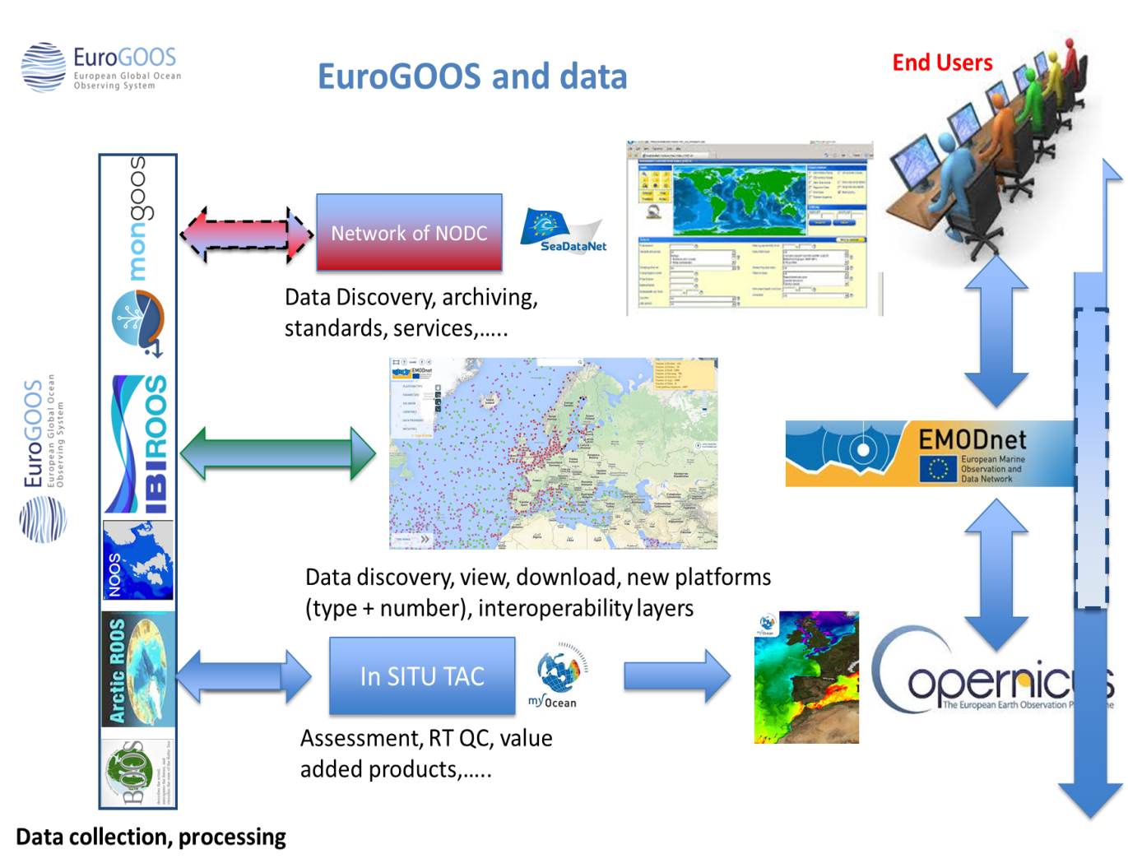




EuroGOOS and data
Interoperability
Providing a European data package to global initiatives

Slide 14
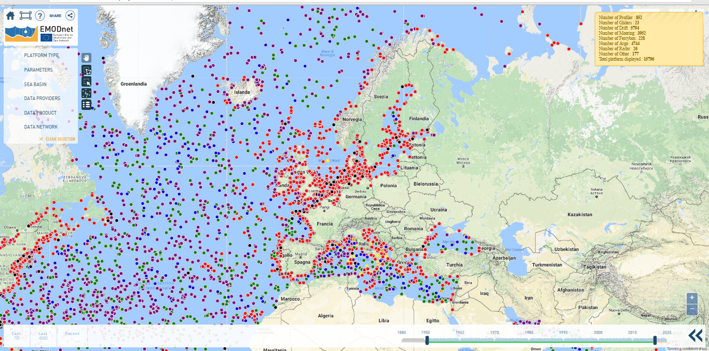
 | drifting buoy (DB) | Ferrybox and ship (FB) | glider (GL) | fixed platform and mooring time series (MO) | profiling float (PF) | Argo Float (AR) | Radar (RD) | TOTAL
platforms | 4063 | 34 | 20 | 2570 | 644 | 4772 | 13 | 12116
http://www.emodnet-physics.eu

Slide 15
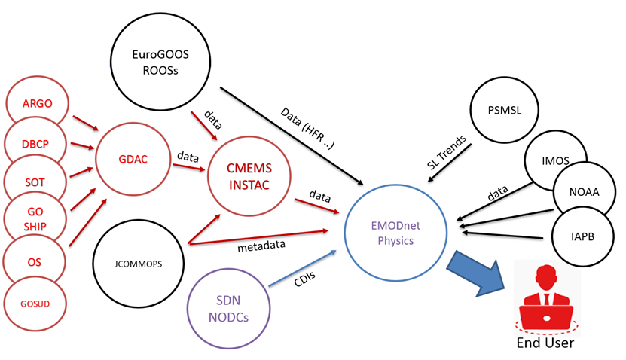

Slide 16
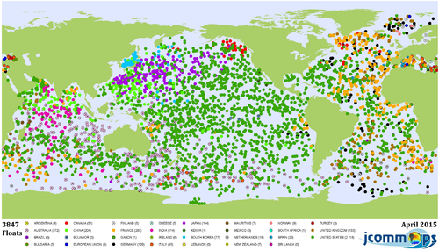
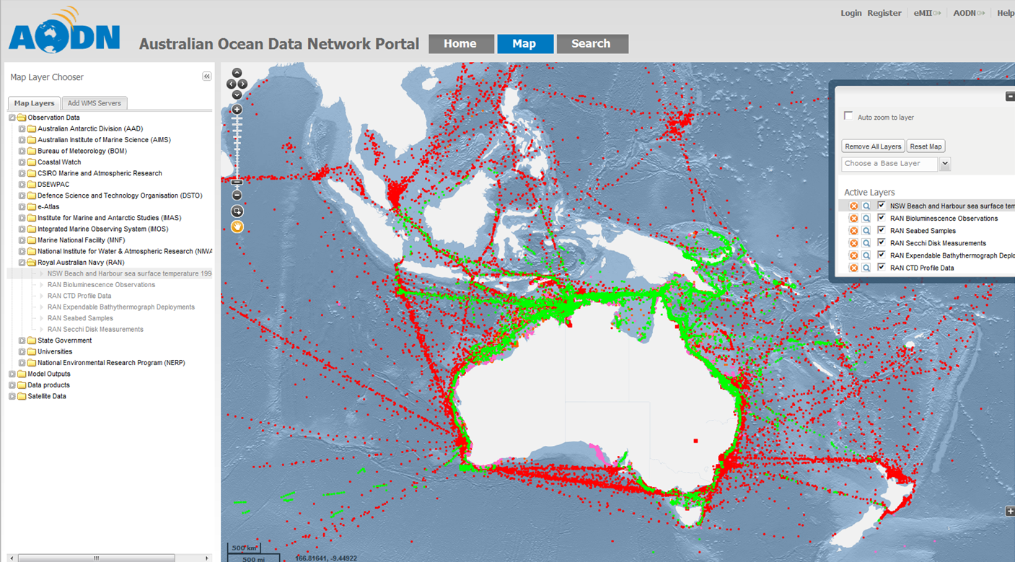

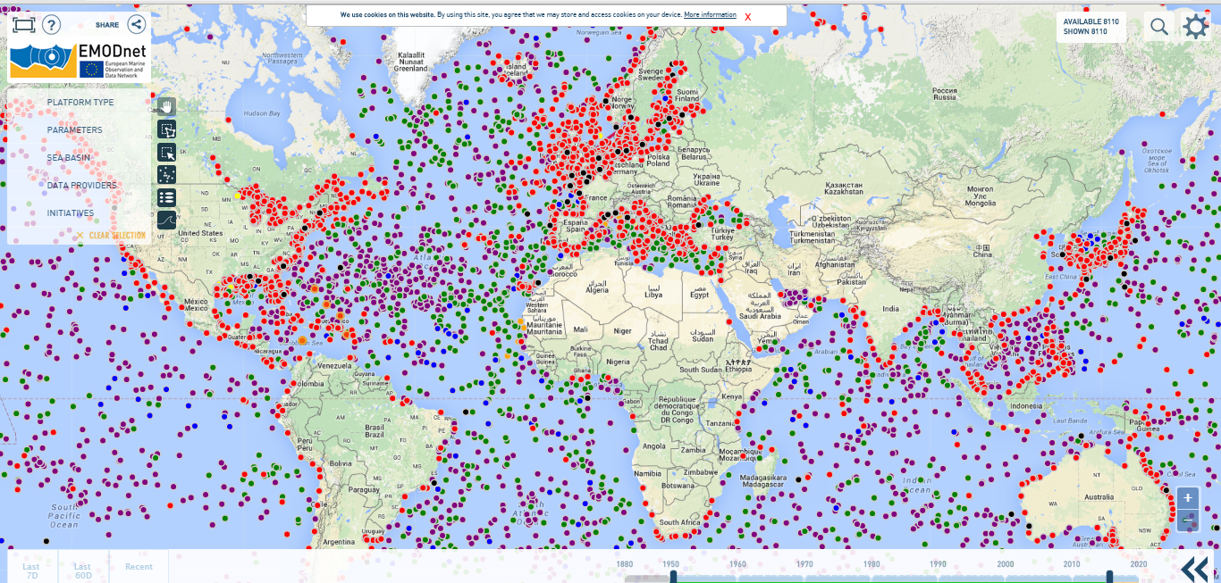

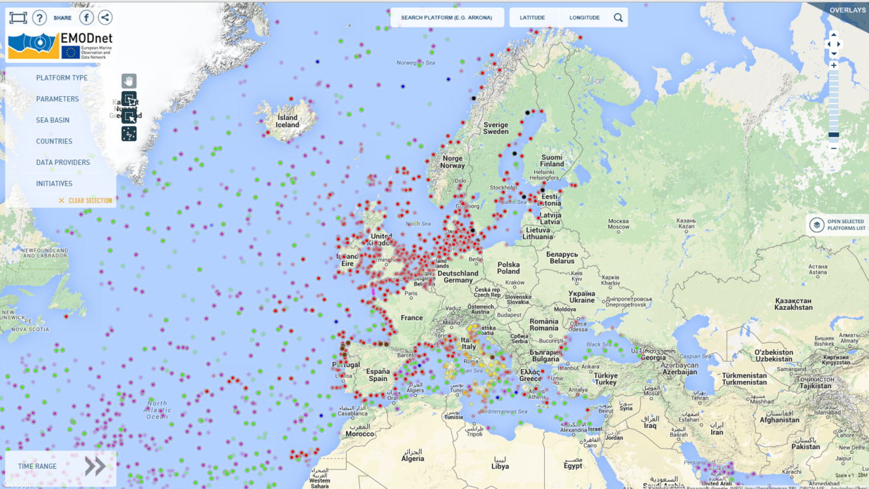

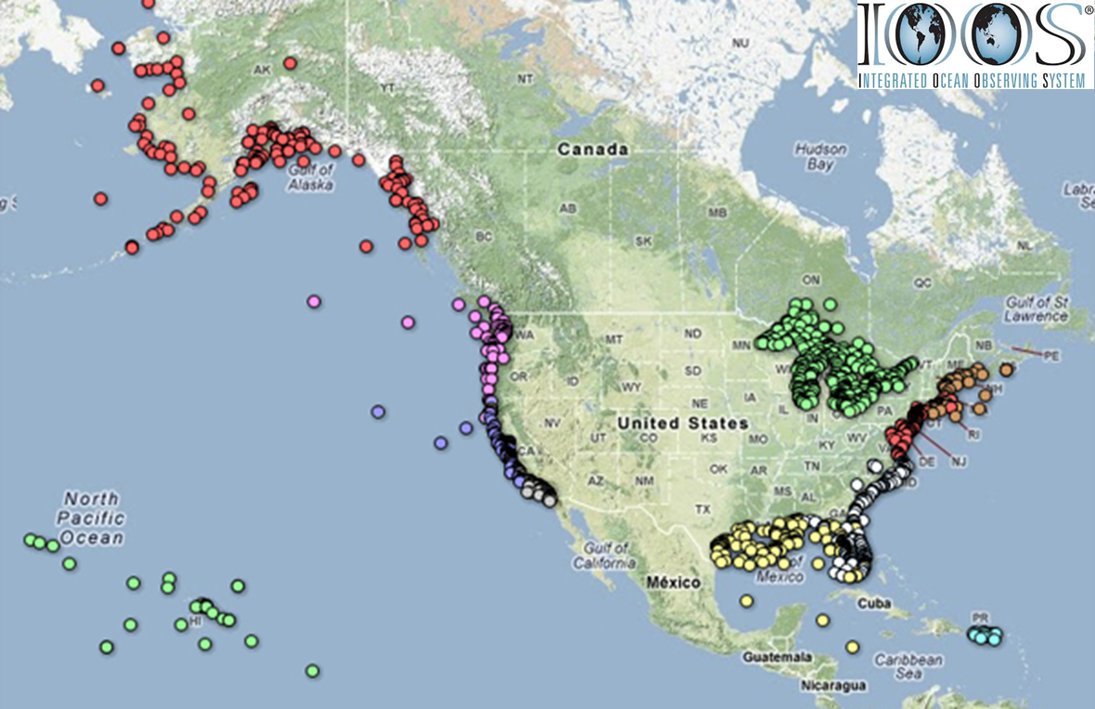
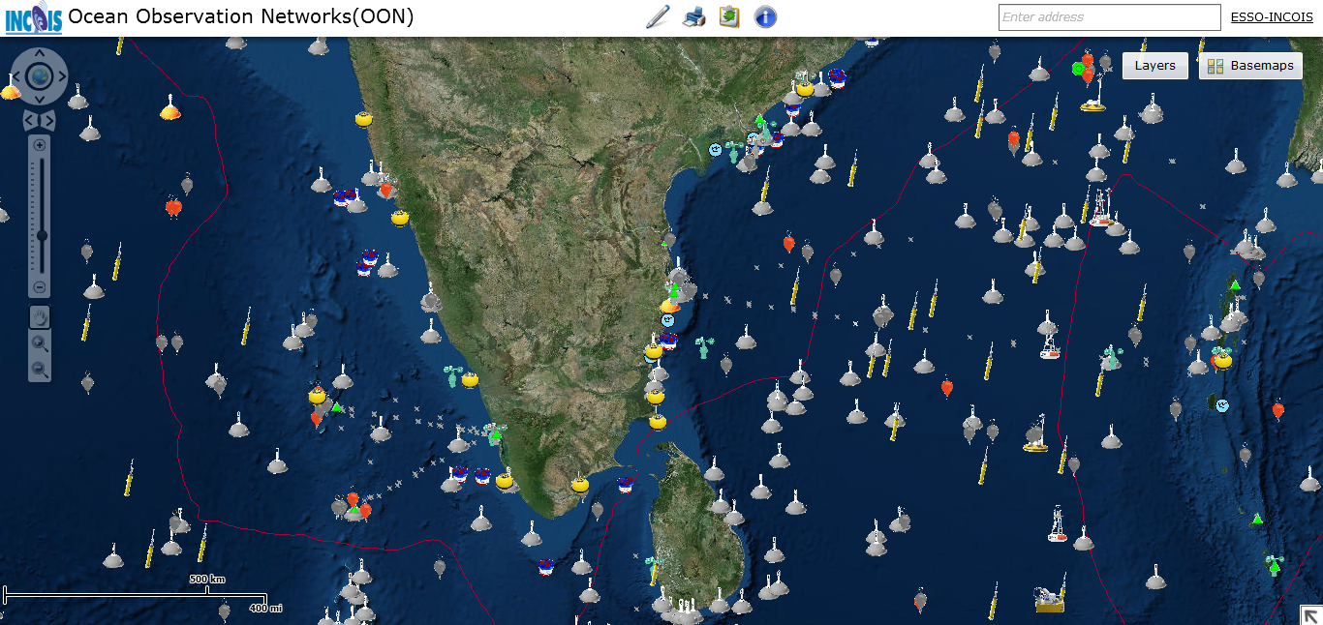

Slide 17

EOOS – European Ocean Observing System
EOOS is a coordinating framework designed to:
align and integrate Europe’s ocean observing capacity;
promote a systematic and collaborative approach to collecting information on the state and variability of our seas;
underpin sustainable management of the marine environment and its resources

Slide 18
patrick.gorringe@eurogoos.eu

