Slide 1
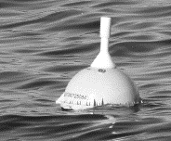
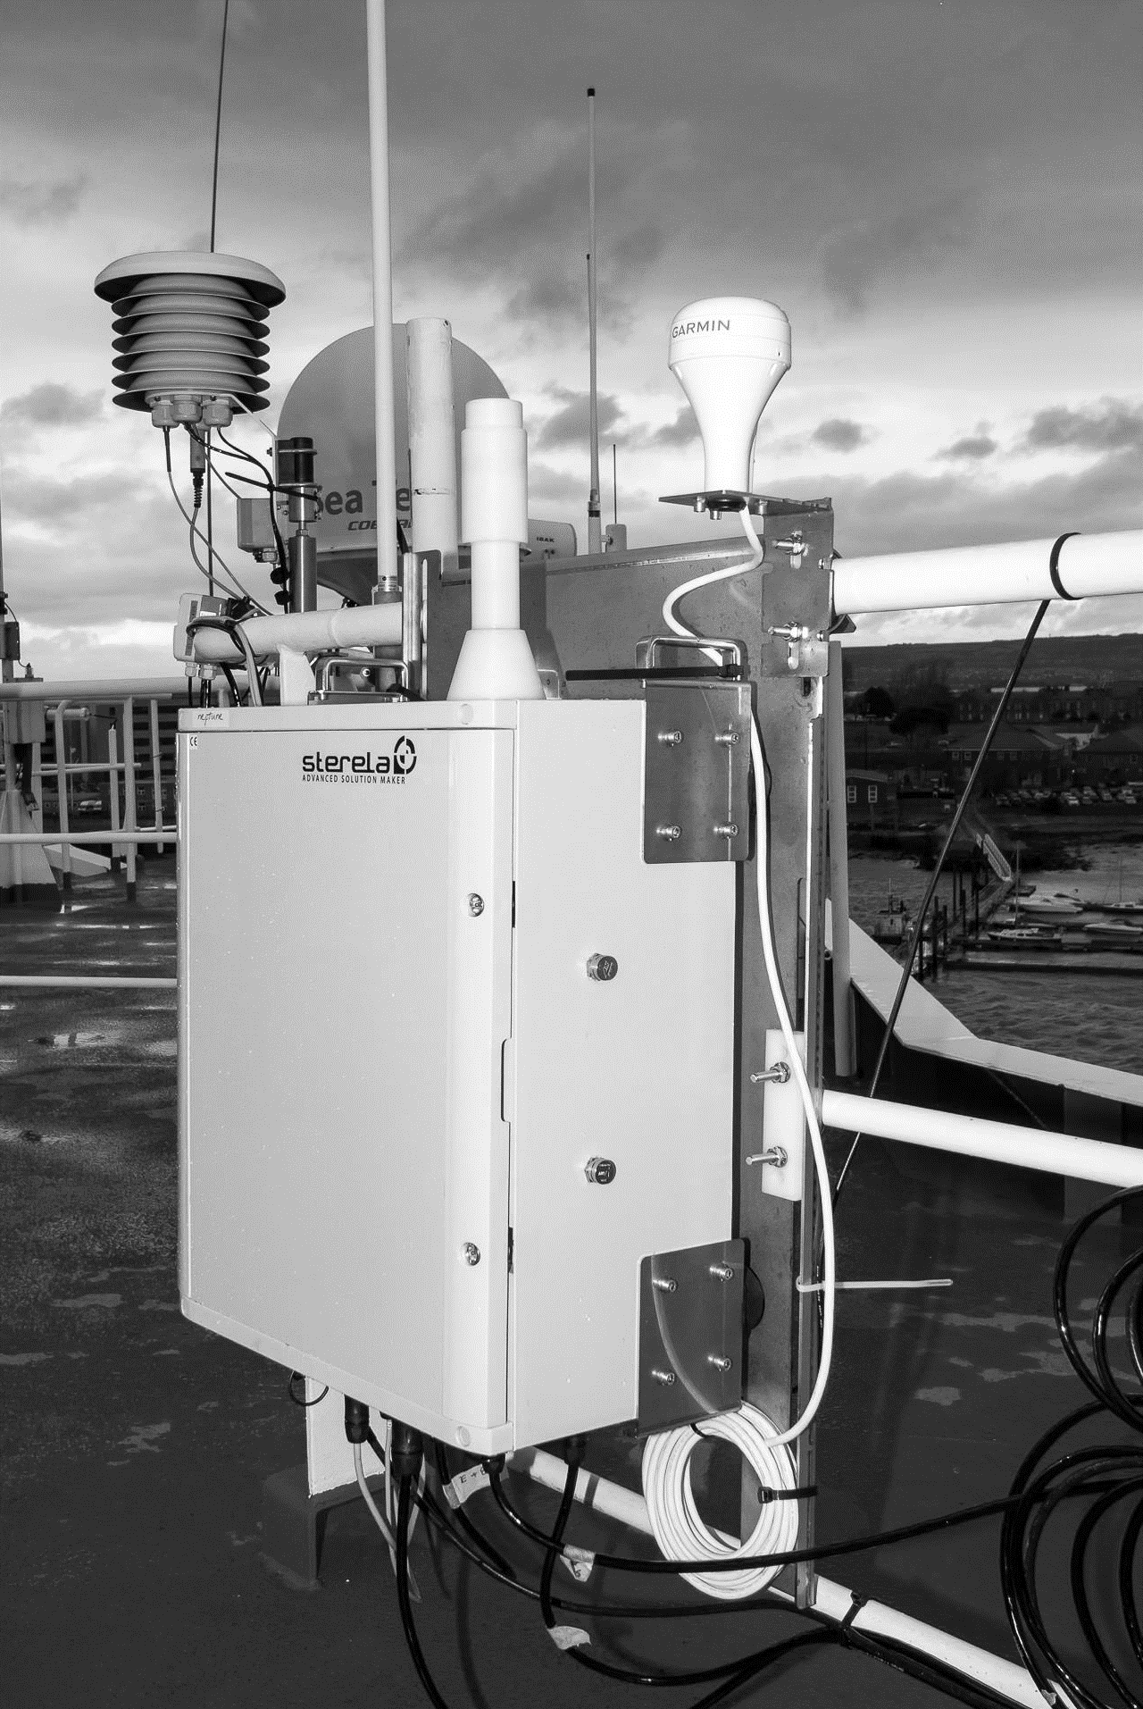
E-SURFMAR activities and enhancing partnerships
Pierre BLOUCH, Paul POLI
WIGOS Workshop RA-VI – Split, Croatia – 5-7 September 2016

Slide 2
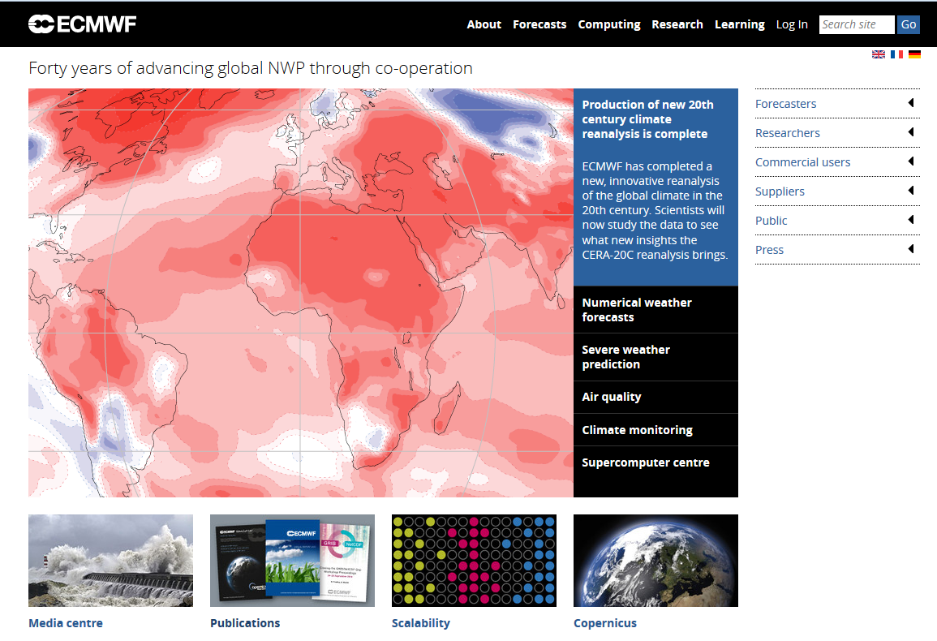
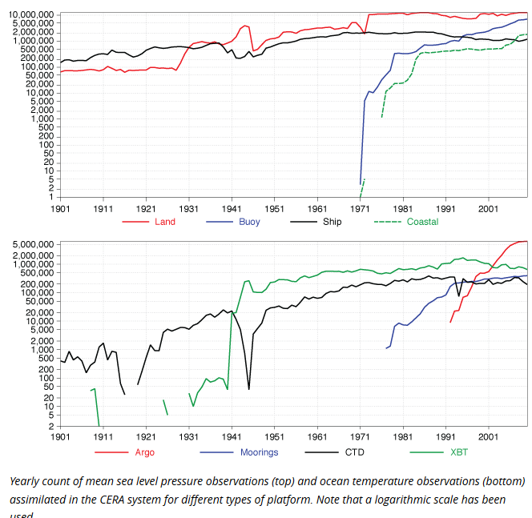
ECMWF news (3 Aug. 2016):
A New 20th century reanalysis
Similar to ERA-20C
(Poli et al., 2013, ERA Rep.14; 2016, Journal of Climate)
Novelty! Coupled data assimilation
Atmosphere
+Observations
Primary forcing: SST
(+sea-ice, aerosols, greenhouse gases, ozone, solar; similar to CMIP5, whose projections are by IPCC)
Ocean
1. Surface marine observations: among most important variables in the climate system
2. Coupled systems are there… making progress will require to understand better atmosphere and ocean interactions ➔ measurements at the marine surface!

Slide 3
E-SURFMAR: a service of EUMETNET
EUMETNET is a grouping of
31 European Meteorological Services
19 participate in E-SURFMAR
Austria, Belgium, Croatia, Cyprus, Czech Republic, Denmark, Estonia, Finland, France, FYROM, Germany, Greece, Hungary, Iceland, Ireland, Italy, Latvia, Luxembourg, Malta, Montenegro,Netherlands, Norway, Poland, Portugal, Serbia, Slovak Republic, Slovenia, Spain, Sweden, Switzerland, United Kingdom
Objectives
  to coordinate, optimise and progressively integrate the European activities for surface observations over the sea
  in support of weather forecasting and climate monitoring
Two components
  Drifting and Moored Buoys
  Ship-based observations

Slide 4
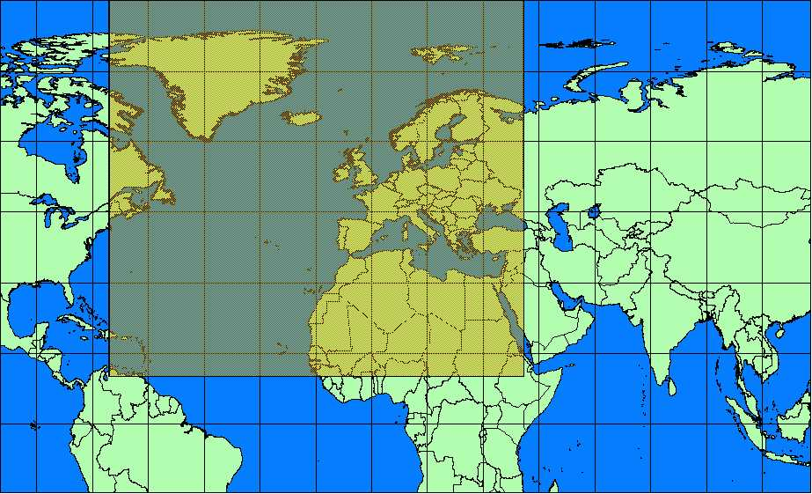
EUMETNET area

Slide 5
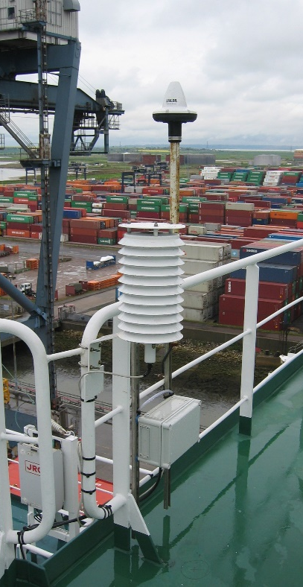
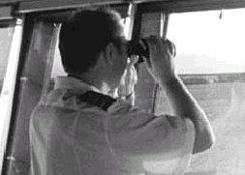
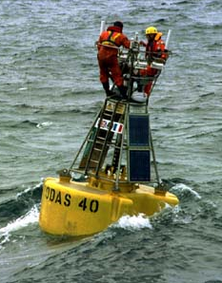
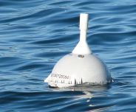
E-SURFMAR = 2x2 components, at various levels of integration
Shipborne AWS
National fleets
+Integrated fleet
Conventional VOS
National fleets
Moored buoys
National networks
Drifting buoys
Integrated network

Slide 6
Outline
What is E-SURFMAR?
Partnerships in E-SURFMAR
VOS partnerships in E-SURFMAR
Fostering cooperations

Slide 7
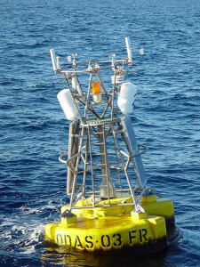
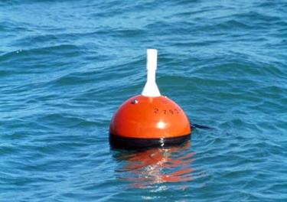
Buoys

Slide 8
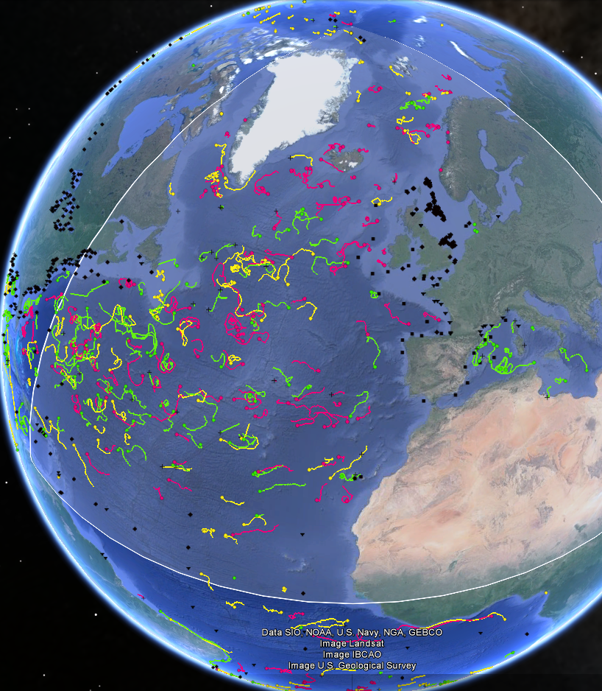
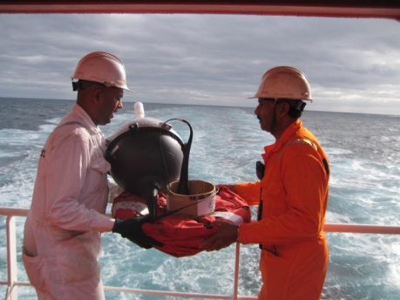
Network status
E-SURFMAR drifter, measuring Air P.
Other drifter, measuring Air Pressure
Drifter measuring SST only
Moored buoy
June 2016

Slide 9
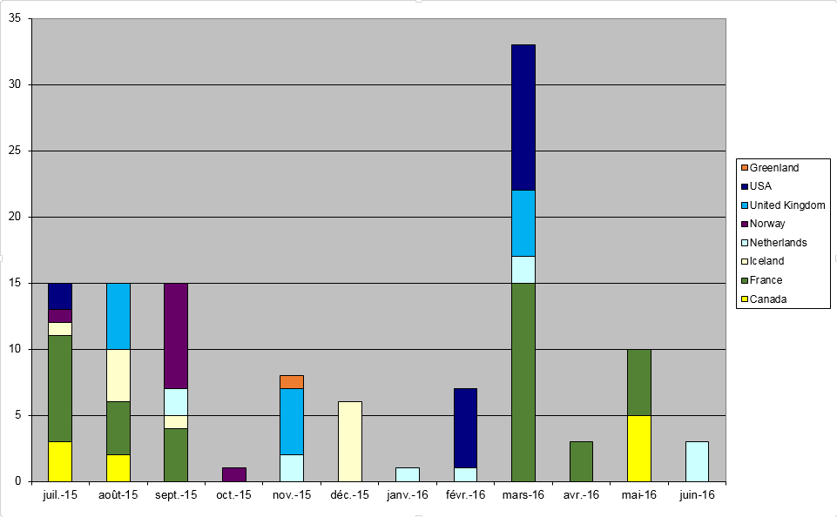
Drifting buoys: deployed through partnerships (July15-June16,117 units)

Slide 10
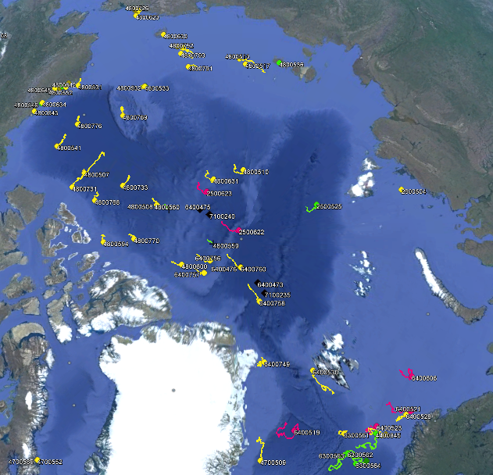
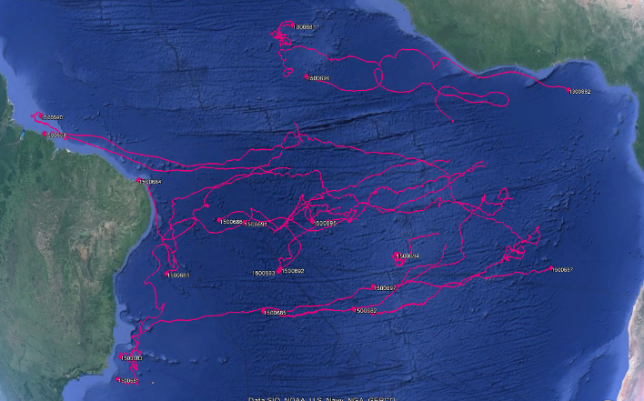
Other contributions by E-SURFMAR to the DBCP, at the margins of the EUMETNET area
Arctic Polar region: International Arctic Buoy Programme (IABP)
  A handful of deployments every year
  Using typically Arctic research campaigns by partner institutions
    This year: deployment by RV Polarstern, Alfred Wegener institute (AWI)
Tropical Atlantic region: H2020 AtlantOS project (large consortium led by Geomar)
  13 deployments per year, for 4 years
  EU funding

Slide 11
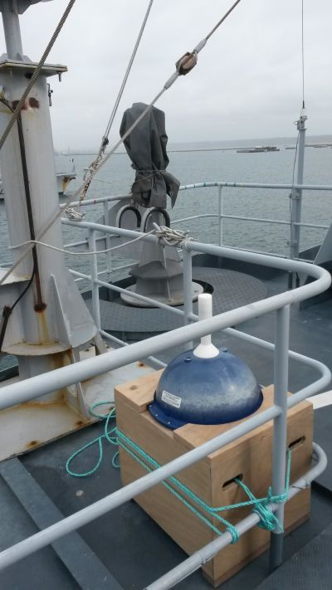
Environmental responsibility:
Recovery and refurbishment whenever possible
For about 2 years, drifting buoys are recovered (with or without drogue) by Météo-France or other partners.
If the buoy is undamaged, batteries are refurbished in order to be :
redeployed,
used as deck-drifter on opportunity ships,
used as training tool for capacity building,
Last year
France : 15 (7 redeployed)
Norway : 2
Iceland : 3

Slide 12
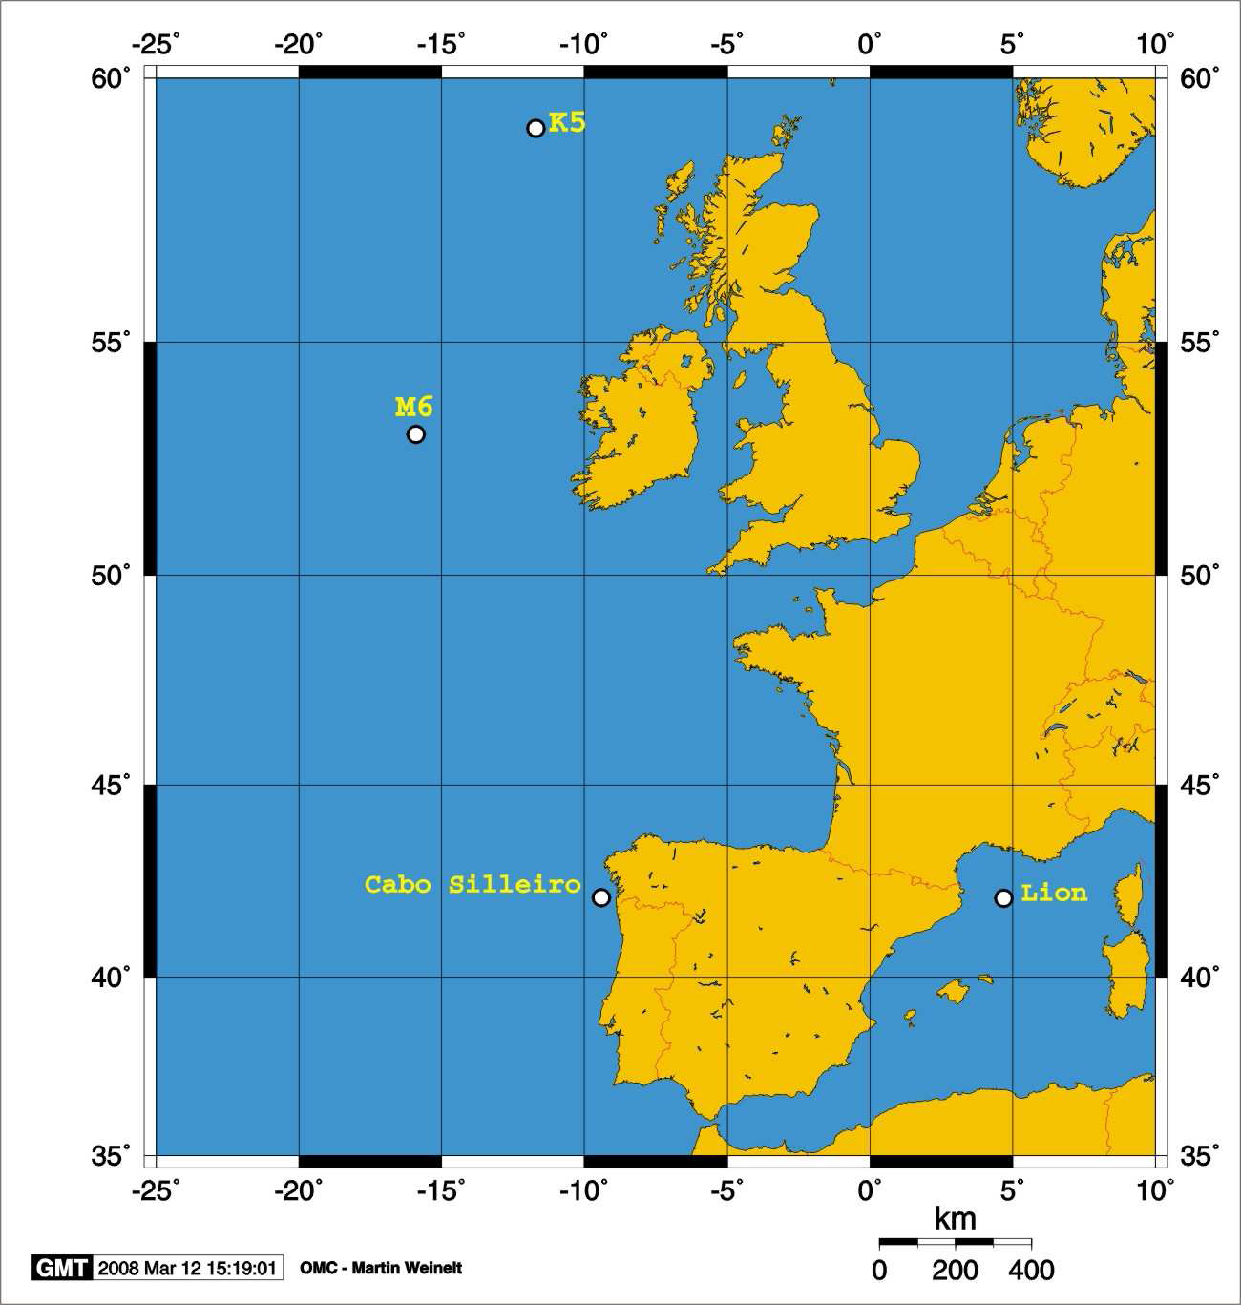
Moored Buoys
4 moored buoys compensated by the service
K5 operated by the Met Office
M6 operated by IMI and Met Eireann
Cabo Silleiro operated by
Puertos del Estado
Lion operated by Meteo-France
  Several European oceanographic agencies among EUROGOOS members (such as Instituto Hidrográfico in Portugal)
  Several Mediterranean partners in MONGOOS (MOON and MEDGOOS), such as Puertos del Estado in Spain, Istituto Nazionale di Oceanografia e di Geofisica Sperimentale in Italy, Bundesamts fur Seeschifffahrt und Hydrographie in Germany

Slide 13
Outline
What is E-SURFMAR?
Buoy partnerships in E-SURFMAR
VOS partnerships in E-SURFMAR
Fostering cooperations

Slide 14
VOS
Ship Automated Weather Stations (S-AWS)
Conventional VOS
National fleets

Slide 15
Availability
Observations carried out by EUMETNET ships
inside the EUMETNET area (includes E-SURFMAR fleet)
Manned VOS
S-AWS
Target 2013-2017
Target 2007-2017

Slide 16
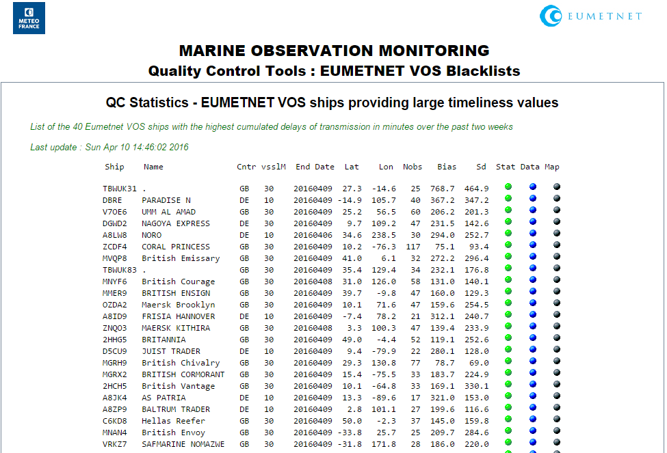
Blacklist (Timeliness – Conv. VOS)

Slide 17
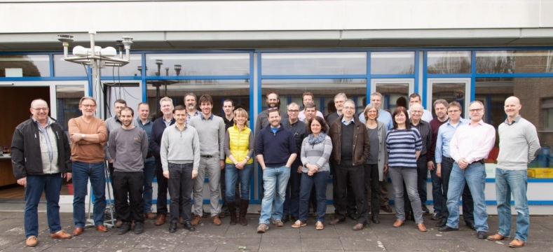
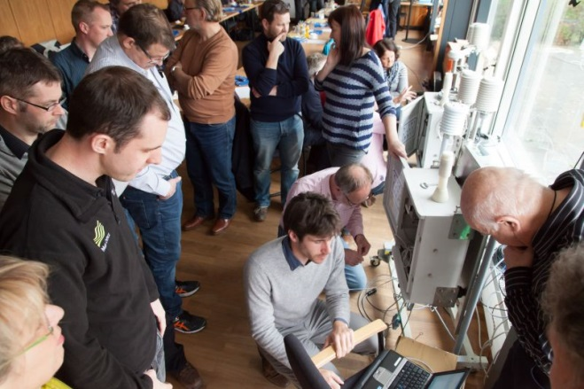
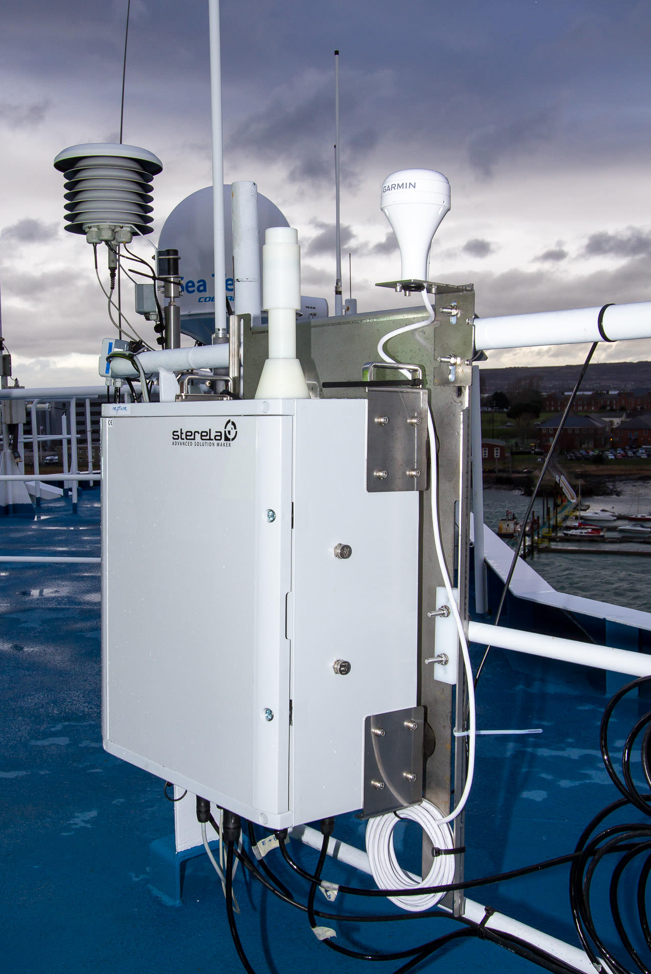
A product of cooperation: the EUCAWS
European Common Automatic Weather Station
EUCAWS workshop at DWD in Hamburg, 18-19 April 2016
~30 participants!
A diverse set of stakeholders … raise the bar for high-quality observations at sea
  Specifications commonly defined by EUMETNET members
  1st EUMETNET call for tender; issued in 2012
  Contracts signed in 2013
  Factory Acceptance Test: passed December 2014
  Site Acceptance Test: passed June 2015
  Verification of Regular Service: passed March 2016
Various countries have expressed intentions to purchase. Expect around 300 units in total at present

Slide 18
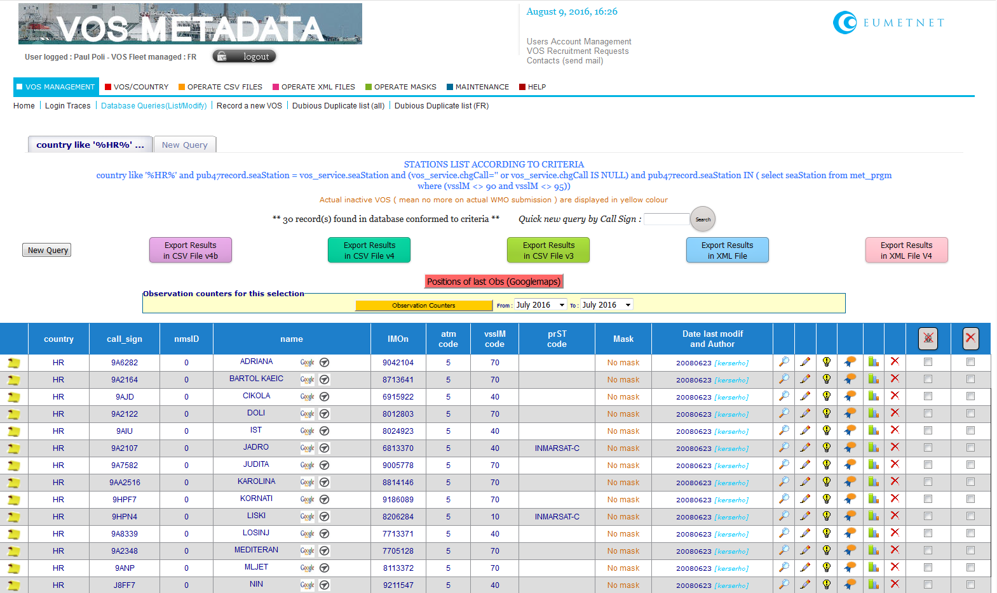
VOS metadata database:
Entries from Croatia (30)

Slide 19
Outline
What is E-SURFMAR?
Buoy partnerships in E-SURFMAR
VOS partnerships in E-SURFMAR
Fostering cooperations

Slide 20
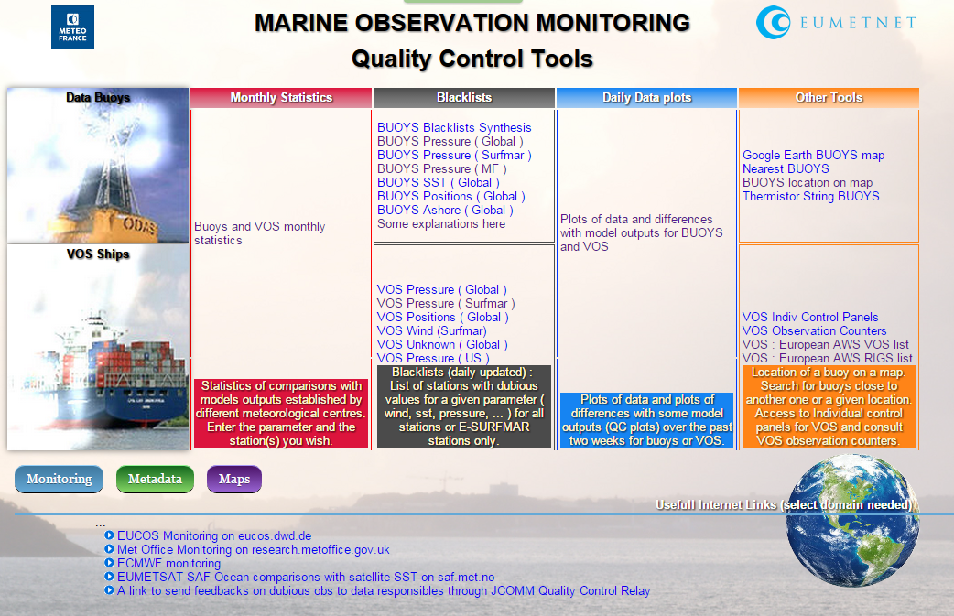
Data
Quality
Control
Tools
http://www.meteo.shom.fr/qctools/
Serves timeseries, maps…

Slide 21
E-SURFMAR expert team meetings
Open to all in the domain of surface marine meteorological observations
  Not just NHMS, there are also attendees from hydrographic institutes for example
Topics include
  Reviewing the service performance
  Sharing practices
  Discussing issues found with platforms and data
  Steering the actions of the service!

Slide 22
Conclusions
Given E-SURFMAR responds first to met. community through its funding,
Noting that E-SURFMAR’s
  expert teams are not restricted to NHMS
  data collected serve as references in the climate system over oceans
  metadata collected have closed a yawning gap in the census of VOS,
  quality control tools have consistently helped to pinpoint and improve data quality from all partners,
Noting also that emerging coupled ocean-atmosphere data assimilation systems open possibly more opportunities,
E-SURFMAR brings together metocean partners in Europe
  Next expert team meeting in Spring 2014 in Portugal

Slide 23
Thank you!

