Slide 1
Spain and Puertos del Estado activities with regard to marine meteorological and oceanographic observations, opportunities and challenges Marta de Alfonso (mar@puertos.es ) Physical Environment Department Puertos del Estado

Slide 2
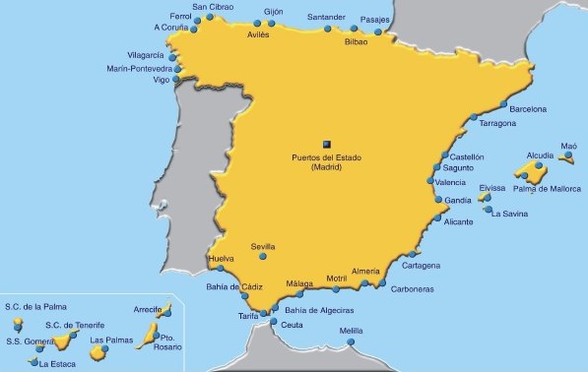
Puertos del Estado
About us
Puertos del Estado is the Spanish holding of harbours (ports):
The State-owned Spanish Port System includes 46 ports of general interest, managed by 28 Port Authorities, whose coordination and efficiency control corresponds to the government agency Puertos del Estado, a body answerable to the Ministry of Public Works that is responsible for implementing the government's port policy.

Slide 3
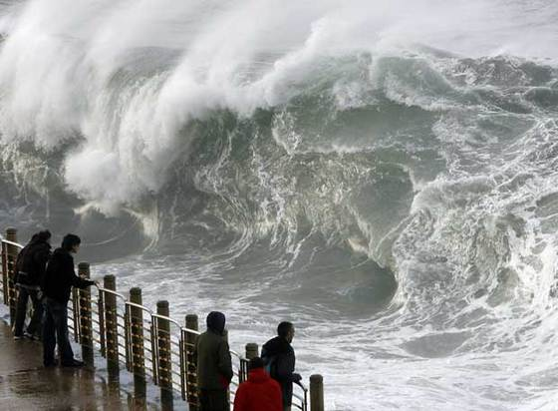
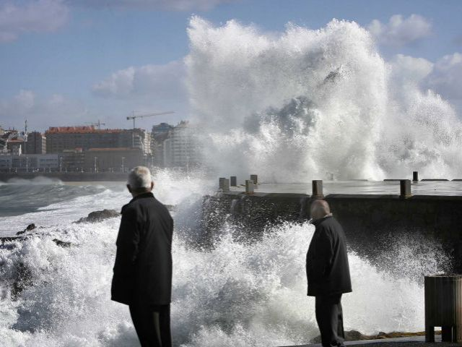
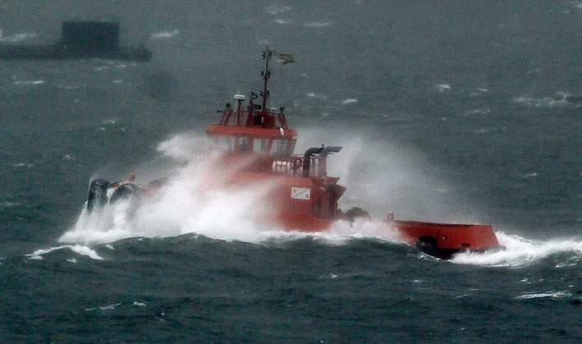
Puertos del Estado
Why we are measuring marine observations
Puertos del Estado has (by law) the responsibility of:
The development of measurement systems and operational techniques in oceanography and marine climate required for the design , operation and management of port areas and infrastructures.
State Ports and Merchant Navy Law, 2003
Spain is a country with a long coastline (~ 7.880 km).
An active environment…
High waves
Large tides, surges
High frequency oscillations (Meteo-tsunamis, long waves…)
Important winds and currents
…for several socioeconomic sectors
Harbour security, design and operability
Aids to navigation
Fisheries
Search and Rescue
Tourism
Marine safety
…

Slide 4
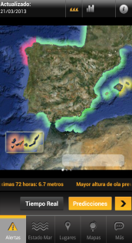
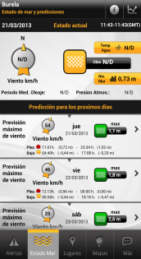
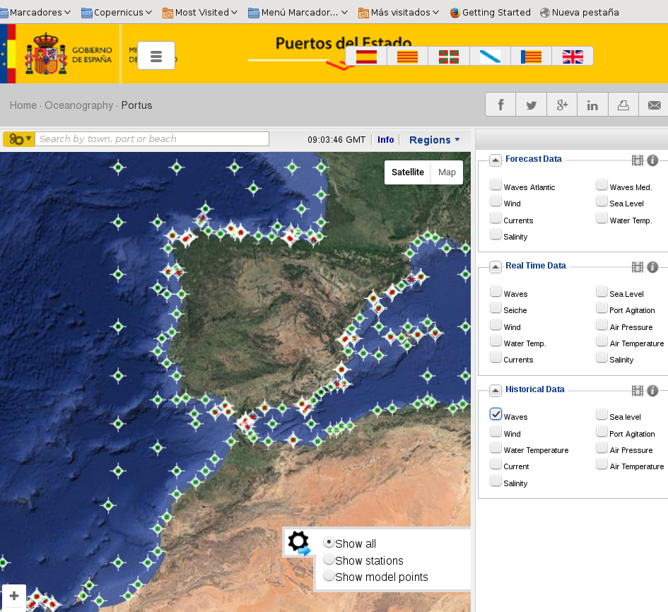
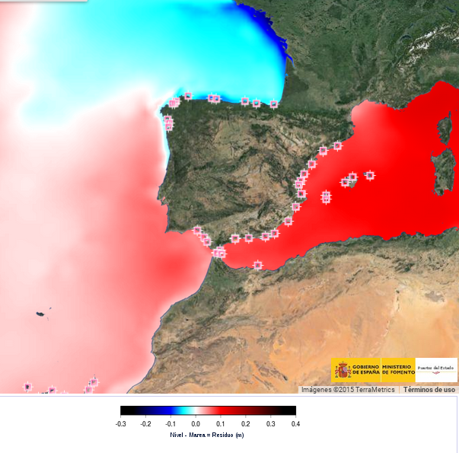
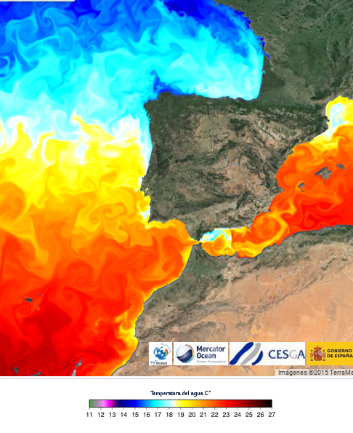
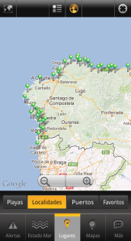
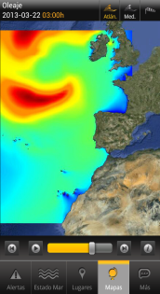
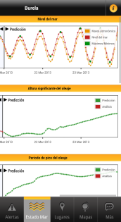
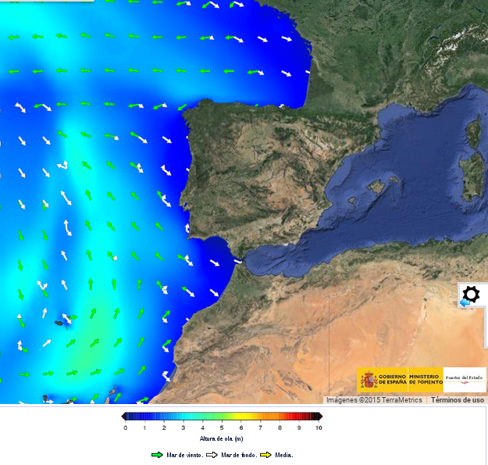
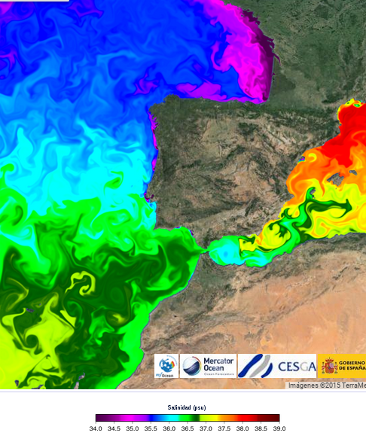
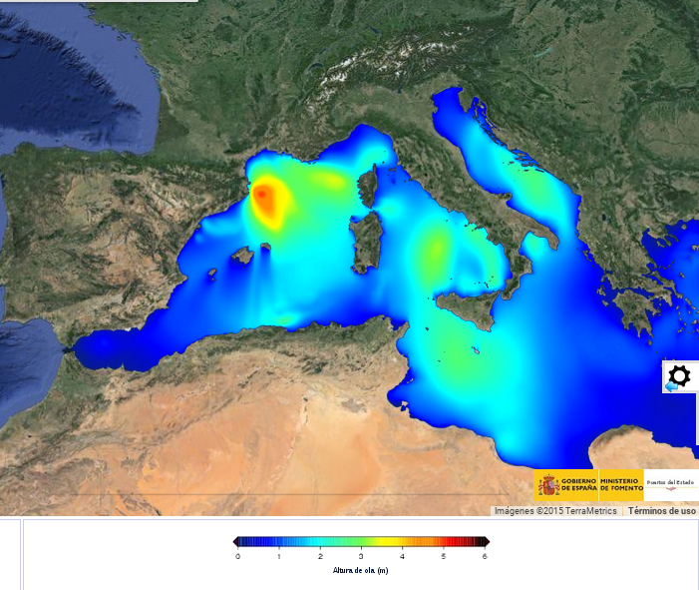
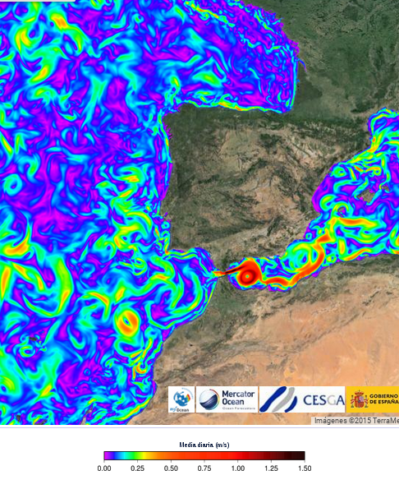
Puertos del Estado (http://www.puertos.es)
Puertos del Estado Systems
Observational networks (RT):
Deep water complex buoy network
Coastal buoy network
Tide gauges network
HF Radar network
Meteorological network
Modelling: Forecasting systems & Reanalysis
Waves
Sea level
Circulation
Data Base and value added products
PORTUS system (http://www.puertos.es)
iMar APP for mobile phones
DWBN 2016
Coastal Network
Tide Gauges Network
Radar HF Network
Meteorological Net.
Sea
Level
Waves
Atl
Waves
Med
Temperature
Salinity
Currents

Slide 5
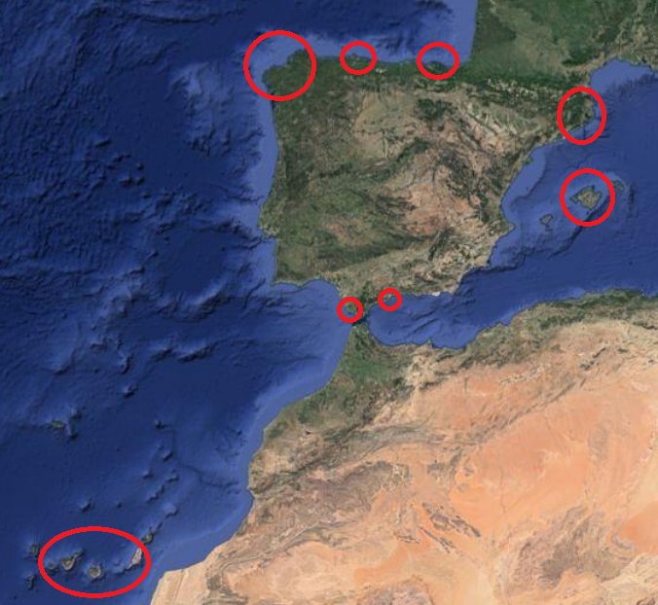
Marine observations in Spain
National level:
Puertos del Estado: operational national marine observations networks
AEMET: operational meteorological observations
IEO: one operational buoy, tide gauges, oceanographic campaigns & ARGO
Local Systems:
Regional institutions:
SOCIB, LIM, PLOCAN, VIGIA, Xunta Galicia
Regional Met offices:
Euskalmet / MeteoGalicia
Universities:
U. Cádiz, U. Málaga
Very good collaboration between all the institutions. Most of the systems integrated in Puertos system (PORTUS)

Slide 6
Puertos del Estado’s participation in European systems
At European level:
EuroGOOS & EMODnet: Regional alliances IBI-ROOS / MONGOOS and WG & Task Teams: DATAMEQ WG, Tide gauges task team, Fixed Platform task team
Eumetnet / E-surfmar: one of the 4 buoys integrating the European moored buoys network is owned by Puertos del Estado (Cabo Silleiro)
Data from deep water buoys is sent in real time to GTS, through AEMET
Copernicus Marine Environment Monitoring System (CMEMS): http://marine.copernicus.eu
CMEMS is an operational service
6 regions (Arctic, Baltic, NWS, IBI, MED & Black Sea) + Global component
Modelling (forecast&reanalisys): circulation, BGQ & Waves
TACs: Satellite & In-Situ data
Cross-cutting activities: quality, standardization, validation & assessment, evolution & improvement, interaction with users

Slide 7
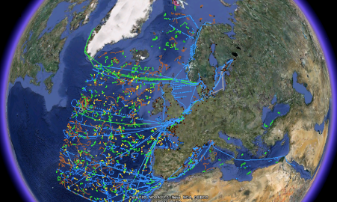
CMEMS
Puertos del Estado is participating in two CMEMS services:
- IBI (Iberia-Biscay-Ireland) MFC (Monitoring & Forecasting Center) (Leader: PdE) :
3D ocean circulation modelling: Forecast and Reanalysis (all variables included)
- IN SITU TAC (Thematic Assembly Center) (Leader: Ifremer) responsible of IBI region:
Same data format (NetCDF - OceanSites 1.2)
Same RTQC & quality indexes / Same FTP structure
NRT (near real time) and REP (reprocessed) products

Slide 8
Opportunities & challenges
Opportunities:
Set up an operational oceanographic system at European (EOOS)/Global level
Increase the visibility of the Systems demonstrating their usefulness & economical and social benefits
Challenges:
Oceans are undersampled. Some regions are missing basic & not expensive measurement systems (f.i. tide gauges in the South Mediterranean)
Offer a qualified service that satisfies the users needs
Guaranty the sustainability of the systems. Due to the economical crisis some of the systems have disappeared. Lecce declaration, 2014 (concern of MonGOOS community on the sustainability of the observing systems)

Slide 9
“Models will evolve and improve, but, without data, will be untestable, and observations not taken today are lost forever”
Carl Wunsch (1941- )
Professor of Physical Oceanography at the Massachusetts Institute of Technology

