Slide 1
COASTAL FLOODING ISSUES IN CROATIA
WIGOS WORKSHOP FOR REGIONAL ASSOCIATION VI WITH FOCUS ON MARINE METEOROLOGICAL AND OCEANOGRAPHIC OBSERVING REQUIREMENTS
SPLIT, CROATIA, 5-7 SEPTEMBER 2016
Ivica Plišić and Marijan Babić
Hrvatske vode

Slide 2
OUTLINE
Legal framework in Croatia
Water management planning documents
Implementation of Directive 2007-60-EC on Assessment and Management of Flood Risks
Data and analysis of coastal flooding for the 1st FRMP
Importance of improved monitoring and forecasting

Slide 3
Water ACT
Art 1: The Water Act regulates the legal status of water, water management, protection from flooding, drainage and irrigation, public water supply and public drainage, and institutional structure of these activities (Art 1)
Art 2: The Water Act regulates all surface water and groundwater issues, but:
  regarding coastal waters, it regulates only water protection issues
  regarding territorial sea waters, it regulates only their chemical status and drinking water supply issues
Art 4: The objective of water management is to ensure sufficient quantities of quality water, protection of people and property from flooding and to achieve good water status in order to protect human life and health

Slide 4
WATER MANAGEMENT PLANNING DOCUMENTS
Water Management Strategy, adopted by the Croatian Parliament in 2008
River Basin Management Plan (RBMP) for 2016-2021, adopted by the Croatian Government in 2016
Flood Risk Management Plan (FRMP) for 2016-2021, which is an integral part of the RBMP
Multiannual programme of construction of regulation and protection facilities and amelioration facilities, adopted by the Croatian Government in 2015 = programme of structural flood risk management measures for the FRMP
Hrvatske vode are responsible for preparation of the draft RBMP including the FRMP
THERE ARE NO STRUCTURAL COASTAL FLOOD RISK MANAGEMENT MEASURES IN THE FRMP!

Slide 5
Implementation of Directive 2007-60-EC on Assessment and Management of Flood Risks
1st step: Preliminary Flood Risk Analysis (2011, 2017,…)
2nd step: Flood Hazard and Flood Risk Maps (2013, 2019, …)
3rd step: Flood Risk Management Plan (2015, 2021, …)
The FRMP must include:
  Objectives of flood risk management
  Measures for meeting these objectives, including preventive measures
  Protection, preparedness and flood forecasting
  Systems for informing and warning

Slide 6
FLOOD HAZARD AND FLOOD RISK MAPS
Hrvatske vode are responsible for preparation of flood hazard maps (showing potential flood event scenarios, i.e. extent and depth of floods) and flood risk maps (showing potential consequences of floods, i.e. potentially affected population, economic activities, natural and cultural heritage)
1st set of FH and FR maps were prepared for the 1st FRMP
Improved maps will be prepared for the 2nd FRMP

Slide 7
FLOOD HAZARD MAPS
The greatest damages from the floods are expected in the Danube River Basin, but damage are also expected in the Adriatic area (15%)

Slide 8
FLOOD RISKS

Slide 9
FLOOD HAZARD MAPS FOR COASTAL AREAS

Slide 10
FLOOD RISK MAPS FOR COASTAL AREAS

Slide 11
COASTAL FLOODING IN CROATIA
Croatian Hydrographic Institute produced a study "Flooding from the sea in coastal areas"

Slide 12
COASTAL storm suRges

Slide 13
COASTAL SEICHES
(šćige)

Slide 14
tsunamiS

Slide 15
assessment of high sea level on the Croatian coast

Slide 16
monitoring

Slide 17
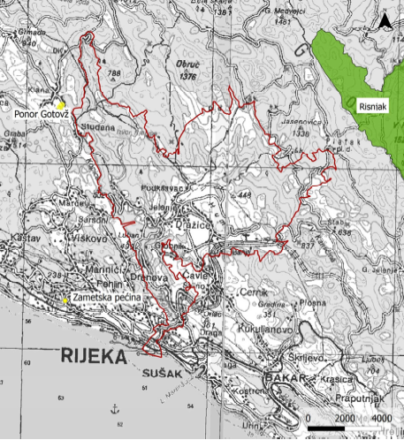
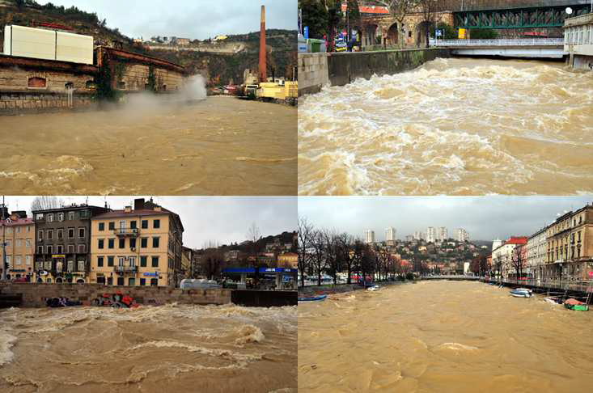
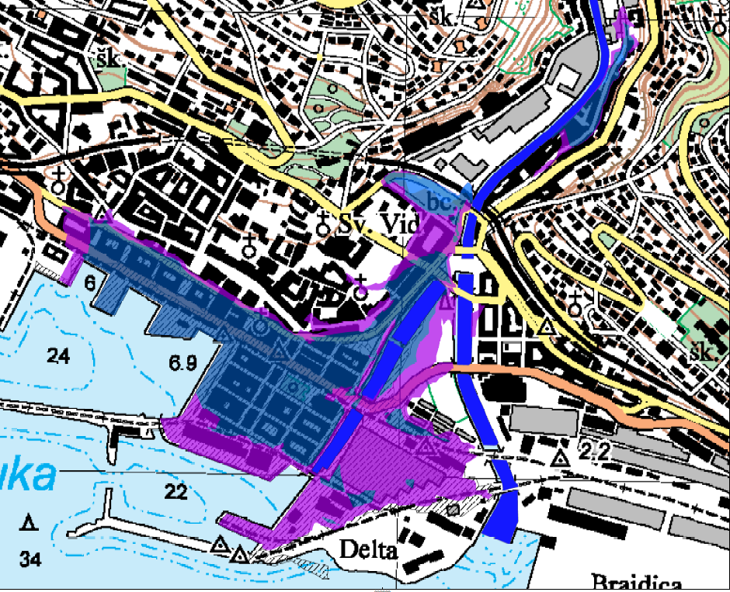
POTENTIAL FLOODING OF CITY OF RIJEKA DUE TO A COMBINATION OF HIGH SEA LEVEL AND HIGH DISCHARGE OF RJEČINA RIVER

Slide 18
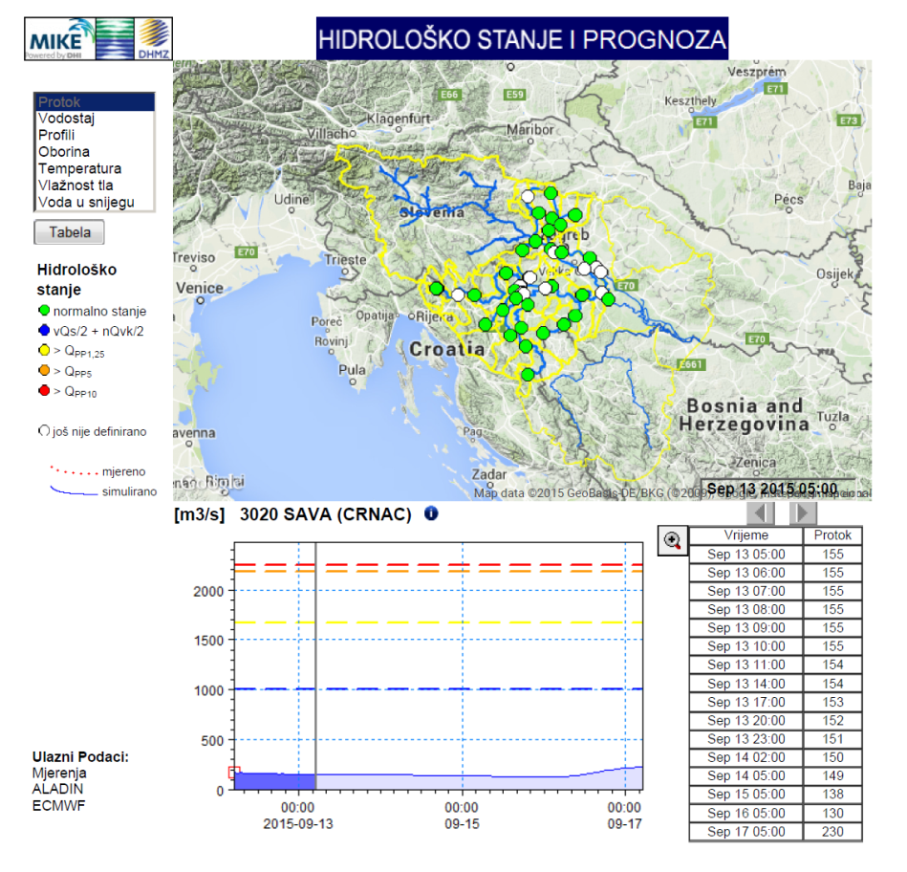
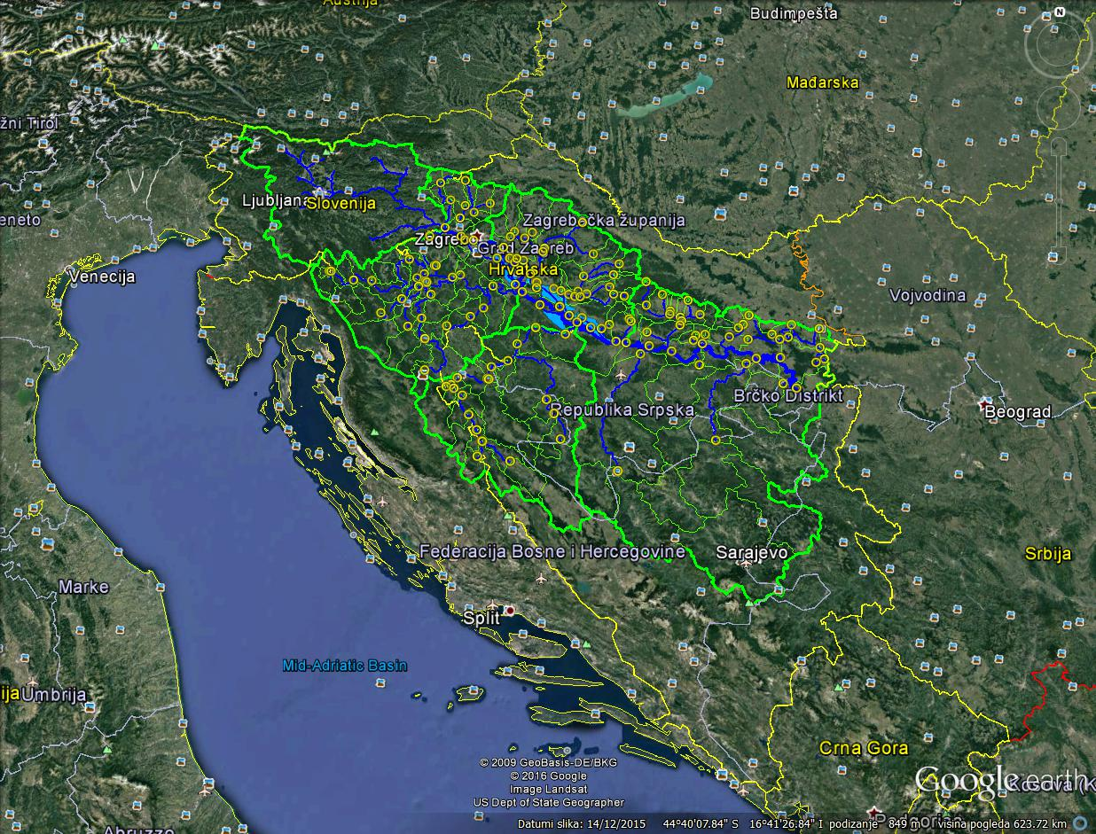
DEVELOPMENT OF FLOOD FORECASTING SYSTEMS IN CROATIA
Joint project(s) of Hrvatske vode and DHMZ
MIKE-based hydrologic and hydrodynamic modeling
Completed 2015: Sava and Kupa Rivers from the border with Slovenia to Sisak (10.000 km2)
To be completed 2016: Sava River up to the border with Serbia (40.000 km2)
Future: the entire territory of Croatia, including coastal river basins
For coastal rivers, need forecast of discharge (hydrology) and forecast of sea level

Slide 19
FRMP – MEASURES
Preparation of concept of flood risk management for coastal flooding.

Slide 20
COASTAL FLOODING - GAPS
Missing or insufiicient:
  Objectives
  Measures,
  Protection, preparedness, forecasting floods,
  Systems for informing and warning.
Hrvatske vode are responsible for developing plans but it is not clear who is responsible for for developing and implementing measures
Hrvatske vode are responsible for reporting, and that means to monitor progress in this area.
Therefore, we propose:
  Enhance monitoring of sea levels and monitoring waves
  Flooding should be included in meteoalarm
  Improve legal framework and define responsibilities for implementation of measures for flood protection from the sea

