Slide 1

Croatian marine meteorology from national to regional
WIGOS activities
Dijana Klarić
AMMC project manager
DHMZ
www.meteo.hr
dijana@cirus.dhz.hr

Slide 2


Croatian marine meteorological services
DHMZ center PMC – Split and Rijeka harbors
PMC is national marine meteorological call service, linked to DHMZ data production and WIS center in Zagreb, equipped with resources and
trained Marine weather forecasters (MWF) and data and IT operators.
MWFs work in 24/7h shifts and provides: NEWS 1 January 2016
- marine weather and sea state watch, forecast weather and sea phenomena
- issues multi language warnings for hazardous wather and sea state phenomena at inner seas and coastal areas,
forecasts and warnings for SOLAS and recreational vessels
- Meteoalarm warnings for inner sea and coastal zones ( February 2016)
- Copericus space on education (Satellite altimetry – Supetar Oct. 2016)
- MOB application Nautical Information Service ( nIS )

Slide 3
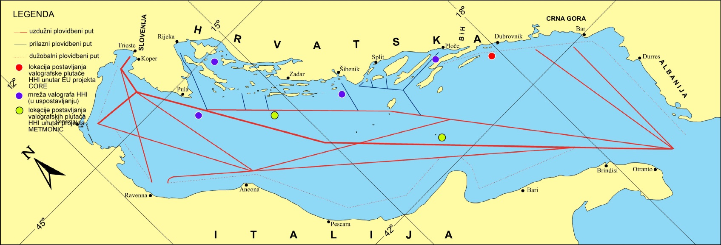
Marine traffic lines and alternate rutes
VTS traffic managment
- weather and se state condition and alternate rutes
Example of routes from HHI

Slide 4
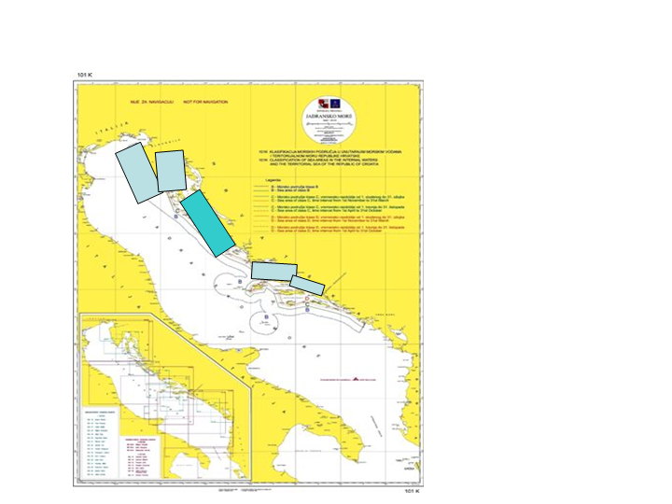
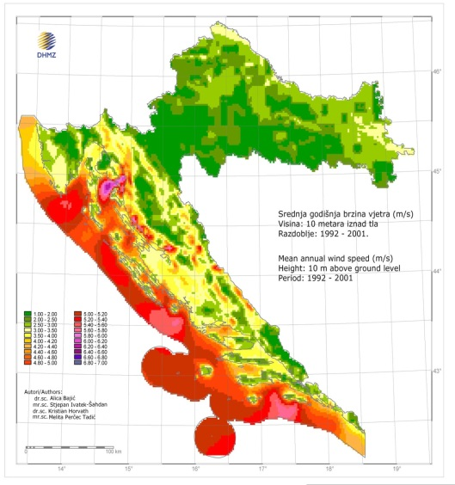
Risk assessments and high impact costal zones areas
Maps of marine traffic risk zones with highest risk to
ship collisions (left),
ships groundings (right).
High impact costal zones areas
Weather conditions
10m Wind atlas (left)
High impact coastal zones (right)
Notes:
Maritime Transport and Possible Accidents in the Adriatic Sea, by D. Zec, Maglić, Hlača, 2008
Left - Weather conditions - Wind atlas, 10m wind intensity based on wind re-analyses data , downscaled to 2x2km horizontal resolution; the strongest winds are at red to purple colours scheme.
Right - High impact coastal zones : West Istria Cost, Kvarner bay- Rijeka Port , Split Port Area, Ploce Port area (light blue), Kornati national park area - recreational zones (blue)

Slide 5
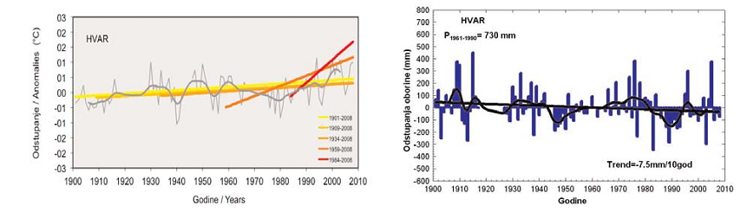
160 years of meteorological observations and their application in Croatia
Dubrovnik 1851 – the first station with regular observations
Dubrovnik 1858 – the first climatological report
Zagreb- Grič 1862 – the first meteorological observatory,
continuous observation records till today
The end of 19th st. : 17 stations with 20 years obser. records
Hvar, Zagreb-Grič, Pula, Rijeka with 30 years records
Centennial (secular)climate series for monitoring climate variation
Zagreb-Grič, Osijek, Požega, Gospić, Crikvenica, Hvar

Slide 6
Croatian VOS observations
Started at year 1956, max activities 144 ships
current status - 3 ships (2 line ships, 1 cargo)
Number of VOS national vs. JCOMM for period 1987 -2013
left axes- max 145; right axes 8000

Slide 7

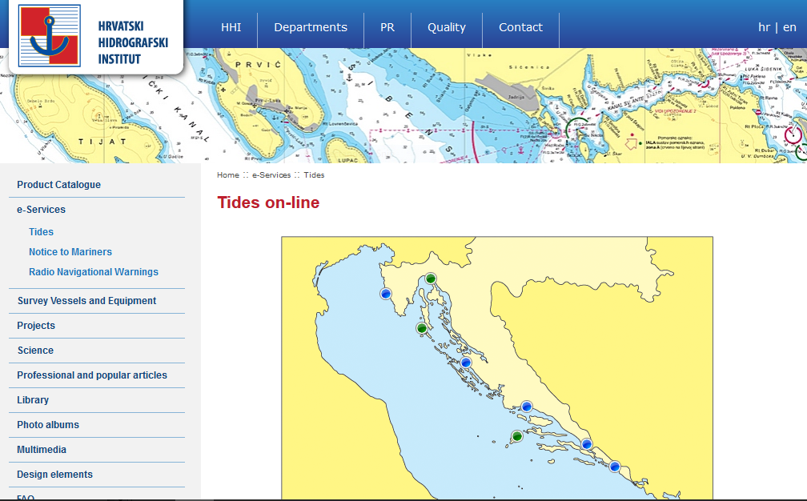
Croatia tide gauge network
85 years of Bakar tide guage

Slide 8
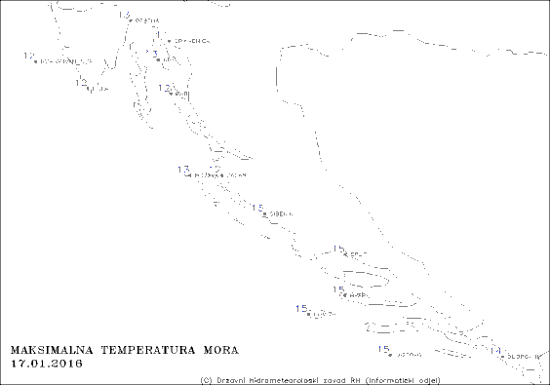
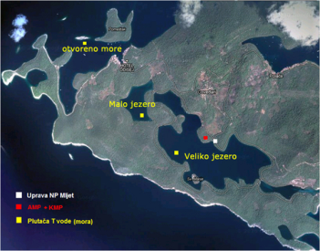
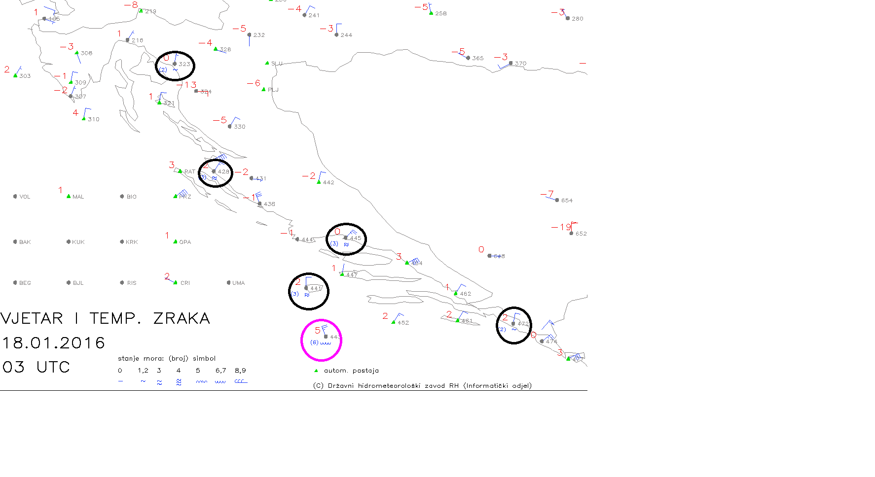
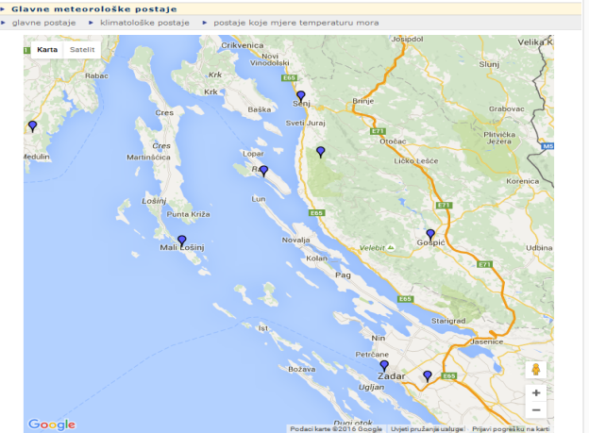
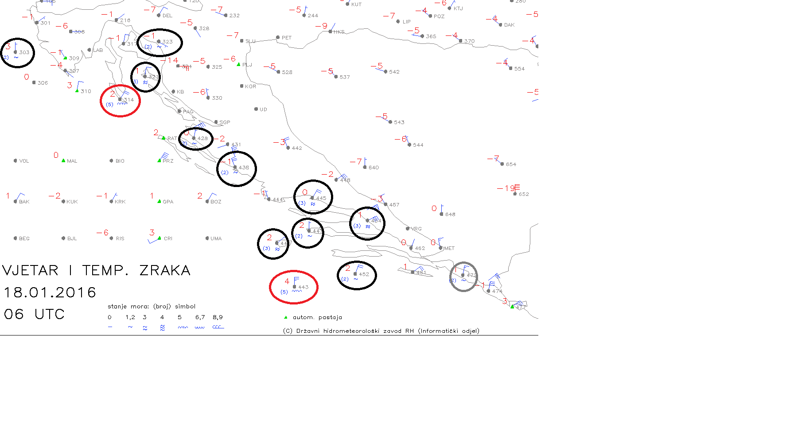
DHMZ observing system at Adriatic
Real-time: main synoptic stations, AWS
SST measurements near stations manual + 5 buoys
- sea state observations
18.1.2016. 03UTC, 06 UTC,
6bf
5bf

Slide 9

AMMC national strategy
To in cooperate JCOMM and IOC objectives from
medium term strategy 2014-2021
To provide DHMZ Action plan for marine meteorology
capacity building
- procedures to strengthen marine forecasters competences
- provide national WIGOS Implementation plan and IT infrastructure
- update atmospheric-ocean measurements
- setup the system for Adriatic Sea monitoring
(nowcasting, HR met-ocean forecasts and early warning systems)
- monitoring on Adriatic sea climate and climate of sea state phenomena
- AMMC geoportal with WIS WIGOS and INSPIRE functionality
WMO Marine Weather Forecaster Competence Standard Framework
17th WMO Congress 2015

Slide 10
AMMC national strategy
To provide Action plan for national cooperation
- to provide national inventory of met-ocean observations
- to cooperate on modernization and maintenace of met-ocean observation
- to optimize atmospheric-ocean measurements networks (WIGOS tools)
- to provide efficient real-time data exchange
- to estublish Quality Managment procedures
- to estublish scientific and operative cooperation integrated
meteorological-ocenographic forecasting system
- to cooperate on Adriatic sea reanalyzes actions
(historic data rescue and digitalization)
........

Slide 11




National partnership
Toward operative marine meteorological and oceanographic service: Started 2015
National board of institutions and
WG for met-ocean monitoring infrastructure
at Adriatic area JOZO 1
WG for operative oceanographic modeling JOZO 2
WG for marine safety products and procedures / started 2016
Cooperation agreement on scientifical, tehnological and operative cooperation signed summer 2016

Slide 12
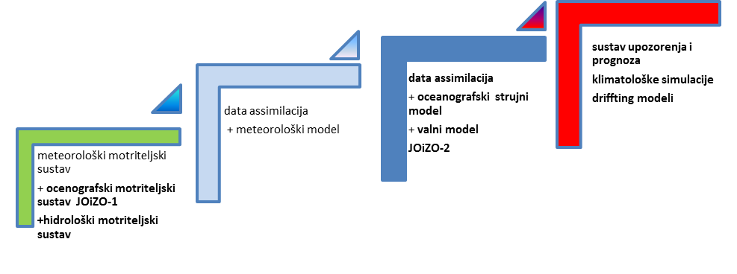
Operative met-ocean system
Jadranska operativna i znanstvena oceanografija JOZO
Observations + Meteorological models + Oceanograpic models + end products

Slide 13
National observations
New AWS at lighthouses ( WIGOS)
- Ministry of marine add AWS as support for VTS
- DHMZ have to provide QM procedures
Inventory of oceanographic observing systems
- buoys ( 2 active), vave riders, tide gauges, VF radars
- no funds for operative runs
- no procedures for RT data exchange
- common projects
Common plans for modernization met-ocean observing network

Slide 14
DHMZ modernization of observing networks
Meteorological Observation Network Modernization in Croatia – METMONIC
Croatian EU Structural funds (ERDF + CF)
- Project ~28 mil €
- timeline 2016– 2023
Integrated met-ocean observing and
forecasting system
Integrated solution for WIGOS set-up implementation
Equipment + IT
~400 AWS
5 moored buoys
20 SST buoys
2 radiosonding stations
3 wind – profilers
3 lidars
6 weather radars
(3 at Adriatic coast)

Slide 15
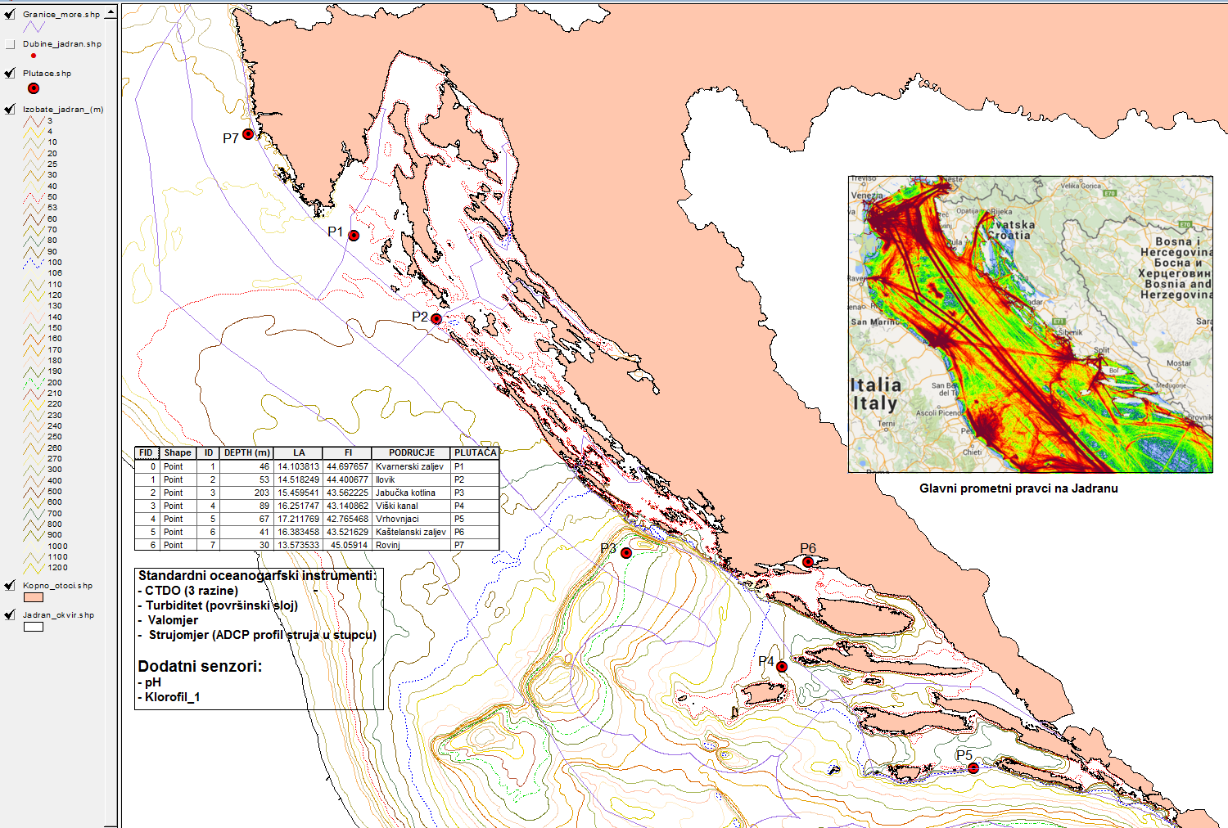
Moored buoys at Croatia 2 active 5 planned

