Slide 1
Using the WMO Rolling Review of Requirements for observing network design: Application to E-SURFMAR
Pierre BLOUCH, Paul POLI
WIGOS Workshop RA-VI – Split, Croatia – 5-7 September 2016

Slide 2
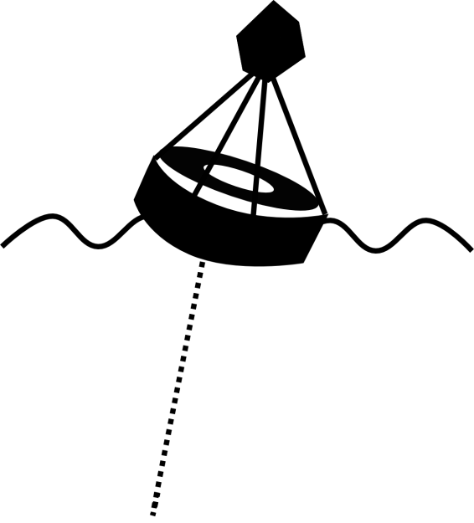
SST, wind, currents, and waves observed by buoys are essential to use satellites. (calibration, validation, monitoring)
E-SURFMAR in the greater context
EUMETSAT (+OSI-SAF…)
EUMETNET
ECMWF
Automated Shipboard Aerological Programme (ASAP) P., Temp., Hum., Wind (z)
(ocean-atmosphere exchange of momentum and heat)
Data Buoy Cooperation Panel (DBCP)
Surface P, SST, SSS Current Wind, waves
Voluntary Observing Ship (VOS) Surface P, Temp., Hum., Wind, Visual param.,
Sea-Surface T. (SST)
(air mass)
E-SURFMAR
Global Sea Level Observing System (GLOSS)
H
EuroGOOS
SST, SSS
Global Ocean Surface Underway Data (GOSUD)
(heat)
T, S (P)
Ship of Opportunity Programme (SOOP)
Argo float
T, S, current (P)
Dissolved C, pH, T, S (P) Global Ocean Ship-based Hydrographic Investigations Program (GO-SHIP)
Icons not to scale

Slide 3
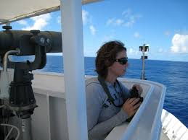
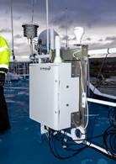
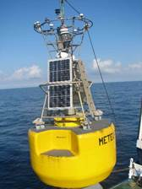
Obs. System Network Evolution
2002
2015
December
December
Legend
Plus…
6-hourly ➔ hourly
Reception delays shortened
Quality improved thanks to service QC
Metadata traceability
Conventional VOS
AWS on VOS
Moored Buoy
Drifting Buoy

Slide 4
Why redesign E-SURFMAR?
We need to ensure the core mission still meets stakeholders needs: weather forecasting (and climate monitoring)
Review of capacity with respect to user requirements
The context has evolved:
Emerging needs from new operational applications
European Copernicus services: oceanography, climate monitoring, emergency
National or regional needs: coastal prediction
➔ New opportunities
Allowed by technological developments
➔ Network design has matured
e.g., "Observing network design principles“, WMO Pub. 1160

Slide 5
Observing system needs and evolutions
Gaps, Impact, Feasibility
Statements of Guidance,
by application area
JCOMMOPS database already includes KPIs, by network
Actual Capacity
Requirements
WIGOS Information Resource
OSCAR Requirements

Slide 6
1st method: use Statements of Guidance
Structured by application area,
and then by variable
Considerations
Weight the various applications by « importance » for the funding body
Observations serve more (in the end) than the intended purpose of whoever funds the network
Capacity of a network, unless global or unique, is not that described in the SoG
➔ Homework needed to re-do the gap analysis, for the particular observation network

Slide 7
2nd method: Gap analysis, based on OSCAR database and current network capacity
Database of requirements: essentially a list
Each entry contains
Variable
Application area
Uncertainty*
Horizontal resolution*
Observing cycle*
Timeliness*
Plus some other metadata (date of requirement, comment…)
*There are 3 levels: threshold, breakthrough, and goal

Slide 8
E-SURFMAR gap analysis w.r.t. OSCAR
Select variables relevant to the marine surface:
40 eligible variables
Then order the variables according to a relevance index: mix of
Feasibility
Impact
Consider variables with highest feasibility & impact
Derive current capacity of the network, by variable, and compare with requirements for
Quality
Spatio-temporal sampling
Timeliness
The following slides show examples for each.

Slide 9
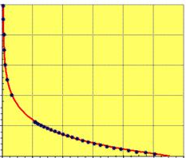
Quality example 1: Surface pressure observations at sea
Observation error estimates from Desroziers diagnostics applied to ECMWF observation feedback for observations at the sea surface between July and September 2015, for observations assimilated in the EUMETNET area
0.35 hPa for drifting buoys
0.41 hPa for moored buoys
0.50 hPa for automated VOS recruited by EUMETNET countries
0.50 hPa for automated VOS recruited by non-EUMETNET countries
0.81 hPa for conventional VOS recruited by EUMETNET countries
0.98 hPa for conventional VOS recruited by non-EUMETNET countries
P(z)

Slide 10
Data quality for MSLP, from automated VOS
Observation error estimates from Desroziers diagnostics applied to ECMWF observation feedback for observations at the sea surface between July and September 2015, for observations assimilated in the EUMETNET area
Separating by ship size, for S-AWS:
by ship length L:
4 m≤L<100 m: 0.39 hPa
100 m≤L<200 m: 0.58 hPa
200 m≤L<400 m: 0.61 hPa
by barometer height H:
1 m≤H<10 m: 0.37 hPa
10 m≤H<20 m: 0.44 hPa
20 m≤H<40 m: 0.58 hPa

Slide 11
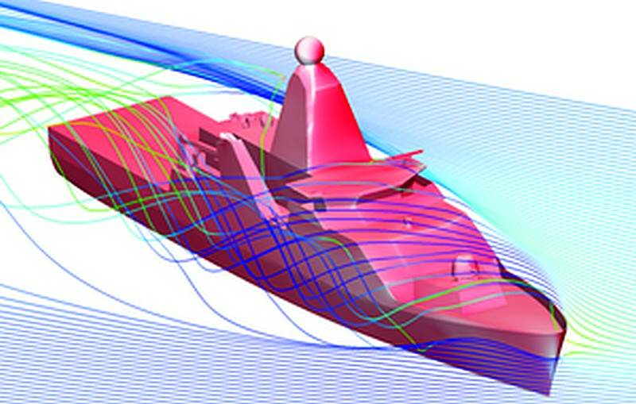
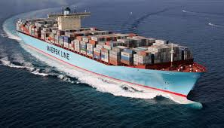
Quality example 2: Wind speed
Observation error estimates from Desroziers diagnostics applied to ECMWF observation feedback for observations at the sea surface between July and September 2015, for observations assimilated in the EUMETNET area
1.8 m/s for VOS (regardless of country of recruitment)
Separating by ship length L:
4 m≤L<100 m: 1.4 or 1.7 m/s (auto or conventional, resp.)
100 m≤L: 1.9 m/s
1.2 m/s for moored buoys

Slide 12
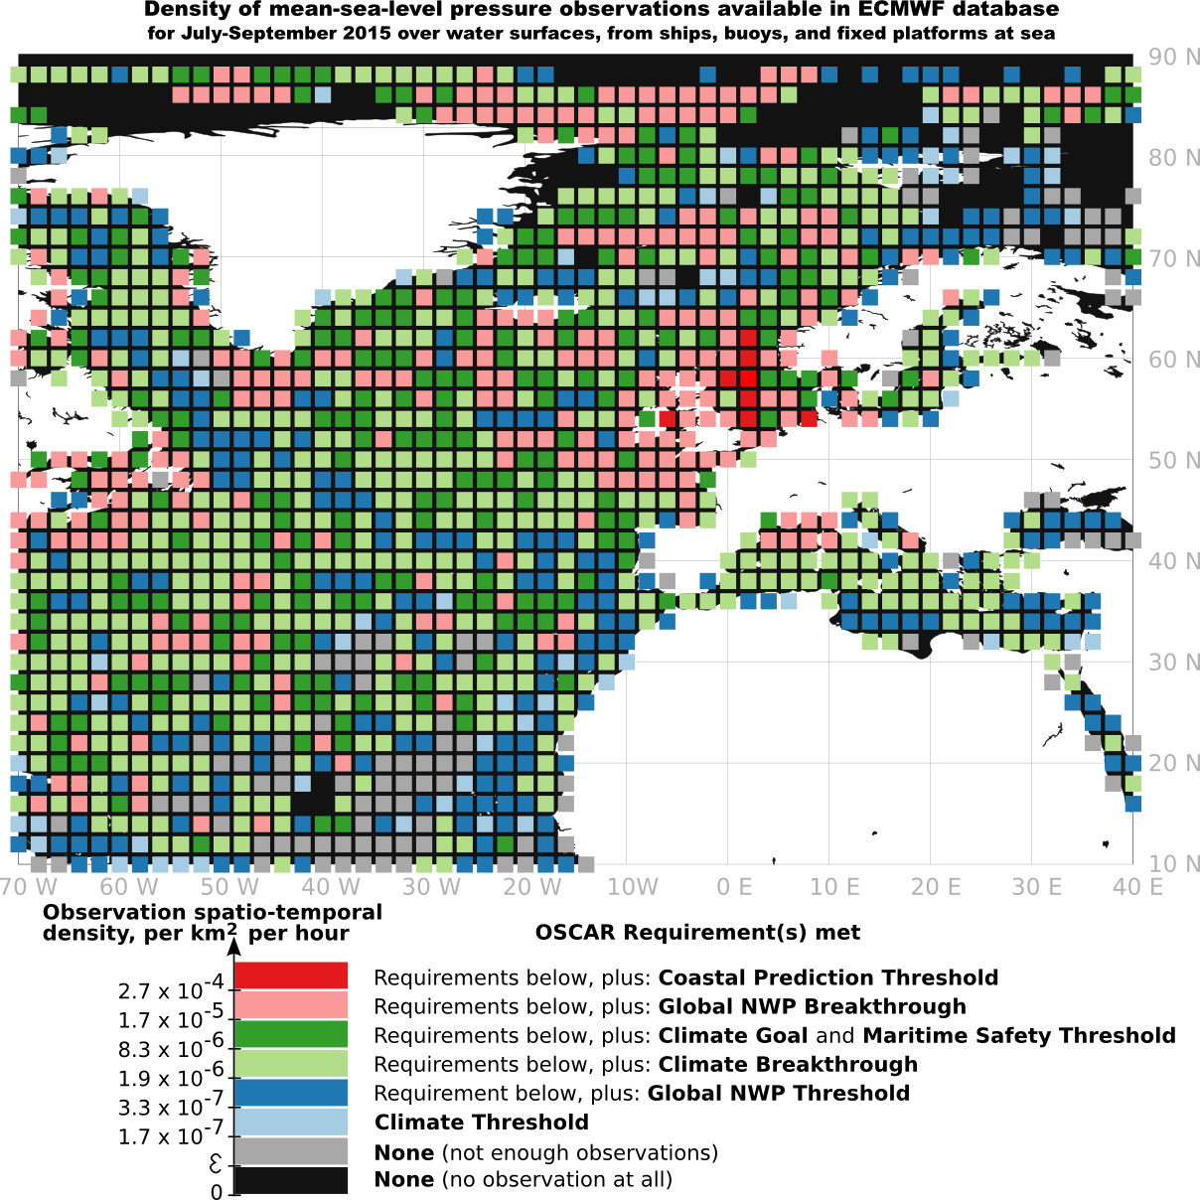
Spatio-temporal sampling example 1 Surface pressure observations at sea
Applica-tion area | Type of requirement | Equivalent Spatio-temporal density, per km² per hour
Climate-AOPC | Goal | 8.3 x 10⁻⁶
 | Breakthrough | 1.9 x 10⁻⁶
 | Threshold | 1.7 x 10⁻⁷
Global NWP | Goal | 4.4 x 10⁻³
 | Breakthrough | 1.7 x 10⁻⁵
 | Threshold | 3.3 x 10⁻⁷
High Res NWP | Goal | 2.0
 | Breakthrough | 4.0 x 10⁻²
 | Threshold | 8.3 x 10⁻⁴
Maritime Safety | Goal | 2.0 x 10⁻²
 | Breakthrough | 8.0 x 10⁻⁴
 | Threshold | 8.3 x 10⁻⁶
Coastal ocean forecasting | Goal | 1.0
 | Breakthrough | 3.3 x 10⁻³
 | Threshold | 2.7 x 10⁻⁴

Slide 13
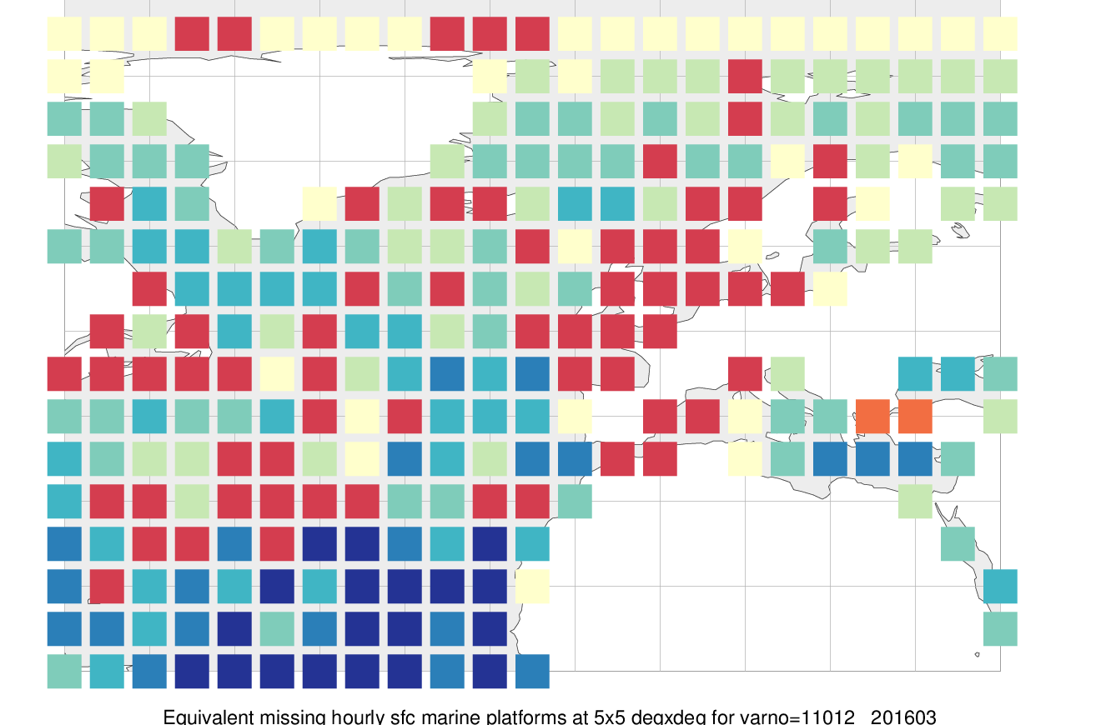
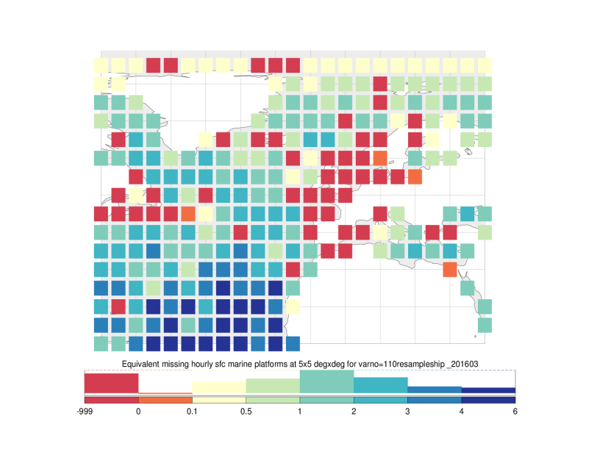
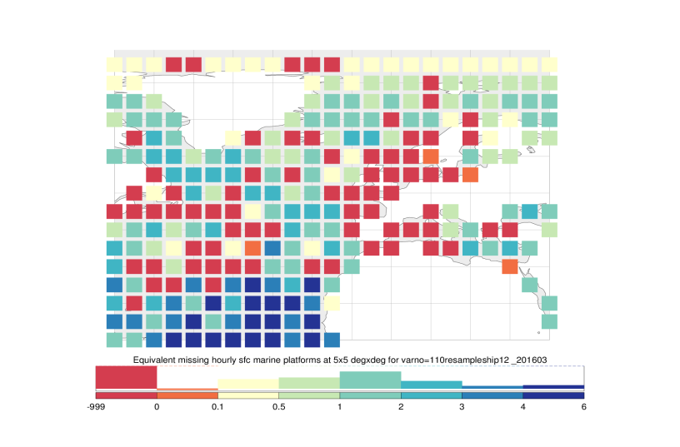
Example evolution scenarios for meeting Global NWP Breakthrough target
WHAT IF …
Upgrade all (107) NOAA SST drifting buoys with barometers
(13 → 23%)
Convert EU fleets CONV VOS into AWS (13 → 15%)
Both
(13 → 27%)
ABOVE target
BELOW target
Density mapped into equivalent number of hourly platforms

Slide 14
Spatio-temporal sampling example 2: in situ (buoy, VOS) coastal wind observations
Black indicates data within 25 km from shore. If you can see the coastline (red or blue) then it means there are no wind data there.

Slide 15
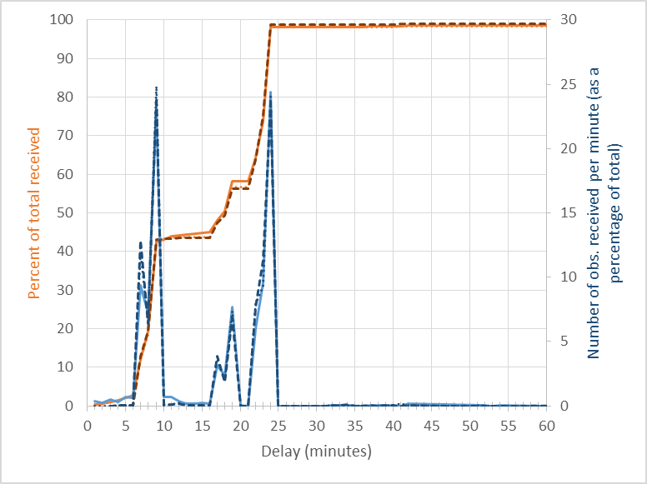
Timeliness example Observations from drifting buoys
High-res NWP goal, breakthrough
All other requirements >1h
Global NWP goal, breakthrough
Maritime safety goal, breakthrough

Slide 16
Other considerations: Relative impact of the network, for a given application
ECWMF result: obs. impact on data assimilation
Similar result in ECMWF reanalyses (ERA-Interim)
In fact SST (+sea-ice) and surface pressure form the backbone of a climate reanalysis system (ERA-20C)
András Horányi and Carla Cardinali, December, 2014, “The impact of mean sea level pressure observations from drifting buoys”,
WMO-ECMWF study.
Nov-Dec 2010
Jul-Aug 2012
Observations made by buoys have the largest per-observation impact on the reduction of 24-hour forecast error (according to a global dry energy norm)
This benefit comes mostly from drifters measuring surface pressure
Other impact studies, other domains (LAM, N.Atl.), other metrics (DFS, OSE…) have shown similar results

Slide 17
Other considerations: Data of no immediate measurable impact on the mission at hand*, but still highly relevant through satellite calibration and data assimilation Example: Wave data from moored buoys
*in situ wave data are generally not assimilated by global NWP

Slide 18
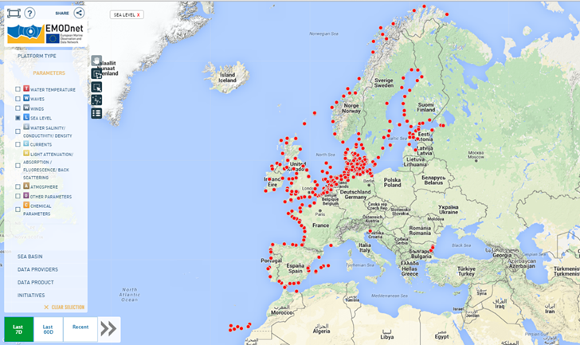
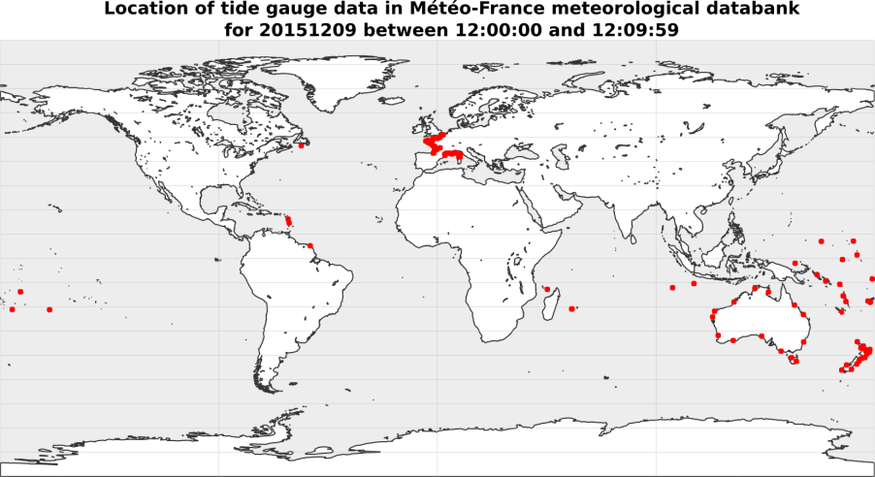
Other example: sea-level tide gauges
The European ocean community (EuroGOOS) concentrate the data into the EMODNET Physics portal
The link to the GTS is missing, so few get exchanged there
Their absence from the GTS is pointed out by SoG
Several NHMS have responsibility to predict surges
Pushing these data to the GTS should be done
➔ MoU to be prepared between EUMETNET and EuroGOOS

Slide 19
Conclusions
E-SURFMAR network redesign builds heavily on Statements of Guidance and OSCAR requirements
Two key elements of RRR
However, for a non-global or non-unique network, it is still required to carry out a gap analysis
e.g., the SoG generally comments on global capacity
In the future, one may expect
Capacity estimates (quantified) across the networks
To be enabled by WIGOS Information Resource
Notable progress already made (recently) by JCOMMOPS, with KPIs by network and by area
Gap analysis by network and by area

Slide 20
Thank you!

