Slide 1

WIGOS Workshop for Regional Association VI (RA-VI) with Focus on Marine Meteorological and Oceanographic Observing Requirements
(Split, Croatia, 5-7 September 2016)
The WIGOS Metadata Standard
And OSCAR
Etienne Charpentier, Chief, WMO Observing Systems Division
Luis Nunes, WMO, WIGOS Project Office
Estelle Grüter, MeteoSwiss
Jochen Dibbern, DWD

Slide 2
Contents
The WIGOS Metadata Standard (WMDS)
Scope and purpose
The WMDS structure and main features
Current status and future developments
OSCAR
Observational User Requirements
Space-based capabilities
Surface-based capabilities
Final remarks

Slide 3
WIGOS Metadata Standard (WMDS)
Scope and background
The WIGOS Metadata Standard (WMDS) is a semantic standard, defining a common set of requirements for observational metadata and describing the elements to be recorded/reported:
    Its practical implementation will be done through OSCAR
It is applicable to all observing systems:
    In-situ, remote, fixed, mobile, on land, on sea, on ice, on rivers, etc
It is meant to be used by all application areas:
    Climate, NWP, Oceans, Atmospheric Composition, Hydrology, Agriculture, etc
    The official WMO Application Areas are described here: http://www.wmo.int/pages/prog/www/OSY/GOS-RRR.html

Slide 4
WIGOS Metadata Standard (WMDS)
Description
WIGOS metadata is observational or description metadata – enables data values to be interpreted;
It is not discovery metadata – that facilitates data discovery, access and retrieval, which is part of WIS (WMO Information System)
The practical implementation of the WMDS is done through the OSCAR tool (Observing Systems Capability Analysis and Review)
What Members will have to do to comply with the Tech.Regulations (WMO-No. 49, Volume I, Part I – WIGOS and Manual on WIGOS):
  Keep records of WIGOS metadata
  For those observations that are exchanged internationally:
    Exchange also the associated WIGOS metadata
  For surface observations:
    Review the information in OSCAR/Surface
    Keep entries in OSCAR/Surface up to date

Slide 5
WIGOS Metadata Standard (WMDS)
Background and milestones
The WMDS was developed by WMO:
  through the Inter-Commission Coordination Group on the WMO Integrated Global Observing System (ICG-WIGOS) Task Team on WIGOS Metadata (TT-WMD)
The 1st version of WMDS was approved by the 17th World Meteorological Congress as part of the Manual on WIGOS:
  http://www.wmo.int/pages/prog/www/wigos/documents/WIGOS-RM/1160_en.pdf#page=49
It has entered into force for WMO Members on 1 July 2016
OSCAR/Surface (the web-based inventory of all surface-based observing stations) was launched operationally on 2 May 2016
The implementation of WIGOS metadata exchange will be done using an XML schema, which format is being tested/finalized
Guidance is being developed to assist Members with the WMDS:
    The first (online) edition is planned to be available in June 2016

Slide 6
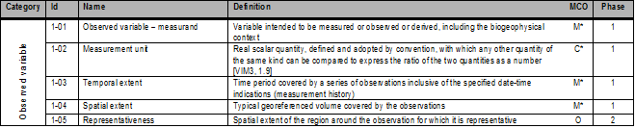
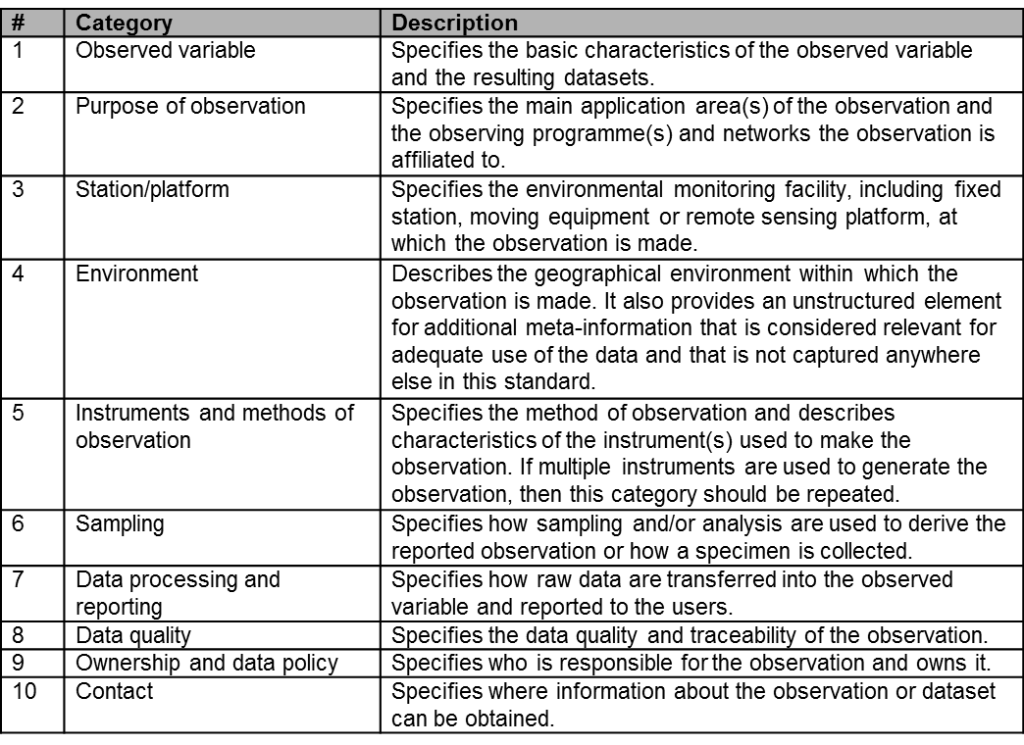
WIGOS Metadata Standard (WMDS)
Structure (1)
It is organized in 10 categories
Each category consists of 1 or more elements: 65 in total (+2 new)

Slide 7
WIGOS Metadata Standard (WMDS)
Structure (2)
There are 3 levels of MD reporting:
Mandatory - Required for all WIGOS observing systems/platforms
Conditional - Required if applicable
(e.g. instrument calibration is not applicable to a human observer)
Optional – Desirable/useful, but non-compulsory
The WMDS includes 45 Code Tables – Example of a Code table:

Slide 8
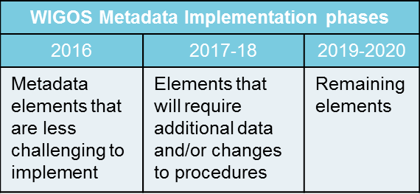
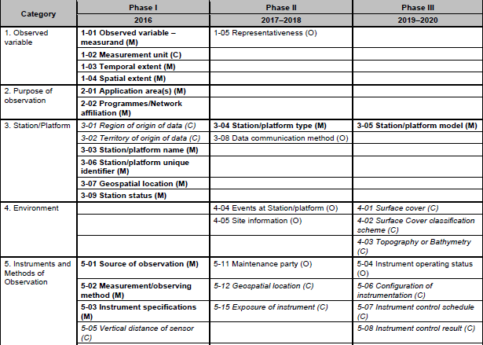
WIGOS Metadata Standard (WMDS)
Implementation Phases
Extract of the WMDS elements per Implementation Phases

Slide 9
OSCAR
(Observing Systems Capability Analysis and Review tool
One of the priorities for the
WIGOS Pre-Operational Phase 2016-2019:
Further develop the WIGOS Information Resource (WIR) and the Observing Systems Capability Analysis and Review tool

Slide 10
The Observing System Capabilities Analysis and
Review platform (OSCAR) oscar.wmo.int
OSCAR is comprised of 3 components
    OSCAR/Requirements : A record of technology free observational user requirements
    OSCAR/Space: capabilities of all satellite sensors, whether historical, operational or planned
    OSCAR/Surface: surface-based capabilities; developed by MeteoSwiss for WMO under MoU, and with strong financial commitment of Switzerland

Slide 11
OSCAR/Requirements https://www.wmo-sat.info/oscar/observingrequirements
Technology free observational user requirements recorded quantitatively in terms of space & time resolution, timeliness, uncertainty, stability for
  20 Application areas
  262 observed variables
  5 Vertical domains (Atmosphere, Ocean, Terrestrial, Outer Space, and Cross-Cutting) totalling 30 vertical layers
  8 Horizontal coverage domains (global, global ocean, global land, coastal areas, regional, sub-regional, local, and point)
  2 Cross-Cutting themes linked to 19 variables
In total there are 587 observational user requirements recorded in OSCAR

Slide 12
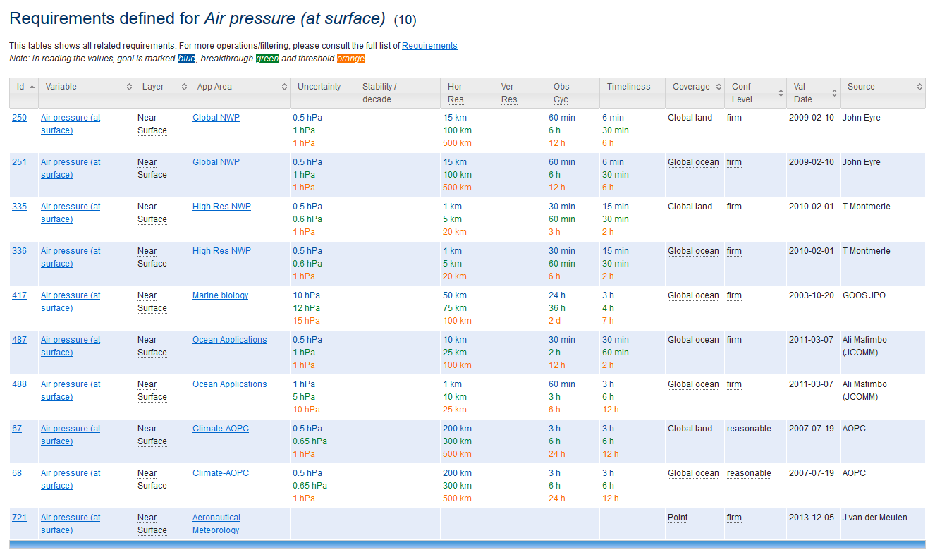
Example of obs. requirements in OSCAR http://www.wmo-sat.info/oscar/variables/view/10

Slide 13
OSCAR/Space – oscar.wmo.int/space
Available since September 2012
Contains factual information on satellites and instruments
    Satellite details (> 600 satellites)
    Instrument specifications (> 900 sensors incl. ≈ 260 for space weather)
≈1000 visits per day, from worldwide users : space agencies, application centres, consultants, researchers, students, and feeds the WMO and CGMS websites
Used as reference for reports, application planning, gap analysis, socio-economic benefit studies, frequency management, etc.
New version 2.0 integrating objective rules linking instruments to observed variables (now in Beta testing)

Slide 14
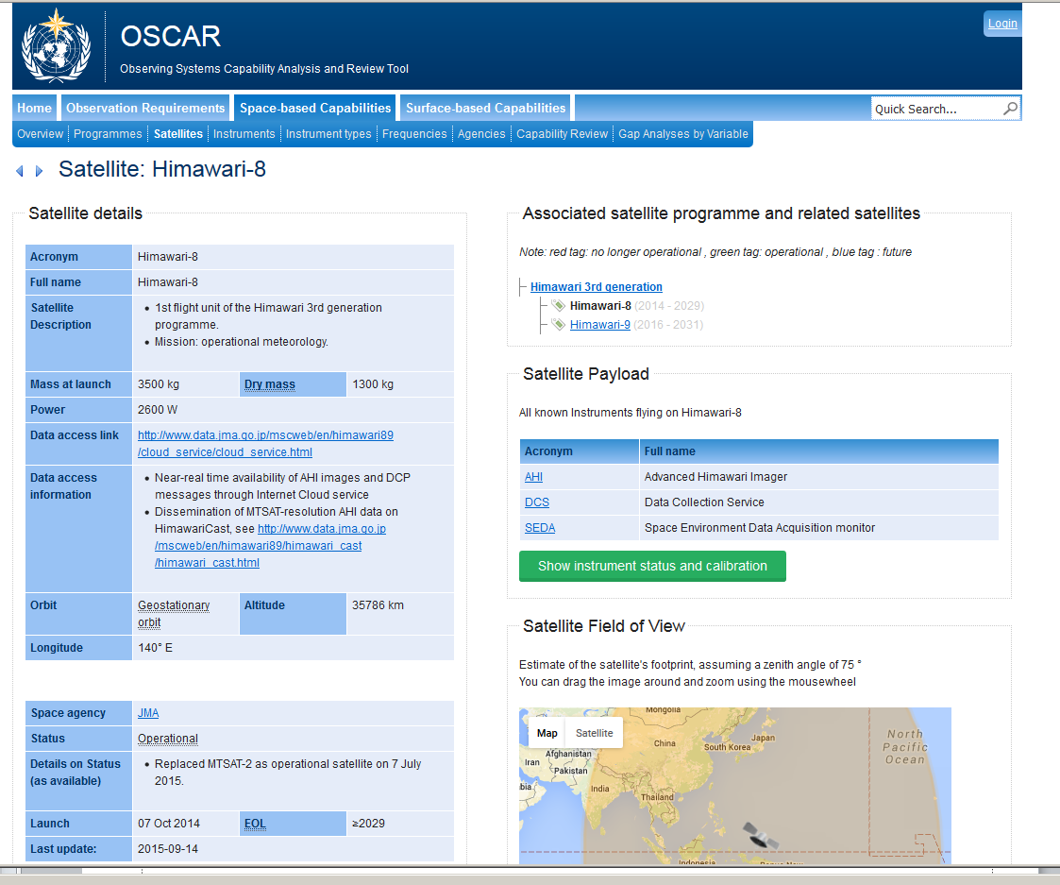
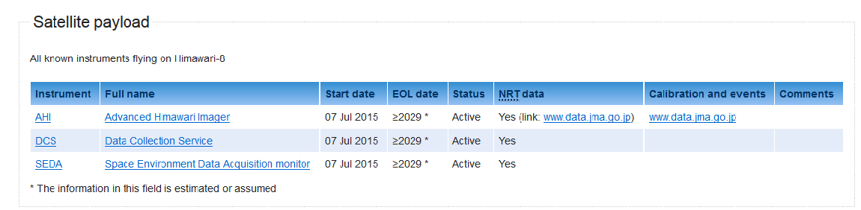

Slide 15
OSCAR/Surface – oscar.wmo.int/surface
OSCAR/Surface is the repository of surface-based observing systems contributing to WIGOS
The official repository of WIGOS Metadata
An evolution/modernization of WMO No. 9, Volume A, Observing Stations and WMO Catalogue of Radiosondes
Includes GAW stations (GAWSIS), weather radars, aircraft-based observations, marine observing systems
A database for recording surface-based observing systems capabilities for the purpose of the WMO Rolling Review of Requirements
  Objective gap analysis / critical review
  A tool for planning evolution of the observing system
  Monitoring evolution of capabilities, compare with plans, look at progress

Slide 16
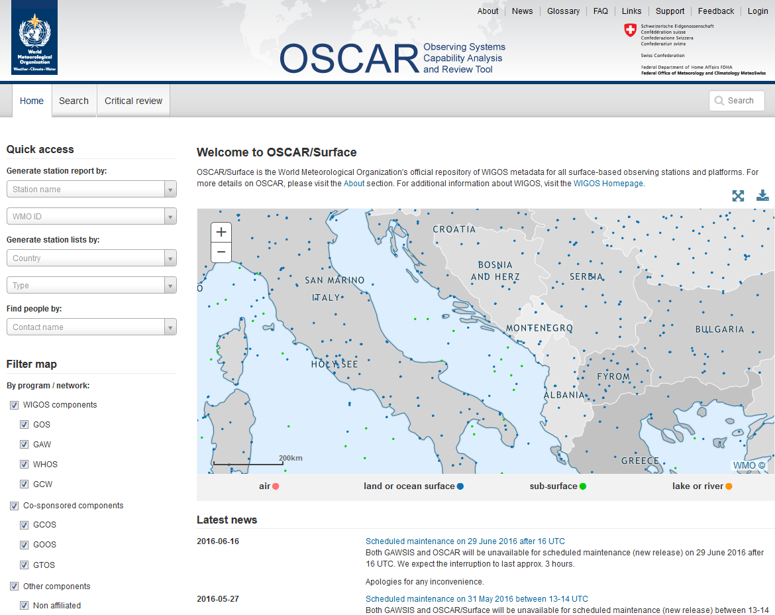
OSCAR/Surface – oscar.wmo.int/surface
Operational as of 2 May 2016
Legacy version of Volume A maintained during transition period (2016)

Slide 17
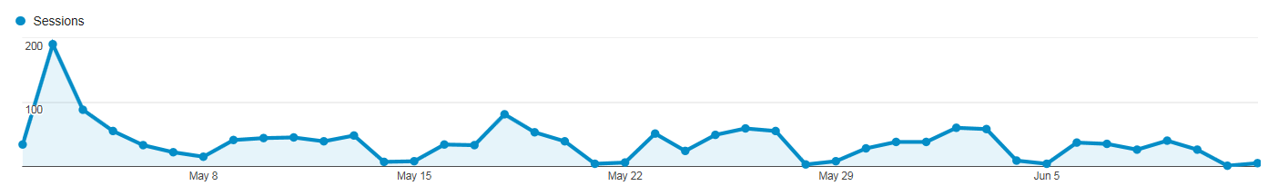
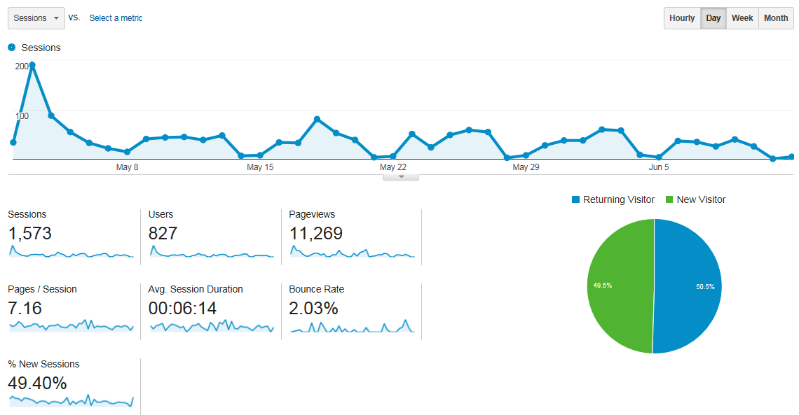
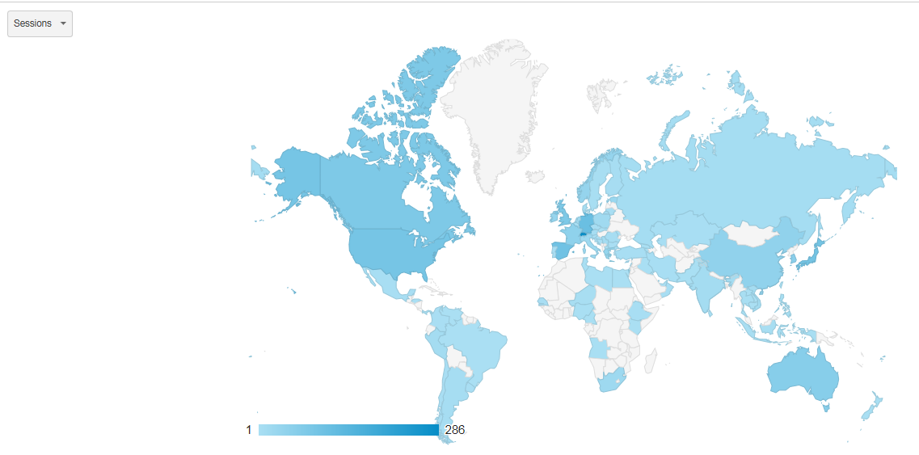
Web Stats, 2 May-12 June 2016
50 % returning visitors
globally distributed

Slide 18
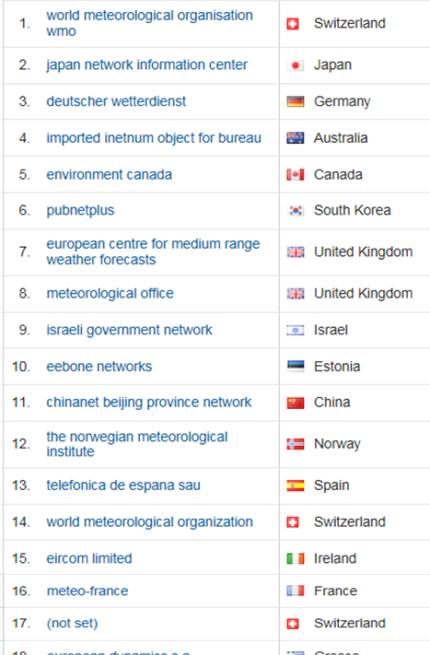
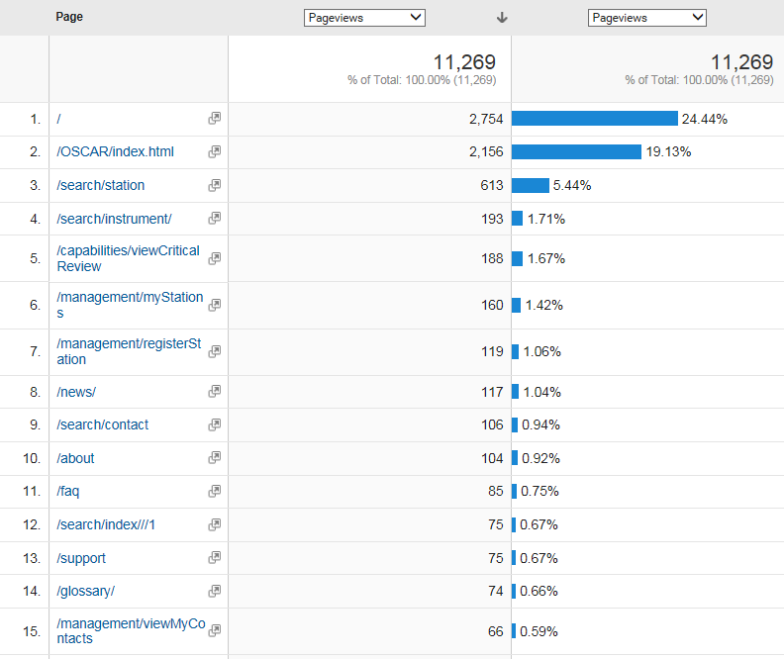
Web stats, 2 May-12 June 2016
Most active organisations
Most visited pages
Homepage view / search
Under construction
~ 100 users logged in
at least once
~ 230 station updates
Search
Search
~ 20 tickets for support/feedback
~ 20 contacts added/updated
Notes:
Total pageviews corresponds to approx. 280 pageviews per day

Slide 19
Benefits of OSCAR/Surface to Members
An holistic view within WIGOS about multi-disciplinary observational user requirements and observing systems capabilities
  One-stop-shop for surface- and space-based observing instruments & platforms metadata for (global, for weather, climate, air quality, hydrology …)
  Allows users to understand data and decide which data to request, which data to use, and for which purpose(s)
Allows to identify potential synergies and to develop partnerships
A Platform for gap analysis
A tool for WIGOS data quality monitoring
A Platform readily available to Members who prefer not investing in a national database

Slide 20
Benefits of OSCAR/Surface to Members
Increased national visibility for NMHS
  An opportunity for NMHS to position itself as a central, national resource for all information about meteorological observing systems, irrespective of ownership, by taking the lead and supporting national partners in getting all stations/platforms registered in OSCAR/Surface
Useful tool to support network design activities, facilitate discussions about national observing priorities and strategies, data policies, etc.

Slide 21
Obligations of Members with regard to OSCAR
  It is mandatory to register in OSCAR/Surface those stations for which data are exchanged internationally
  Other stations may be registered in OSCAR/Surface at the discretion of the Member

Slide 22
What are NMHSs expected to do?
Familiarize themselves with the system
Test it out and provide feedback
Assign a national focal point for OSCAR/Surface
  This individual will have editing right for all stations in your territory and can assign similar rights to others, e.g. in partner organisations
Review that all station information is correct
Add any additional metadata required per the WIGOS Metadata Standard
Enter additional stations that might have been missing from Vol. A

Slide 23
How to submit metadata ?
Marine/ocean observing systems
  Submit via JCOMMOPS – http://www.jcommops.org
GAW Stations
  Submit via identified data sources of GAWSIS – https://gawsis.meteoswiss.ch/
Weather radars
  Submit via Weather Radar Database – https://www.wmo.int/pages/prog/www/WRO/index_en.html#WRD
Other surface-based observing systems
  Develop Machine to Machine Interface (preferred)
  OSCAR/Surface National Focal Point to Log in to OSCAR/Surface and enter metadata

Slide 24
OSCAR/Surface - oscar.wmo.int/surface

Slide 25

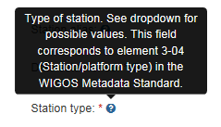



OSCAR Taining
Develop guidance material (OSCAR Guide to be included in WIGOS Guide)
Document OSCAR components inline
  FAQ
  Tooltips
  Glossary
Develop e-Learning material
Organize hands-on training
Provide operational support
  MeteoSwiss (24/7 via ticketing service)
  WMO (work days during office hours)
Support «Vol A» to OSCAR transition
  Mohan Abayasekara recruited by WMO until end of 2016

Slide 26
Conclusion
Collaboration with various communities to the further development of the WMDS has been, and will continue to be, essential
Feedback on the current version of WMDS and OSCAR/Surface will help improve the next edition which is expected to be submitted to Cg-18 (2019)
All groups dealing with observational metadata are encouraged to use OSCAR/Surface at: http://oscar.wmo.int/surface
  Machine to Machine interface with national database encouraged
  Many Members will be needing WMO support
  OSCAR/Surface will only be as good as the information Members enter into it!
Some changes to version 1.0 of the WMDS will be submitted to the 16th Session of CBS (November 2016)

Slide 27

Thank You!

