Slide 1
WIGOS Identifiers WIGOS Workshop for RA-VI with Focus on Marine Meteorological and Oceanographic Observing Requirements
Technical Coordinator - Data Buoy Cooperation Panel
Champika Gallage
Notes:
Why we need WIGOS identifiers
What is a WIGOS identifier, the structure and how certain sections of th identifier are handled
at the end I would like to discuss the involvement of different organizations in ID allocation.

Slide 2
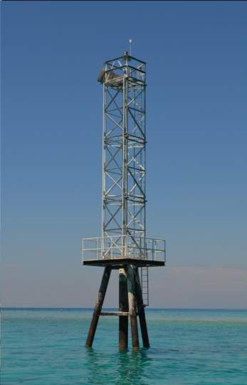
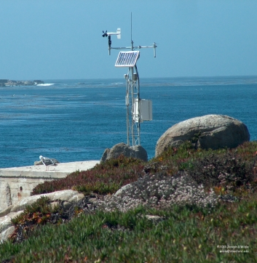
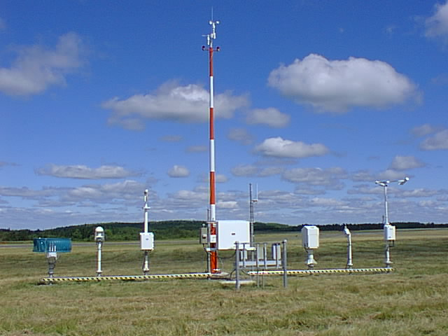
Purpose
WIGOS station identifiers ;
provide a link between observations and the metadata associated with the conditions under which the observations were made.
Reduce the need to transfer unchanging station metadata with observed values.
Notes:
I will start with why we have the WIGOS ID, the purpose of these identifications.
Primary purpose of WIGOS IDS is to provide a link between observations and the metadata associated with the conditions the observations were made.
This will reduce the need to transfer static information like some station metadata with regular observation values.
By doing so telecom messages will become shorter and have more space for observational data transmission. As you all know telecom costs bares a considerable station maintenance cost.

Slide 3
Introduction
WIGOS station identifiers ;
only be associated with one station or platform (called an “observing facility” in WIGOS metadata terminology)
single observing facility can be associated with more than one WIGOS station identifier in order to maintain a link with historic station identifiers
stations that had already been allocated an identifier under a previous scheme (e.g.WMO ID) should not create additional WIGOS station identifiers
Provisions are in place to map existing station identifiers to WIGOS identifiers
Notes:
Here I have listed the characteristic of WIGOS Identifiers
A WIGOS ID can only be associated with one station or platform (called an “observing facility” in WIGOS metadata terminology)
Each observing station must have at least one WIGOS station identifier associated with it. This identifier associate the station with its WIGOS metadata.
But single observing facility can also be associated with more than one WIGOS station identifier to maintain a link with historic station identifiers
Stations that had already been allocated an identifier under a previous scheme such as WMO IDs for drifters floats should not create additional or new WIGOS station identifiers .
Existing such identifiers can be adopted to WIGOS ID scheme
Requirements and instructions are in place to map existing station identifiers to WIGOS identifiers

Slide 4
Structure of WIGOS Identifier
Example:
This would be written as : 0-191-326-4400150
WIGOS Identifier Series (number) | Issuer of Identifier (number) | Issue Number (number) | Local Identifier (characters)
0 -14 | 0-65534 | 0-65534 | 16 characters
WIGOS Identifier series 0 | Issuer of Identifier 191 | Issue Number 326 | Local Identifier 4400150
Notes:
Next couple of slides I will explain the structure of the WIGOS IDs.
There are 4 sections to the identifiers
WIGOS Identifier Series
Issuer of the Identifier
Issue number and
local identifier
WIGOS Identifier Series can be a number between 0-14
Issuer of the Identifier is between 0-65,534
Issue number can be between 0-65,534 and
local identifier can be up to 16 characters
The number is displayed as the example at the bottom with Dashes in between the sections.

Slide 5
Structure of WIGOS Identifier
WIGOS Identifier Series (number) | Issuer of Identifier (number) | Issue Number (number) | Local Identifier (characters)
0 -14 | 0-65534 | 0-65534 | 16 characters
WIGOS Identifier Series:
Only WIGOS Identifier Series 0 has been defined. This series is used to identify observing stations.
This is used to distinguish between different systems for allocating identifiers. It allows future expansion of the system so that entities do not have to be issued with new identifiers if the structure of the WIGOS identifiers proves unable to meet future requirements.
Different values of the WIGOS Identifier Series may correspond to different structures of the WIGOS identifier. Initial permitted range: 0-14
Notes:
Lets take each section of the Ids and see their specifics.
The first section WIGOS Identifier Series can be a number between 0-14 . At the moment Only WIGOS Identifier Series 0 has been defined.
Zero in the WIGOS Identifier Series is used to identify observing stations.
Thai section is used to distinguish between different systems.
It allows future expansion of the system

Slide 6
Structure of WIGOS Identifier
WIGOS Identifier Series (number) | Issuer of Identifier (number) | Issue Number (number) | Local Identifier (characters)
0 -14 | 0-65534 | 0-65534 | 16 characters
Issuer of Identifier :
A number that is used to distinguish between identifiers issued by different organizations.
It is allocated by WMO to ensure that only one organization can create a given WIGOS station identifier.
Notes:
The second section of the WIGOS ID is for the Issuer of the Identifier. This can be a number between 0 and 65,534.
This number is alocated to the Issuing organization by WMO and no two organization get the same number.
I will talk more about issuer of identifier in a minute

Slide 7
Structure of WIGOS Identifier
WIGOS Identifier Series (number) | Issuer of Identifier (number) | Issue Number (number) | Local Identifier (characters)
0 -14 | 0-65534 | 0-65534 | 16 characters
Issue Number:
An identifier that an organization responsible for issuing an identifier may use to ensure global uniqueness of its identifiers.
For example, allocating one issue number for hydrological stations and another for voluntary climate observing stations would enable the managers of the two networks to issue Local Identifiers independently without needing to check with each other that they were not duplicating identifiers.
Notes:
The third section of the WIGOD ID is Issue number. This is a nember between 0 and 65,534.
These numbers can be issues by an organization responsible for issuing identifiers , means the organizations who has an identifier received from WMO for the second section identified in blue here.
One feature is that Issue Numbers can be used to organize the internal requiremnts of the organization. For example if a NWS become the issuer of Identifiers. That NWS had many dufferent observing sections or departments such as hydrometric deplartment, surface weather department, upper air observations department, marine observations department.
Then this organization can use different issue numbers for each department.

Slide 8
Structure of WIGOS Identifier
WIGOS Identifier Series (number) | Issuer of Identifier (number) | Issue Number (number) | Local Identifier (characters)
0 -14 | 0-65534 | 0-65534 | 16 characters
Local Identifier :
This is the individual identifier issued for each station/platform/observing facility.
An organization issuing identifiers must ensure that the combination of Issue Number and Local Identifier is unique; This will guarantee the global uniqueness of numbers.
Notes:
Forth and last section of a WIGOS ID is the Local Identifier:
This is the individual identifier issued for each station/platform/observing facility
One important rule to remember is an organization issuing identifiers have to ensure that the combination of Issue Number and Local Identifier is unique; no duplicates.
This will guarantee the global uniqueness of numbers.

Slide 9
Issuer of Identifier
Range of Issuer of Identifier | Category of issuer | Method of allocating | Procedures for issuing Issue Number and Local Identifier
0 | Reserved for internal use by OSCAR | OSCAR allocates the value | Determined by OSCAR
1-9999 | Member state or territory for which there is an ISO 3166-1 numeric country code | ISO 3166-1 three digit numeric country code (by convention leading zeroes are not shown in WIGOS Identifiers). See *ISO web site for more details | Issuer identifies its own procedures. Further guidance is available in the section **"Guidance on recommended practices for the allocation of 'issue number' and 'local identifier' for Member states and territories that have an 'issuer of identifier' allocated to them".
10000-11999 | Member state or territory for which there is no ISO 3166-1 numeric country code | WMO Secretariat allocates an available number on request | Issuer identifies its own procedures. Further guidance is available in the section "Guidance on recommended practices for the allocation of 'issue number' and 'local identifier' for Member states and territories that have an 'issuer of identifier' allocated to them".
12000-19999 | Reserved for future use. | To be determined. | To be determined.
* https://www.iso.org/obp/ui/#search
** http://wis.wmo.int/page=WIGOS-Id-WMOProg
Notes:
Lets see how the Issuer of Identifiers are alocated.
As I have already mentioned Issuer identifiers can run from 0 to 65,534
0- reserved for OSCAR internal use
1-9,999 for Member state or territory for which there is an ISO 3166-1 numeric country code
10,000 – 11,999 for Member state or territory without an ISO 3166-1 numeric country code
12,000-19,999 Reserved for future use.
ISO 3166-1 three digit numeric country code (by convention leading zeroes are not shown in WIGOS Identifiers). See ISO web site and click on "Officially assigned codes" (on the left of the screen)

Slide 10
Issuer of Identifier ctd.
Range of Issuer of Identifier | Category of issuer | Method of allocating | Procedures for issuing Issue Number and Local Identifier
Identifiers in the ranges 20000-21999 and 22000-39999 are intended only to be used to allocate WIGOS identifiers for observing facilities that had one or more pre-existing identifiers.
20000-21999 | WMO Secretariat for identifiers associated with WMO Programmes. | Details are provided in the section ***"Allocation of 'issuer of identifier' for station identifiers associated with WMO Programmes" | Details are provided in the section ***"Allocation of 'issuer of identifier' for station identifiers associated with WMO Programmes"
22000-39999 | WMO Secretariat for identifiers associated with programmes of Partner organizations. | Details are provided in the section ***"Allocation of 'issuer of identifier' for station identifiers associated with WMO co-sponsored programmes". | Details are provided in the section ***"Allocation of 'issuer of identifier' for station identifiers associated with WMO co-sponsored programmes".
40000-65534 | Reserved for future use. | To be determined. | To be determined.
65535 | Missing value (reserved value in Table Driven Code Forms).
*** https://wiswiki.wmo.int/tiki-index.php?page=WIGOS-Id-WMOProg
Notes:
20,000 to 39,000 numbers are intended to be used for observing facilities with pre existing identifiers. I will talk little bit more about this block of IDS in next couple of slides
20,000 to 21,999 are for identifiers associated with WMO Programmes.
And from 22,000 to 39,999 for identifiers associated with programmes of Partner organizations.
40,000 to 65,534 are reserved for future use

Slide 11
‘Issuer of identifier' for station identifiers associated with WMO Programmes
Issuer of Ident. | Category of station identifier | Method of allocating Issue Number | Method of allocating Local Identifier
20000 | WWW land station with sub-index number (SI) = 0 | 0: station defined in WMO-No. 9 Volume A on 1 July 2016. Any other positive number: to distinguish between different observing facilities that used the station identifier in the past. | Use the block number (II) and the station number (iii) as a single five digit number IIiii (with leading zeroes). Example: station 60351 would be represented by 0-20000-0-60351
20001 | WWW land station with sub-index number (SI) = 1 | 0: station defined in WMO-No. 9 Volume A on 1 July 2016. Any other positive number: to distinguish between different observing facilities that used the station identifier in the past. | Use the block number (II) and the station number (iii) as a single five digit number IIiii (with leading zeroes). Example: upper air station 57816 would be represented by 0-20001-0-57816
20002 | WWW Marine Platform (moored or drifting buoy, platform, etc.) | 0 - platform for which the identifier was in use on 1 July 2016. Any other positive number - to distinguish between different platforms that used the same identifier at different times. | Use the region/platform number combination A1bwnbnbnb Examples: the data buoy 59091 would be represented by 0-20002-0-59091. The WWW list of data buoys lists two buoys with identifier 13001. The buoy most recently used at the time WIGOS station identifiers were introduced is allocated 0-20002-0-13001 and the second is issued identifier 0-20002-1-13001 (note - the Issue Number is different from that for the first buoy).
http://wis.wmo.int/page=WIGOS-Id-WMOProg
Notes:
The table defines the value of Issuer of identifier in the range 20000-21999 to be used for WIGOS station identifiers.
This range is used to ensure that observing facilities that had pre-existing station identifiers can be allocated a WIGOS station identifier in a way that retains an association with the pre-existing identifier.
Any new observing facility will be given an identifier within the range allocated to the Member operating the observing facility outside this range.

Slide 12
‘Issuer of identifier' for station identifiers associated with WMO Programmes
Issuer of Id. | Category of st. Id. | Method of allocating Issue Number | Method of allocating Local Identifier
20003 | Ship identifier based on ITU call sign | 0 - ship allocated the identifier more recently on 1 July 2016. Any other positive number - to distinguish between different ships that used the same ship identifier at different times. | Ship call sign. Example: the (now obsolete) weather ship C7R would be represented by 0-20003-0-C7R
20004 | Ship Identifier - issued nationally | 0 - ship allocated most recently on 1 July 2016. Any other positive number: to distinguish between different ships that used the same ship identifier at different times. | Ship identifier. Example: the fictitious ship XY123AB would be represented by 0-20004-0-XY123AB
20005 | AMDAR/TAMDAR aircraft identifier | 0 - aircraft most recently issued the identifier on 1 July 2016. Any other number: to distinguish between different aircraft that used the same aircraft identifier at different times. | Aircraft identifier. Example:aircraft EU0246 would be represented by 0-20005-0-EU0246
20006 | ICAO airfield identifiers | 0 - airfield most recently allocated the identifier on 1 July 2016. Any other positive number: to distinguish between airfields that used the same airfield identifier at different times. | ICAO airfield identifier. Example: Geneva airport (LSSG) would be represented by 0-20006-0-LSGG
20013-21999 | Reserved for future use. | To be determined. | To be determined.
Refer to http://wis.wmo.int/page=WIGOS-Id-WMOProg for more information
Notes:
Here are couple of more Issuer identifications for ships , AMDAR, and Airfields.
Similerly you can find the allocations for other programs like satellite program, Radar program, through the link included at the bottom of the slide.
Issuer of Identifiers are defined upto 20,012 and 20,013 to 21,999 are reserved for future use at the moment.
There are some observing programmes which did not have a pre-existing international system for assigning station identifiers and have not been allocated Issuer of Identifiers such as Sea Level Network.
Members operating the stations supporting these observing programmes should allocate WIGOS identifiers using their national system. Sea level network. In the past, station identifiers have been issued according to national conventions. In cases where the identifier of another WMO Programme has been used (for example a land station identifier), the WIGOS identifier corresponding to that identifier should be used. Tsunamometer network. In the past, station identifiers have been issued according to national conventions. In cases where the identifier of another WMO Programme has been used (for example a land station identifier), the WIGOS identifier corresponding to that identifier should be used.

Slide 13
Proposed SOT ID Scheme
Proposed SOT ID Scheme:
Limitations with TurboWin software limits the local identifier to maximum 7 characters
Increasing local identifier beyond 7 characters will increase the Telecommunication cost significantly
To maintain the uniqueness of local identifiers , propose to have 7 Character ID allocated by JCOMMOPS
First two characters are letters to identify the Platform Type (VOS, SOOP, ……)
Last 5 characters are random numbers and/or letters (order TBD)
Examples : VA A123Z, VM 1A2B3, SX 24ABC
Corresponding WIGOS ID : 0-22000-0-VAA123Z (example)
Notes:
I have included here the Ship observing team ID scheme which faces some limitations and how they are proposing to go forward.
Majority of shipd use TurboWin software to provide weather data to the GTS which has a limitation the local identifier to maximum 7 characters
Increasing local identifier beyond 7 characters will increase the Telecommunication cost significantly due to exceeding the size of the message transmit through Inmarsat satellite
Therefore to maintain the uniqueness of local identifiers, and to be comply with WIGOS requirements SOT task team on IDS agreed to have a 7 Character ID for ships allocated by JCOMMOPS
First two characters are letters to identify the Platform Type (VOS, SOOP, ……)
Last 5 characters are random numbers and/or letters (order TBD)
Reason to issue new numbers for existing platforms is that in the past used call sign of the ship as the identifier. There are ships with more than one observing station on the same ship and may be from two different countries/Organizations.
ITU (International Telecommunication Union) call signs

Slide 14
Principles to guide allocation of station identifiers
Issuers of identifiers are responsible for guaranteeing uniqueness of identifiers; no two observing facilities share the same station identifier .
Issuers of identifiers can allocate different Issue Numbers to the organizations delegated to allocate "Local Identifiers" for their observing facilities.
The issuer of identifiers should maintain records on Issue Numbers and organizations responsible for managing Local Identifiers.
An organization issuing a Local Identifier must ensure that no two observing facilities share a WIGOS station identifier.
An organization responsible for allocating Issue Numbers and Local Identifiers must ensure that no two observing facilities have the same combination of Issue Number and Local Identifier. If the organization is only allocating Local Identifiers then it is sufficient for that organization to ensure that it does not issue the same Local Identifier to the more than one observing facility.
The organization must maintain a record of the Local Identifiers (and Issue Numbers) that it has issued (it may choose to use OSCAR for this).
An organization issuing a Local Identifier may choose to use an existing national identifier for the observing facility as the Local Identifier.
Historically, re-used station IDs can be retained with different Issue Numbers to maintain the link. (Example: 0-20002-0-4400123 and new allocation is 0-20002-1-4400123)
Notes:
Guiding Principles of allocating station identifiers
Issuers of identifiers are responsible for guaranteeing that no two observing facilities share the same station identifier. Note that the structure of WIGOS station identifiers guarantees that issuers of identifiers cannot create station identifiers that have already been allocated by another issuer of identifier.
Issuers of identifiers may choose to use the Issue Number to allow them to delegate the allocation of Local Identifier to other organizations responsible for managing individual observing networks. Issuing each organization with a different Issue Number will allow those organizations to allocate "Local Identifiers" for their observing facilities.
The issuer of identifiers has to record which Issue Numbers have ever been allocated, and which organization is responsible for managing Local Identifiers for each.
An organization issuing a Local Identifier must ensure that no two observing facilities share a WIGOS station identifier.
An organization that is responsible for allocating both Issue Numbers and Local Identifiers must ensure that no two observing facilities have the same combination of Issue Number and Local Identifier. If the organization is only responsible for allocating Local Identifiers then it is sufficient for that organization to ensure that it does not issue the same Local Identifier to the more than one observing facility.
The organization must maintain a record of the Local Identifiers (and Issue Numbers) that it has issued (it may choose to use OSCAR for this).
It is allowed for the organizations to use an existing national identifier for the observing facility as the Local Identifier. Doing so in a systematic way may decrease the administrative load for the body.
In the past, station identifiers may have been re-used when observing facilities closed and new ones opened. If the organization has been allocated a range of Issue Numbers, the organization may wish to consider using different Issue Numbers to distinguish between the different locations, allowing the Local Identifier to retain the link to the identifier that was used while the observing facility was open at a location. (Ex. 0-20002-0-4400123 and new allocation is 0-20002-1-4400123)

Slide 15
Principles to guide allocation of station identifiers (ctd).
WIGOS station identifier must not be issued to more than one observing facility; though it is permitted for a station to have more than one WIGOS station identifier associated with it.
The WIGOS station identifier for a closed observing facility must not be re-used unless the observing facility reopens.
Stations may have more than one WIGOS station identifier. In this case, the organization issuing the Local Identifier should associate all these identifiers with the same WIGOS metadata record.
The organization must use meteorological judgement in deciding to use the same WIGOS ID for a station which moves its location.
Search Oscar/surface for the proposed WIGOS station identifier before issuing the identifier to make sure that it has not already been allocated.
Organizations are strongly advised to document their procedures for allocating WIGOS station identifiers in their Quality Management System.
Notes:
Although a single WIGOS station identifier must not be issued to more than one observing facility, it is allowed for a station to have more than one WIGOS station identifier associated with it. For example, although all observing facilities with pre-existing WWW station identifiers have a WIGOS station identifier based on the WWW identifier, the organization may wish to create a new identifier that is linked to a national numbering scheme.
The WIGOS station identifier for a closed observing facility must not be re-used unless the observing facility reopens.
The organization responsible for allocating the WIGOS station identifier should ensure that the operator of the observing facility has committed to providing and maintaining WIGOS metadata for that observing facility.
Stations may have more than one WIGOS station identifier. In this case, the organization issuing the Local Identifier should associate all these identifiers with the same WIGOS metadata record so that only one WIGOS metadata record needs to be maintained. OSCAR will provide tools to document this linkage.
The organization must use meteorological judgement in deciding to use the same WIGOS ID for a station which moves its location.
Search Oscar/surface database for the proposed WIGOS station identifier before issuing the identifier to make sure that it has not already been allocated.
More importantly organizations are strongly adviced to document their procedures for allocating WIGOS station identifiers in their Quality Management System.

Slide 16
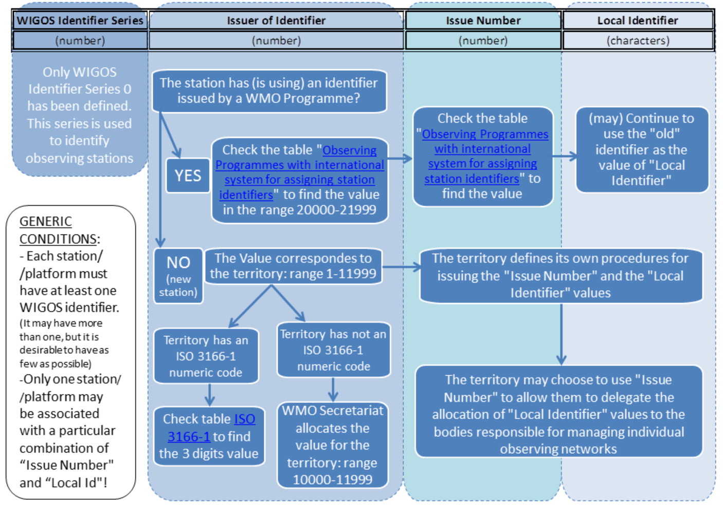
Assigning WIGOS Identifiers to observing stations
Notes:
This figure summarizes what I have talked about so far.
sections to the ID
WIGOS Identifier is zero for the moment for Observing stations
Issuer of Identifier is defined based on whther the station already has an id or not. For the ones with an existing ID, Issuer of identifier is between 20,000-21,999
If there is no existing ID the rage alocated is between 1-11,999 and the number depend on whether the teritory has an ISO code or not.
Issue number will be used to either to defferentiate duplicate local identifier or to fullfill the requirements of the issuing agency, as I have given you some examples.
Local identifier can be what you already use it can be a new number based on your requirements for internal assets organization

Slide 17
Advice for users of WIGOS Identifiers
WIGOS Identifiers do not have meaning in themselves. Users must not interpret any patterns they see in WIGOS Identifiers.
Metadata associated with WIGOS identifiers are available through OSCAR at
https://oscar.wmo.int/surface/index.html#/
WIGOS station identifiers cannot be represented in the Traditional Alphanumeric Code forms such as FM-12 SYNOP / FM-13 SHIP / FM-18 Buoy / FM-35 TEMP.
WIGOS station identifiers can be included in Table Driven Code Form equivalents (FM-94 BUFR or FM-95 CREX, or, in the future, model driven code forms. Information available on http://wis.wmo.int/page=WIGOS-ID-BUFR).
Centers unable to process Table Driven Code Form will not be able to access the reports from stations that only have WIGOS station identifiers.
Notes:
Few important facts to remember on WWIGOS identifiers are listed here.
WIGOS Identifiers do not have meaning in themselves. Therefore Users must not try to interpret any patterns they see in WIGOS Identifiers.
Metadata associated with WIGOS identifiers are available through OSCAR at
https://oscar.wmo.int/surface/index.html#/
WIGOS station identifiers cannot be represented in the Traditional Alphanumeric Code(TAC) forms such as FM-12 SYNOP / FM-13 SHIP / FM-18 Buoy / FM-35 TEMP.
WIGOS station identifiers can be included in Table Driven Code Form (TDCF)equivalents (FM-94 BUFR or FM-95 CREX, or, in the future, model driven code forms. Information available on http://wis.wmo.int/page=WIGOS-ID-BUFR).
Centers unable to process Table Driven Code Form(TDCF) will not be able to access the reports from stations that only have WIGOS station identifiers.

Slide 18
Discussion
Who shoud be the issuer of identifiers?
Depend on the station Category (ARGO ptfs, SOT ptfs, DBCP ptfs, etc.)?
WMO programmes of Partner organizations?
Regional center ?
National Organisation ?
Some or all of above ?
Multinational operators: which country code can be used (e.g. TAO/TRITON, ships) ?
How to handle third party operated stations who are currently not providing data to the GTS?
Third party operators having agreements/MOU with NMHS?
Third party operators without existing agreement/MOU with NMHS?
Notes:
Now I would like to open the floor for discussion mostly along following lines listed here.

Slide 19
For questions contact the Secretariat at
wigos-help@wmo.int
Thank you

