Slide 1
Republic of Croatia
Meteorological and Hydrological Service
http://meteo.hr
Calibration capabilities of
DHMZ-SOUL

Slide 2
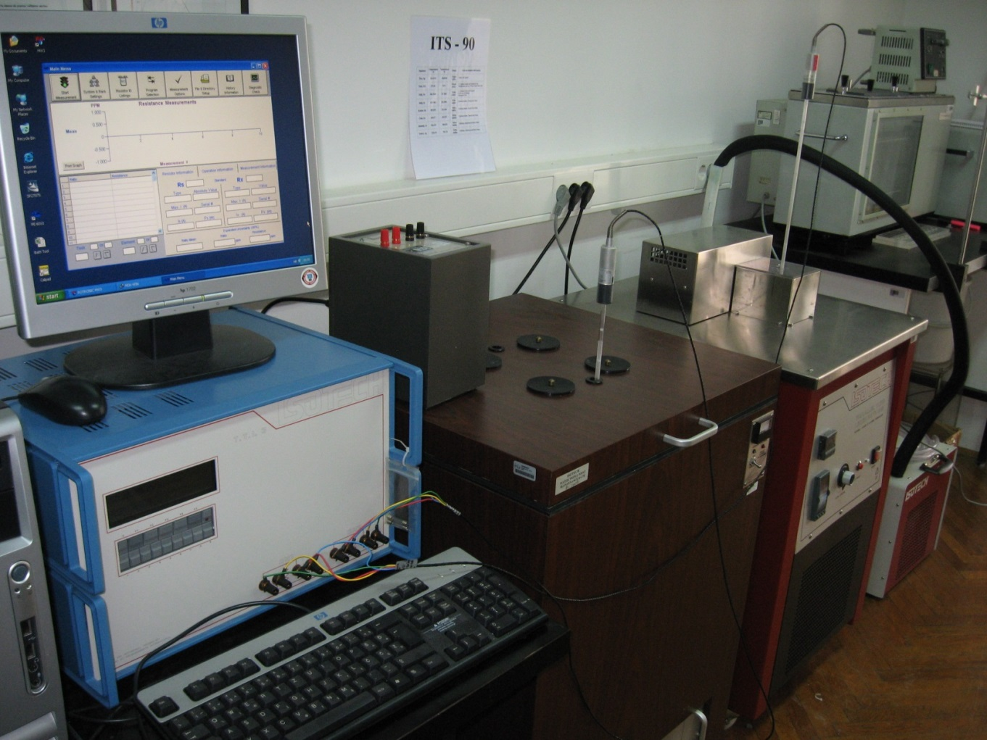
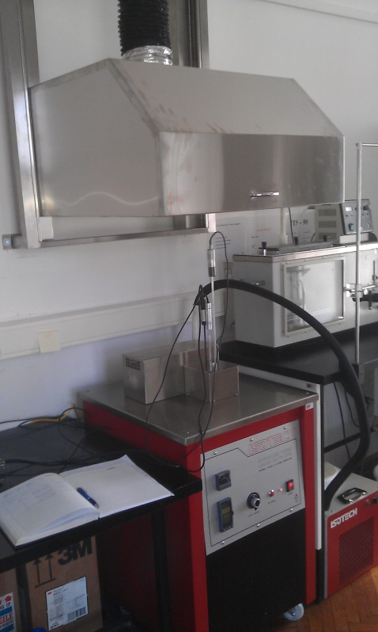
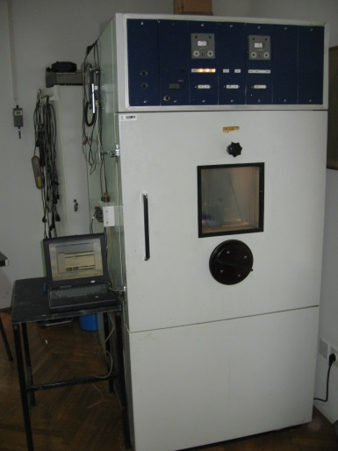
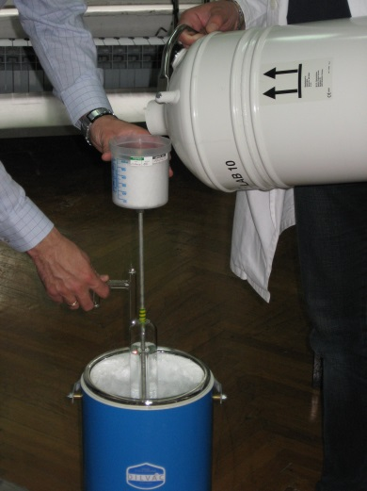
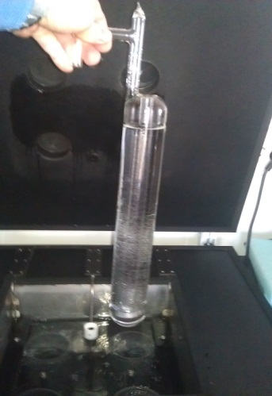
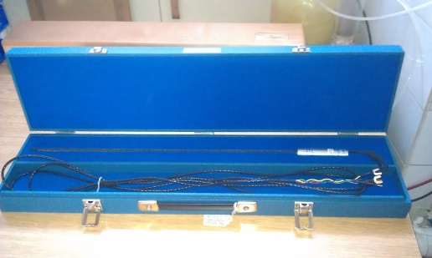
CL Facilities: Temperature (-60 – 200 °C)

Slide 3
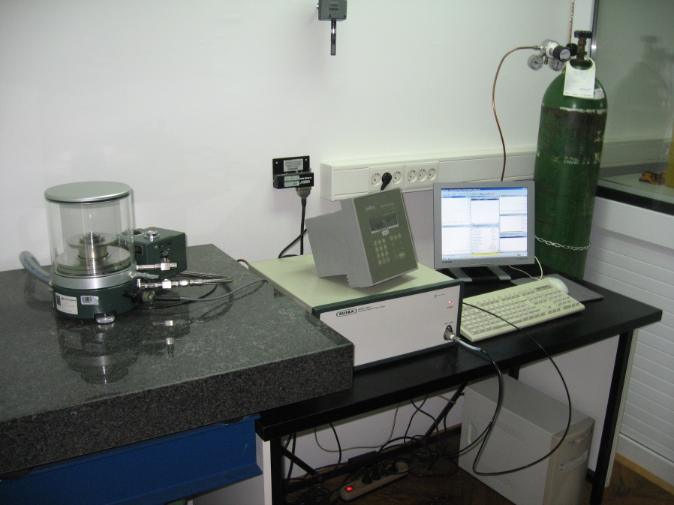
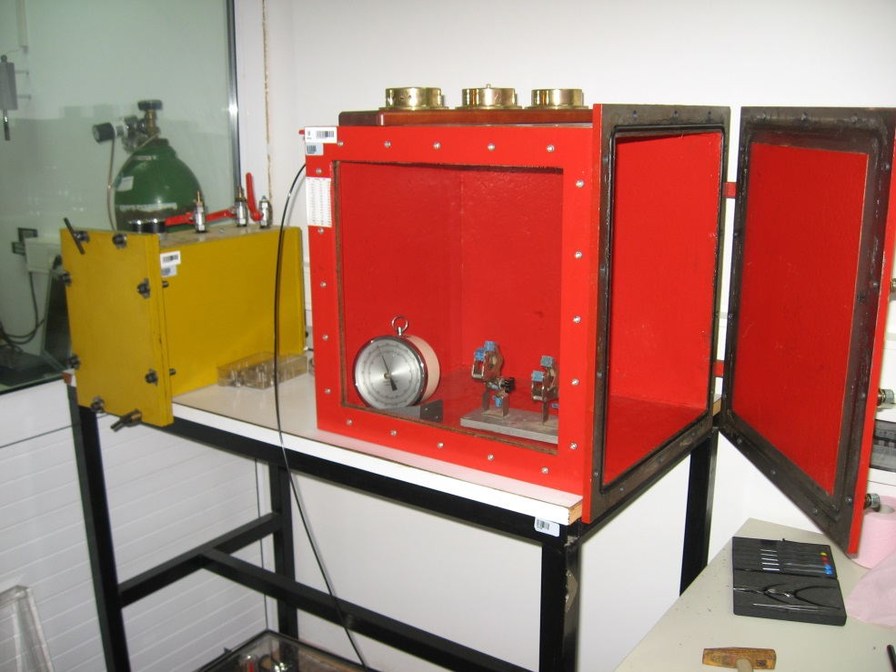
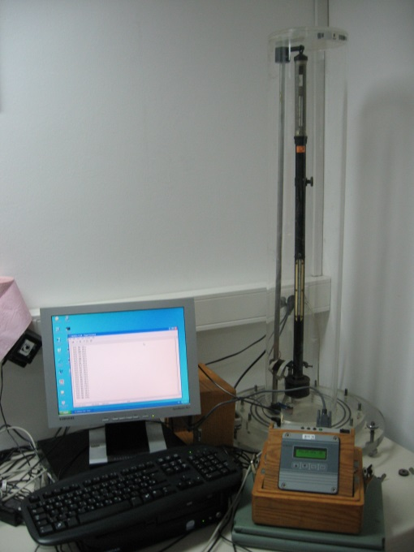
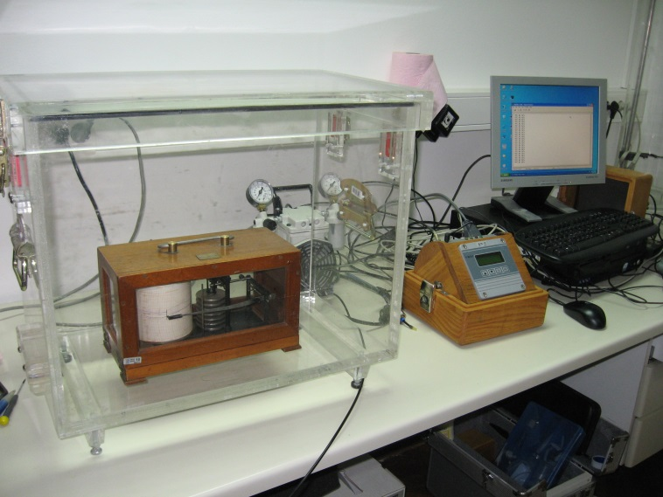
CL Facilities: Pressure (50 – 1400 hPa)

Slide 4
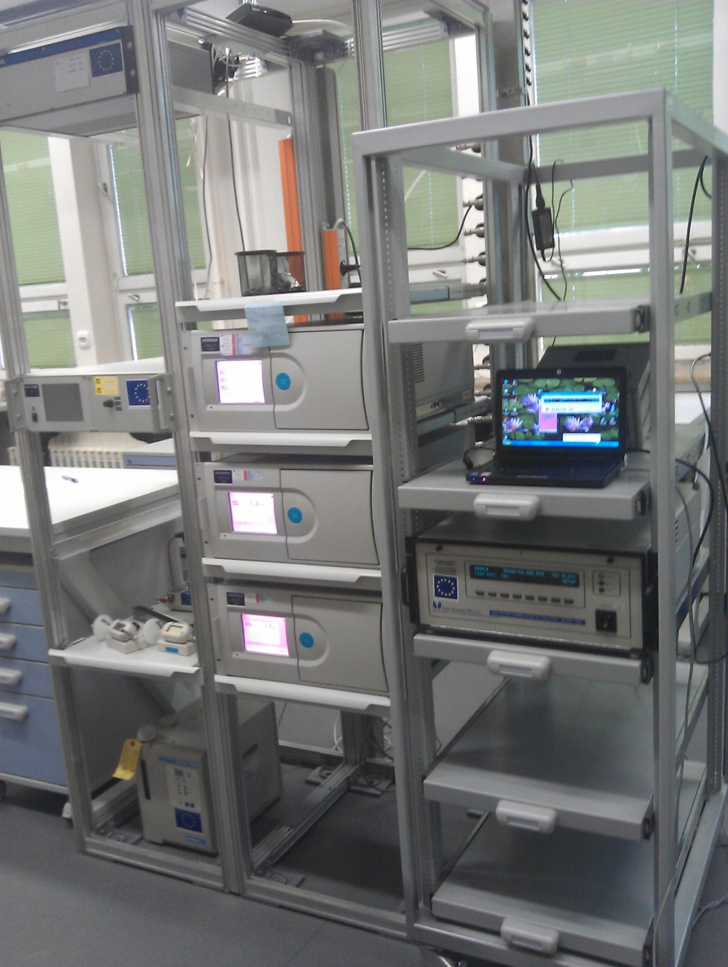
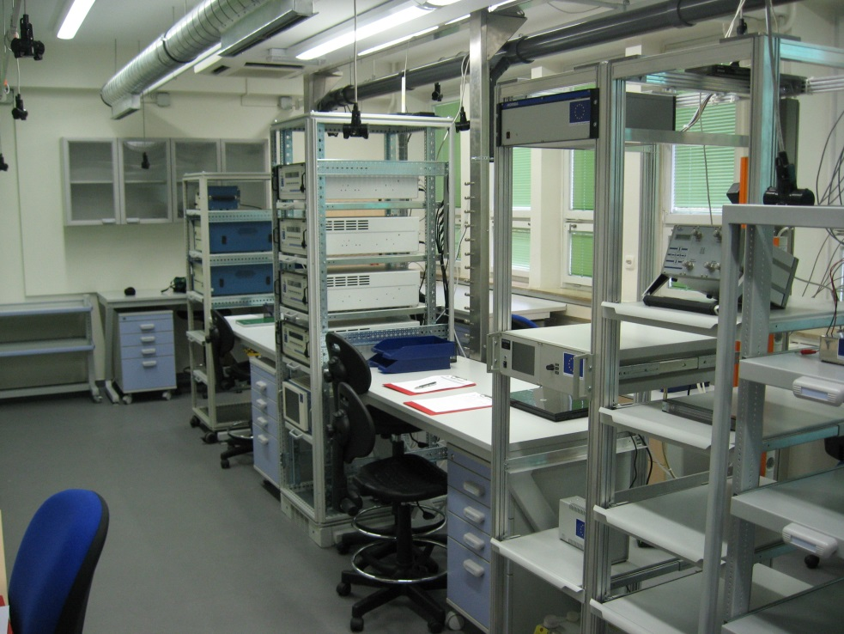
CL Facilities:
CO, SO2, NO (NOx) analyzers
CO: 0-70 000 nmol/mol
SO2: 0-300 nmol/mol
NO(NOx): 0-800 nmol/mol

Slide 5
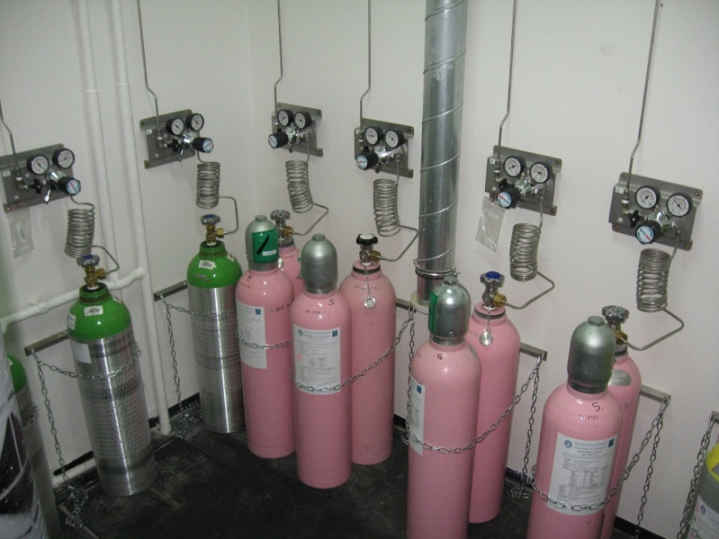
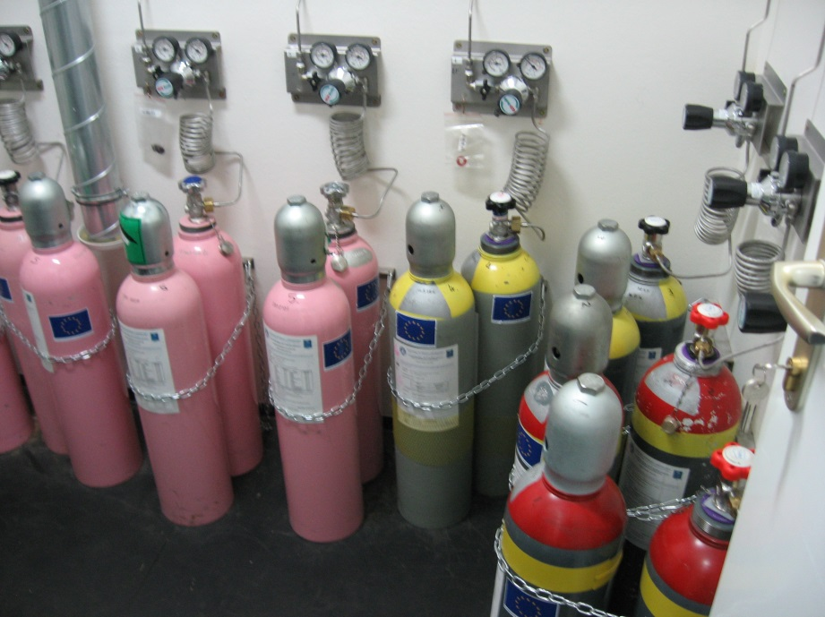
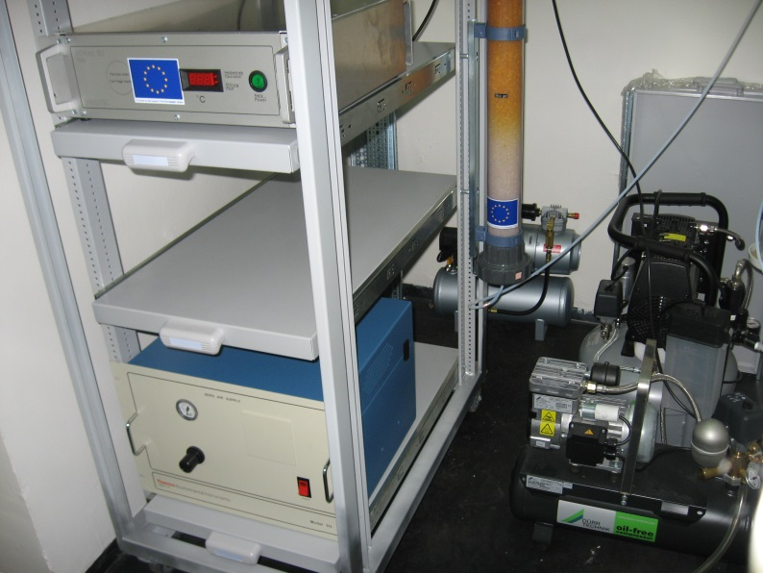
CL Facilities: Gas mixtures
CO: 200-70 000 nmol/mol
SO2: 2-300 nmol/mol
NO: 2-800 nmol/mol

Slide 6
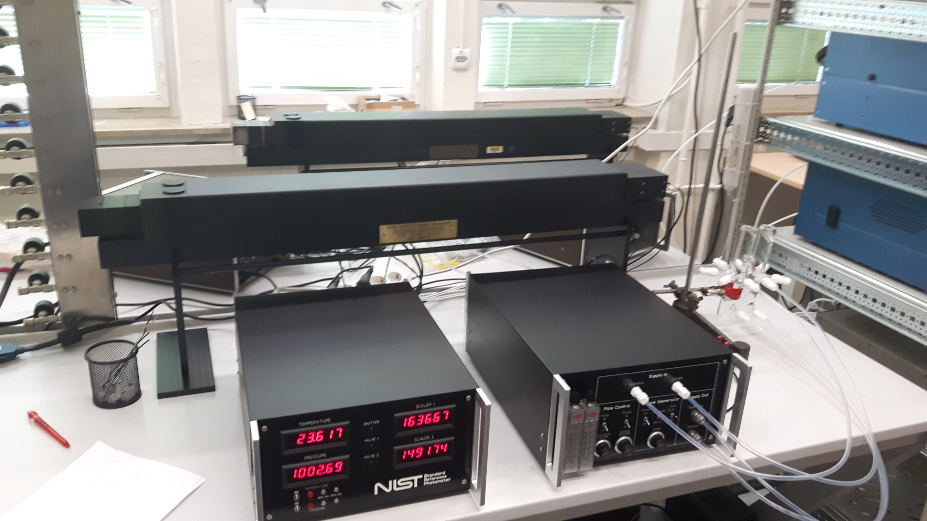
CL Facilities: Surface ozone
(0 - 1000 nmol/mol)

Slide 7
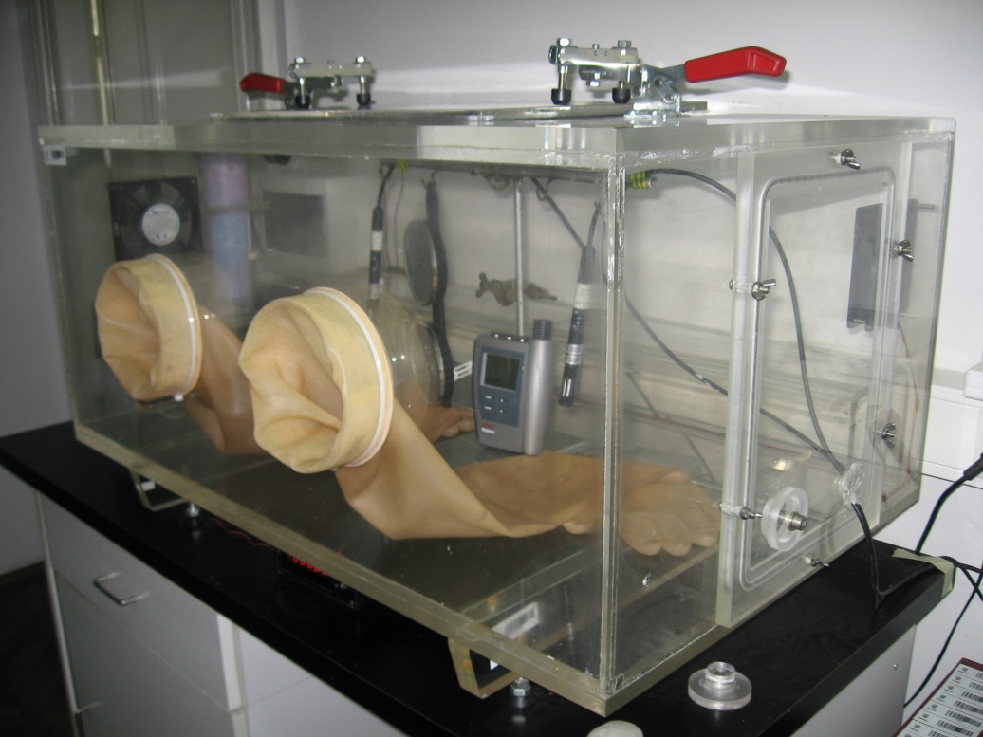
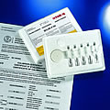
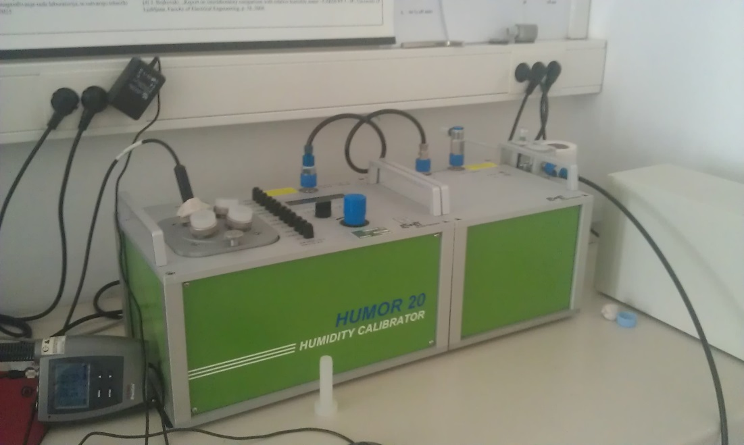
CL Facilities: Rel. Humidity (10-95 %)

Slide 8
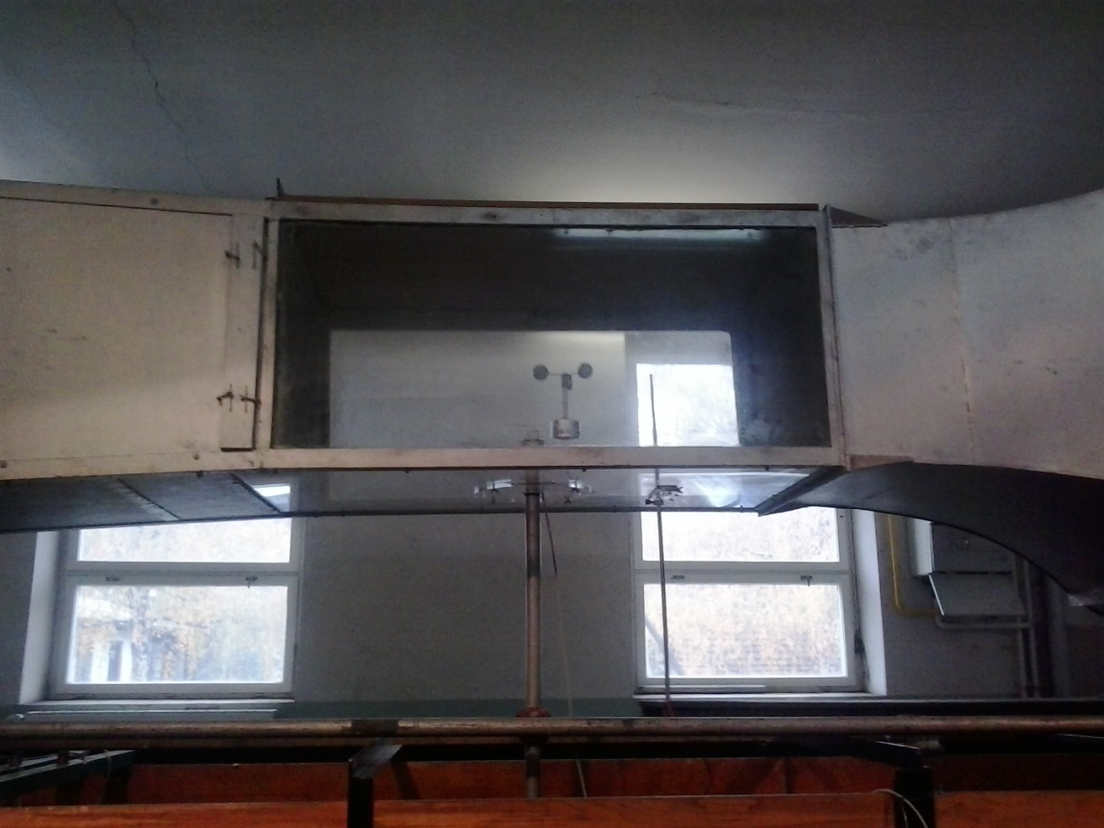
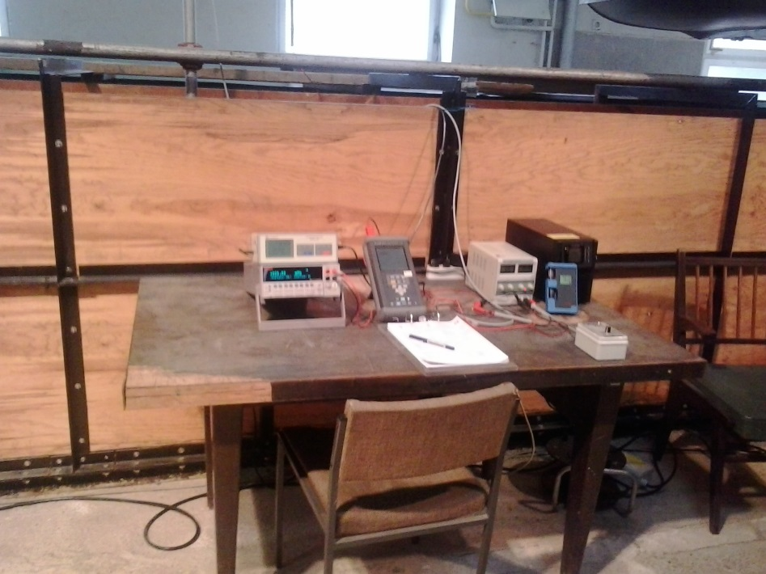
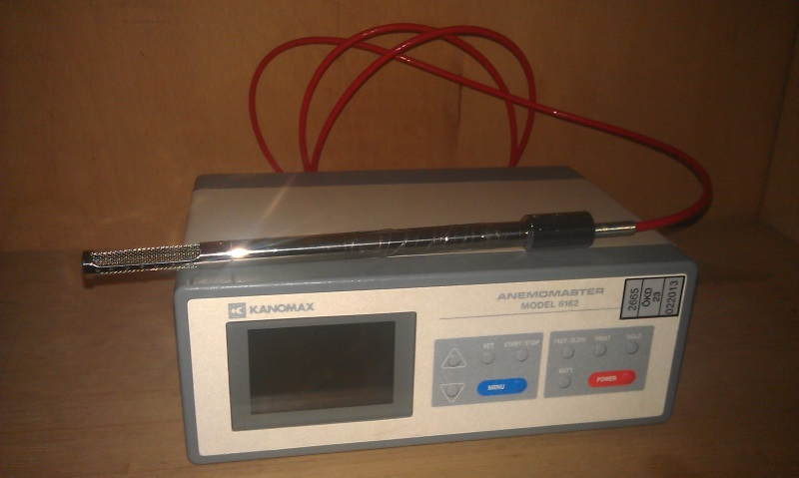
CL Facilities: Wind speed (0-40 m/s)
EkoPark Kraš, Zagreb, Croatia, 8-10 July, 2013

Slide 9
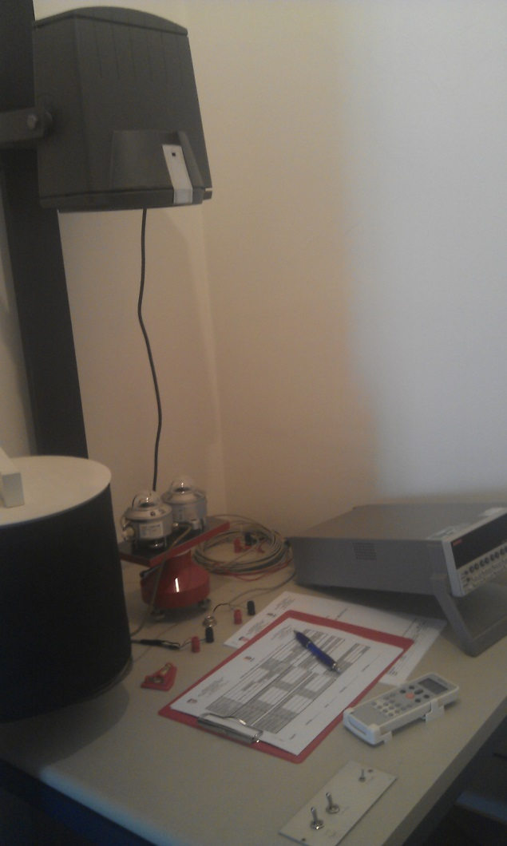
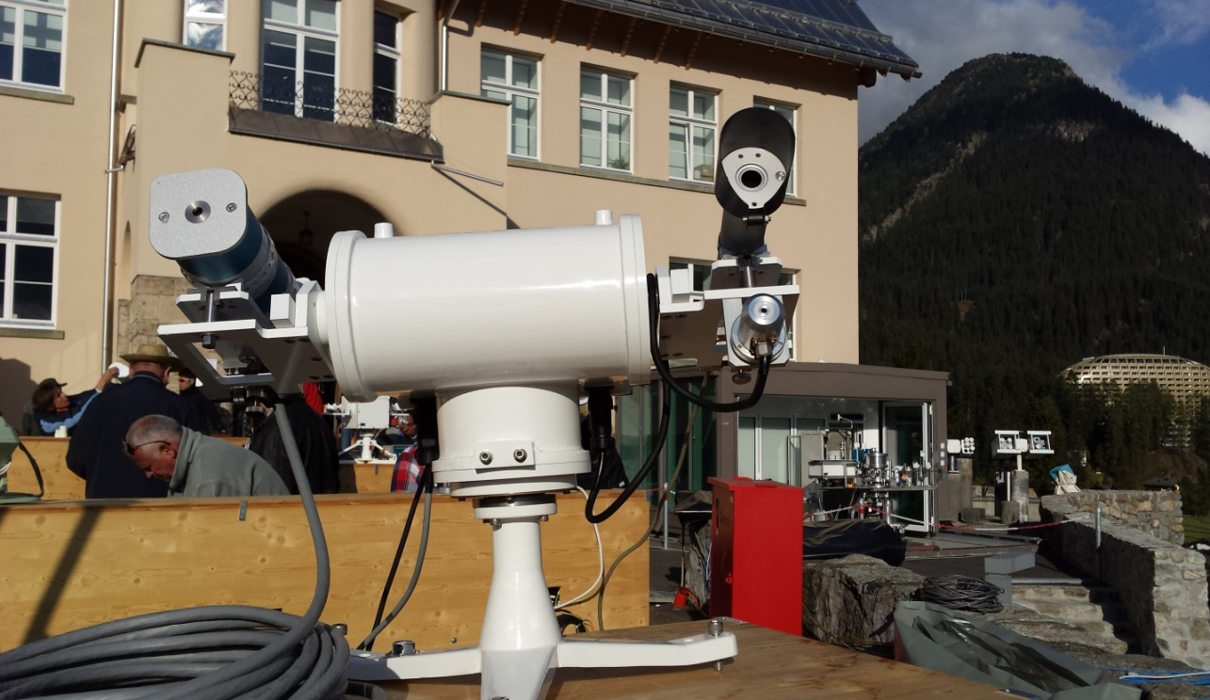
CL Facilities: Solar radiation (0-1400 W/m2)

Slide 10
CL –Traceability Assurance to SI:
- Throughout the accredited calibration laboratories, national (NS) / regional (RS) / world standards (WRC)
Parameter | CL | C | Holder
Temperature | University of Lj, - FE-LMK | SLO | NS
Re. Humidity | E+E, Linz | A | NS
Pressure | University of Zg, FSB-LPM | HR | NS
Wind speed | E+E Linz | A | NS
Solar radiation | PMOD – Davos | CH | WRC
Surface ozone | DHMZ - SRP | CZ | NS
Carbon monoxide | UBA, Vienna | A | NS
Air Quality (NOx, SO2) | Linde AG, Munich ČMI - Brno | D, CZ | NS

Slide 11
Interlaboratory Comparisons:
WMO (IOM 91) – X International Pyrheliometer Comparison, WRC PMOD Davos, Switzerland (2005)
WMO (IOM 98) – Sub-Regional Pyranometer Intercomparison of the RA VI members from South-Eastern Europe – DHMZ, Split, Croatia (2007)
CARDS 2006 – Report on the interlaboratory comparison with relative humidity meter – MIRS/FE-LMK Ljubljana, Slovenia (2008)
CARDS 2006 – Report on the interlaboratory comparison with digital thermometer – MIRS/FE-LMK, Ljubljana, Slovenia (2008)
WMO - Interlaboratory comparison in the south-eastern part of WMO RA-VI using calibration kit (temperature, relative humidity, pressure) – RIC Ljubljana, Slovenia (2008)
WMO (IOM 108) – XI International Pyrheliometer Comparison, WRC PMOD Davos, Switzerland (2010)

Slide 12
Interlaboratory Comparisons:
WMO (IOM 108) – XI International Pyrheliometer Comparison, WRC PMOD Davos, Switzerland (2010)
EARS/DHMZ – Interlaboratory Comparison on O3 Report, RIC Ljubljana, Slovenia (2011)
EC/JRC - Evaluation of Laboratory Comparison Exercise for SO2, CO, O3, NO and NO2, Ispra, Italy (2011)
IPA 2011 - Report on the interlaboratory comparison with SPRTs – MIRS/FE-LMK, Ljubljana, Slovenia (2013)
WHO/JRC – Intercomparison Workshop on Air Quality Monitoring CO, NO/NO2,SO2 and O3, Langen, Germany (2013)
DHMZ/ARSO – Interlaboratory Comparison on Air Quality, (2014)
EC/JRC - Evaluation of Laboratory Comparison Exercise for SO2, CO, O3, NO and NO2, Ispra, Italy (2015)
WMO (IOM 108) – XI International Pyrheliometer Comparison, WRC PMOD Davos, Switzerland (2015)

Slide 13
Thank you

