Slide 1
WIGOS Workshop for RA VI with Focus on
Marine Meteorological and Oceanographic Observing Requirements
Split, Croatia, 5-7 September 2016
WIGOS Data Quality
Monitoring System (WDQMS)
Krunoslav Premec

Slide 2
Outline
Background
Plan for WIGOS Pre-Operational Phase (PWPP)
WIGOS Data Quality Monitoring System (WDQMS)
WIGOS Quality Monitoring and Performance Targets
WIGOS Evaluation Functions
WIGOS Incident Management Procedure
WDQMS Demonstration project in RA I
Summary

Slide 3
Background (I)
The highest priorities for the WIGOS Pre-operational Phase
(2016-2019):
National WIGOS implementation;
WIGOS Regulatory Material complemented with necessary guidance material to assist Members with the implementation of the WIGOS technical regulations;
Further development of the WIGOS Information Resource (WIR), with special emphasis on the operational deployment of the Observing Systems Capability Analysis and Review (OSCAR) databases;
Development and implementation of the WIGOS Data Quality Monitoring System; and
Concept development and initial establishment of Regional WIGOS Centres.

Slide 4
Background (II)
Proposed by ECMWF and WMO:
The 1st Workshop on Observational Data Quality Monitoring
(10-12 December 2014, Geneva, Switzerland)
Organised as a part of the ongoing revision of the performance monitoring for the Global Observing System (GOS) and the WIGOS Quality Management activities, with focus on:
the modernisation of the NWP-based monitoring of data availability,
observational data quality, and
the development of a framework and procedures for the identification, documentation and rectification of various issues revealed by this type of monitoring.

Slide 5
Background (III)
With the primary aim of discussing and refining the development of the Quality Monitoring and Incident Management pilot projects:
The 2nd WIGOS Workshop on Quality Monitoring (QM) and Incident Management (IM), was held
(15 to 17 December 2015, Geneva Switzerland).
A significant outcomes:
- Quality Evaluation was added to QM and IM functions of WDQMS
- the detailed plans and recommendations for GOS implementation of WIGOS, including the plan for a Demonstration Project in RA I.

Slide 6
Background (IV)
The 5th Session of the Inter-Commission Coordination Group on the WMO Integrated Global Observing System (ICG-WIGOS-5)
(25 to 28 January 2016, Geneva, Switzerland)
Task Team on WIGOS Quality Management
(TT-WQM)
Task Team on WIGOS Data Quality Monitoring Systems
(TT-WDQMS)

Slide 7
Background (V)
TT-WDQMS Terms of Reference:
1) Develop the concept and provide technical support to the implementation of the WIGOS Data Quality Monitoring System (WDQMS), including the three basic components:
a) a monitoring function for data availability and data quality (QM),
b) an analysis and evaluation function (Ev),
c) an incident management function (IM);
2) Ensure that the WDQMS will be:
a) applicable to all WIGOS observing components,
b) fully interoperable with OSCAR (Observing Systems Capabilities Analysis and Review) – the monitoring tools to be integrated with OSCAR, to the possible extent;
3) Develop appropriate pilot and demonstration projects (depending on available funding) in order to test and consolidate the concept of the WDQMS;
4) Report to ICG-WIGOS on the development and implementation of the WDQMS;
5) Propose updates to the Manual on WIGOS needed for the implementation of the WDQMS;
6) Develop WDQMS related guidance material.
Members:
Mr Stuart Goldstraw (UK), Chair; Mr Robert Grumbine (USA); Ms Estelle Grüter (Switzerland); Mr Henry Karanja (Kenya); Mr Timothy Oakley (UK); Mr Yukinari Ota (Japan); Ms Cristina Prates (ECMWF).

Slide 8
PWPP (I)
In accordance with Plan for WIGOS Pre-Operational Phase (2016-2016) Annex to Resolution 5.1.(1)/1 (EC-68)
In regard to WDQMS, the key priority is:
development of a modern and efficient performance monitoring and reporting system for observational data availability and data quality.
Deliverables (…):
By the time of Congress-18 in 2019, the WIGOS framework will have been completed, encompassing:
WDQMS concept tested and consolidated. Observational data quality monitoring practices and procedures defined, incorporated in the WIGOS Regulatory Material and WIGOS Data Quality Monitoring System implemented;
Outcomes (…):
(i) Progressively improved availability and quality of WIGOS observational data and metadata.

Slide 9
WDQMS (I)
Modern and efficient performance monitoring and reporting system for observational data availability and quality.
Essential for measuring the effectiveness and impact of WIGOS, and for developing robust incident management practices that will lead to improved WIGOS data quality and availability.
How well is WIGOS functioning?

Slide 10
WDQMS (II)
1. WIGOS Quality Monitoring Function:
Essentially provided by Global NWP Centres, who have been working on monitoring reports, as a by-product of the data assimilation process;
Several additional NWP Centres (e.g. DWD, JMA) expressed their interest in joining ECMWF and NCEP the efforts.
2. WIGOS Evaluation (and reporting) Function:
Takes the QM outputs from contributing centres, extracts metadata from OSCAR, and generates routine reports based on performance indicators (e.g. compared with the status in OSCAR).
It will determine if the issues identified justify to formalize them as Incidents with the data provider. A semi-automated Global Centre is planned to provide routine reports and make available specific info to regional/thematic centres.
3. WIGOS Incident Management Function:
If the issues considered by the Evaluation function merit being raised as Incidents, this will be undertaken by the Incident Management Function.
Key to the success of this function will be the clear communication of incidents with the data providers and with data users to ensure they take suitable precautions regarding the affected data.

Slide 11
WIGOS Quality Monitoring (I)
Focus on the measurement of the performance of the system against a set of targets (the functional specifications of GOS). The categories:
Data availability (No. of observations provided / No. of observations scheduled in OSCAR/Surface, %);
Timeliness (the delay between the observation time and reception of the data by the users, min);
Accuracy - measurement uncertainties (mainly derived from O – B NWP results from Global NWP Centres for particular parameters (p, T, v, w-dir, RH; RMS error);
Discrepancies in metadata (OSCAR/Surface to BUFR reports);
Discrepancies in encoding (TAC,TDCF, BUFR);
Suspicious values of particular parameters.

Slide 12
WIGOS Quality Monitoring (II)
WDQMS Performance Targets have to be agreed and based on:
WMO Guidance (e.g. inputs from CBS/IOS ET-EGOS);
WMO requirements on Global and High-Resolution NWP, Nowcasting and Climate Application Areas (as indicated in OSCAR);
OSCAR/Surface – official repository of metadata required for international exchange;
Requirements from WMO Members and data users;
Constraints of WMO Members.

Slide 13
WIGOS Quality Monitoring (III)
General terms used:
The “threshold" is the minimum requirement to be met to ensure that data are useful.
The "goal" is an ideal requirement above which further improvements are not necessary.
The "breakthrough" is an intermediate level between "threshold" and "goal" which, if achieved, would result in a significant improvement for the targeted application. The breakthrough level may be considered as an optimum, from a cost-benefit point of view, when planning or designing observing systems.

Slide 14
Performance targets: Surface Synoptic Land Stations
WIGOS Quality Monitoring (IV)
Surface Synoptic Land Stations
Parameter | Target (TR) | Comment
Pressure (hPa) | 1.0 hPa | Network average of monthly RMSE
Temperature (K) | 1.0 K | Network average of monthly RMSE
Wind Vector (m/s) | 4.0 m/s | Network average of monthly RMSE
Specific Humidity (%) | 10 % | Network average of monthly RMSE
Data availability: Percentage of observations received from Network | 95% | Total monthly availability from the surface land station network according to the daily schedule as outlined in OSCAR/Surface
Timeliness: % received by HH+100 HH+50 | 95% 90% (BR) | Targets relate to percentage of data actually received, not expected.

Slide 15
WIGOS Quality Monitoring (V)
Web tools and Automated Daily Quality Monitoring Reports:
Global NWP:
to produce automated data availability and monitoring reports (3-h; 6-h, or daily basis);
to make available and maintain these reports in appropriate Web-tools.
RWC:
to use these reports for daily quality monitoring, evaluation, and to identify issues and raise an incident.

Slide 16
WIGOS Quality Monitoring (VI)
Web-monitoring tools: WIGOS Quality Monitoring Web-tool http://128.65.196.37/wdqms Purpose: to be used for daily quality monitoring and evaluation OSCAR/Surface https://oscar.wmo.int/OSCAR Purpose: to identify (non-)compliance in station metadata information
ECWMF Wiki page ‘Demonstration Project’ https://software.ecmwf.int/wiki/display/WIGOS/Demonstration+Project Purpose: to identify silent stations (RA I)
WMO Quality Monitoring Portal operated by EUMETNET https://eucos.dwd.de/ravi Purpose: to identify stations providing less data than required

Slide 17
WIGOS Data Quality Evaluation (I)
Regional WIGOS Centre (RWC):
To evaluate the performance of all synoptic surface land stations and territorial radiosonde stations of all countries of RA on a daily workday’s basis.
How?
to check available web-tools and quality monitoring reports (yesterday’s ↔ to previous days’ performance);
to identify non-compliances;
to raise and issue ticket (if needed);
to check performance of stations with users’ raised issue;
to check status of identified issues;
to monitor status of raised incident reports;
to close an IM ticket, as appropriate.

Slide 18
WIGOS Incident Management
IM Procedure relies on clear identification of roles and responsibilities.
Essential:
Contacts for each county of the Regional Association are clearly defined and are responsible for ensuring that corrective action is taken once requested by RWC.
Beneficial:
To have generic email addresses of persons available for each country who are accessible by all national contact points to ensure that several persons can be informed about the incident at once.

Slide 19
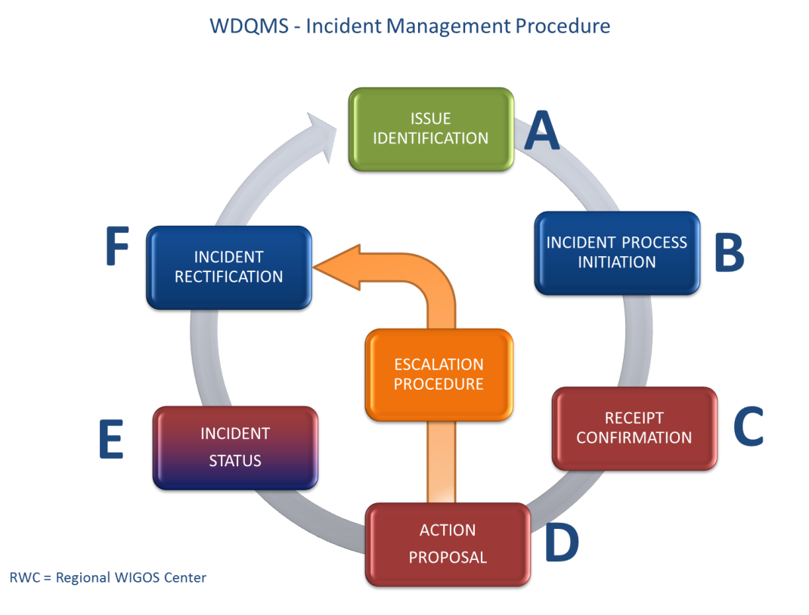
WIGOS IM procedure steps

Slide 20
WIGOS IM Ticket
A | The name of the person and organization who raised the issue, including contact details (email address)
 | Station details in particular WMO ID and network type, stations name and country
 | A full description of the issue, including the dates of the issue firstly being identified, characteristics of the issue, category of incident type (examples: availability of data, quality of data), source observing systems identified and application areas impacted by the issue.
B | A unique reference number for the incident
 | Date of incident creation (process initiation)
 | Priority level assigned to incident (low, medium, high, very high)
 | Information/comments after reception of issue identification by the RWC if no process initiation is required
C | Receipt confirmation from concerned national contact including date/time, name of recipient and potential comments
D | Action proposal to be completed by national contact containing date/time, name of responsible focal point and details of proposed action including timeline to solve the incident and additional comments
E | A record of the activities undertaken to resolve the incident, by whom and when – essentially a work log of the tasks undertaken during the lifetime of the ticket.
F | Status of the incident (examples: Open (after process initiation) / In Progress (after action proposal) / Closed)

Slide 21
WDQMS Demonstration Project RA-I
Demonstration project in RA I, started operations 4 July 2016 with Kenya (KMD) and Tanzania (TMA):
https://sites.google.com/a/wmo.int/wdqms-demo-ra-i/home

Slide 22
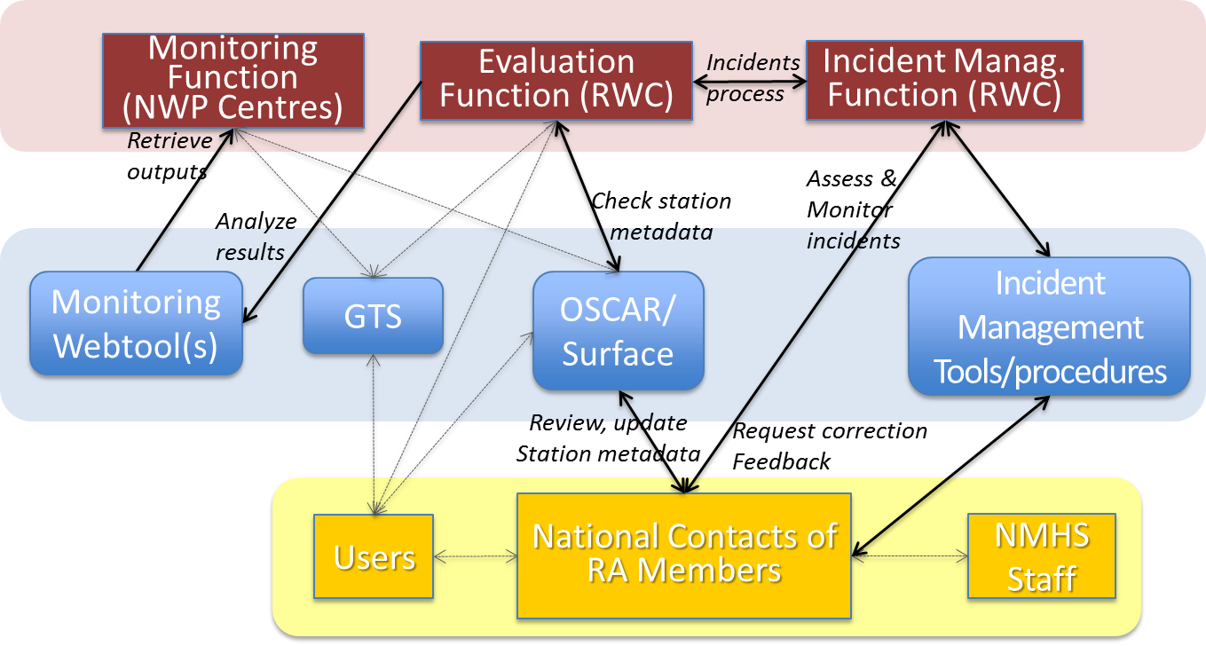
Summary: Process of WDQMS

Slide 23
Summary: detailed process of WDQMS

Slide 24
Thank you

