Slide 1
WIGOS Workshop for RA VI with Focus on
Marine Meteorological and Oceanographic Observing Requirements
Split, Croatia, 5-7 September 2016
Purpose of the Workshop
Ivan Cacic
President of RA VI (Europe)

Slide 2
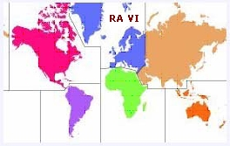
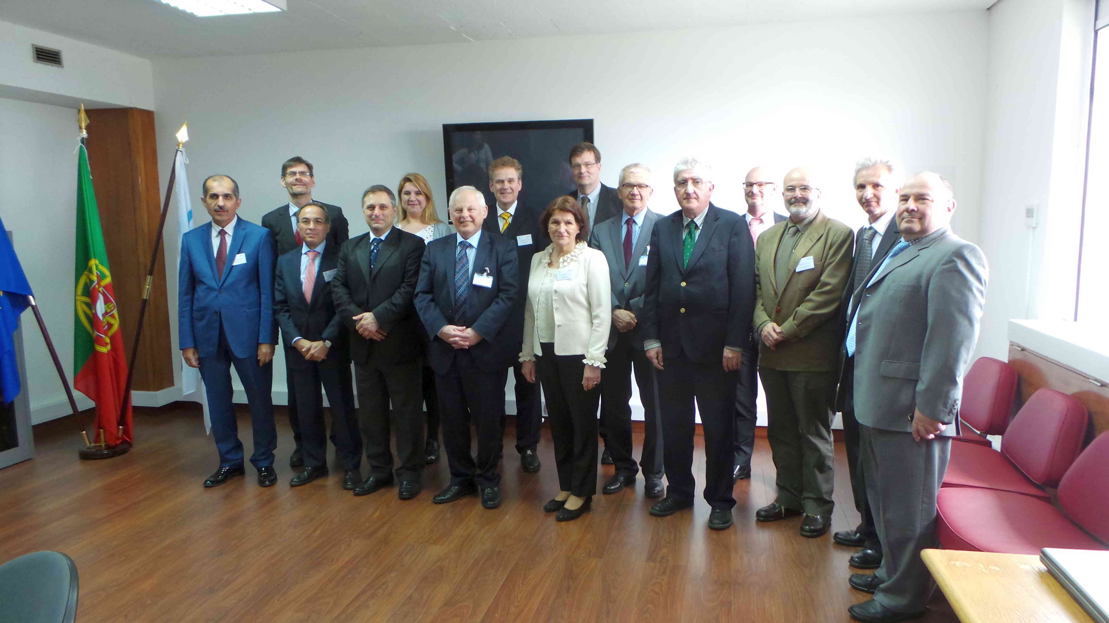
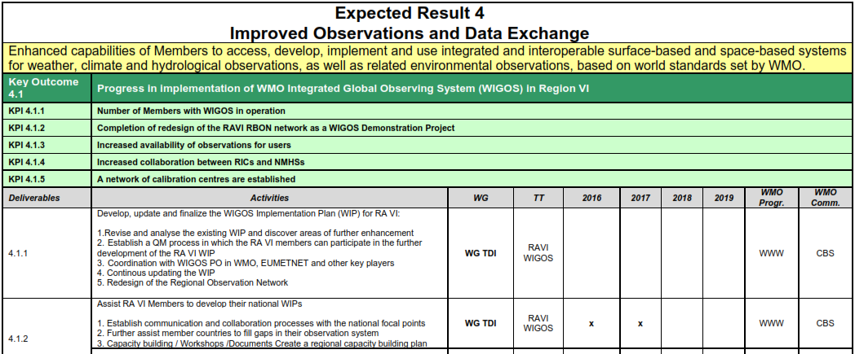
Key points 1/2
Contribution to the process of the RA-VI and global WIGOS Implementation respecting complementary WIS environment
Milestone towards RA VI 2017 session in Croatia, in accordance with the
RA VI Management Group decisions
To establish a RA VI Regional WIGOS Centers (RWC)
as a network of contributing NMHSs (virtual center structure)
To establish a “proof of concept” phase in setting-up of
RWC-Network
RA VI Operational plan 2016 - 2019
for
Regional WIGOS Centre development through virtual center structure assigned to Members / NMHSs represented in the RA VI TT on WIGOS that will start to work as a “nut shell” - with reduced set of functions and geographical coverage
National WIGOS implementation
what is (at the RA VI level) under
responsibility of the RA VI Task Team on WIGOS
supervision of the RA VI Working Group on Technology Development and Implementation
RA VI 4th RA VI MG Meeting
Lisbon, Portugal, April 2016

Slide 3
Key points 2/2
Kick-off for consolidation of
internal NMHSs disunite network starting with the marine and oceanographic monitoring
disunite marine and oceanographic monitoring networks of NMHSs and partner organizations on national and sub-regional level
Integration and quality monitoring of marine and oceanographic measurement
Enhancement of the WIS-DCPC Marine Meteorological Centre for the Adriatic Sea Area by the
upgrade to the RWC (Regional WIGOS Marine / Ocean Centre)
strengthening national boards on
marine meteorological and oceanic infrastructure of common interest
(in Croatia started as JOZO 1)
marine / oceanographic modeling (in Croatia started as JOZO 2)
development of a Regional Marine Instrument Centre
Development of RWC for the Adriatic Sea Area also as a template for other regions (closed seas, gulfs,...)

Slide 4
Thank you

