Slide 1
RA-VI Task Team on WIGOS Implementation Outcomes and Recommendation (Belgrade November 2015)
WIGOS Workshop on Marine Meteorological and Oceanographic Observing Requirements, Split, Croatia, 5-7 September 2016
Ivan ČAČIĆ
President WMO RA VI
Ercan BÜYÜKBAŞ
TT-WIGOS Leader, Assistant Director TSMS
Milan DACIĆ
WMO Representative for Europe

Slide 2
RA VI TT-WIGOS and Friends

Slide 3
Some links:
RAVI-TT-WIGOS-3-XVI Meeting Report: http://public.wmo.int/en/events/meetings/ra-vi-task-team-wigos-implementation-third-meeting-xvi-inter-sessional-period-ra-vi
List of Decisions from TT-WIGOS-3 Meeting https://drive.google.com/open?id=1zNWgfhUbBb3-FMpftVqeyEM6xP4QtlQloZPNg02UsrQ
WIGOS Internet forum: https://groups.google.com/a/wmo.int/forum/#!forum/wigos-ra-vi

Slide 6
TT-WIGOS decided to establish the following break-out groups that will continue collaboration after the meeting:
Group on Update of R-WIP-VI: Ercan Büyükbaş, Olaf Schulze, Fernando Belda Esplugues, Alper Çubuk
Group on ToR of RWC in a nutshell: Dieter Schröder, Stefan Klink, Luis Nunes, Simon Gilbert:
improved content of OSCAR/Surface
~2 to 3 electronic meetings per months till end of 2016
concept paper on station metadata consistency checks
TECH_3 to be carried out by DWD (Rainer März)
Wiam and Ercan volunteer to check their national database with the help of OSCAR
WIGOS Data Quality Monitoring System
EUCOS (Tanja Kleinert?) will be responsible for trainings for TECH_2_2 volunteers
TECH_2_1: Stefan’s team
TECH_2_2: Kemal
non-EUMETNET Members: Serbia, Turkey, BiH
Group on Concept of RWCs: Dieter, Stefan, Simon, Miroslav
Group on Development of a template for N-WIPs: Kemal, Wiam, Özden, Cihan

Slide 7
The TT-WIGOS meeting:
urges experts in RA VI to make use of the WIGOS Internet forum that can be accessed here: https://groups.google.com/a/wmo.int/forum/#!forum/wigos-ra-vi
recognizes that review, revise and update of the R-WIP-VI could and should have influence up-stream on the global WIP and therefore all other R-WIPs.

Slide 8
The meeting of the sub-TT on Radar Data Exchange:
notes that RWC are not identical with regional radar centres even though some tasks could be carried out or supported by RWCs.
considers to approach the OPERA consortium in parallel to other advances to promote establishment of a “RA VI unified met infrastructure”.
considers to follow good practices and guidelines of OPERA in the establishment of sub-regional networks.
notes that the sub-TT currently prepares a draft proposal on radar data exchange

Slide 9
1. Introduction
As one of the five priority areas for WIGOS Pre-Operational Phase for 2016-2019 period, Regional WIGOS Centers (RWCs) will be an important tool and a milestone for the efficient implementation of WIGOS at regional and national level.
RWCs will play a key role for the implementation of WIGOS successfully at global, regional and national level by assisting the Members, and as functioning a communication and coordination mechanism among all related bodies of WIGOS implementation.

Slide 10
2. Objectives of Proposal for RWC
a) to raise and expand the awareness of WIGOS concept among the Members
b) to provide support for the implementation of WIGOS in RA-VI
c) to assist the Members to develop and implement their National WIGOS Implementation Plan (N-WIP)
d) to make the coordination and communication among all related bodies such as the Members, RA-VI MG, ROE, WIGOS Project Office (WIGOS PO), RWCs of other Regions, Technical Commissions (TCs), etc.
e) to ensure the sustainability of WIGOS implementation in RA-VI

Slide 11
3. The Main Tasks and Functions of RWC
1) To organize and coordinate WIGOS related activities and develop necessary tools (e.g. newsletter, workshop, training, introductory videos, web pages, etc.) for raising awareness of WIGOS concept among the Members.
2) To provide the guidance and information, e.g. a template for N-WIP, good practice examples, requested by Members to develop and implement their N-WIPs.
3) To encourage the Members to implement WIGOS metadata standards, and to use and support OSCAR/Surface for maintaining WIGOS metadata.

Slide 12
3. The Main Tasks and Functions of RWC
4) To cooperate with other RWCs in both Region VI and other Regions for achievement of common and sufficient level for WIGOS implementation.
5) To act as a hub for maintaining the communication among the related entities.
6) To provide guidance and assistance for designing, operating, integrating and status monitoring of observing networks operated by the Members.

Slide 13
3. The Main Tasks and Functions of RWC
7) To provide guidance how to involve the observing systems, operated by third parties other than NMHSs, in WIGOS.
8) To support the activities for re-design of regional observing networks.
9) To support and coordinate the WIGOS related projects in Region VI.

Slide 14
3. The Main Tasks and Functions of RWC
10) To provide a platform for the Members to consult on the WIGOS issues. (a kind of help desk; online or offline)
11) To monitor the status of regional observing networks in real (or near real) time (optional similar to EUCOS monitoring)
12) To act as radar data center of sub-regional radar network to generate and distribute composite products (optional)
13) Support countries with WIGOS Data Quality Monitoring

Slide 15
4. Requirements and Capabilities of RWC
a) having necessary IT infrastructure to perform the required functions.
b) being able to assign sufficient human resources of administrative and technical staff for carrying out the tasks for RWC.
c) having financial resources for fulfilling its functions.
d) sustaining its assignment for future period.
e) developing and operating a web page for easy access of its facilities by the users.

Slide 16
4. Requirements and Capabilities of RWC
f) being open for the assessment of its capabilities and functions in certain interval.
g) cooperating with other Regional Centers of WMO in Region VI, e.g. Regional Training Center (RTC), Regional Instrument Center (RIC) to get benefit from them and to contribute their activities as well.
h) being in close cooperation with related Regional entities and ROE for performing its functions efficiently.
i) developing and maintaining the collaboration with other RWCs in Region VI and in other Regions of WMO as well.

Slide 17
5. Other Remarks
More than one RWC in sub-regional basis can be established to cover whole Region.
Tasks required from a RWC could be shared between RWCs.
The responsibility for required resources for RWCs could be shared among the Members.

Slide 18
Proposed functionalities of RWC (following RA-VI Workshop on WIGOS, Belgrade, November 2015)
Coordination (if implemented as Virtual Center involving more than one NMHSs)
Overarching coordination and communication with all RWCs in the Region, WMO Regional Office, relevant RA Working Groups and Task Teams RA, WMO Secretariat
Communication … and more (Problem Management).
Act as Regional information resource for Members concerning various aspects of WIGOS implementation
Collect and document regional experience with WIGOS implementation and its benefits
Support for education & training in WIGOS implementation, especially concerning
Establishment of partnerships
WIGOS metadata management (OSCAR/Surface)

Slide 19
Proposed functionalities of RWC (continued)
Technical Support
Regional network management (network design and coordination)
Regional data monitoring & data quality management (WDQMS)
Regional metadata management (OSCAR/Surface)
(Support concerning national data management)*
Linking WIGOS to external entities/ establishing partnerships
Establishing and maintaining links with Regional Oceanographic Groups
Establishing and maintaining links with Regional Climate Centres
Establishing and maintaining links with Regional Instrument Centres
Establishing and maintaining links with Regional Hydrological Groups

Slide 20
Thank you
Hvala

Slide 21
Possible implementation of RWCs (following RA-VI Workshop on WIGOS, Belgrade, November 2015)
Difficult for most NMHSs to identify new resources for such entities of RWC
However, it is felt that it would be attractive for many Members to take on responsibility for one or more functionalities
In RA-VI:
RWCs could be implemented as virtual centers, where a group of NMHSs would share the relevant tasks between them under the overall coordination of one of them (illustrated in the next slide)
RWCs need not cover the Region as a whole; tasks could be shared between Regional WIGOS Centers covering subregions, with areas of responsibilty aligned with existing geographic or linguistic boundaries within the Region
In RA-VI, the existing EUMETNET activities could be strengthened and broadened to encompass several intended RWC functionalities at the WMO level

Slide 22
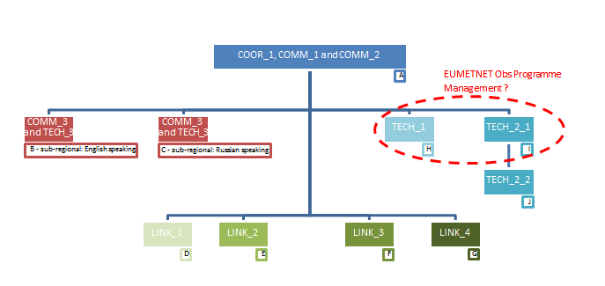
Structure of (virtual) RWC in RA VI

Slide 23
Proposed functionalities of RWC (following RA-VI Workshop on WIGOS, Belgrade, November 2015)
Coordination (if implemented as Virtual Center involving more than one NMHSs)
Overarching coordination and communication with all RWCs in the Region, WMO Regional Office, relevant RA Working Groups and Task Teams RA, WMO Secretariat
Communication … and more (Problem Management).
Act as Regional information resource for Members concerning various aspects of WIGOS implementation
Collect and document regional experience with WIGOS implementation and its benefits
Support for education & training in WIGOS implementation, especially concerning
Establishment of partnerships
WIGOS metadata management (OSCAR/Surface)

Slide 24
Proposed functionalities of RWC (continued)
Technical Support
Regional network management (network design and coordination)
Regional data monitoring & data quality management (WDQMS)
Regional metadata management (OSCAR/Surface)
(Support concerning national data management)*
Linking WIGOS to external entities/ establishing partnerships
Establishing and maintaining links with Regional Oceanographic Groups
Establishing and maintaining links with Regional Climate Centres
Establishing and maintaining links with Regional Instrument Centres
Establishing and maintaining links with Regional Hydrological Groups

Slide 25
Proposal: Proof of RWC Concept
The roles of the RWC (probably not LINK 1 … 4) are assign to voluntary TT members. This group forms a “RWC in a nutshell”
“RWC in a nutshell” operate and “experiment” like a real RWC would do it.
Proposals for an “experiment”:
Improving the contents of OSCAR/Surface
WIGOS Data Quality Monitoring
Partnerships
Extent the AMDAR Program to aircrafts of Turkish Airlines

Slide 26
Improving the contents of OSCAR/Surface
OSCAR/Surface metadata management (Tech 3)
Support Members in fulfilling their mandated functions
Review and update content migrated from Vol A and flag errors

Slide 27
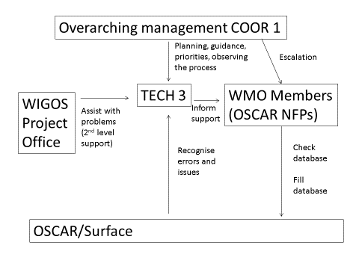
Improving the contents of OSCAR/Surface

Slide 28
Improving the contents of OSCAR/Surface - timelines
identifying the responsible individuals (by the end of July 2016)
running the activities (September-December 2016)
report to TT WIGOS (January 2017)

Slide 29
WIGOS Data Quality Monitoring
WIGOS Data Quality Monitoring
TECH 2.1 (EUMETNET) to extend the list of monitored stations to a subset of the non-EUMETNET RA6 Members
Identify a volunteer from the TT-WIGOS (TECH2.2) to conduct and act on the day to day monitoring

Slide 30
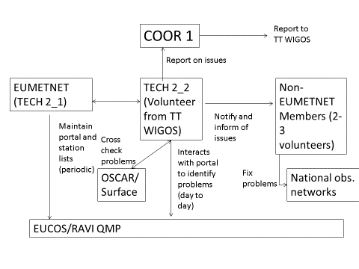
WIGOS Data Quality Monitoring

Slide 31
WIGOS Data Quality Monitoring - timelines
identifying the responsible individuals (by the end of July 2016)
training (September-October 2016)
running the activities (November 2016-February 2017)
report to TT WIGOS and MG (March 2017)

Slide 32
AMDAR with Turkish Airlines
Already an on-going activity, under consideration by EUMETNET members
Turkish State Meteorological Service (TSMS)
E-AMDAR Operational Service Manager
Turkish Airlines

Slide 33
Thank you
Hvala

