Slide 1
RA-VI WIGOS Activities
WIGOS Workshop on Marine Meteorological and Oceanographic Observing Requirements, Split, Croatia, 5-7 September 2016
Wenjian ZHANG
Assistant Secretary General WMO
Ercan BÜYÜKBAŞ
TT-WIGOS Leader, Assistant Director TSMS
Milan DACIĆ
WMO Representative for Europe

Slide 2
What is WIGOS?
WMO foundational activity addressing the observing needs of the weather, climate, water and environmental services of its Members
A framework for integrating all WMO observing systems and WMO contributions to co-sponsored observing systems under a common regulatory and management framework
Together with the WMO Information System (WIS), WIGOS is a WMO contribution to GEOSS.
WIGOS is not:
Replacing or taking over existing observing systems, which will continue to be owned and operated by a diverse array of organizations and programmes, national as well as international.

Slide 3
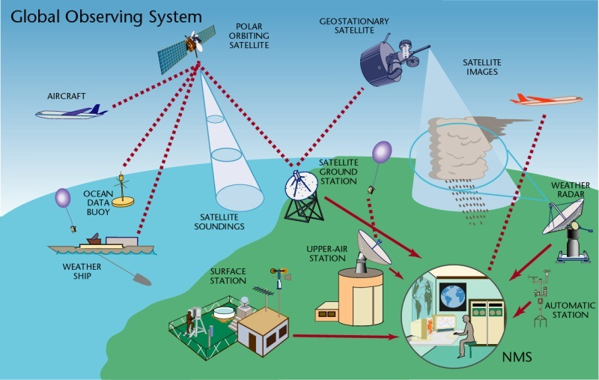
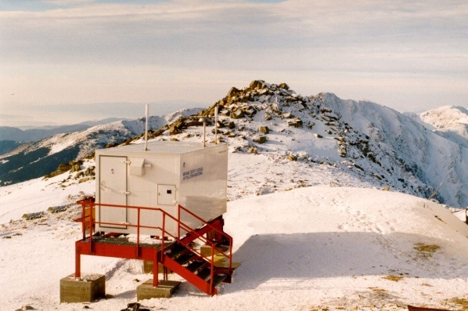
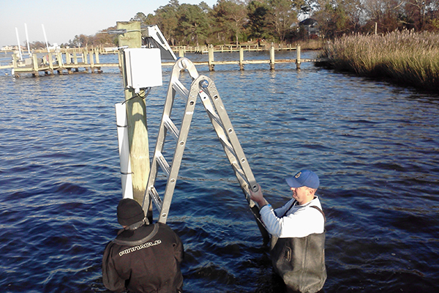
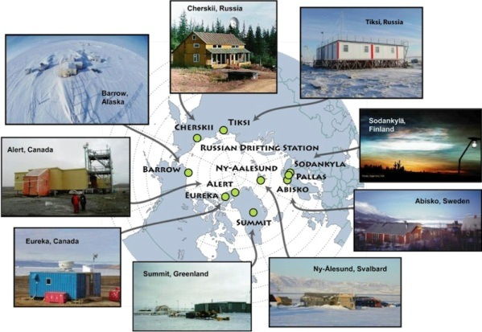
WIGOS Component Systems
Global Observing System (WWW/GOS)
Observing component of Global Atmospheric Watch (GAW)
WMO Hydrological Observations (including WHYCOS)
Observing component of Global Cryosphere Watch (GCW)

Slide 4
Why do we need WIGOS?
I. NMHS mandate typically broader now than when the World Weather Watch and the GOS were created, including e.g.
Climate monitoring, climate change, mitigation
Air quality, atmospheric composition from urban to planetary scales
Oceans
Cryosphere
Water resources
II. Technical and scientific advances:
Observing technology
Telecommunications
Numerical modeling and data assimilation
Increased user demand to access and use observations in decision making

Slide 5
Why do we need WIGOS?
III. Economic realities
Budgetary pressure on many NMHS, in spite of growing mandate and increasing demand for services
Efficiency by exploiting synergies
Integration of observing networks across disciplines (e.g. weather and climate)
Integration across organizational boundaries, e.g. between different national ministries/departments operating observing systems
Integration across technological boundaries, e.g. between surface- and space-based systems
Basic principle: One observation, many applications, many users

Slide 6
WMO Regional Association VI

Slide 7
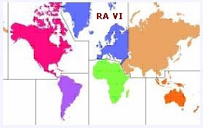
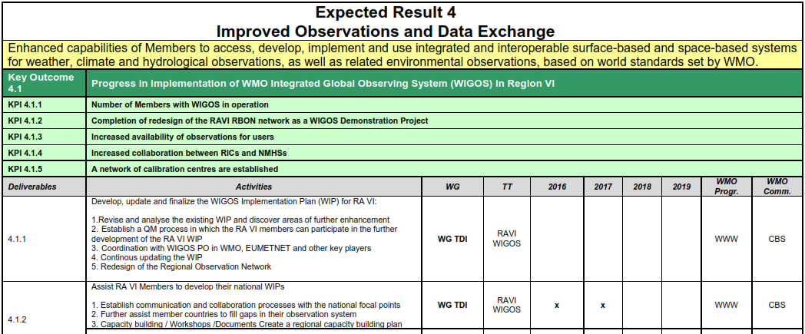
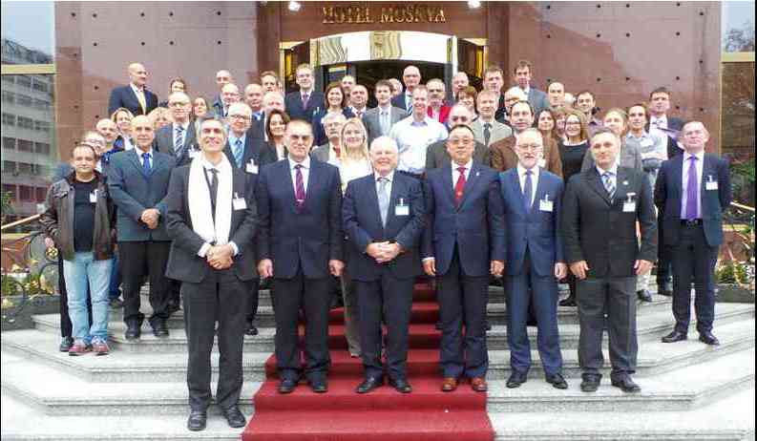
RA VI Operational Plan
“WMO RA VI WIGOS Workshop for RA VI (Europe) Members”, Belgrade, Serbia 24 - 27 November 2015
Support WIGOS Implementation Plan

Slide 8
1. WIGOS Implementation in RA-VI
WIGOS Implementation Plan for Regional Association VI (Europe) (R-WIP-VI) is reviewed and updated based on the discussions during the workshop held in Madrid in 2013. It was then submitted to the 16th session of RA-VI and adopted in Helsinki, September 2013
WG-TDI (Technology Development and Implementation) was re-established at 16th session of RA-VI with one of the key tasks to follow WIGOS issues in RA-VI including review, update and implement the R-WIP-VI (Regional WIGOS Implementation Plan)

Slide 9
1. WIGOS Implementation in RA-VI
A task team (TT-WIGOS) was established under the WG-TDI to perform the required tasks for the WIGOS implementation in RA-VI
Terms of references have been prepared and approved for that task team
A sub-task team for radar data exchange (TT-RDE) was established to prepare a report for data exchange conditions in RA-VI

Slide 10
2. Structure of TT-WIGOS
Name | Expertise | Country
Ercan Büyükbaş | Observing Networks: WIGOS | Turkey
Dr. Olaf Schulze | Observing Networks: WIGOS | Germany
Simon Gilbert | Observing Networks: WIGOS | UK
Stefan Klink | Europe-wide management of non-satellite observations systems | Germany/ EUMETNET
Linih Tatiana | Climate observing networks | Moldova
Dr. Alexander Gusev | Observing Networks | Russian Federation
Özden Tüten | Observing Networks | Turkey
Dr. Fernando Belda Esplugues | Observing Networks | Spain
Kemal Šehbajraktarević | Observing Networks | Bosnia and Herzegovina
Ines Srzić | Observing Networks | Croatia
Wiam Kordab | Observing networks | Lebanon
Predrag Petković | Observing Networks | Serbia

Slide 11
2. Structure of TT-RDE
Name | Expertise | Country
İstvan Sebok | Observing Networks/Remote Sensing | Hungary
Alper Çubuk | Observing Networks/Remote Sensing | Turkey
Cihan Gözübüyük | Observing Networks/Remote Sensing | Turkey
Julijana Nadj | Observing Networks/Remote Sensing | Serbia

Slide 12
3. Activities
The activities tried to follow the directions defined by:
TORs prepared in accordance with R-WIP-VI,
Key activity areas and proposed activities stated in R-WIP-VI,
Request for doable activities and achievable targets

Slide 13
3. Activities
Three face-to-face meetings were held
1) 10-11 June 2015, Ankara, Turkey
2) 16-17 September 2015, İstanbul, Turkey
3) 6-7 June 2016, Belgrade, Serbia
WIGOS workshop for RA-VI was organized
24-27 November 2015, Belgrade, Serbia

Slide 14
3. Activities
Main discussion topics in the meetings and workshop are as follows:
WIGOS concept and R-WIP-VI,
Challenges and proper solutions for WIGOS implementation in RA-VI
The urgent need for the increasing the awareness of WIGOS among Members, particularly at higher management level
Main tasks, composition structure, weakness, challenges, advantages and needs of the task teams

Slide 15
3. Activities
Strengthening the task teams to cover whole region with required expertise
Stressing the Role and importance of WIGOS focal points
Establishing efficient communication mechanism among WIGOS focal points, task teams and other bodies
Preparation of a proposal for radar data exchange
Preparation of a concept for RWCs
Assisting Members in their national WIGOS implementation

Slide 16
3. Activities
1) 30 out of 50 Members designated WIGOS focal points
2) Self-assessment check lists provided by 21 out of 50 Members under evaluation (ongoing)
RA-VI President requested the RA VI Members to designate focal points, and prepare and submit the self-assessment check list

Slide 17
3. Activities
3) A web based discussion forum is created during Belgrade workshop in 2015 and is now available for:
-communication among focal points,
-sharing the information and documents,
-providing assistance to Members,
-monitoring the activities.
(continuing activity in the next RA inter-sessional period)

Slide 18
3. Activities
4) Assisting Members to utilize the capabilities of Regional Instrument Centers (RICs)
-A survey for the assessment of the needs and capacities of Members for the calibration was performed by RA VI Task Team TT-RIC.
-The results will be evaluated and shared with Members for their benefits via focal points (on-going)

Slide 19
3. Activities
5) R-WIP-VI partly updated during WIGOS workshop in Belgrade (to be completed by December 2016)
6) A process to monitor and report on the level of regional compliance with WIGOS standards is under development (to be completed by March 2017)
7) Generating awareness among the Members to provide up-to-date data and metadata to the WIR* and ensure its on-going maintenance (ongoing)
* The WIGOS Operational Information Resource (WIR) is a network platform and tool designed to provide WIGOS stakeholders with all relevant information on the operational status and evolution of WIGOS and its component observing systems, the operational requirements of WIGOS, including standard and recommended practices and procedures used in the WIGOS framework, and their capabilities to meet observational user requirements of all WMO Application Areas.

Slide 20
3. Activities
8) A concept for virtual RWC* in RA-VI has been prepared and submitted to RA-VI MG by the chair of WG-TDI (ongoing for next period)
9) A general concept prepared for RWC will be discussed and finalized (ongoing for next period)
* RWC - Regional WIGOS Center

Slide 21
3. Activities
10) A draft proposal for radar data exchange (considering and utilizing from the existing sub-regional networks such as OPERA, NordRad, Baltrad) was prepared and submitted to RA VI MG by the Chair of WG-TDI
- This proposal will be reviewed and updated (ongoing for next period)
11) A proposal for RBON concept to be submitted to RA-VI MG is under preparation (to be completed by 2017 March)

Slide 22
Thank you
Hvala

