Slide 1

HCMR activities with regard to marine meteorological and oceanographic observations, opportunities and challenges
The POSEIDON System
Antonis chalkiopoulos, leonidas perivoliotis
Institute of oceanography, Hellenic center for marine research
WIGOS Workshop for RA-VI with focus on marine observations, Split, Croatia, 5-7 Sept. 2016

Slide 2
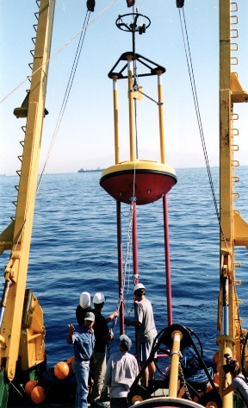
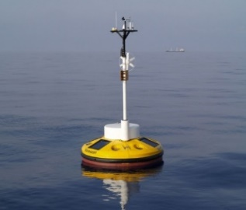
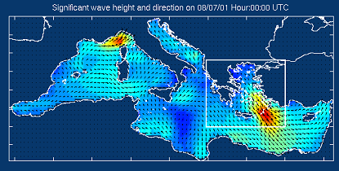
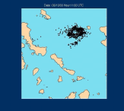
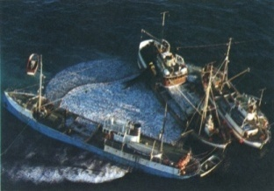
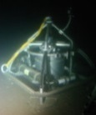
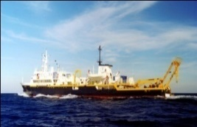
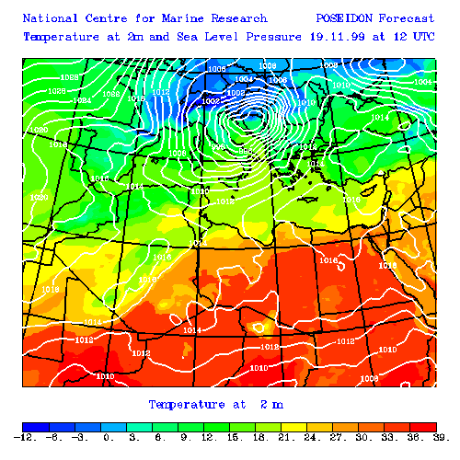
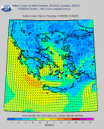
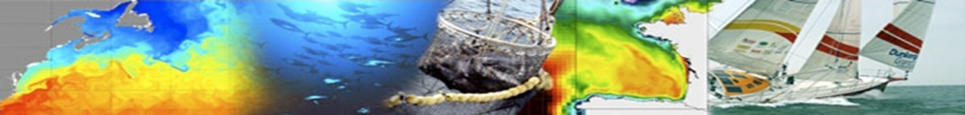
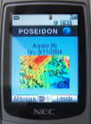
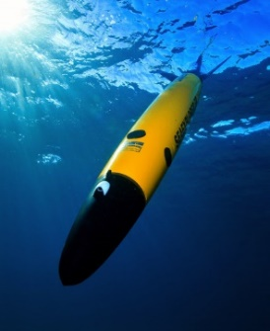
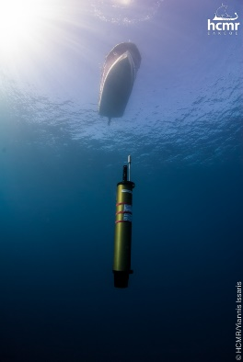
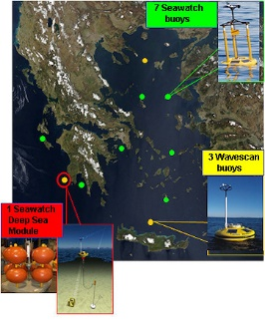
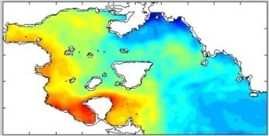
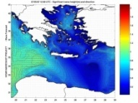
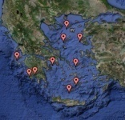
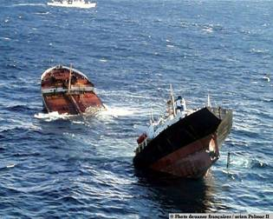
POSEIDON System
An operational monitoring, forecasting and information system for marine environmental conditions in the Eastern Mediterranean
Targeted to end-user needs (incl. public): maritime transport, fisheries, tourism, environment protection, research
Developed through infrastructure funding (EEA & national funds): 14.1 M€ in 1997-2000, 9.8 M€ in 2005-2010, 1.2 M€ in 2010-2012
Operated by I.O. of HCMR since 2000 – Supported by Greek NMS & Navy
Continuously upgraded through collaborative research projects
Integrated with / contributing to major European projects and initiatives
Observations
Processing & Modeling
Information & Decision Support Systems
WIGOS Workshop for RA-VI with focus on marine observations, Split, Croatia, 5-7 Sept. 2016

Slide 3
Vision - Motivation
“An integrated system able to support science, safety, environment and maritime economy in Greece”
Research oriented applications (climatic variability, ecosystem functioning)
Support of maritime transport (forecasts, SAR)
Environment protection (ecosystem health, oil pollution)
Support of tourism industry (water quality, yachting, etc.)
Fisheries and aquaculture management
Coastal zone management (erosion, etc.) & Water framework directive
WIGOS Workshop for RA-VI with focus on marine observations, Split, Croatia, 5-7 Sept. 2016

Slide 4

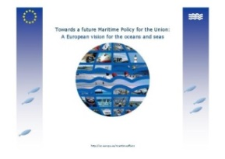

Development Strategy
Embed into appropriate policy frameworks: IOC/GOOS, EuroGOOS, MonGOOS, GEO
Balance between the operational and research character of the infrastructure
Integrate national investments with European initiatives: GMES, EMODnet, ESFRI
Complementarity between national and EU projects: MFSTEP, MERSEA, ECOOP, MARCOAST, MYOCEAN I &II , JERICO, EuroARGO, FixO3 (25 EU projects since 2000)
Integrate coastal - shelf - deep systems & scales: necessary due to specificities of Greek Seas
WIGOS Workshop for RA-VI with focus on marine observations, Split, Croatia, 5-7 Sept. 2016

Slide 5

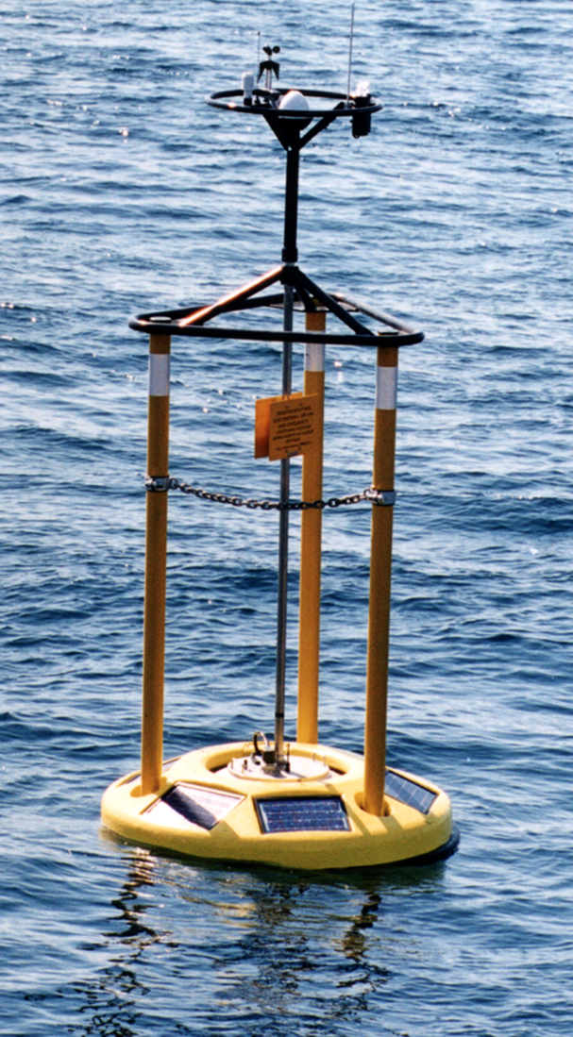
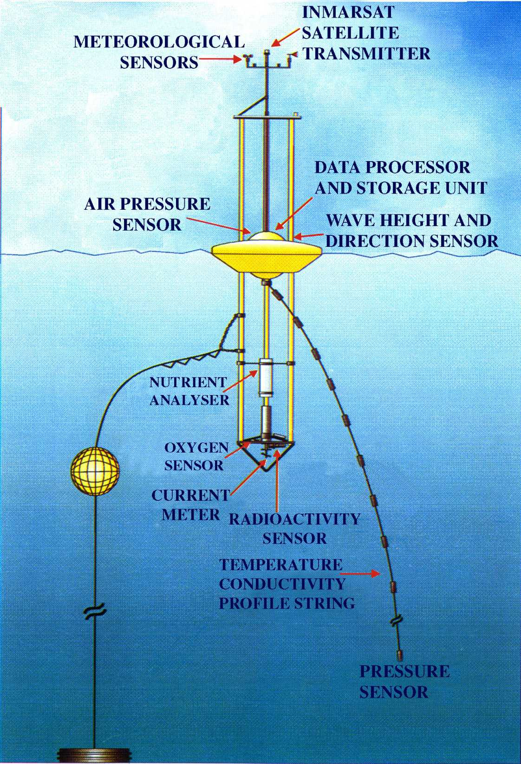
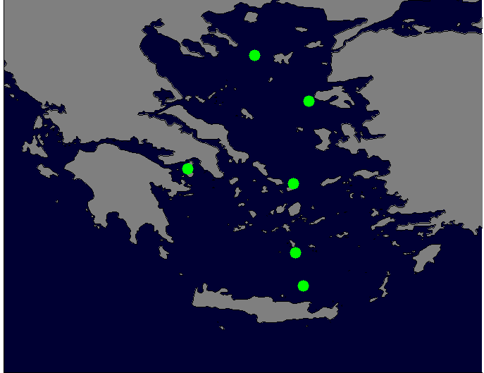
History: 2000-2006 Main system development
11 buoys – 6 locations
Moorings Sensors
Atmospheric:
Air Temperature
Atmospheric pressure
Wind Speed/Direction
Oceanographic:
Temperature
Salinity
Currents
Waves
Water quality:
Chlorophyll-A
Oxygen
Turbidity
Radioactivity
Measurements at the sea surface
Temperature and Salinity down to 50m in selected locations
WIGOS Workshop for RA-VI with focus on marine observations, Split, Croatia, 5-7 Sept. 2016

Slide 6
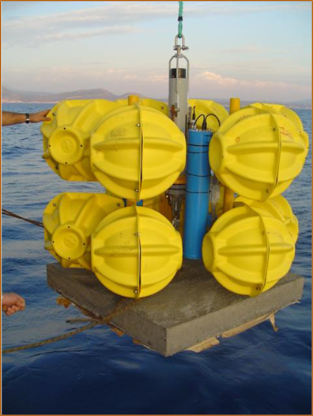
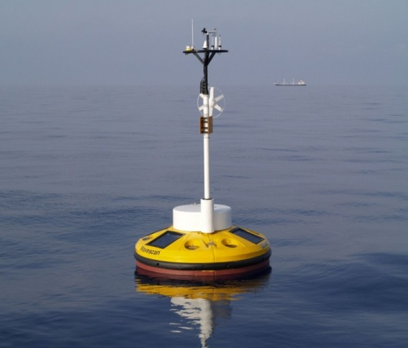
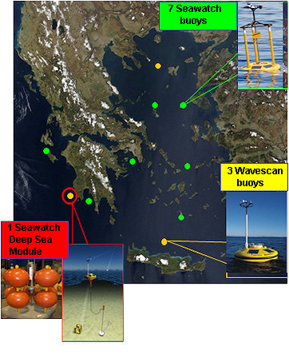
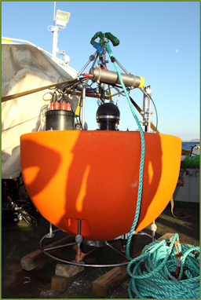
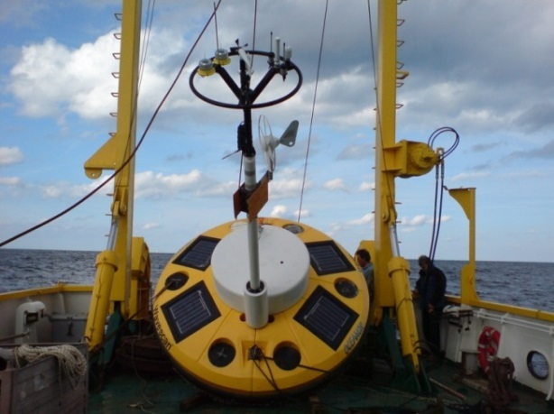
History: 2007-2012 Major system upgrade
16 buoys – 10 locations
Five (5) new moorings (WaveScan) to support deep sea monitoring including ecosystem variables
Two (2) reference stations:
Cretan Sea
Pylos-Ionian Sea
Eight (8) met-ocean buoys:
Atmospheric data (wind speed & direction, atmospheric pressure, air temperature)
Marine data (waves, surface currents, temperature & salinity down to 100m in selected locations)
One (1) seafloor observatory
Monitoring network extended to Ionian Sea
WIGOS Workshop for RA-VI with focus on marine observations, Split, Croatia, 5-7 Sept. 2016

Slide 7
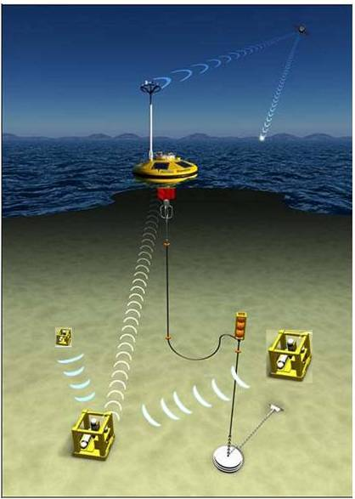
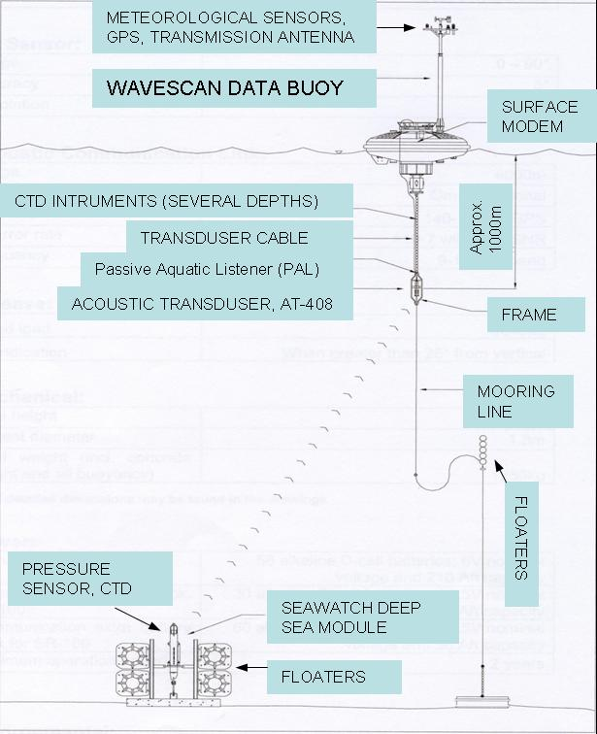
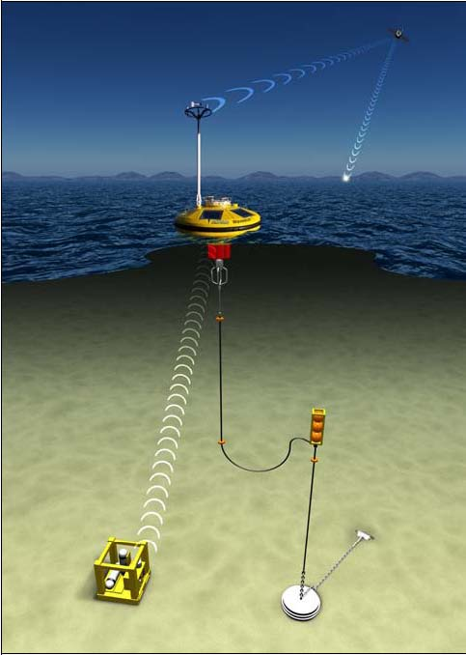
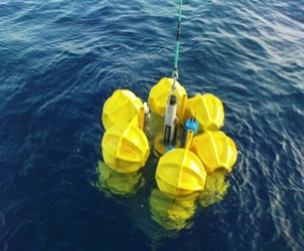
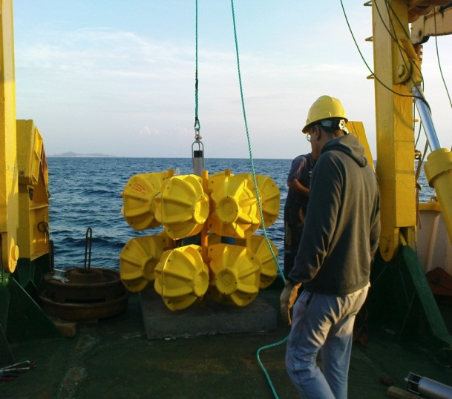
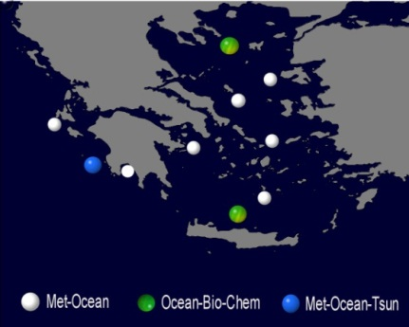
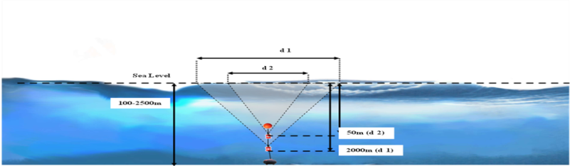
Reference station Pylos
A new Sea-bed observatory developed through POSEIDON –III
Sensors: Pressure (incl. tsunami mode), T, S, DO, Turbidity, CO2, CH4, pH
Multi-node autonomous platform (acoustic link between nodes)
Upgrade of existing platform to form a node of the network
Compatibility of hardware (CPU) with rest of the systems
Modular – expandable system
In operation since November 2008
0-1000m Temperature & Salinity sensors monitoring variability of deep water characteristics
A seabed platform includes a tsunami detection system
Based on the DART system
Developed by PMEL (Pacific Environmental Laboratory)
High resolution pressure measurements (15 sec)
Onboard analysis for Tsunami detection
Also hosting T, S & Dissolve Oxygen sensors
Mooring cable also hosts an experimental PAL (passive aquatic listener) sensor
Deployed in the sea on October 2013
WIGOS Workshop for RA-VI with focus on marine observations, Split, Croatia, 5-7 Sept. 2016

Slide 8
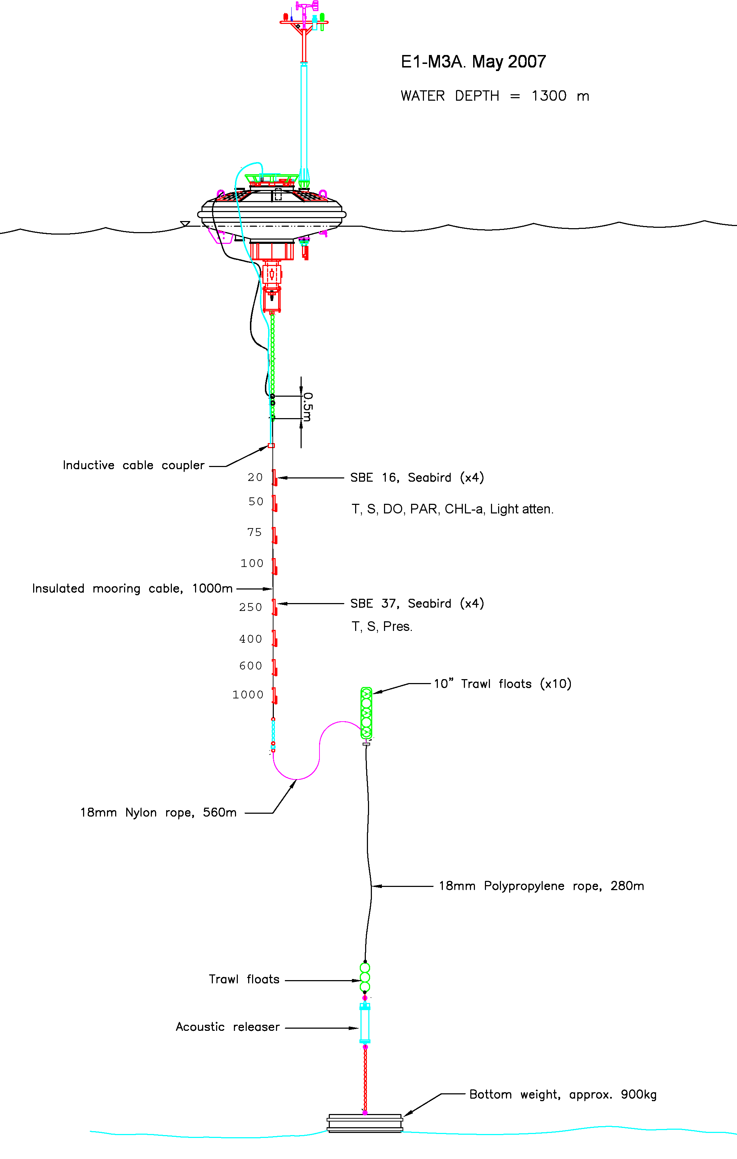
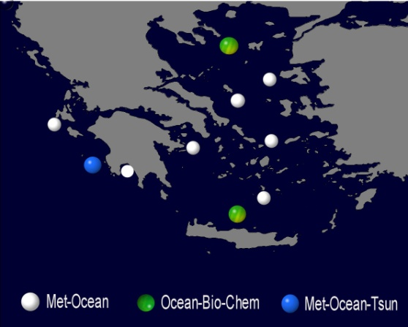
Reference station E1-M3A (Cretan Sea)
Operating since 2000
Emphasis on bio-chemical processes and thermohaline circulation
Recent developments: CO2 sensor and advanced optics
WIGOS Workshop for RA-VI with focus on marine observations, Split, Croatia, 5-7 Sept. 2016

Slide 9
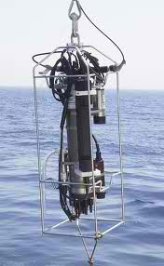
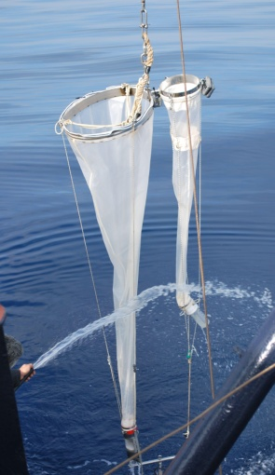
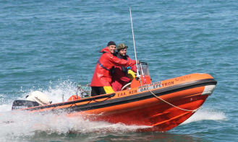

POSEIDON System beyond the buoys
Ecosystem monitoring at E1-M3A site (Cretan Sea)
Parameters:
Temperature & Salinity
Nutrients
CT-AT,
CO2
Chlorophyll-a
Pigments (HPLC)
Planktonic community:
  Phytoplankton
  Coccolithophores
  Bacteria
  Microzooplankton
  Mesozooplankton
Site is visited in monthly basis
Data available since March 2010
WIGOS Workshop for RA-VI with focus on marine observations, Split, Croatia, 5-7 Sept. 2016

Slide 10
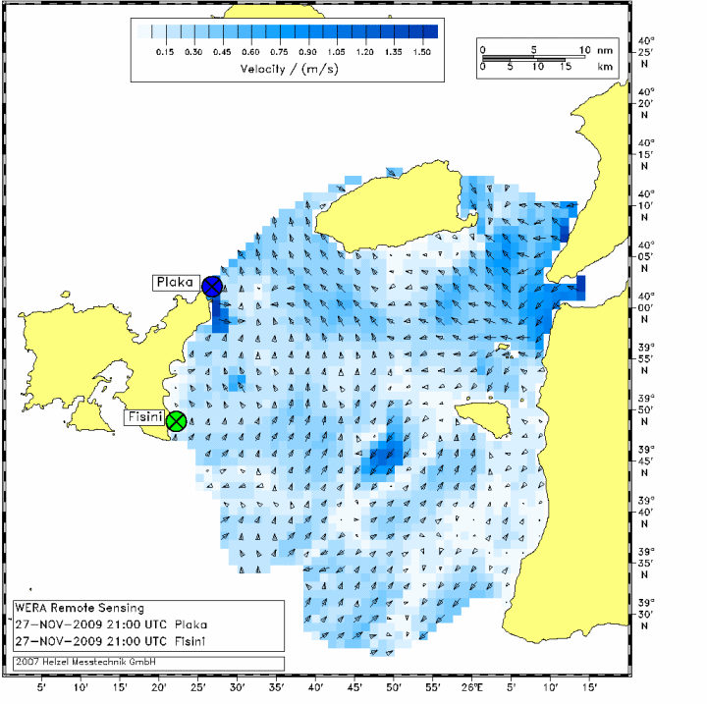
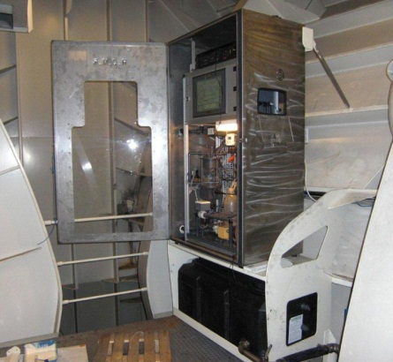
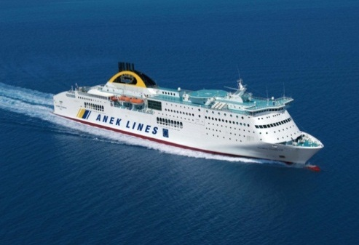
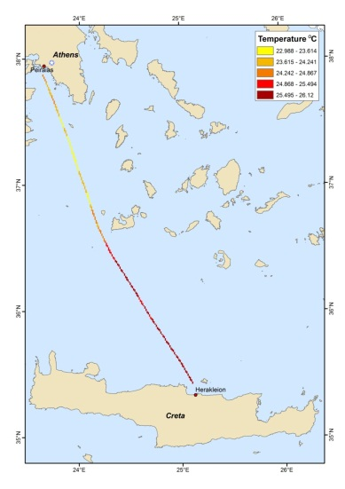
POSEIDON System beyond the buoys
Ferry Box System
Real time continuous recording of:
Temperature
Salinity
Chlorophyll-a
Turbidity
pH
Radar
The Black Sea waters outflow through Dardanelles is an important driving mechanism for the Aegean sea hydrology and circulation.
The systematic monitoring of this outflow is a key issue for:
The validation of the hydrodynamic forecasts
The improvement on the numerical simulations in the Aegean
The Search and rescue activities in the area
Piraeus – Heraklion
Olympic Champion High Speed
In operation since 2012
In operation since June 2009
WIGOS Workshop for RA-VI with focus on marine observations, Split, Croatia, 5-7 Sept. 2016

Slide 11

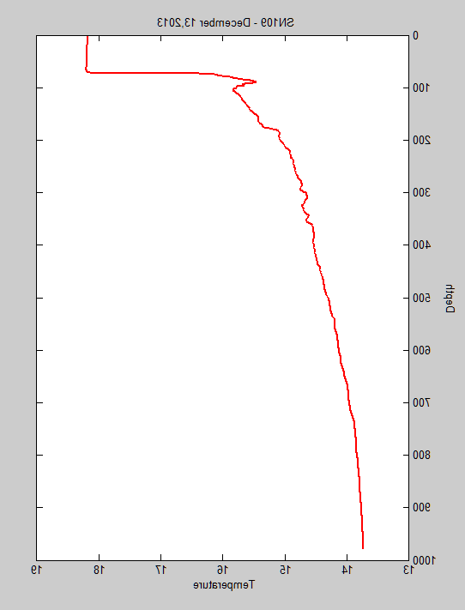
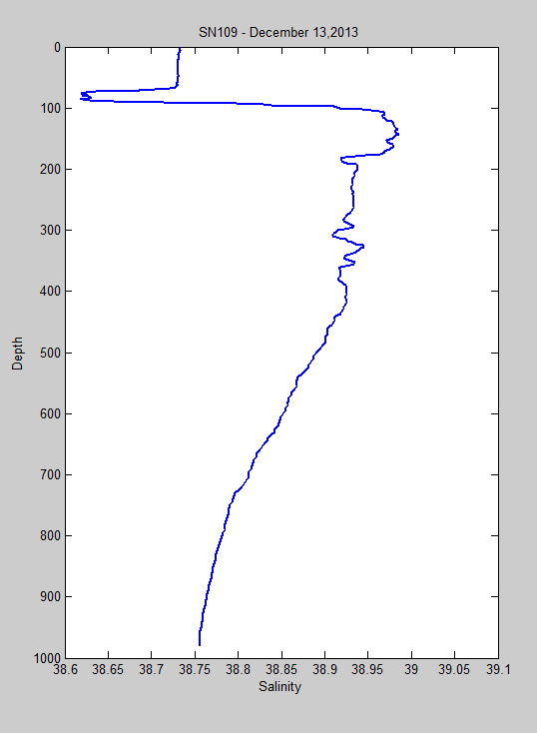
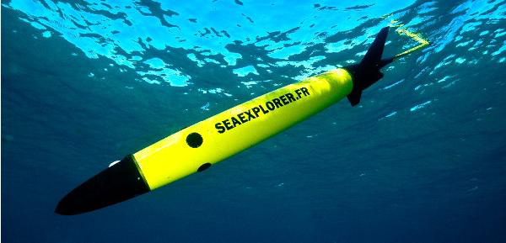
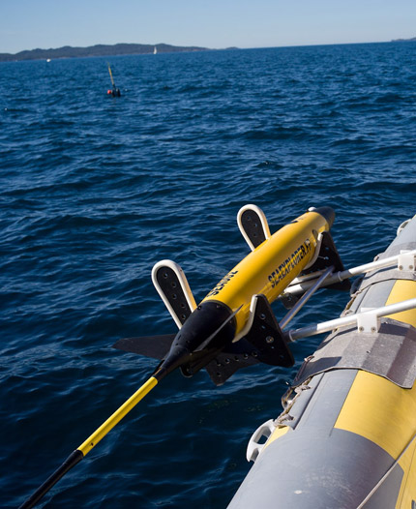
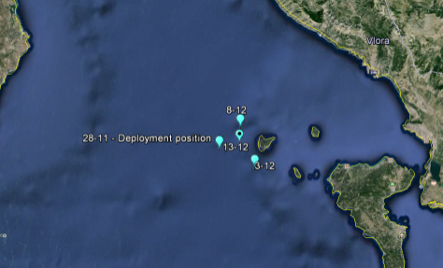
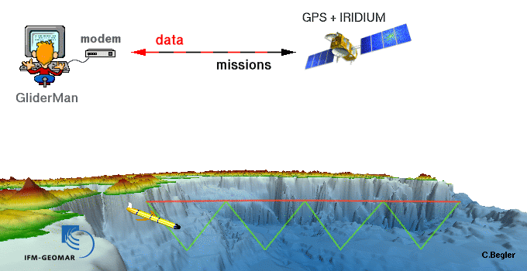
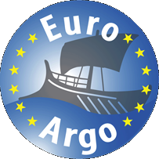
POSEIDON System beyond the buoys
Greek Argo Infrastructure
SeaExplorer Gliders
Scientific Payload: CTD, DO
Typical operational cycle:
Dive to 700 m
One descending + One ascending profile every 4-5 hours
6-10 profiles/day
180-300 profiles/month
Greek contribution to EuroArgo started in 2010
High frequency recording of data
Measuring the Ocean variability
Added to POSEIDON observation facilities on January 2016
WIGOS Workshop for RA-VI with focus on marine observations, Split, Croatia, 5-7 Sept. 2016

Slide 12











Step forward: Towards an Integrated Observatory
Three multi-parametric moorings (Cretan Sea, Ionian Sea, North Aegean) – Biochemical parameters (nutrients, pH, CO2) at several depths
Coastal monitoring: Three stations (+ on demand)
Argo Component: Greek Argo, 20 deployments up to 2017
Introduce the Glider component: Two SeaExplorer gliders are ready to begin the missions at the sea – Implementation of one endurance line – One unit for research activities
Monitoring the ocean on multiple scales
Ferry Box System: Maintain the operation of the system in the Piraeus-Heraklion line
Integrate the EMSO Hellas infrastructure: Cabled observatory, Pylos, Ionian Sea (in operation during 2016)
High resolution recording of surface currents: Integrate the surface drifter component (University of Aegean – National Roadmap)
Introducing a sea level monitoring component: Integrate the existing network of HHS (National Roadmap), addition of new stations
WIGOS Workshop for RA-VI with focus on marine observations, Split, Croatia, 5-7 Sept. 2016

Slide 13





POSEIDON System in the major Operational Oceanography Initiatives
Copernicus Marine Environmental Monitoring Service
EuroGOOS
Global Argo
EMODnet
E-SURFMAR
WIGOS Workshop for RA-VI with focus on marine observations, Split, Croatia, 5-7 Sept. 2016

Slide 14












POSEIDON System Website
poseidon.hcmr.gr
~ 1.5M Sessions/month
WIGOS Workshop for RA-VI with focus on marine observations, Split, Croatia, 5-7 Sept. 2016

Slide 15



MONGOOS Data Portal
oceanobs.mongoos.eu
The Mediterranean Oceanography Network for the Global Ocean Observing System (MONGOOS) Data Portal Operated by I.O. HCMR
Platforms status monitoring
Data & Metadata presentation
250 active platforms
Navigation & Metadata Filtering / Search
2000+ platforms since 1990
Download data from marine.copernicus.eu
WIGOS Workshop for RA-VI with focus on marine observations, Split, Croatia, 5-7 Sept. 2016

Slide 16


Fixed Stations
MONGOOS inventory, updated on http://www.mongoos.eu
Waves: 51
Sea level: 100
Wind: 78
Air Pressure: 81
Air Temperature: 80
Water Temperature: 113
Currents: 37
Salinity: 50
Eight (8) Offshore Deep Ocean Multi Parametric Observatories
LION
ANTARES
DYFAMED
W1-M3A
NEMO-SN1
E2-M3A
PYLOS
E1-M3A
WIGOS Workshop for RA-VI with focus on marine observations, Split, Croatia, 5-7 Sept. 2016

Slide 17


MedArgo: Mediterranean Argo regional center
70 floats active as of 04.09.2016
70 floats active as of 04.09.2016
Deployment per country
Classification per sensor type
nettuno.ogs.trieste.it/sire/medargo/active
WIGOS Workshop for RA-VI with focus on marine observations, Split, Croatia, 5-7 Sept. 2016

Slide 18
MedSVP: Mediterranean Surface Velocity Programme
21 drifters active as of 04.09.2016
http://nettuno.ogs.trieste.it/sire/medsvp/
WIGOS Workshop for RA-VI with focus on marine observations, Split, Croatia, 5-7 Sept. 2016

Slide 19

Ships of Opportunity in the Mediterranean
XBT activity during 2015
MX04
dd.mm.yyyy | Ship name | T4 | Deep Blue | T5/20 | XCTD-1 | Total | Grand Total
05.02.2015 | La Superba | 3 | 13 | 3 |  | 19 | 19
10.03.2015 | La Superba | 5 | 16 | 7 | 2 | 30 | 49
05.05.2015 | La Superba | 8 | 16 | 6 | 1 | 31 | 80
22.06.2015 | La Suprema | 10 | 14 | 7 | 2 | 33 | 113
29.06.2015* | La Superba | 11 | 13 | 5 | 1 | 30 | 143
28.07.2015 | La Suprema | 9 | 19 | 7 | 2 | 37 | 180
16.09.2015 | La Suprema | 8 | 17 | 7 | 2 | 34 | 214
To be updated
29.10.2015
15.12.2015
* Genoa - Tunis
Genoa
MX04
Palermo
Tunis
Total number of XBT casts at 23.10.2015: 214
WIGOS Workshop for RA-VI with focus on marine observations, Split, Croatia, 5-7 Sept. 2016

Slide 20




Mediterranean Gliders fleet
Institute | CSIC/SOCIB | CNRS | OGS | OC-UCY
Country | Spain | France | Italy | Cyprus
Number of Gliders | 7 | 15 | 3 | 2
Type of Gliders | Slocum shallow (1) Slocum deep (4) Seaglider (2) | Slocum shallow (4) Slocum deep (8) Spray (2) Seaglider (1) | Slocum shallow (2) Seaglider (1) | Seaglider (2)
Payload | CTD, DO, Fluo CHLa, Turbidity | CTD, DO, Fluo CHLa, CDOM, Phycoerythrine, SUNA, Backscatter | CTD, DO, Fluo CHLa, Backscatter | CTD, DO, Fluo CHLa, Backscatter
Total number : 27
Slocum deep 12
Slocum shallow 7
Seaglider 6
Spray 2
Routine monitoring missions established in West and East Med
Five new gliders added in the Mediterranean fleet in 2016
Greece : 2 SeaExplorers
Israel: 3 SeaExplorers
WIGOS Workshop for RA-VI with focus on marine observations, Split, Croatia, 5-7 Sept. 2016

Slide 21
Thank you!!

