Slide 1
Challenges & opportunities for developping regional cooperation
Mathieu Belbéoch Argo Technical Coordinator, JCOMMOPS Head belbeoch@jcommops.org
support@jcommops.org
https://twitter.com/jcommops

Slide 2
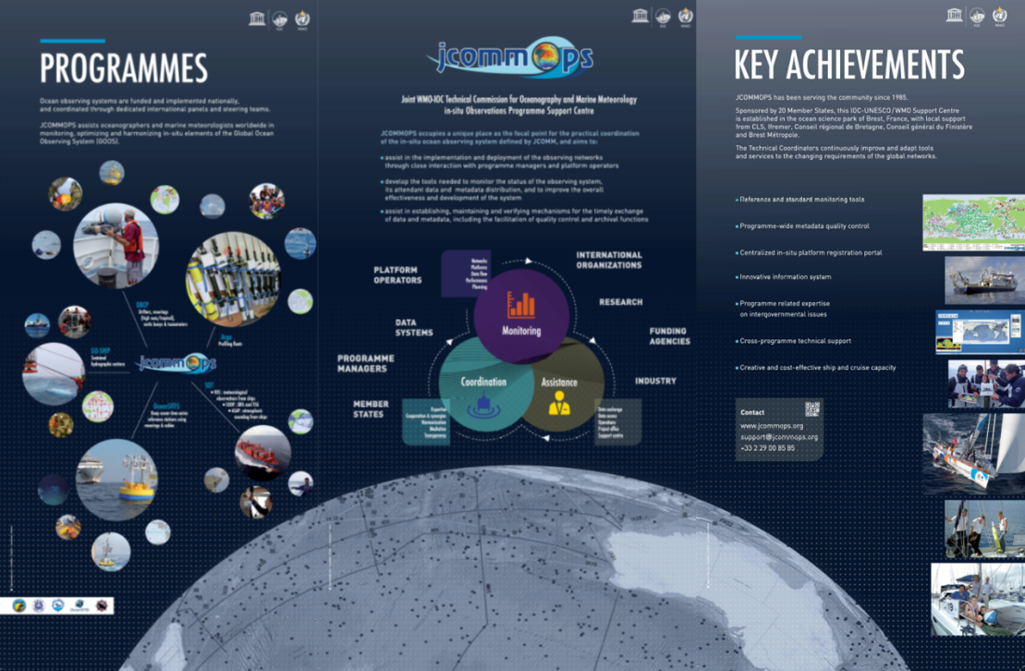
What is JCOMMOPS ?
IOC/WMO coordination, monitoring and support centre for the sustained elements of the GOOS (Argo, DBCP, OceanSITES, SOT, GOSHIP, GLOSS);
Assists oceanographers and marine meteorologists worldwide in optimizing and harmonizing in-situ elements of the observing system, encouraging cooperation between communities and member states;
Monitors and evaluates the performance of the networks;
Acts as a clearing house and focal point on all programme aspects;
Assists in data distribution on the Internet and GTS;
6 staff in Brest (France);
Supported by Ifremer and CLS,
20 Member States, France/Britanny, EU.
Trying to fund a Regional Coordinator position (gliders, coastal obs. systems, polar, marine mammals, etc)

Slide 3
Challenge
Complete and sustain the global (and regional) observing systems
Integrate …
Requirements:
Strengthen every single element first
Develop national/regional integrated components

Slide 4
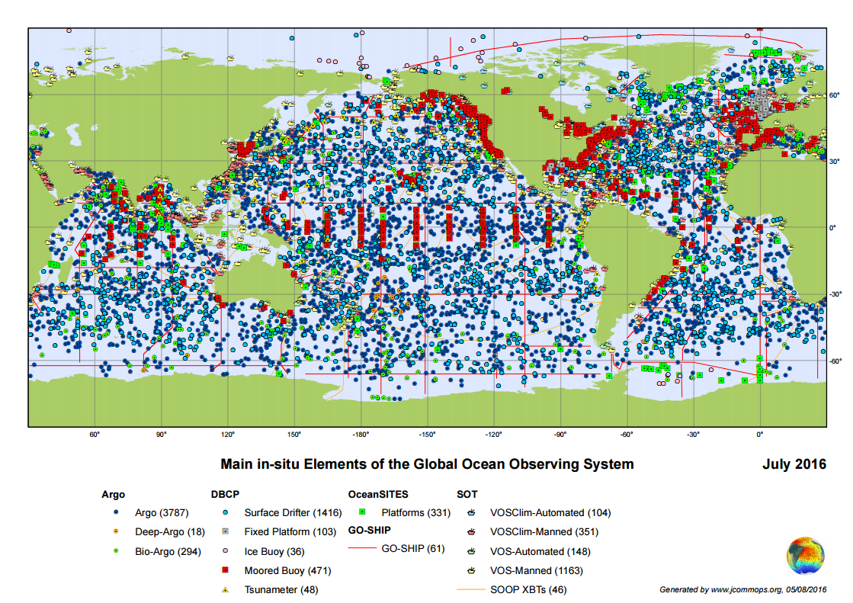
Develop further regional/coastal clusters
Integrate global and regional networks

Slide 5
Regional Observing Systems
Need coordination
Need implementation plan (targets) at least for a common denominator.
Need more international discussions (e.g. GRAs) between “regions” , “territories” and “ocean poles”
Develop blue economy
Develop educational initiatives
=> Might fund obs. programmes

Slide 6
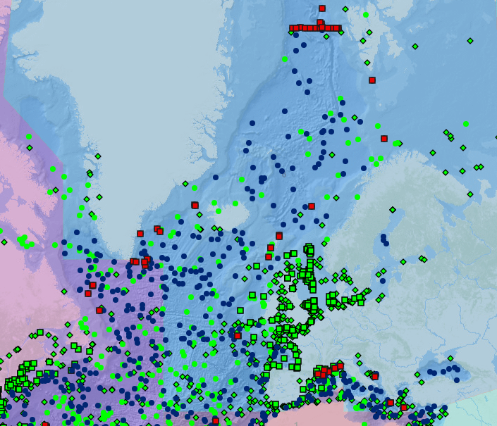
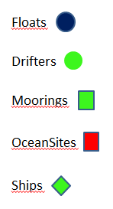
WMO Region VI: operational units

Slide 7
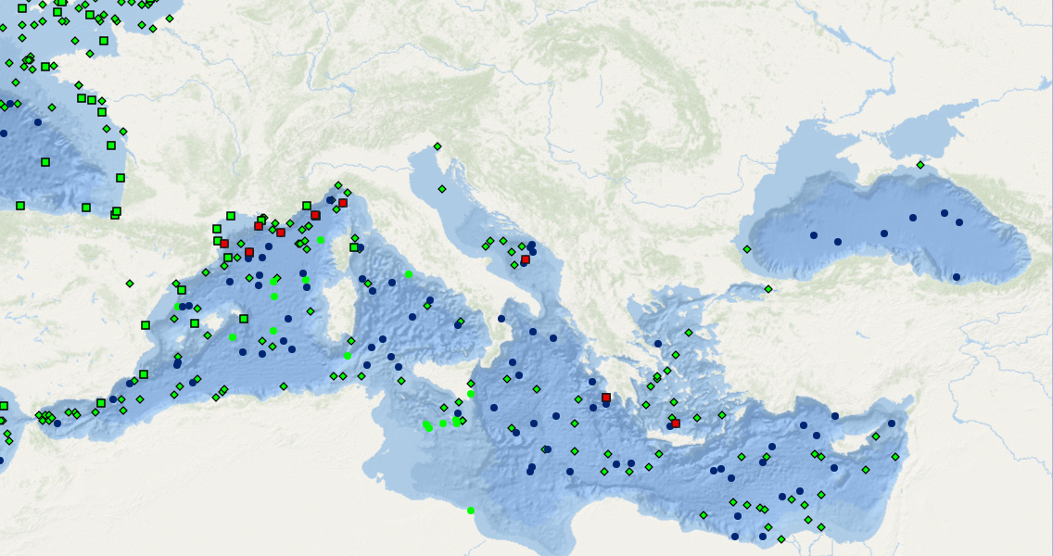
Regional Status
No surface drifters
No moored buoys

Slide 8
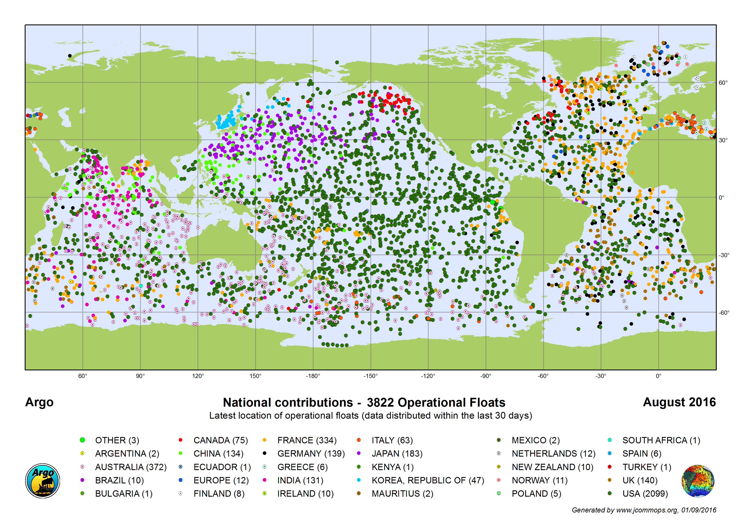

Slide 9
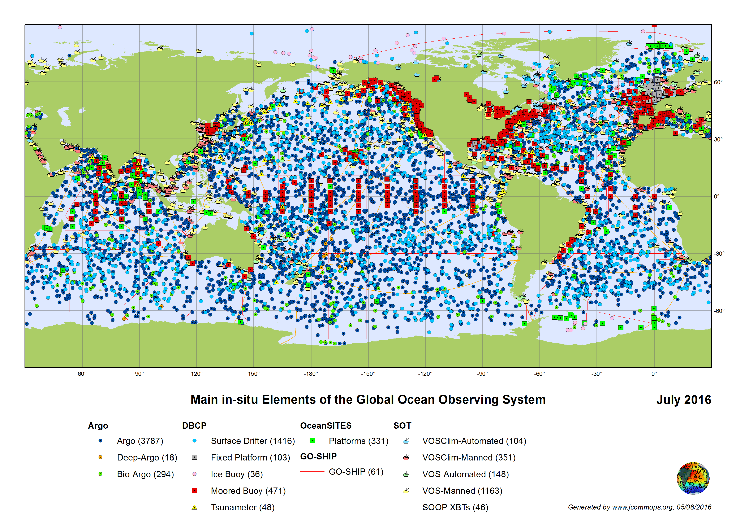

Slide 10
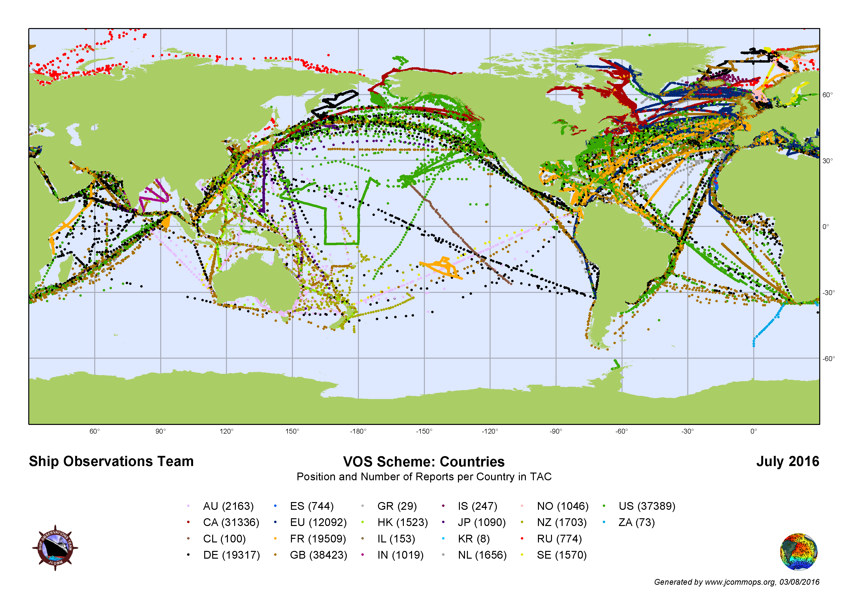

Slide 11
Why participate in
Ocean observation programmes?
Participate to international initiatives (GOOS/WIGOS) that need multiple contributions to sustain the networks.
Improve operational oceanography services and societal applications
Fuel research initiatives
Develop blue economy (jobs)
Enhance Meteo.-oceano. cooperation
Build technical, scientific, engineering, operational expertise
Enhance international visibility (tool for diplomacy)
Develop outreach programmes
Benefit from community expertise and support

Slide 12
How to participate in
Ocean observation programmes?
Talk to JCOMMOPS coordinators for information, assistance and support (all steps)
Share data and metadata of your operating platforms, including from 3rd parties (e.g. oil & gas)
Designate focal points to drive national/regional contribution
Fund and operate instruments
Provide operational support (ship time: maintenance, retrieval, deployment)
Participate to regional and international meetings
Get involved in regional infrastructures development (RMICS, WIGOS RC)
Provide political support to observing programmes (facilitate access to Exclusive Economic Zones) - critical for coastal observations.
Take benefit from European Union calls (AtlantOS, MedOS) and existing infrastructures (e.g. E_Surfmar, EuroArgo)

Slide 13
JCOMMOPS support
Active role within networks to develop cooperation
Provide visibility to small contributors
Provide information on international rules and best practices
Technical assistance and user support worldwide
Guidance for Data processing
Guidance for Data access
Metadata Quality Control (for performance monitoring)
Registration/Certification of platforms
Notification/Warning systems (IOC Res. XX-6, XLI-4) – Argo/ EEZ
Support on requirements (dimensioning of regional contributions)
Monitoring tools (web based) adapted to regional perspective
Reporting (on-demand) on regional networks status

Slide 14
Recommendations
Share information and data with no restriction
Not reinvent the wheel at start (e.g. data processing can be made by partners) – build capacity gradually.
Keep JCOMMOPS in the loop of your activities (international visibility)
Register deployment plans, platforms and metadata through JCOMMOPS website tools www.jcommops.org (WIGOS Ids)
Apply for donor programmes to receive instruments to start contributing. Challenges: only bilateral means, limited international capacity to fund such programmes.
Communicate nationally/regionally on the importance to participate in such ocean observing programmes. (beached instruments, vandalism, data access, etc)
Get involved in regional and international programmes to take benefit from the cooperative effort and enrich them with your perspectives.

Slide 15
Questions and Suggestions
Can we identify funding (in the international organizations?) to develop capacity building (and purchase instruments).
We are looking for civil society partnership (sponsoring).
Existing national contributors could reserve 3% of their instruments to foster new contributors, at regional level. Could this be a high level recommendation?
What can we do to help you to raise a national programme/funding?
Various experts from our community would be glad to promote their activities and transfer technology.

