Slide 1
Sharing information on technology
Paul POLI, Pierre-Marie POULAIN

Slide 2
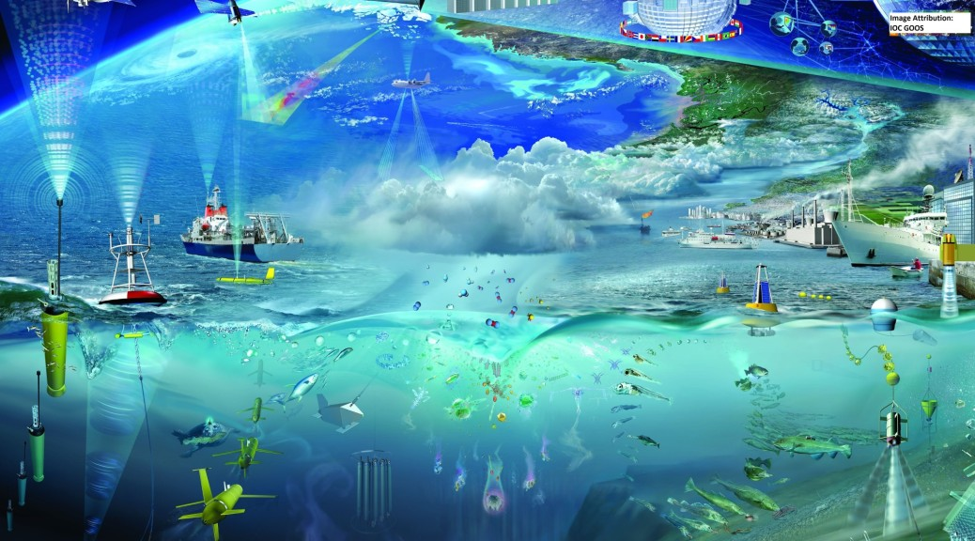
IOC Global Ocean Observing System (GOOS)
… gives an idea of the challenges ahead

Slide 3
Why should we care?
Technological changes will dictate what, how well, and how much of it, we will be able to observe in the future
Past experience suggests these changes are only accelerating, consider for example
Determination of position and time
Data transmission
Types of variables observed
Autonomy of platforms
Program uptakes of new platforms

Slide 4
How have we traditionnally tackled this?
Trial-and-error
First small research programs, for demonstration only
Followed by incremental changes in large-scale programs
These cycles are tied to government procurement cycles (multi-annual planning)
In some cases they have become overtaken by the pace of progress
Leading to new, « private procurement cycles »

Slide 5
Examples of new networks that have mushroomed in the last decade
The tsunami detection network
Uses sensor at bottom of the ocean, with acoustic link to a surface buoy, itself relayed in real-time with two-way satellite communication
Implemented under 10 years after ‘key disaster’ (Indonesia Tsunami 2004)
Aircraft tracking by satellite
On IRIDIUM-Next: to relay aircraft information
To be Implemented within 5 years after ‘key disaster’ (flight MH370 2014)

Slide 6
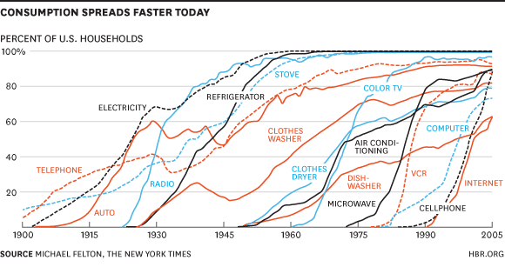
Other illustrations of accelerating change

Slide 7
Example timeline for a selected topic: Autonomous buoy positioning
First autonomous buoys around WWII. No autonomous positioning system known.
First systems for autonomous positioning Argos
EOLE satellite 1972; Nimbus-6 Random Access Measurement System 1975; TIROS-N 1978, POES…
First GPS receivers suitable for buoys: 1994
First multi-GNSS receivers (over 3 systems): ~2013
Each step represents a technological breakthrough:
More precision, more redundancy, more autonomy

Slide 8
Bottom line: Technological evolution accelerates
Consequences
Offers new possibilities to do better for society
Puts expiration dates on entire networks of our existing observation programs
But we do not know yet which ones, and when
Flattening of the landscape with respect to technology means new players can/will pop up quickly
Taking resources away from pre-existing programs (some thought to be the rock foundation of the rest)
Locking ourselves with proprietary technology and possibly few opportunities to act on it

Slide 9
Why coordinate efforts?
In this fast-moving world of technological developments, but (comparatively) slower-moving government agencies
Preferences go increasingly to known annual costs (royalty fee), which can be interrupted, instead of long-term investments (… because other future technology is unknown)
Coordinated efforts between (govt) agencies to keep up with technology could
Increase relevance of the choices made
Deliver the best of both worlds
Long-term view made up of small short-term decisions

Slide 10
Elements to foster discussion
How do you keep up with technological developments?
Do you conduct your own technological dev. program?
Do you interact with private-originated initiatives that propose new sensors or even new networks?
Which developments are you following closely?
What do you think are the overall trends?
What challenges do they pose?
Do you have success stories of new technology implementation at your institution?
What about failures? What lessons were learnt?

