Slide 1
Slovenian Marine Monitoring System
Maja Jeromel
Slovenian Environment Agency
WMO-WIGOS, Split, 5.-7. September 2016

Slide 2
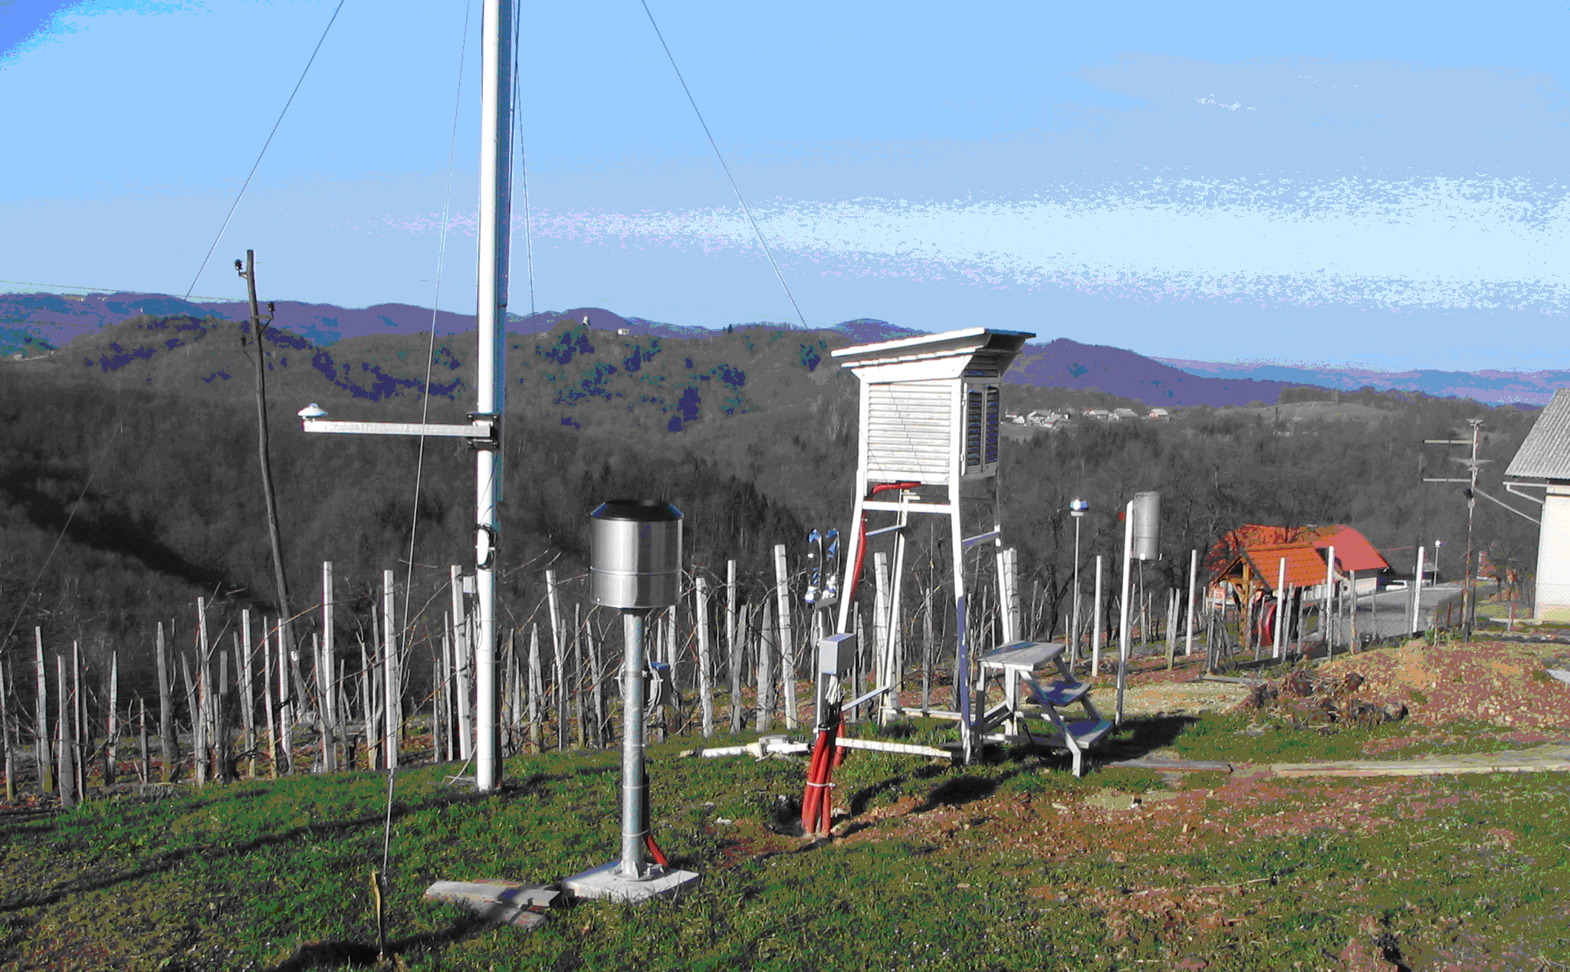
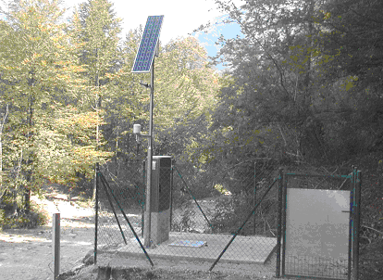
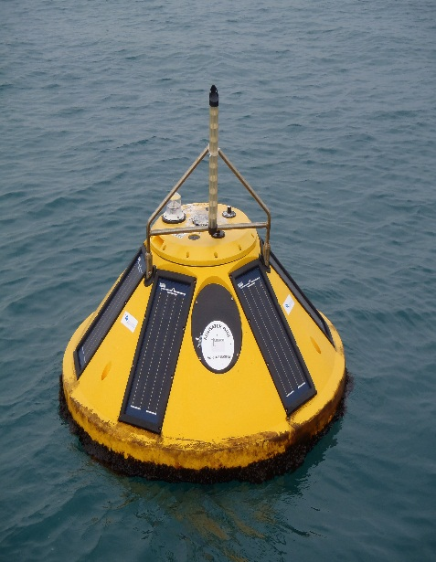
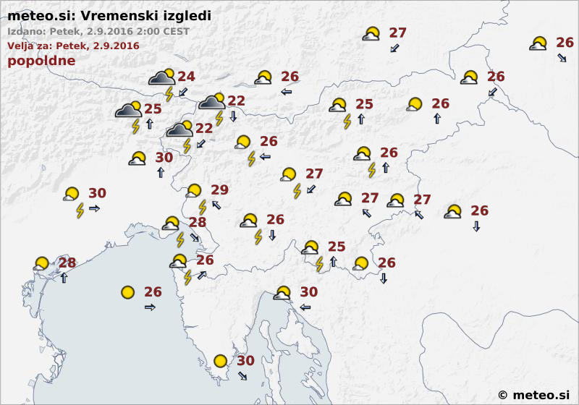
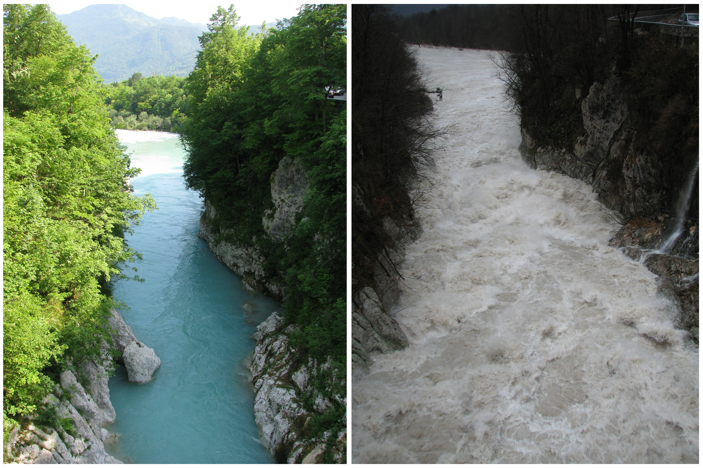
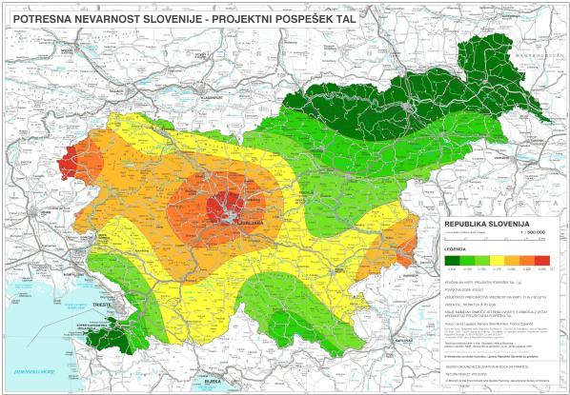
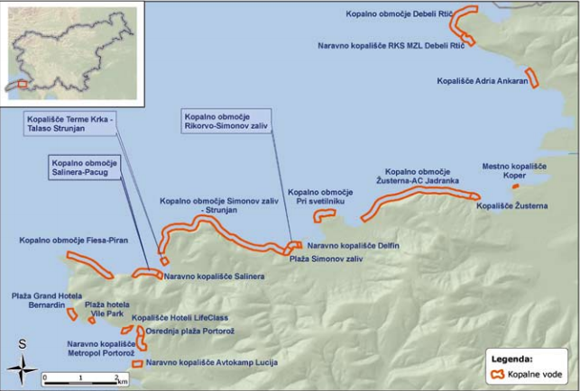
ARSO
Tasks covered by ARSO:
National Meteorological Service
National Hydrological Service
National Seismological Service
Environmental State Monitoring and Reporting
Environmental Permiting and Licensing
~ 17 mio EUR annual budget
303 employees

Slide 3


ARSO
Monitoring activities
Meteorology
Hidrology
(rivers, lakes, underground water, marine data)
Seismology
Water Quality
Air Quality
1100 measuring locations
3800 measurement systems
330 different types of measuring equipment
27.000.000 measured data points/year

Slide 4
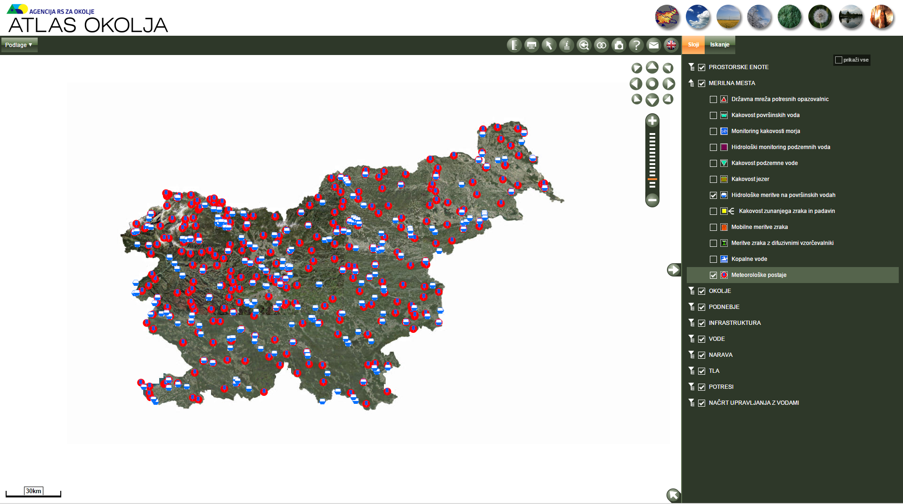
Hidrološki in meteorološki podatki
ARSO Metadata portal – „Environmental Atlas“
Slika: Model ALADIN – napoved padavin
Slika: Modelska napoved pretoka Save
Slika: Modelska napoved valovanja morja

Slide 5
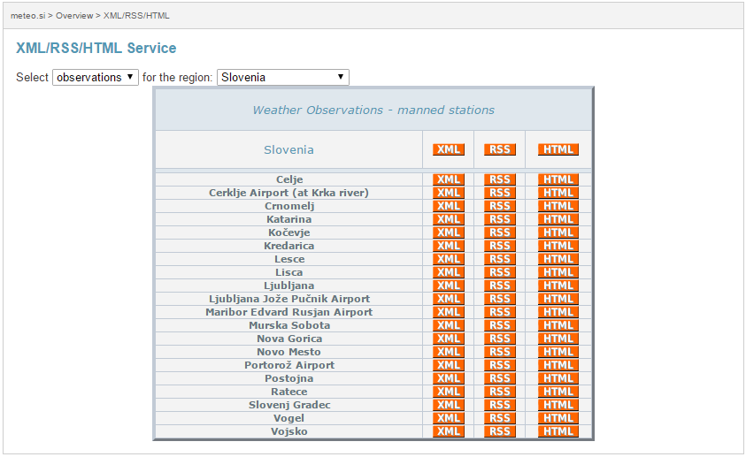
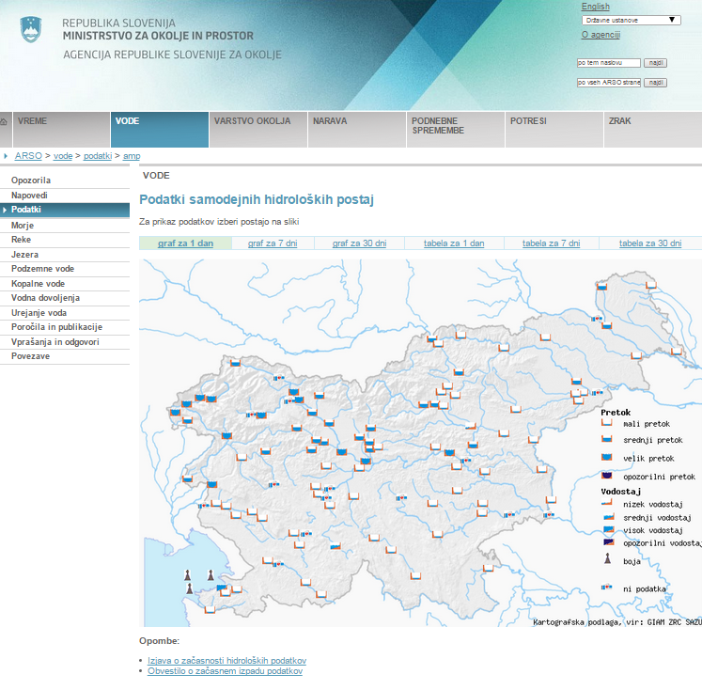
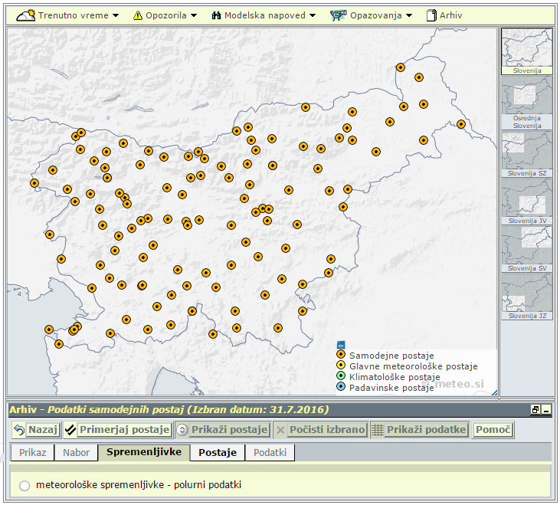
ARSO
Free and open data policy
National Environmental Act (Art.13, Art. 110)
Access to Public Information Act
Directive 2003/98/EC on the re-use of public sector information (PSI Directive)
Aarhus convention

Slide 6
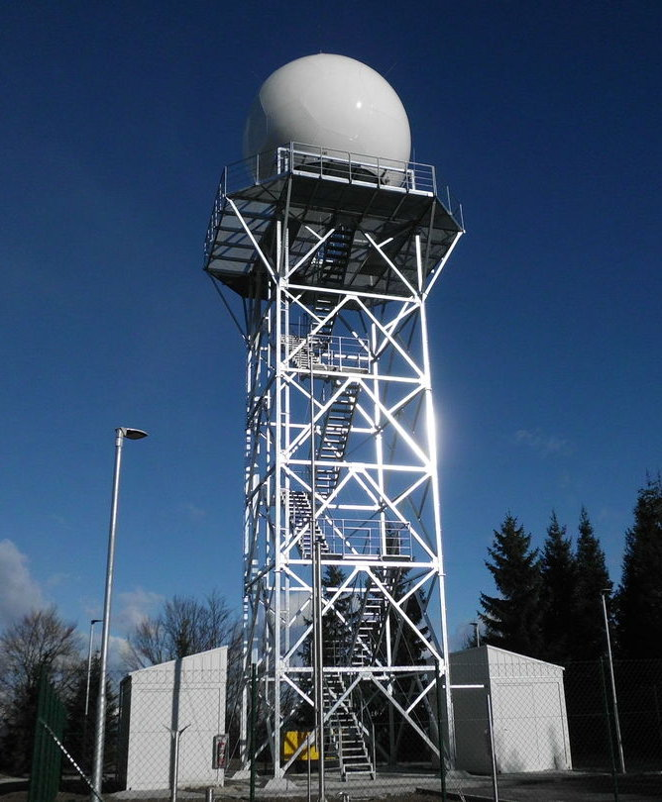
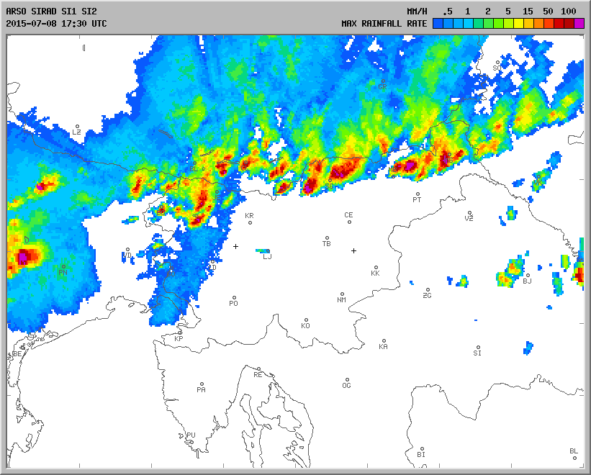
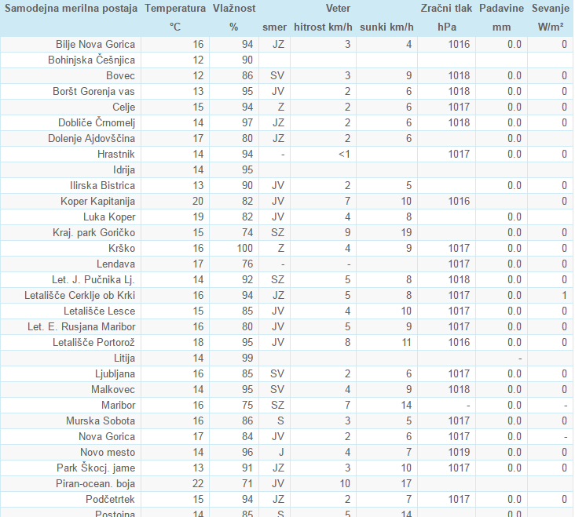
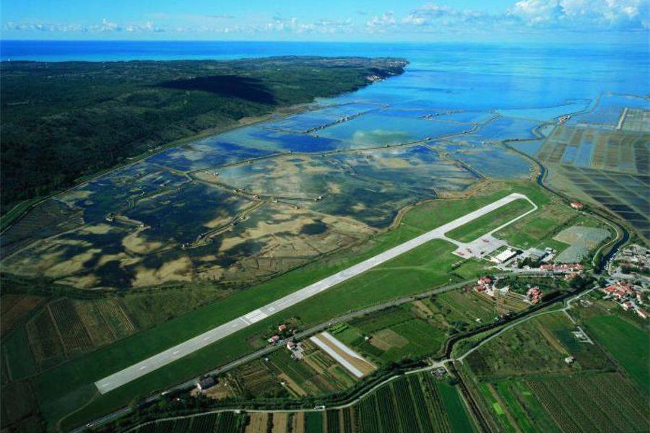
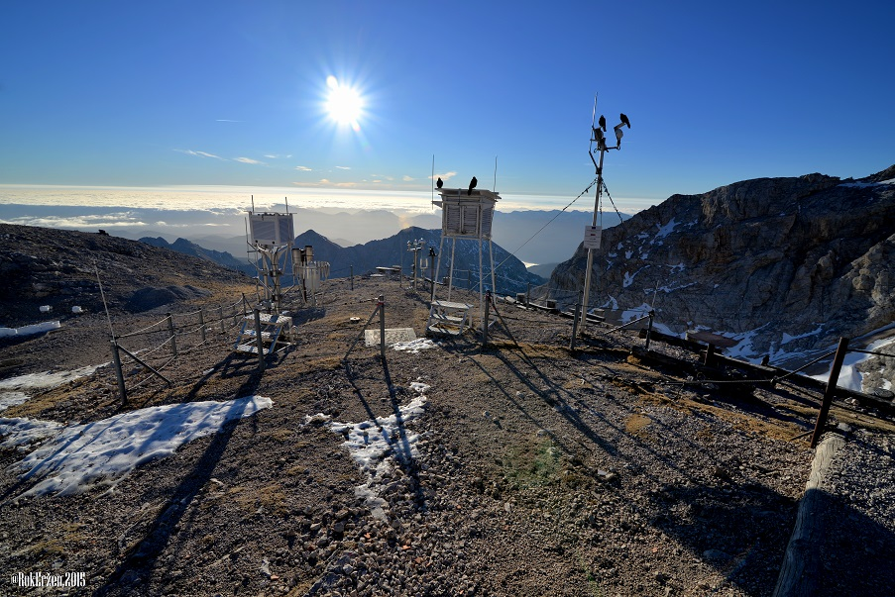
Meteorological data
Real time meteo data
  T, RR, p, wind, solar radiance, ...
Agrometeorological data
  evapotranspiration
  soil moisture&temperature
www.arso.gov.si

Slide 7
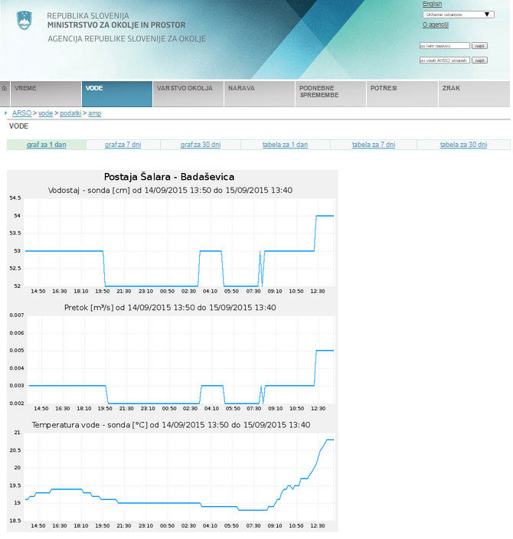
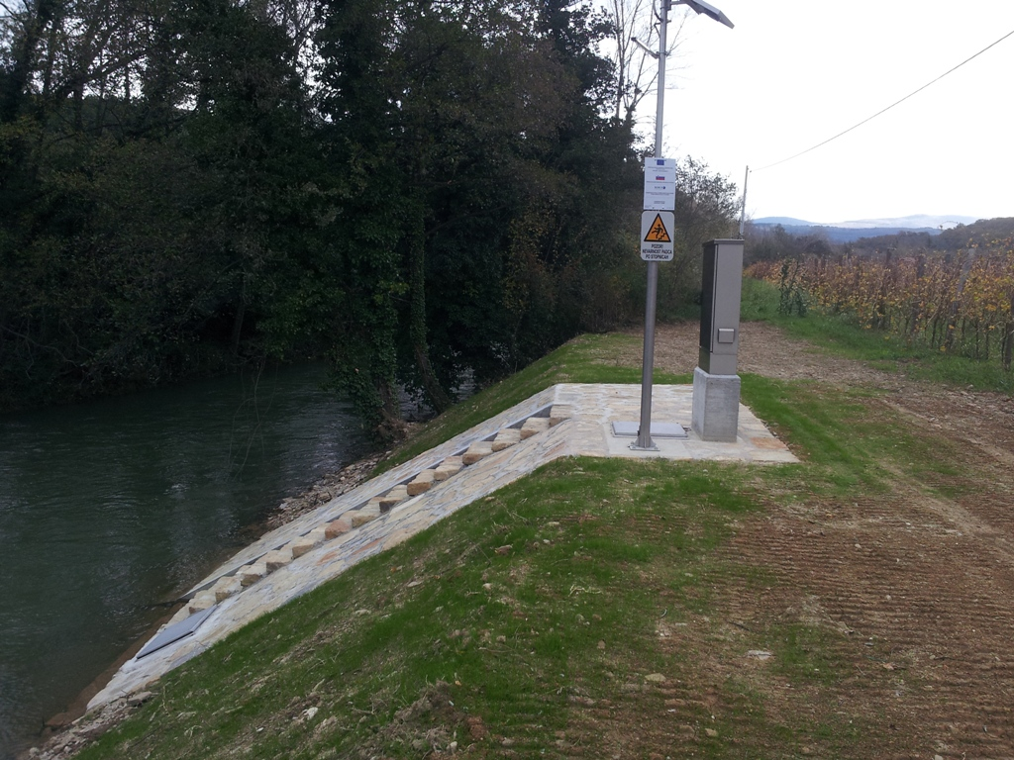
Hydrological data
River monitoring network:
  water temperature
  water level
  discharge (*Qcurves monitoring)
  real time data
  180 stations
River (fresh water) inflow real time data important for the oceanography!
www.arso.gov.si

Slide 8

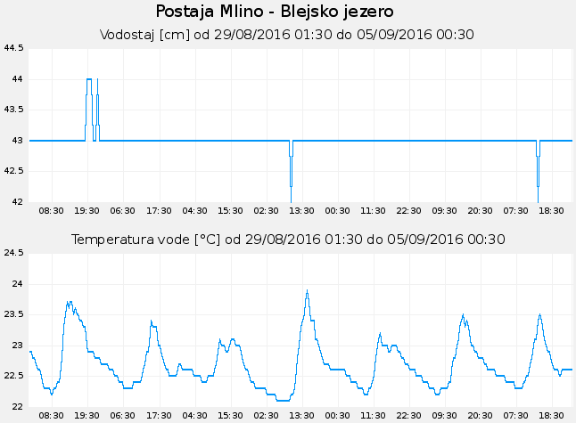
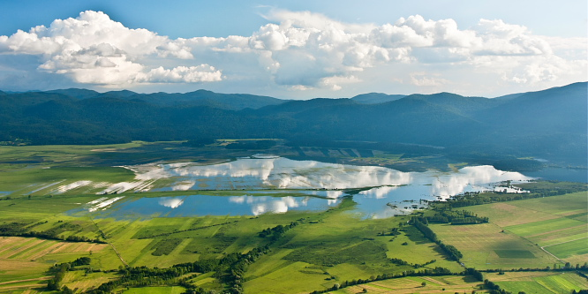
Hydrological data
Lakes monitoring:
  water temperature
  water level
www.arso.gov.si

Slide 9
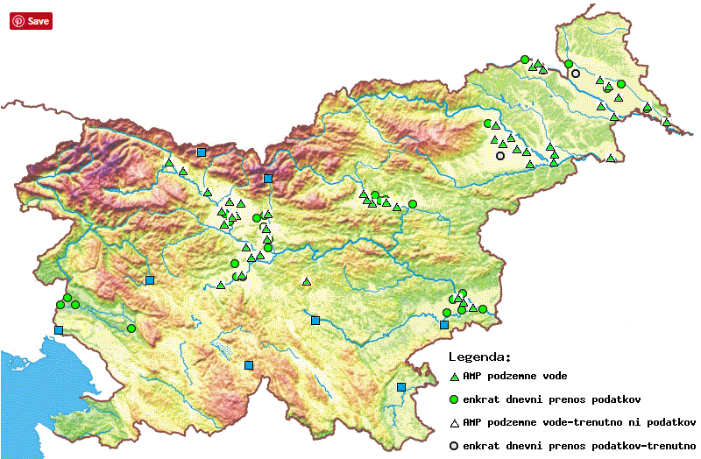
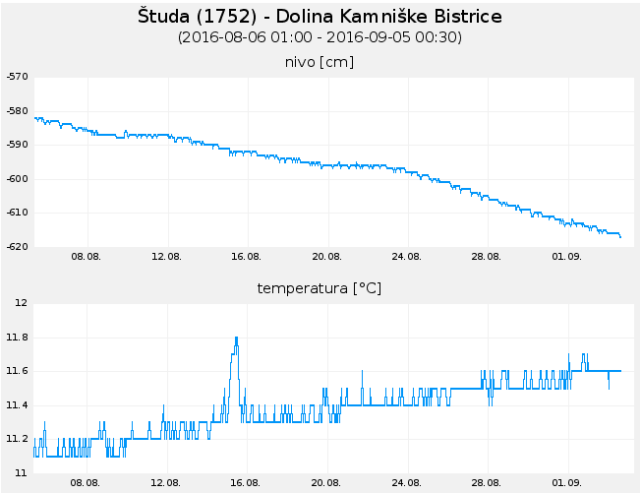
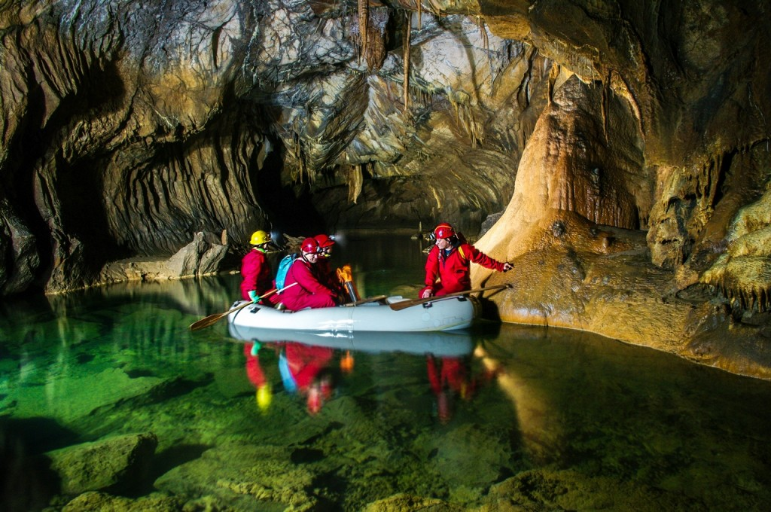
Hydrological data
Underground water monitoring:
  water temperature
  water level
www.arso.gov.si

Slide 10
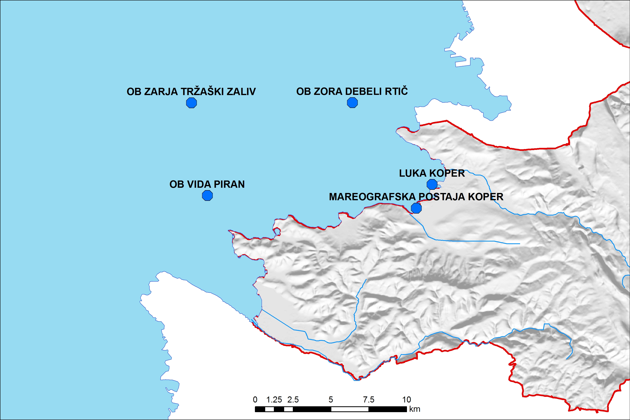
Operational marine monitoring network
Gulf of Trieste – Northern Adriatic Sea
HF antena
Letališče Portorož

Slide 11
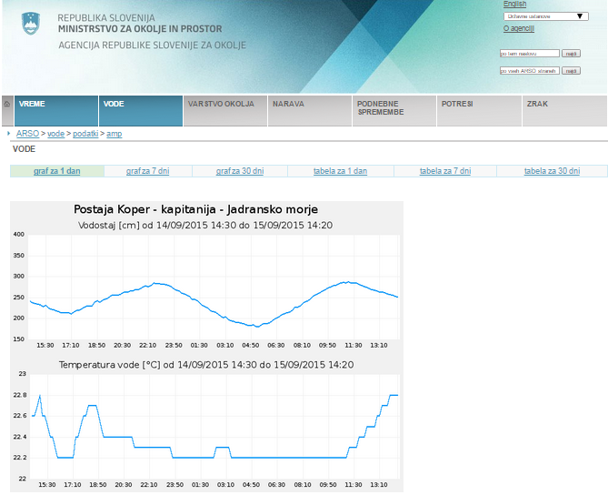
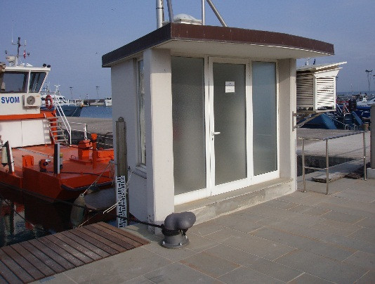
Marine data
Mareographic station Koper:
  Sea data:
  sea surface temperature
  sea level
  Atmospheric data:
  air pressure
  air temperature
  wind
  air humidity
  precipitation
  solar insolation
Funds: ESEAS project
www.arso.gov.si

Slide 12
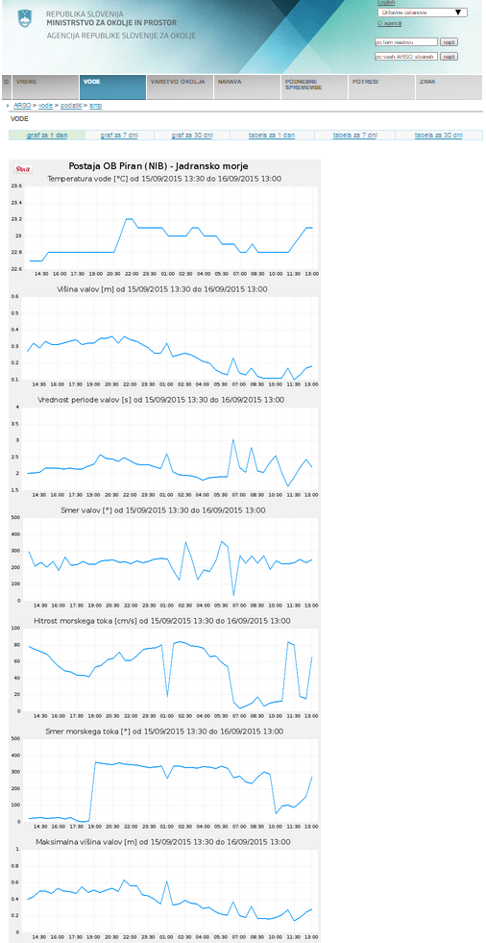
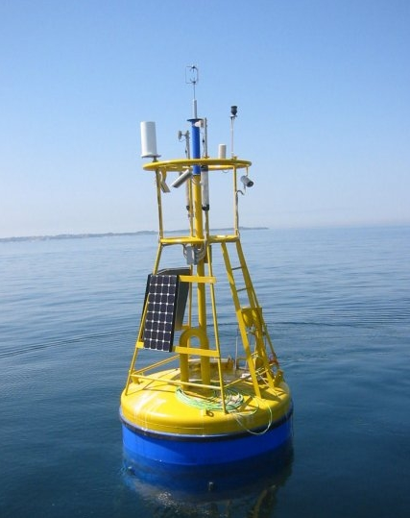
Marine data
Oceanographic buoys - general:
  sea temperature
  waves
  currents
www.arso.gov.si

Slide 13
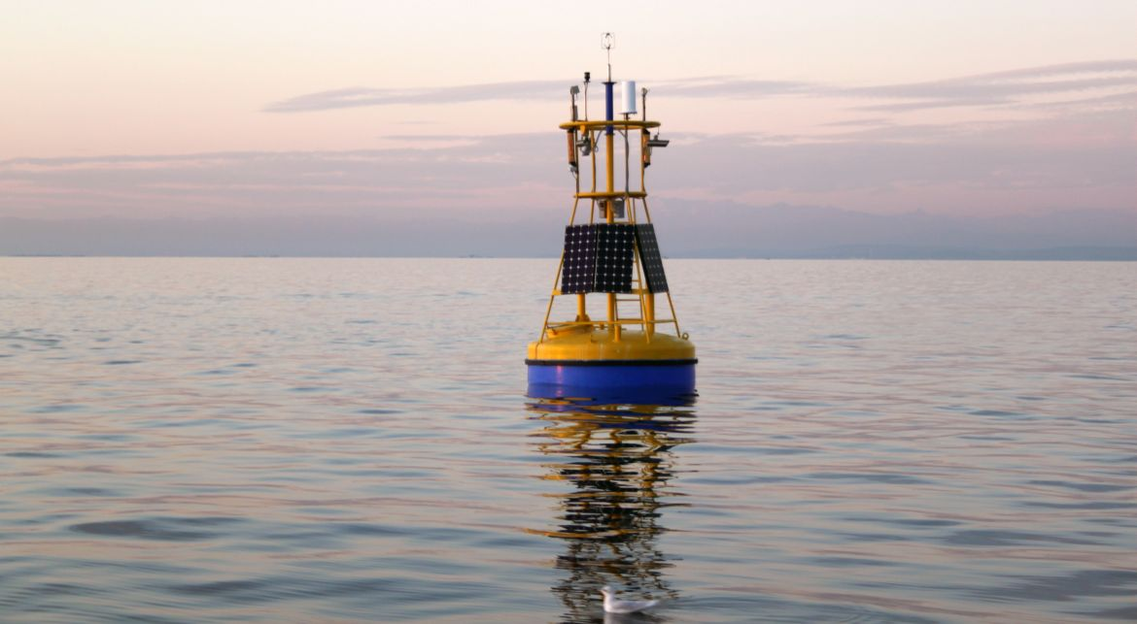
Marine data
Oceanographic buoy Vida:
  sea temperature (surface & bottom)
  waves
  currents in water column
  salinity
  air temperature & humidity
  wind
  dissolved oxygen (bottom)
  clorophyill sensor
Regular monitoring (since 2002)
Marine biology station Piran (NIB-MBP) – buoy owner (buoy financed through Interreg SLO-ITA projects)
ARSO – covers maintainance costs (included in national monitoring network)
common data ownership

Slide 14
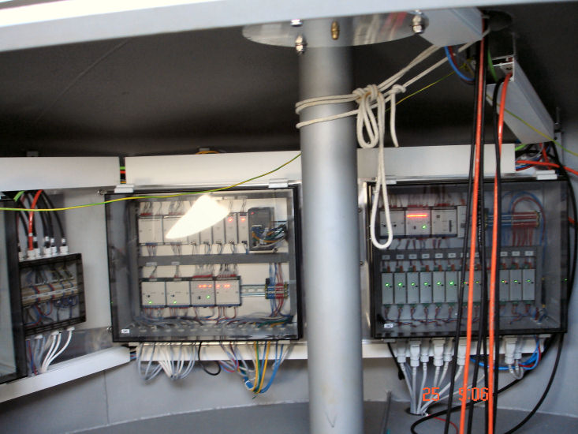
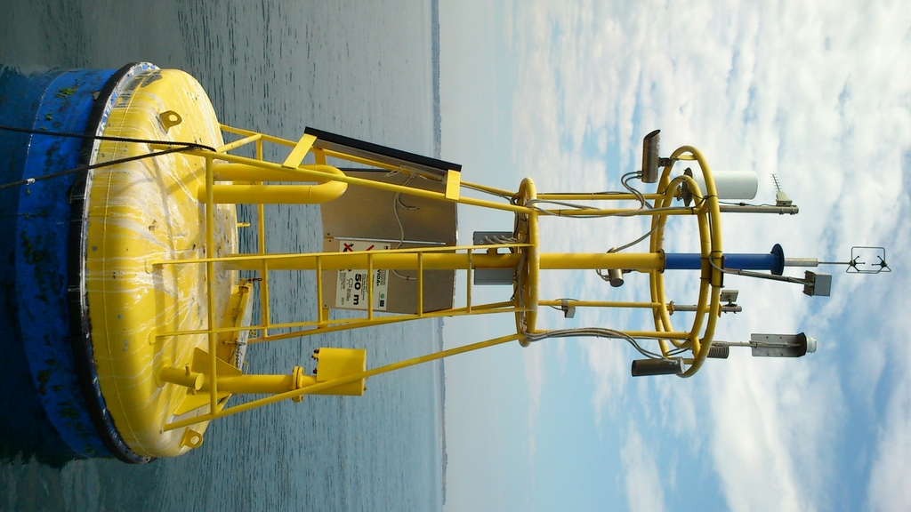
Marine data
Oceanographic buoy Vida:
  product of Slovenian companies
  production year: 2008
  funds: project Interreg Slovenia-Italy
  yearly maintainance cost: ~ 34 k€ (monitoring contract between ARSO and NIB-MBP)
  major remont: 2013 (~3 months out of the water)
  remont cost: ~70k€ (renew and upgrade)
  5 years continously in water
  power suply: solar panels&accumulator + backup methanol fuel cells
  3-point mooring system
  data transfer - antenna

Slide 15
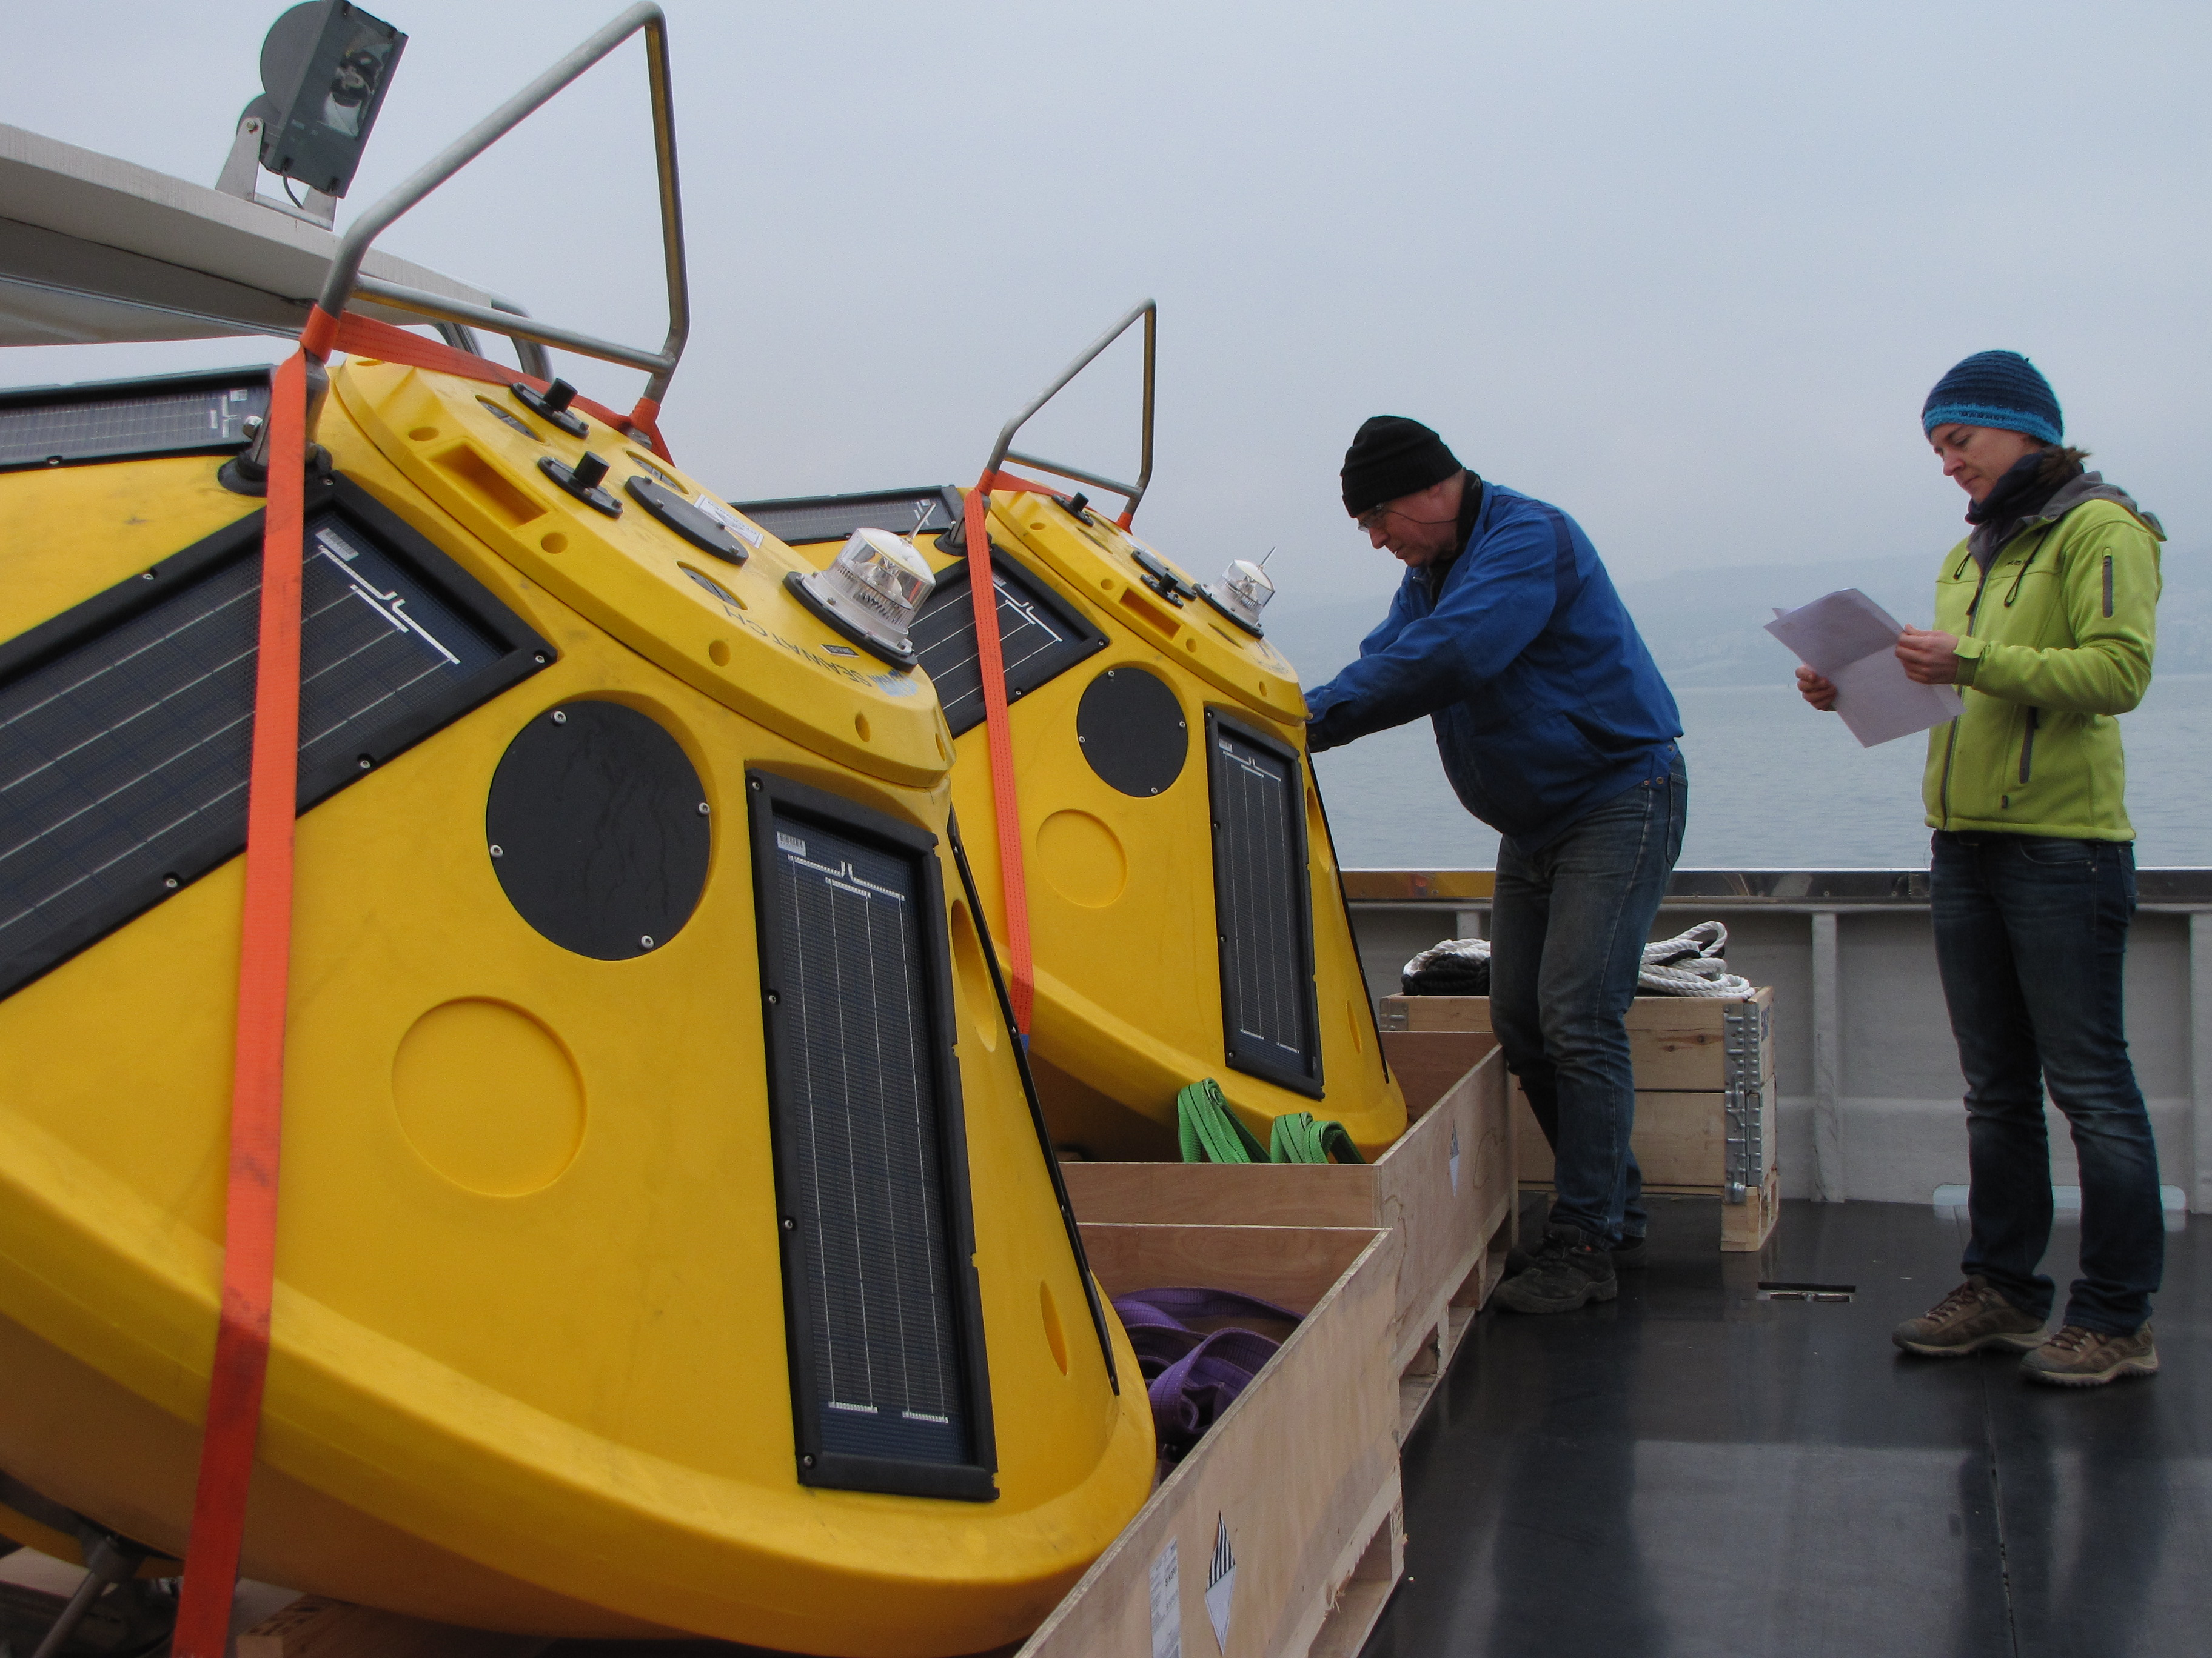
Marine data
Oceanographic buoys – Zora in Zarja:
  sea temperature
  waves
  currents in water column

Slide 16
Marine data
Oceanographic buoys – Zora in Zarja:
  buoy type: Fugro Oceanor Midi 185
  no meteo sensors (lack of funds), but plan to upgrade with meteo mast
  in water since 16th January 2014
  power suply: solar panels&accumulator + backup Lithium batteries
  yearly maintainance cost: ~2k€ for both buoys (boat rental cost, diver, some material)
  2 years continously in the water
  1-point mooring system
  data transfer: GPRS modem

Slide 17
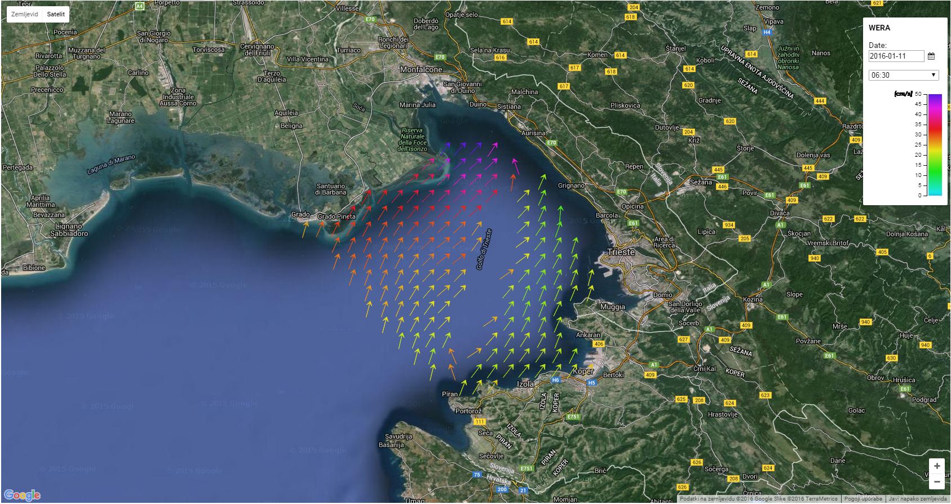
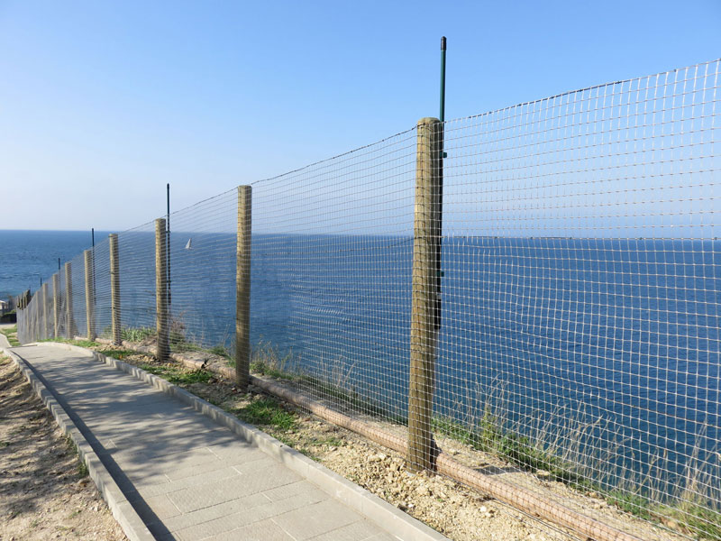
Marine data
HF radar – WERA system:
  sea surface currents
  waves (potentially)
Regular monitoring (since 2015)
Cooperation between:
    Marine biology station Piran (project HAZADR; IPA Adriatic)
    OGS (project HAZADR; IPA Adriatic)
    ARSO – cofinancer of Slovenian part (included in national monitoring network)
common data ownership
2021 – planned ownership transfer of equipment from NIB to ARSO (Slov. part)

Slide 18
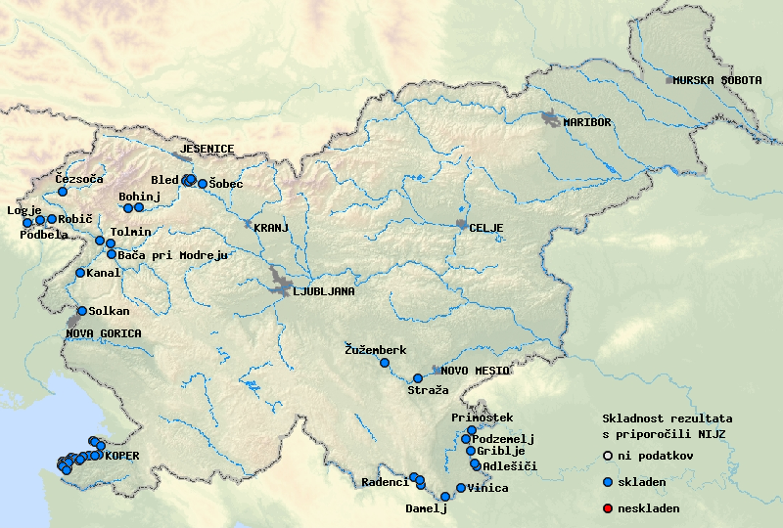
Water quality monitoring
Provided by NIB on behalf of ARSO (yearly contract)
bathing water quality during bathing season (National Laboratory of Health, Environment and Food)
Reporting to EC – Bathing water directive

Slide 19
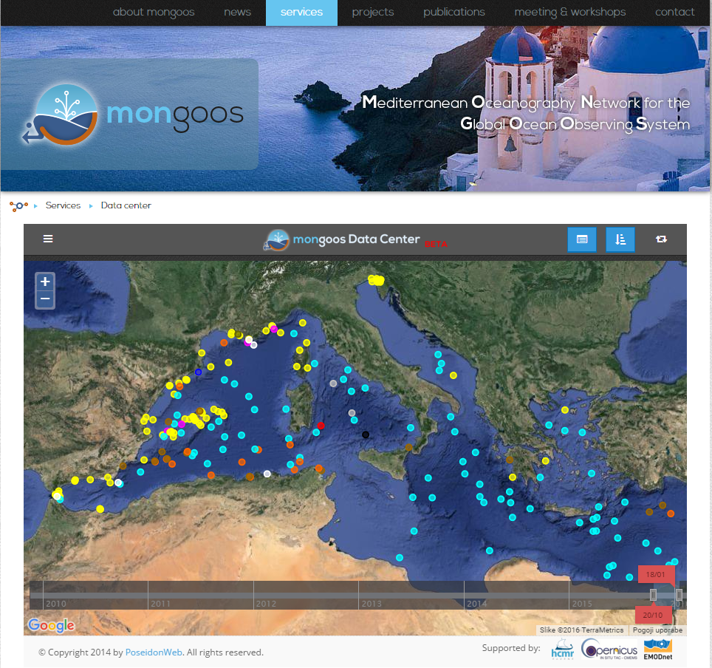

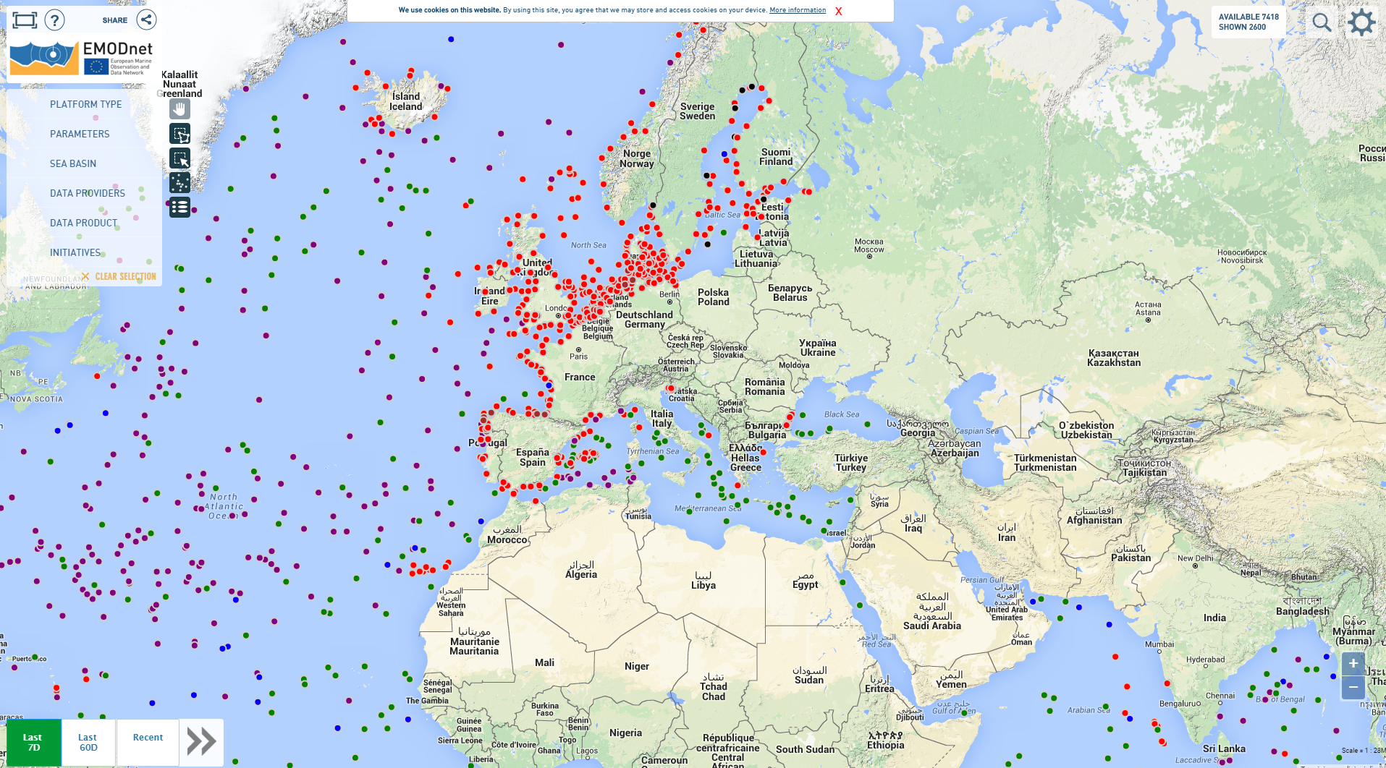
Meteo and Oceanographic Data Exchange
International data exchange:
Meteorology – Synop Data
  exchange format: BUFR
MONGOOS Data Center
  file exchange format: ASCII
EMODNET Physics through MONGOOS
WMO-IOC Data Buoy Cooperation Panel
  buoys reported, data transfer not established yet

Slide 20
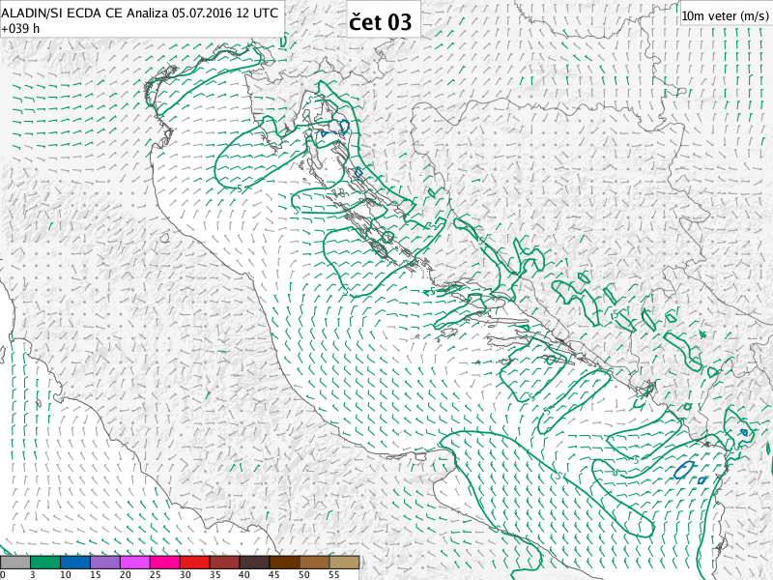
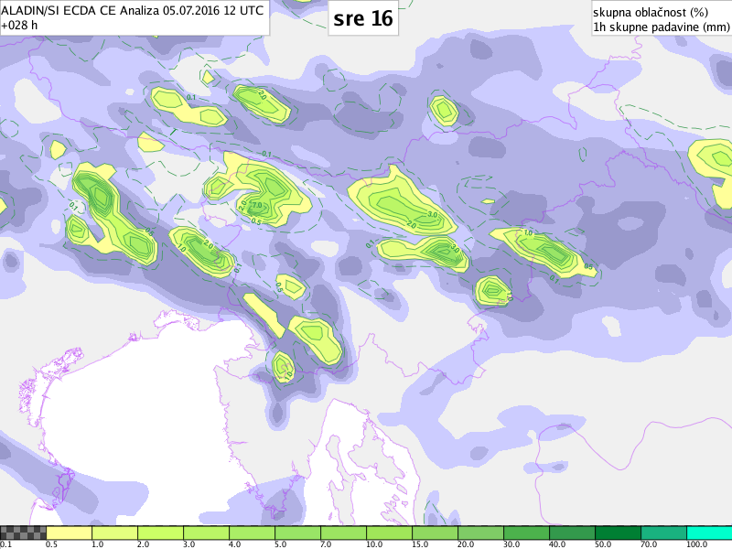
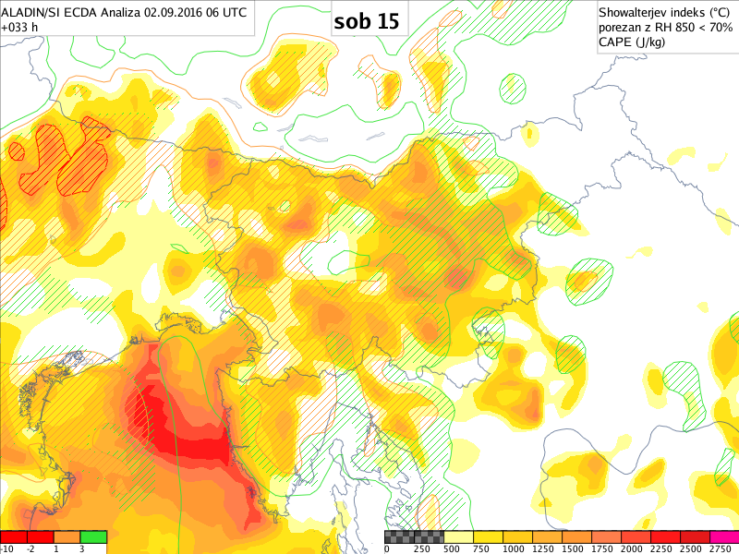
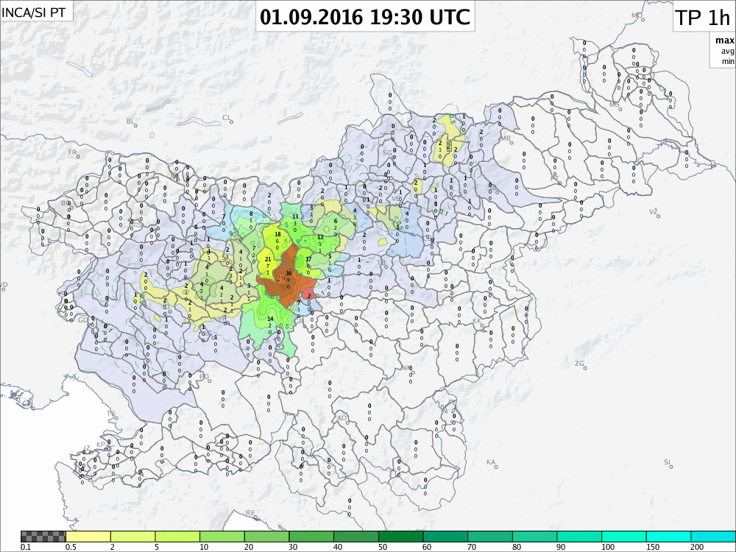
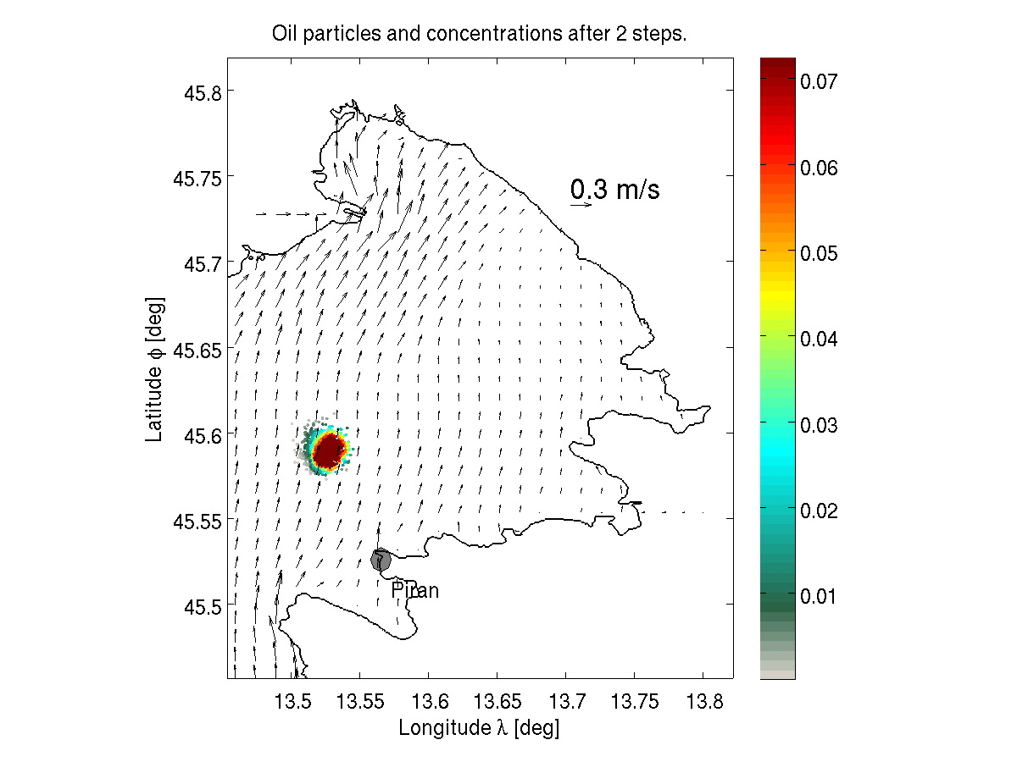
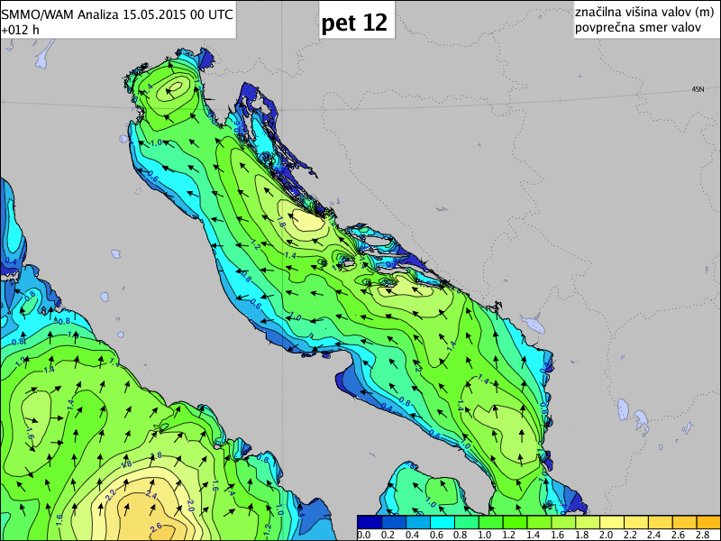
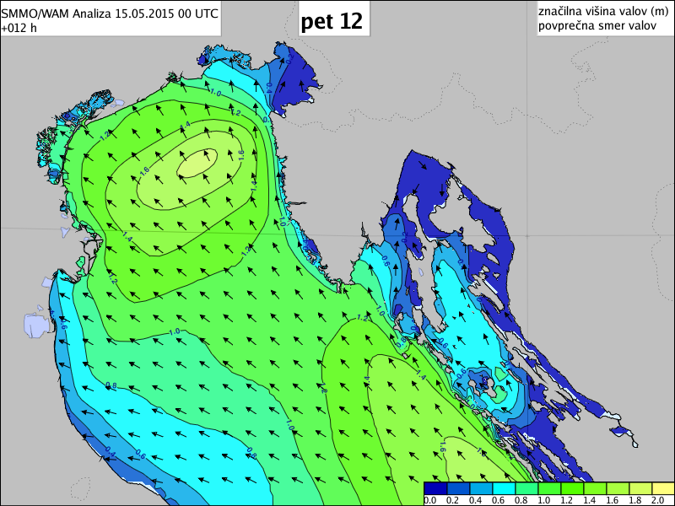
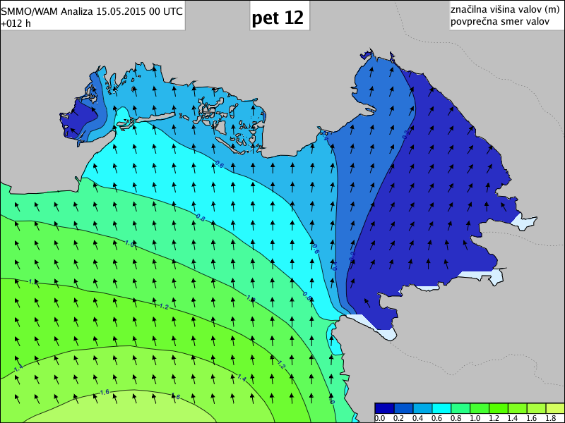
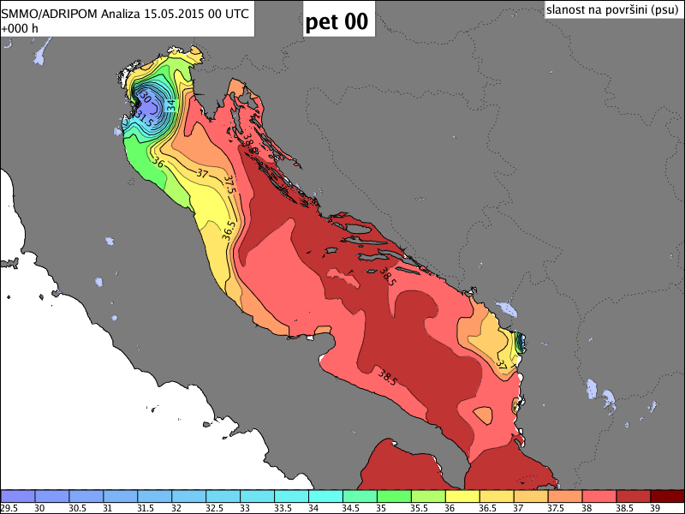
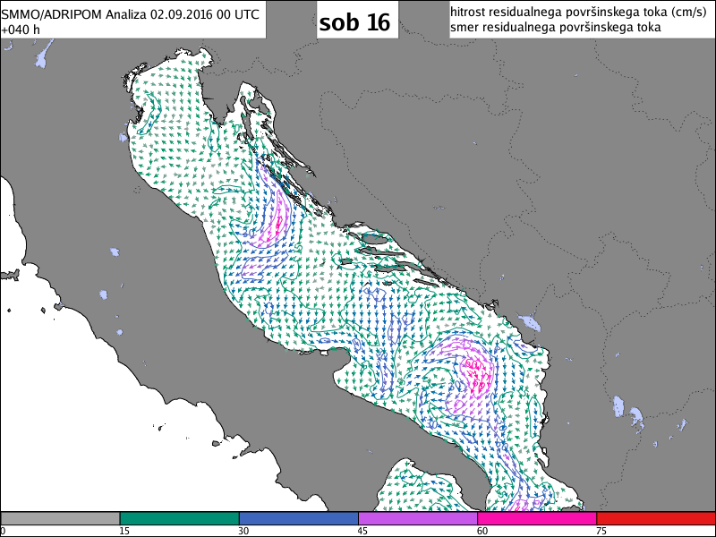
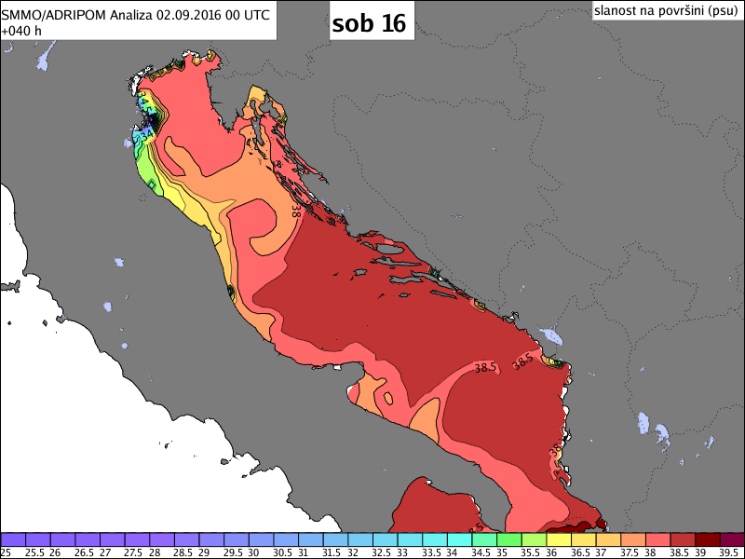
Operational models
ALADIN – meteo LAM
  coupled with ECMWF
  coupled with ARPEGE
  experimental multiway coupling
INCA – meteo nowcasting
Wave Model WAM
Ocean Model AdriPOM
Oil Spill model NASOS

Slide 21
Thank you for your attention.

Slide 22
Conclusions
  ARSO – national meteorological, hydrological and oceanographic data provider, monitoring of water and air quality.
  Operational meteorological, hydrological and oceanographic models.
  Operational oceanographic observations mainly in cooperation NIB – ARSO
    marine water quality monitoring – NIB and NLZOH on behalf of ARSO
    oceanographic monitoring scheme – equipment funding through European projects, maintainance funding from the state budget (national monitoring network)
  Open data policy.
  International exchange – WMO Synop Meteo Data, EuroGOOS Ocean. data

