Slide 1


Mediterranean oceanography Network for GOOS and the Italian Observing System
Giovanni Coppini
Director of the Ocean Predictions and Applications Division of Euro-Mediterranean Centre on Climate Change
Co-chair of Mediterranean Oceanography Network for GOOS
Leader of the Copernicus Marine Environment Monitoring Service Med-MFC
With the contribution of: MONGOOS partners; Aeronautica Militare, OGS; CNR; INGV and ISPRA

Slide 2
Outline
MONGOOS international framework
MONGOOS data portal
The Italian Observing System
The Italian WIS DCPC Centres
Conclusions

Slide 3
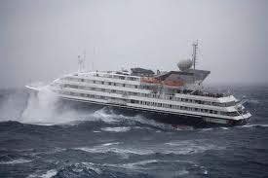
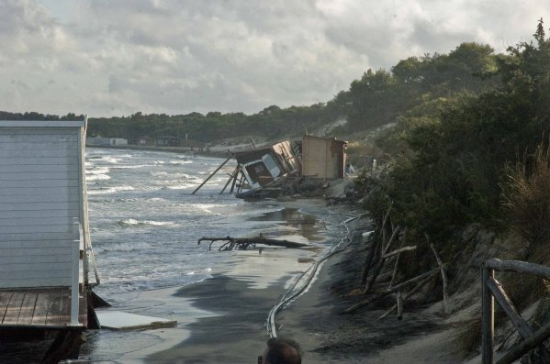
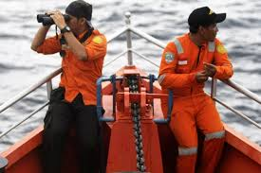
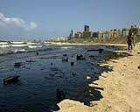
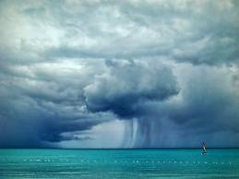
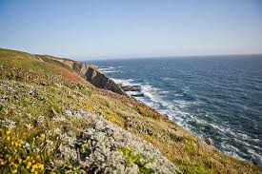

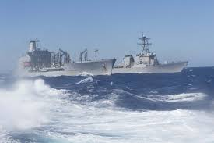
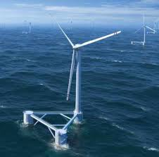
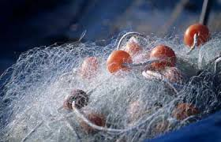
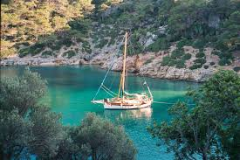
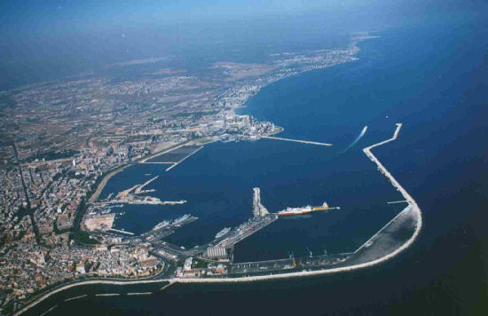
Operational Oceanography User-centered Services
Why? For whom?
Safety of navigation
Coastal protection and erosion
Pollution emergencies
Search and Rescue
Protection&management
of maring ecosystems
Off-shore
activities
Military activities
Climate Change
Renewable energies
Fishery&acquacolture
Tourism
Harbours

Slide 4
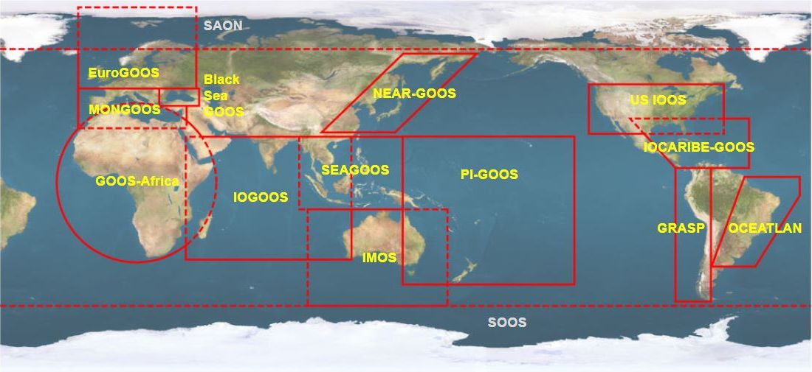
What is Mongoos?
(Mediterranean Operational Network for the Global Ocean Observing System)
GOOS regional alliance for Operational Oceanography at the Med Sea.
Objective of fostering operational oceanography in the Med Sea and promote collaboration
Mediterranean component of EUROGOOS
35 partners form 13 countries
MONGOOS principal objectives:
  Improved Fitness for Purpose.
  Greater Awareness.
  Increased Down-streaming.
  Improved Capacity.
www.mongoos.eu

Slide 5
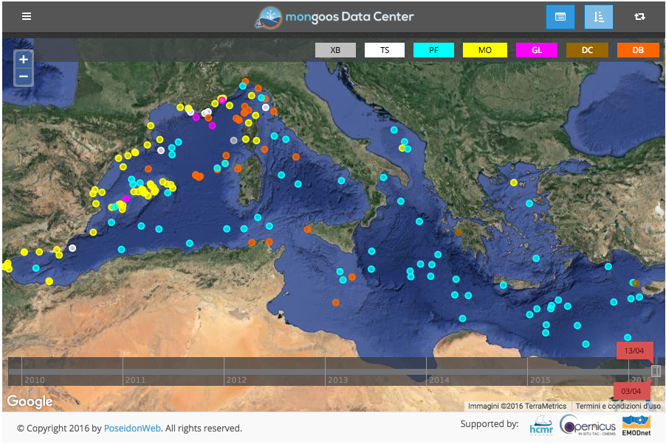
Contribution to the CMEMS in situ TAC by MonGOOS

Slide 6
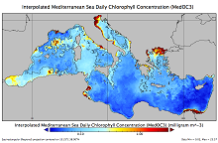
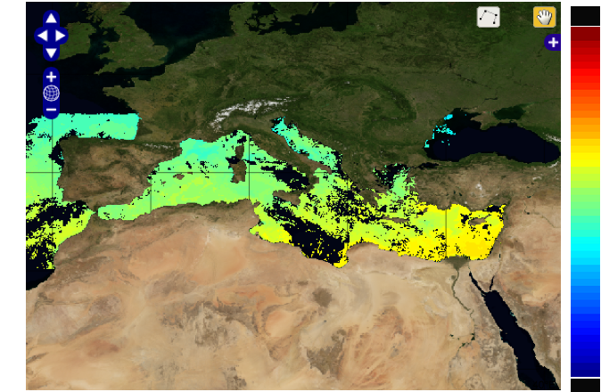
Contribution to CMEMS Ocean Color and OSI (SST) TAC by MonGOOS
CNR is coordinating the Ocean Color TAC, produce the Ocean color products for the Med and the SST products for the MED in the OSI TAC

Slide 7
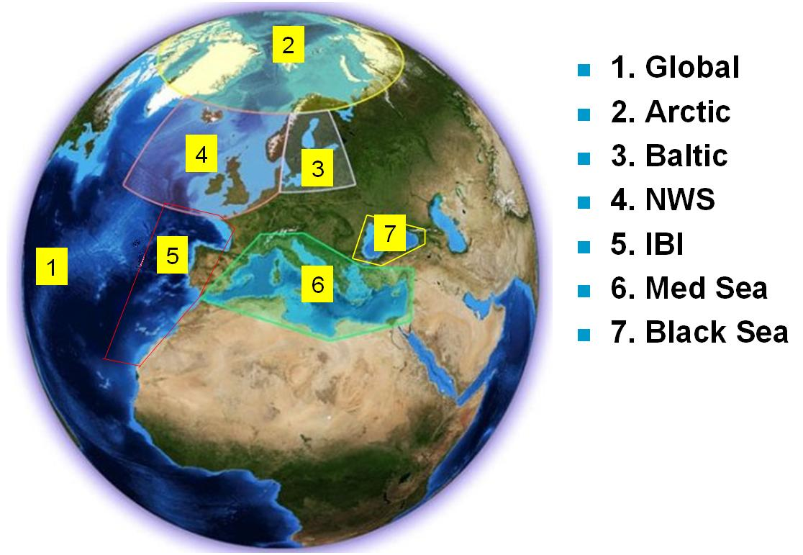
CMEMS - Forecasting and reanalysis, coord by Mercator Ocean
Arctic
A Pan-European network of existing infrastructures, value-added by the Copernicus initiative,
coordinated and with common quality standards
Baltic
North West Shelves
Global
Ocean
Black Sea
Mediterranean
Eastern North Atlantic
CMEMS MED-MFC is
coordinated by CMCC with OGS, INGV and HCMR

Slide 8
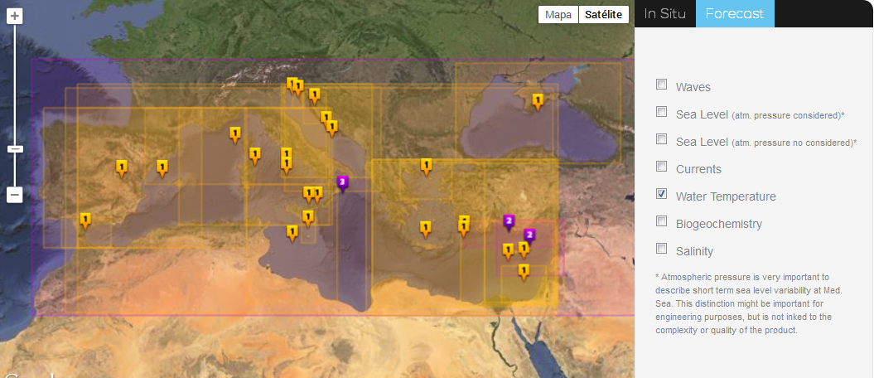
Mongoos Downscaling from CMEMS Med-MFC
Circulation forecast systems
Italy runs several high resolution forecasting systems nested in CMEMS MED-MFC

Slide 9
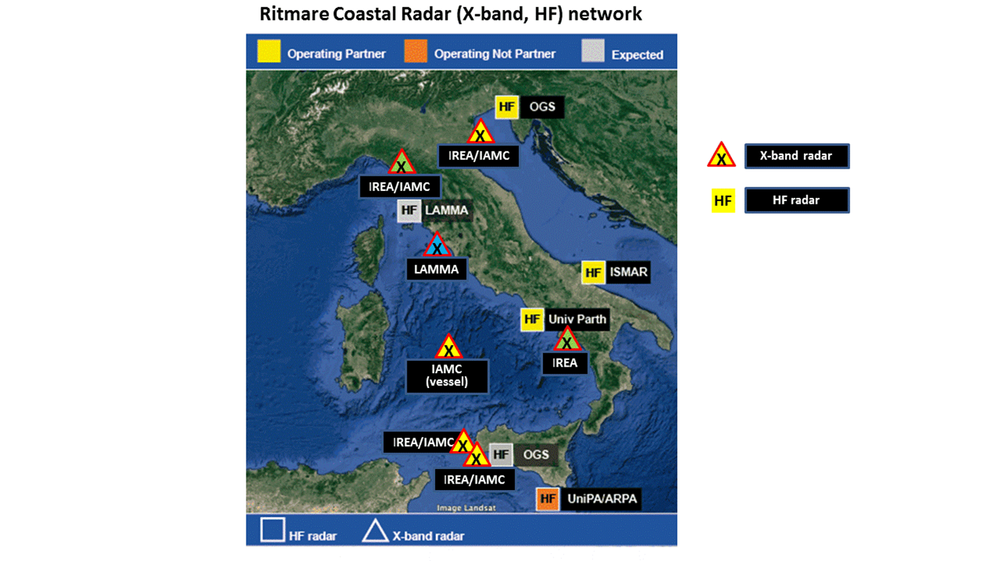
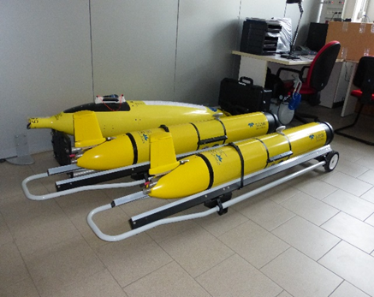
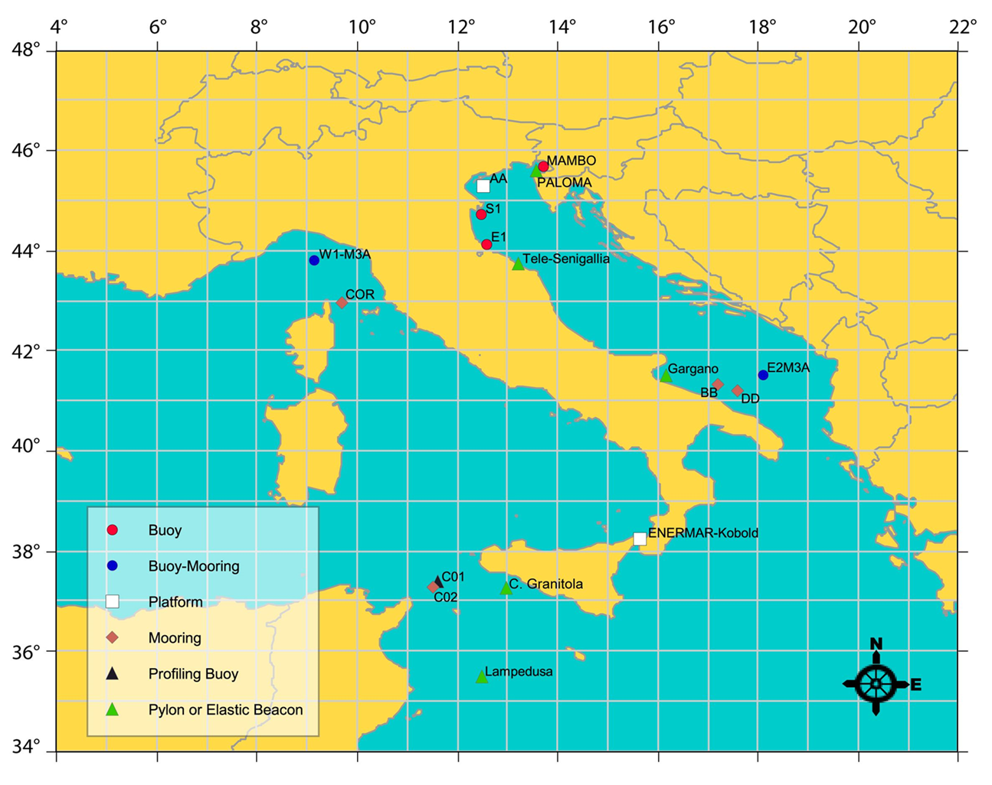
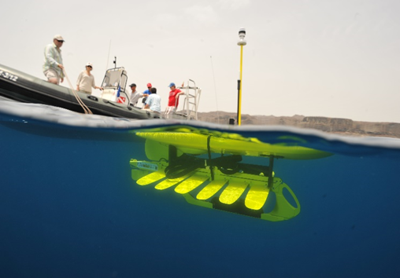
Italian Observing System
RITMARE OOS Infrastructure
Infrastructure
Fixed-point mooring | 12(+2)
Gliders | 5
Radars (HF, X band) | 3+2, 4+3
Relocatable equipment | 2 additional deep-sea moorings
Pre-opeartional models | 7 (2 Mediterranean scale)

Slide 10
International Dimension
- Italian component of MonGOOS/EuroGOOS
- EC H2020 JERICO NEXT
- EC FIXO3
- EC GROOM/EGO
- Link with ESFRI EuroARGO, EMSO (ICOS, LTER Europe)
- COPERNICUS Marine Services
- JCOMM
Notes:
RITMARE is an Italian Flagship Project but its activities are to be harmonized with the European landscape. Major contributions are foreseen both at Italian and European level.

Slide 11
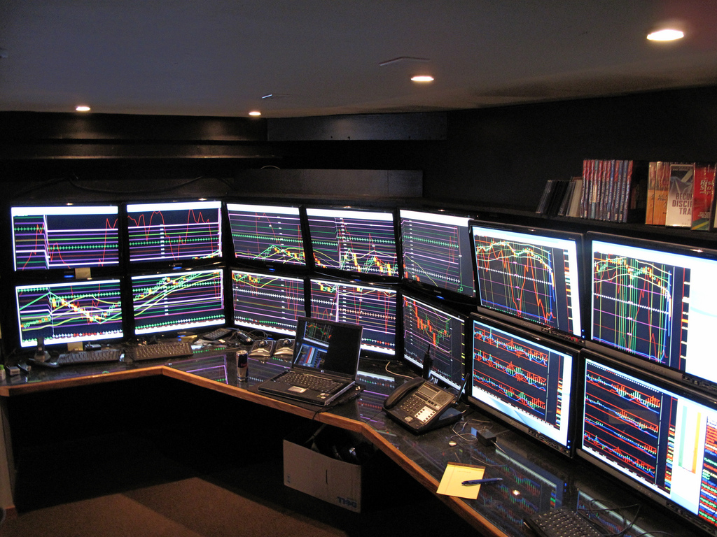
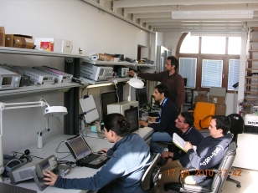
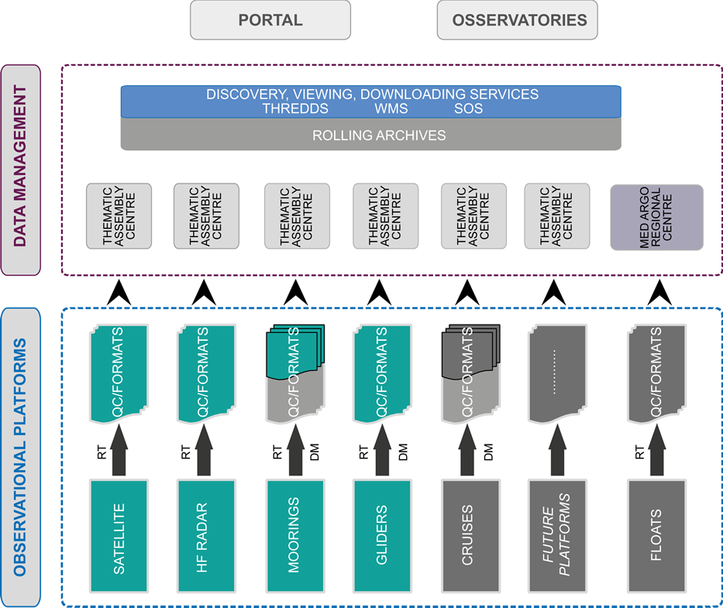
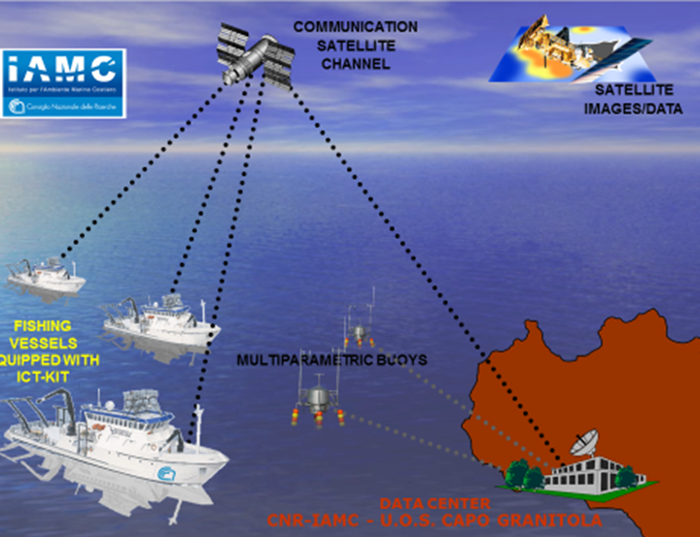
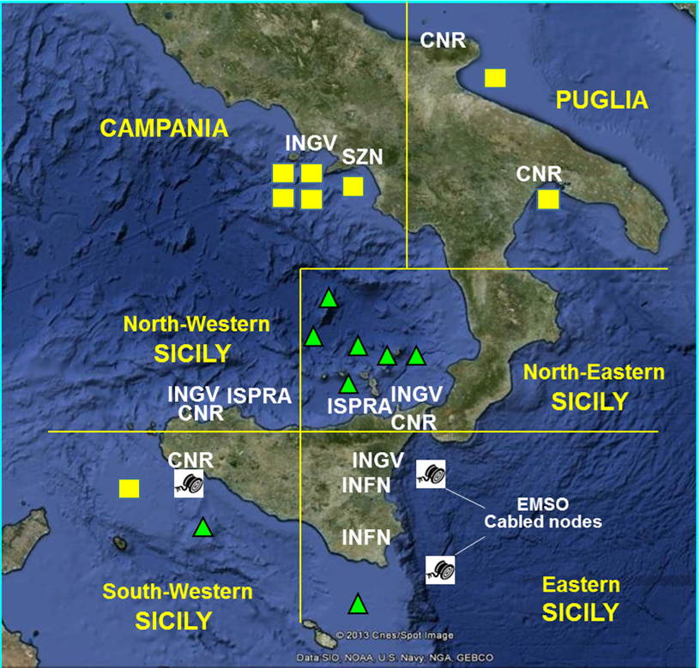
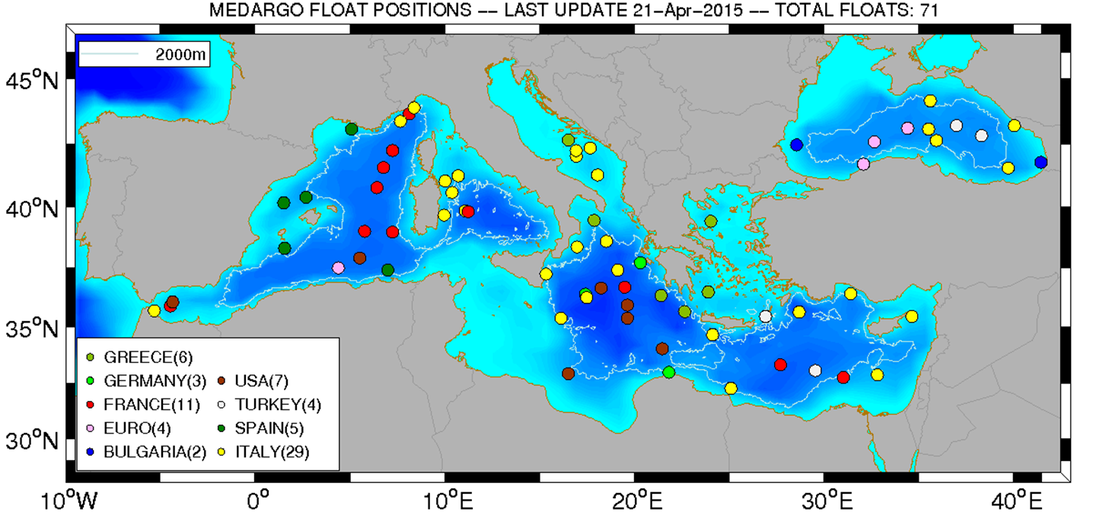
Extended RITMARE OOS
Portal
Fishery Oceanography
Observing System
Infrastructure
BioAcoustics
Infrastructure
EMSO-MedIT
MedARGO

Slide 12
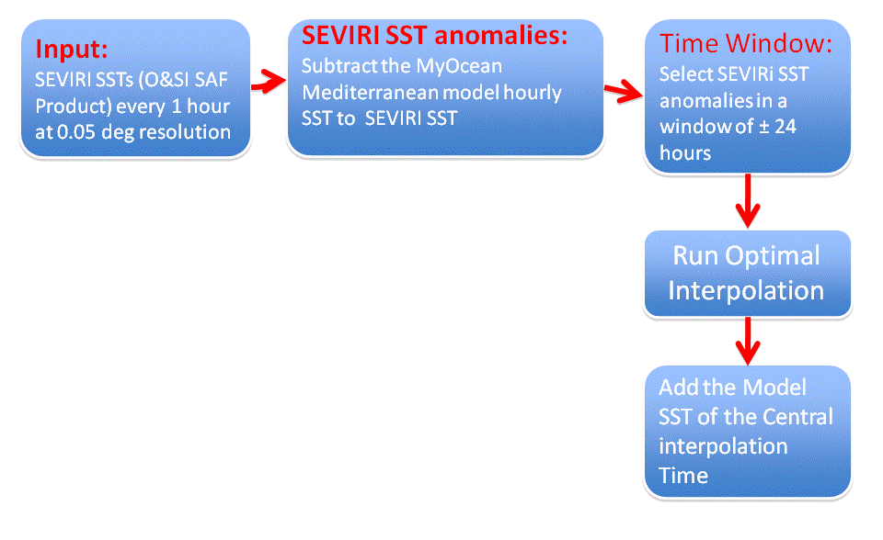
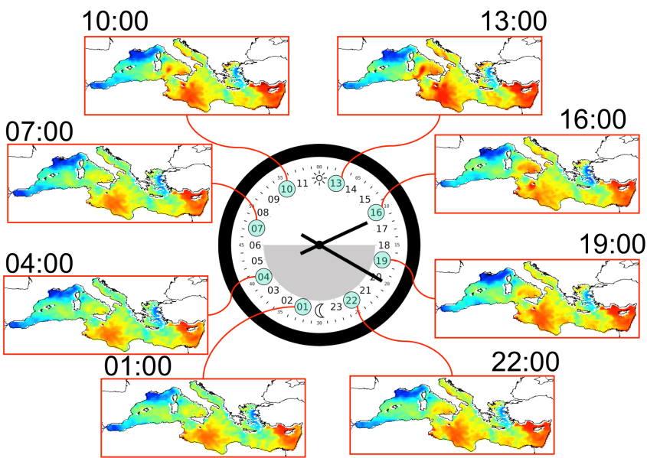
Integrated remote sensing observing component
SAT_LBR: SST hourly field on 07.06.2011
Test and validation
Density plot of observations against model for the DOISST validation
Marullo et al. RSE, 2013
Notes:
Here is an innovative product from WP2: the Sea Surface Temperature hourly field made available on a daily base.
The blue boxes show the methodology implemented for the field reconstruction and validation from satellite images.

Slide 13
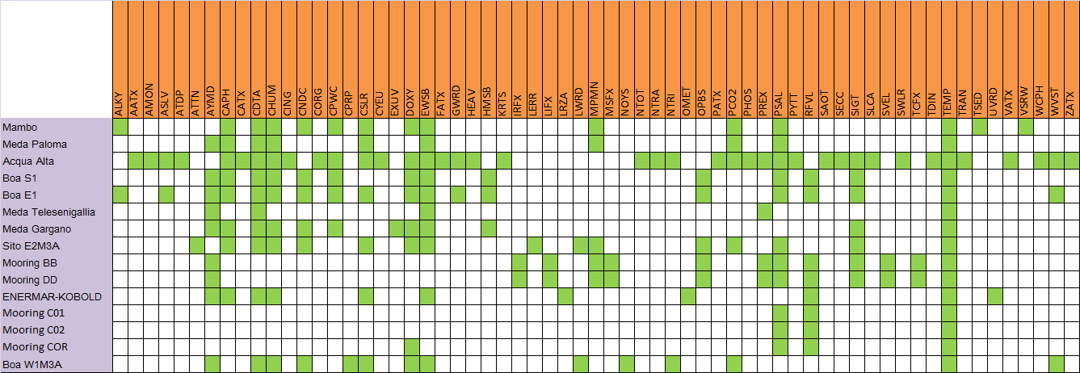
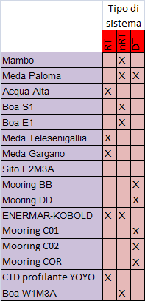
Network of fixed sites for sea observation
Data availability
Measured variables

Slide 14
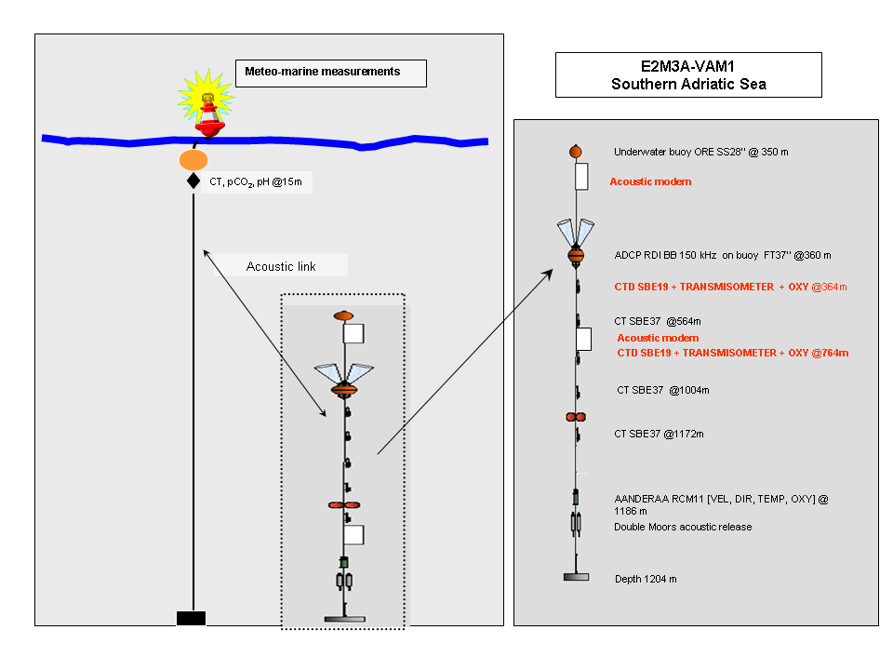
E2M3A Deep-sea Observatory
The surface buoy line is completely of:
▸ hull and superstructure Resinex
▸ mooring system
▸ data acquisition and control system
▸ telemetry system Iridium
▸ power system
▸ payload (sensors)
▸ auxiliary equipment
▸ meteorological station
▸ pCO2 Pro-Oceanus
▸ pH SAMI
The second mooring line holds most of the scientific instruments:
▸ 1 ADCP RDI150 kHz upward
▸ 2 CTD SBE 16plusV2 SEACAT, RS-232
▸ 3 CT SBE 16
▸ 1 RCM11 Aanderaa

Slide 15
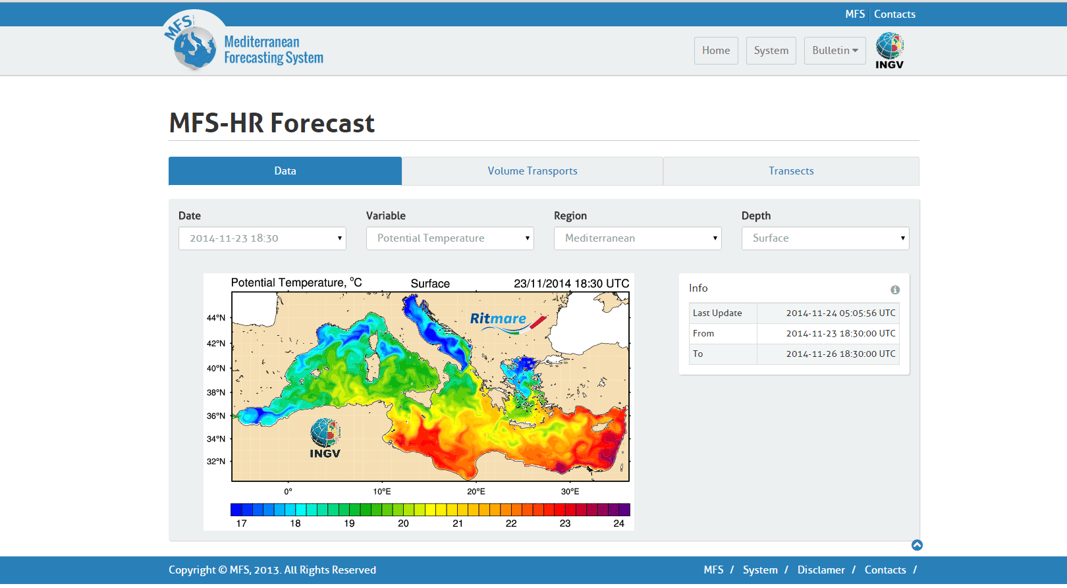
Forecasting Systems: MFS-HR
Notes:
Development of the Mediterranean Forecasting System, forced with the COSMO-ME system (Italian Air Force).
This system differs from MFS, that is part of the Copernicus Marine Service, because a different high resolution atmospheric forcing is used.
Products are released on daily base and include analysis and 72-hour forecast maps .

Slide 17
RITMARE Data Policy
Single data policy for the whole project
Open and free access for all users (internal and external)
Data originator must be quoted
Data originator must be contacted before any publication (in the first 2 years)
A observation-dependent moratorium is adopted to preserve the data originator publication priority
Metadata delivery is required

Slide 18
Italian WIS DCPC Centres (1)
ITALIAN DCPC - RTH (Rome Regional (Telecommunication Hub)
WWW-GTS-RTH >> WIS-RTH with the role of WIS DCPC
ITALIAN DCPC RSMC MMO-Med:
Regional Specialized Centre for Marine Meteorology and Oceanography over Mediterranean Sea with the role of WIS DCPC

Slide 19
The Italian WIS RTH DCPC Structure
GISC
(DWD)
GISC
(MOSCOW)
ITALIAN DCPC - RTH
NATIONAL CENTRE
(GREECE)
NATIONAL CENTRE
(LEBANON)
NATIONAL CENTRE
(MALTA)
NATIONAL CENTRE
(TURKEY)
NATIONAL CENTRE
(ITALY)
NATIONAL CENTRES
NATIONAL CENTRES
NATIONAL CENTRES

Slide 20

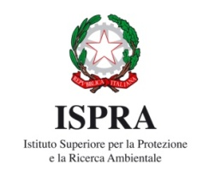

Italian WIS DCPC RSMC MMO-Med Structure
GISC- DWD
(principal)
GISC-MOSCOW
Italian DCPC RSMC MMO-Med
NATIONAL CENTRES
OTHER NCs
INGV
INGV
ISPRA
OGS
Notes:
20

Slide 21
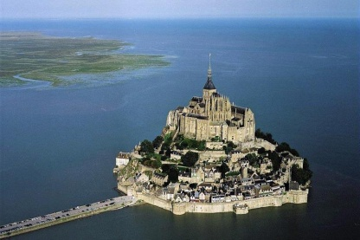
Italian DCPC RSMC MMO-Med
Examples of porducts
Marine Meteorological products
Observations | Wave monitoring system
Forecasts | NWP including EPS; post-processing including expert systems; value-added products
Notes:
21

Slide 22
Italian DCPC RSMC MMO-Med
Examples of porducts
Oceanographic products
Observations | profiling floats, tide gauge monitoring network
Forecasts | ocean and wave (including coastal) forecasts; on-line validation products; post-processing products; value-added products.
Future additional products: | new classes of observation, reanalyses and climatological oceanographic products, biogeochemical analyses, etc.).
Notes:
22

Slide 23
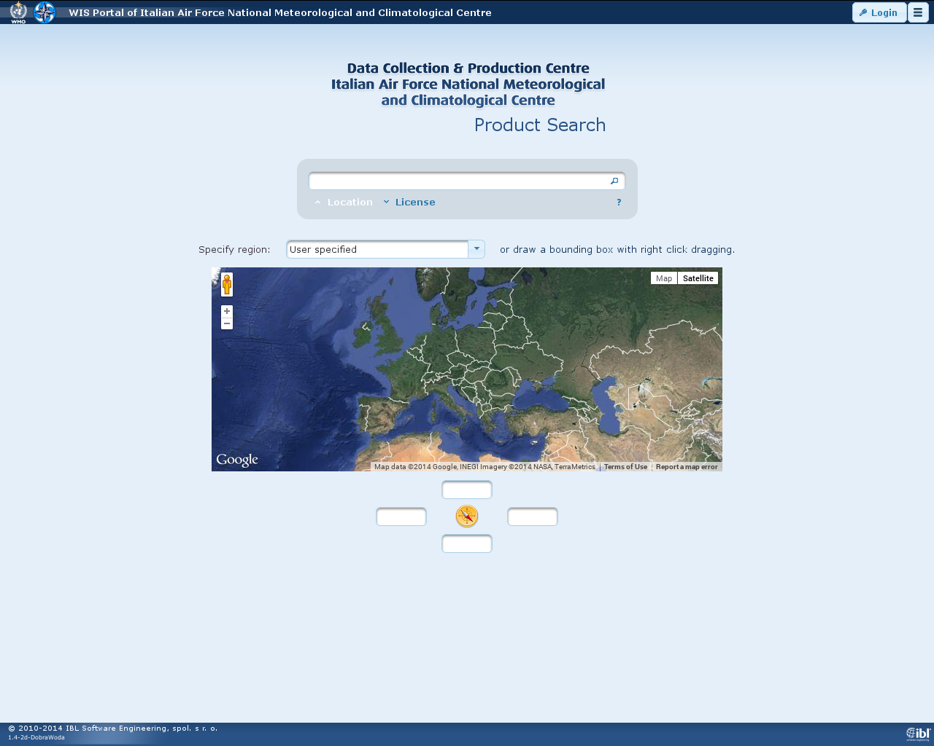
Italian WIS DCPC(s) WEB Portal
http://dcpc.meteoam.it
Notes:
23

Slide 24
Conclusions
MONGOOS facilitates the consolidation of operational oceanography in the Mediterranean
Italy coordinate the Copernicus Marine Service MED-MFC which represents state of the art operational forecasting system for the Mediterranean Sea
MONGOOS coordinate the effor of the Mediterranean Observing system in coordination with EMODET and CMEMS and should coordinate with WIGOS
Italian Observing system contribution supports CMEMS and EMODNET and should be included into WIGOS
Italy coordinate and contribute to the CMEMS MED-MFC, OC TAC and contribute to the In-situ TAC and OSI TAC
Italian Observing system data are available and more data will become available in the final phase of RITMARE
The ITALIAN DCPC RSMC MMO-Med is an opertational Regional Specialized Centre for Marine Meteorology and Oceanography over Mediterranean Sea with the role of WIS DCPC. It’s working and will be expanded in the future.

