Slide 1
Introduction on WIGOS Regional Centers --Congratulations to the RA VI WIGOS Workshop On Marine Met & Oceanography Requirements
Dr Wenjian Zhang
Assistant Secretary-General
World Meteorological Organization (WMO)
Split, Croatia, Sept. 5-7, 2016
WMO; OBS/SAT

Slide 2
Draft Decision 5.1(1)/1 (EC-68) WMO Regional WIGOS Centres
THE EXECUTIVE COUNCIL,
Recognizes the critical role that Regional WIGOS Centres (RWCs) will play in advancing operation of WIGOS and providing regional coordination, technical guidance, assistance and advice to Members and regional associations;
Recognizes that the Regions differ and that such differences will need to be taken into account in establishing and operating RWCs that address the specific Members’ needs and circumstances of the respective Region;

Slide 3
Draft Decision 5.1(1)/1 (EC-68) WMO Regional WIGOS Centres
THE EXECUTIVE COUNCIL,
Recalls Resolution 23 (Cg-17) – Pre-operational phase of the WMO Integrated Global Observing System, deciding that one of the highest priorities for the WIGOS pre-operational phase will be concept development and initial establishment of Regional WIGOS Centres; and Resolution 8 (EC-67) – Inter-Commission Coordination Group on the WMO Integrated Global Observing System (ICG-WIGOS), requesting ICG-WIGOS to develop a concept for the establishment and further development of regional WIGOS centres in each WMO Region;
Having examined the Concept Note on establishment of WMO Regional WIGOS Centres developed by ICG-WIGOS,

Slide 4
Draft Decision 5.1(1)/1 (EC-68) WMO Regional WIGOS Centres
THE EXECUTIVE COUNCIL,
Endorses the Concept Note on establishment of WMO Regional WIGOS Centres (thereafter referred to as “RWC Concept”) as provided in the Annex to this decision as general guidance to regional associations outlining the basic principles and providing a clear specification of mandatory and optional functions;
Urges regional associations and Members to familiarize themselves with the RWC Concept;
Urges Members to actively participate in the implementation of the RWC;

Slide 5
Draft Decision 5.1(1)/1 (EC-68) WMO Regional WIGOS Centres
THE EXECUTIVE COUNCIL,
Requests that consideration be given by regional associations and Members to building RWC functions into existing WMO centres as an alternative to establishing new centres;
Requests presidents of regional associations to consider specific solutions for establishing and operating RWCs in their respective Region and to invite them to share their findings with ICG-WIGOS-6 (2017);
Requests ICG-WIGOS to provide Members with detailed guidance on RWCs, their capabilities, establishment and performance evaluation.

Slide 6
MANDATORY functions for RWCs
The RWCs will provide overall support and assistance to Members in the Regions for their national and regional WIGOS implementation.
Mandatory functions
OSCAR/Surface implementation: ensure correct metadata availability
Regional WIGOS network monitoring: (coop. in case of virtual centers)
Operational performance monitoring of WIGOS networks, with info from Global monitoring centers (data availability, timeliness, quality, etc), to facilitate identifying data problems, and follow-up with data providers for taking corrective actions.
Assist Members: regional information resource and pool of expertise for supporting Members implement WIGOS regulatory practices.

Slide 7
OPTIONAL functionalities could include:
Assistance in the coordination of regional/sub-regional WIGOS projects
Advice to Members on the requirements for the regional network design.
All areas of support listed above are expected to be covered in all WMO Regions. However, this may be accomplished via several RWCs with complementary areas of expertise rather than through a single RWC covering all areas.

Slide 8
The RWCs will also work closely with their respective WMO Regional Office and other Regional centers to ensure efficient and effective implementation of WIGOS
RA MG
WIGOS RWG/RO
RCC/DRR
Coop & tech support
User driven
governance
RIC/RMIC
Partners
etc
RWC
liaison
RTC
WIS
Assist Member/s

Slide 9
4. Regional WIGOS Centres (facilities)
RAs
Contribute to development of concept
Identify the most suitable RWC structure best fit to your Region through consultations and pre-decisions with MG
Start trial phase ASAP and then go through the audit process for facilitating the nomination.
Communication at RA Sessions for Members decision.
TCs
Provide necessary technical expertise support to Regions to performance both mandatory and optional functions.

Slide 10
PLAN FOR THE WIGOS PRE-OPERATIONAL PHASE 2016-2019 (PWPP)
3.5 Concept development and initial establishment of Regional WIGOS Centres
Regional guidance, oversight and support for national WIGOS implementation efforts will be a major item of priority.
Many WMO Members are already now requesting guidance and support for their implementation efforts, and this can be provided better and more efficiently via a regional support structure rather than in direct interaction between the WMO Secretariat and individual Members.
WMO
Notes:
10

Slide 11
PLAN FOR THE WIGOS PRE-OPERATIONAL PHASE 2016-2019 (PWPP)
3.5 Concept development and initial establishment of Regional WIGOS Centres
The following key items with milestones are proposed:
(a) Development of the Concept document on Regional WIGOS Centres for EC-68;
(b) Establishment of one or more Regional WIGOS Centres in pilot mode from 2017;
(c) Operational phase of initial Regional WIGOS Centres by mid-2018;
(d) Establishment of Regional WIGOS Centres covering all WMO Regions by 2019.
The Regional WIGOS Centres will work closely with the WIGOS Project Office as well as with the WMO Members in their Region (or sub-Region) on their implementation activities.
WMO
Notes:
11

Slide 12
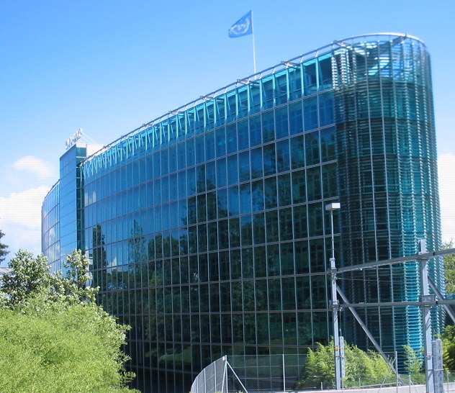
World Meteorological Organization
7bis, avenue de la Paix
CH-1211 Geneva 2
Switzerland
Thank you
Notes:
12
12

Slide 13
Back up slides

Slide 14
WIGOS implementation
WIGOS – general promotion
Recognition and commitment to WIGOS by
PRs and
higher level representatives from the private sector
can and should be still improved
More information material should be prepared to explain the benefits of
WIGOS and to mitigate the misunderstanding concerning WIS and WIGOS
WMO
Technical Support for OSCAR/Surface
Requirements / demands
comprehensive manual for the use of OSCAR/Surface
guidelines and examples for populating OSCAR/Surface using the
machine-to-machine interface
NMHS are advised to consolidate national metadata databases
checklist of basic principles should be provided
Notes:
14

Slide 15
WIGOS implementation
Support Platforms
Urgent need for an online WIGOS technical support forum
Specific Region VI newsletter - as an easy way to keep up with regional WIGOS activities (prepared by ROE with input from RA-VI/TT-WIGOS)
Help Desk function - as one of the possible tasks for Regional WIGOS Centers
The main task would be the interpretation of WIGOS requirements
Communication Platforms
Quarterly teleconferences and increased frequency of face-to-face meetings
(if resources are available) would be helpful in keeping the momentum
of the WIGOS implementation and in enhancing coordination
National WIGOS Implementation Plan
Support to NMHSs can be provided e.g. via a template National WIGOS Implementation Plan, including examples for smaller and larger NMHSs
Guidelines would be also helpful for the development of relationships with third parties
WMO
Notes:
15

Slide 16
Proposed functionalities of RWC
The main tasks for RWCs identified by the group include
coordination between Members and WMO bodies
improved communication through provision of contact points
education and training concerning WIGOS implementation
technical support
network design / management
data quality monitoring
meta data management
providing links to external entities and establishing of partnerships with different regional groupings
(oceanography, climate, hydrology, instrument calibration)
WMO
Notes:
16

Slide 17
Proposed functionalities of RWC
Coordination, communication working packages
Coordination (if implemented as Virtual Center involving more than one NMHSs)
Overarching coordination and communication with all RWCs in the Region, WMO Regional Office, relevant RA Working Groups and Task Teams RA, WMO Secretariat
Communication.
Act as Regional information resource for Members concerning various aspects of WIGOS implementation
Collect and document regional experience with WIGOS implementation and its benefits
Support for education & training in WIGOS implementation, especially concerning
Establishment of partnerships
WIGOS metadata management (OSCAR/Surface)
WMO
Notes:
17

Slide 18
Implementation of Regional WIGOS Centers
Difficult for most NMHSs to identify new resources for such entities
However, it is felt that it would be attractive for many Members to take on responsibility for one or more functionalities
RA-VI
RWCs could be implemented as virtual centers, where a group of NMHSs would share the relevant tasks between them under the overall coordination of one of them (illustrated in the next slide)
RWCs need not cover the Region as a whole; tasks could be shared between Regional WIGOS Centers covering subregions, with areas of responsibilty aligned with existing geographic or linguistic boundaries within the Region
In RA-VI, the existing EUMETNET activities could be strengthened and broadened to encompass several intended RWC functionalities at the WMO level
WMO
Notes:
18

Slide 19
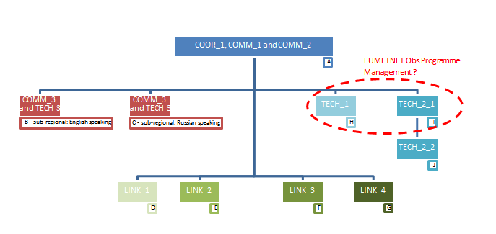
Structure of (virtual) RWC in RA VI
WMO
Notes:
19

Slide 20
Next steps
RA-VI Management Group will discuss the Virtual Center model proposed by the RA-VI Workshop and the RA-VI WG-TDI
Since this is heavily dependent on EUMETNET and its infrastructure, EUMETNET STAC, PFAC, and Plenary will need to discuss this
If EUMETNET agrees, existing EUMETNET / WMO MoU could be amended to include this
Possible prototype implementation of RWC for Region VI could take place in 2017/18
In parallel, possible implementation mechanisms will be discussed also with other WMO Regions
WMO
Notes:
20

Slide 21
Overcoming barriers
WMO
Sub-regional informal groupings could help eliminate some of the barriers
resulting from different
time zones
languages
limited resources
RA-VI/TT-WIGOS could be enhanced with a sub-group
on a structure for RWC and
support of N-WIP and OSCAR/Surface
Notes:
21

Slide 22
Summary
The meeting concluded that RA VI should with no delay
proceed with the preparations for setting up of the regional WIGOS centers,
presumably as a
virtual centre/s with distributed roles and responsibilities among different
NMHSs and/or DCPCs.
WMO
Notes:
22

