Slide 1
The WIGOS Data Quality Monitoring System (WDQMS) and the Role of the Regional WIGOS Centers (RWC)
Workshop …
September 2016
WIGOS Project Office, WMO Secretariat

Slide 2
Outline
The WIGOS Pre-Operational Phase 2016-2019
Focus on three out of five priorities:
WIGOS Information Resource and OSCAR
WIGOS Data Quality Monitoring System
Regional WIGOS Centers
More specifically on the WDQMS
Final remarks
WMO

Slide 3
The WIGOS Pre-Operational Phase (2016-2019)
Increased emphasis on regional and national activities
Five main priority areas:
National WIGOS Implementation, coordination and governance mechanisms
WIGOS Regulatory Material, supplemented with necessary guidance material
WIGOS Information Resource, including the Observing Systems Capabilities analysis and Review tool (OSCAR), especially OSCAR/Surface
WIGOS Data Quality Monitoring System (WDQMS)
Regional Structure; Regional WIGOS Centers
Priority areas III and IV will enable us to:
Describe what WIGOS is, and
Measure how well it performs
Initial role of this priority area (RWCs):
Provide support for areas III and IV

Slide 4
OSCAR
WIGOS (and its Rolling Review of Requirements) is supported by three key databases of OSCAR, the Observation Systems Capabilities Analysis and Review tool :
OSCAR/Requirements, in which “technology free” requirements are provided for each application area, expressed in units of geophysical variables (260 in total currently), not measurands; not just atmosphere, also terrestrial, ocean, cryosphere, …
OSCAR/Space, listing the capabilities of all satellite sensors, whether historical, operational or planned
OSCAR/Surface, list surface-based capabilities; developed by MeteoSwiss for WMO
oscar.wmo.int/surface
“What is WIGOS?”

Slide 5
OSCAR/Space (“What is WIGOS?”)
Repository of metadata about all satellite sensors (past, present and future) relevant to WMO Programs and Application Areas
Instrument type, measurement technique
Instrument characteristics (mass, power, data rate)
Programmatic information, e.g. agency, measurement program, operating period, heritage, etc.
Orbit, coverage, repeat frequency, resolution
Capabilities, expressed in terms of geophysical variables that can be derived from the measurements provided by the sensor, listed in order of decreasing fidelity
Unique to OSCAR/Space

Slide 6
OSCAR/Surface
(“What is WIGOS?”)
Implementation layer of the WIGOS Metadata Standard: Modern, electronic, searchable inventory of metadata for all observing stations/platforms under WIGOS
OSCAR/Surface is replacing WMO Pub. 9, Volume A, but will also include information from similar inventories for other (non-GOS) components of WIGOS
Developed jointly by WMO and MeteoSwiss, with the Swiss government providing the major part of the funding
Operational mode started May 2, 2016
Education and training to Members in populating, editing and using OSCAR/Surface is a major priority for 2016-19

Slide 7
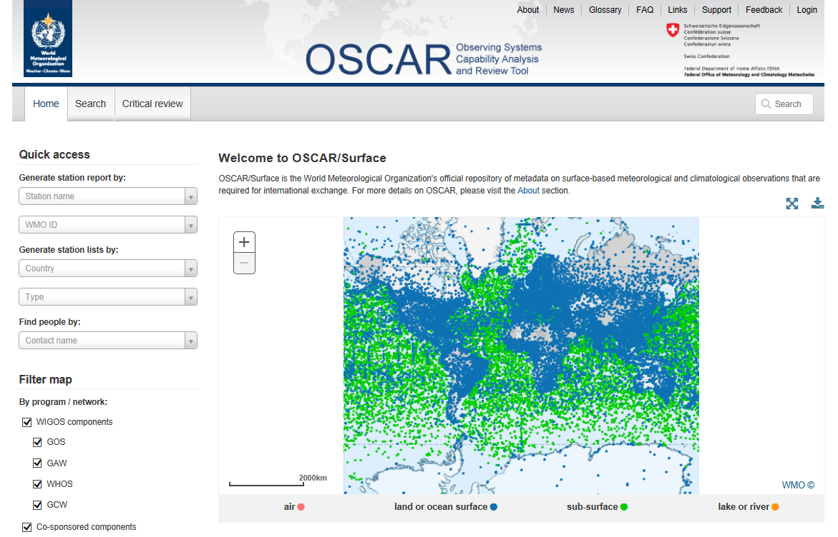
Screenshot from OSCAR/Surface home page

Slide 8
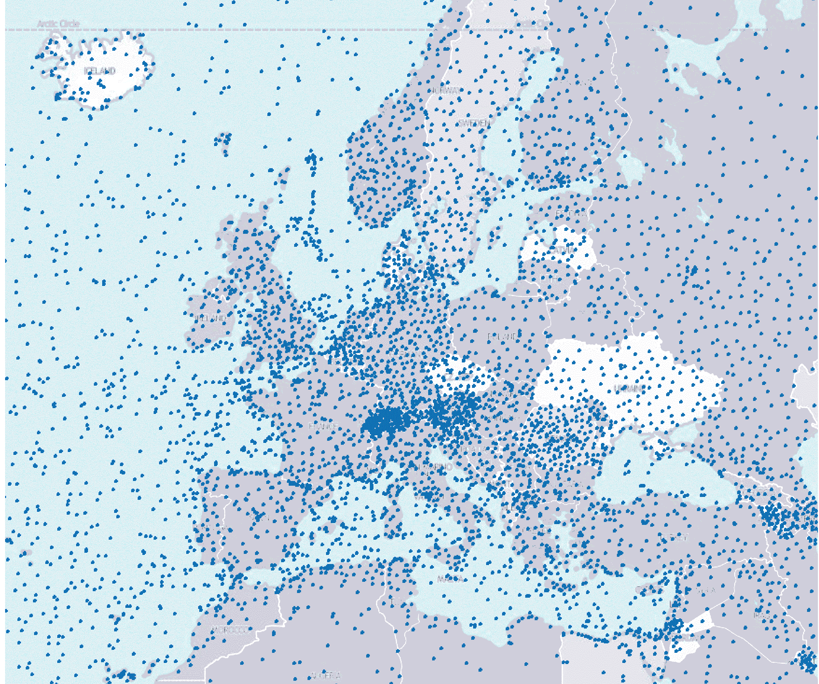
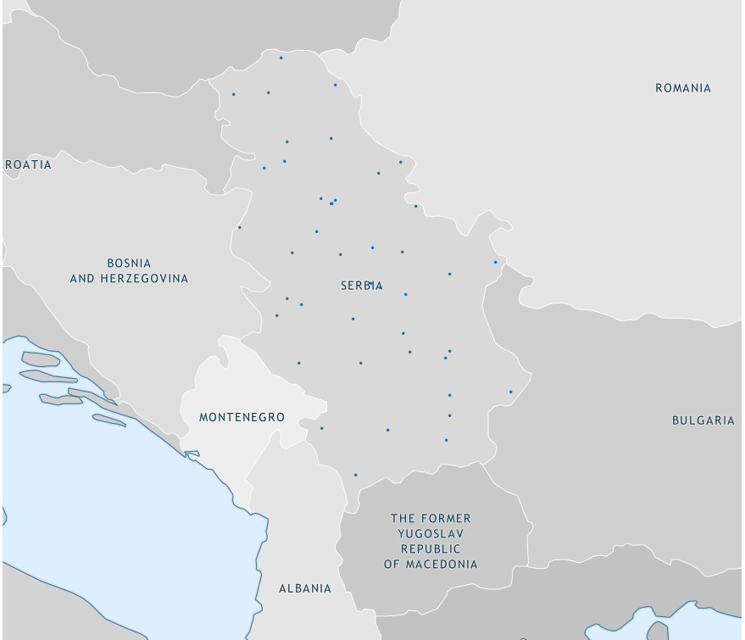
Screenshots from OSCAR/Surface for a certain region and country

Slide 9
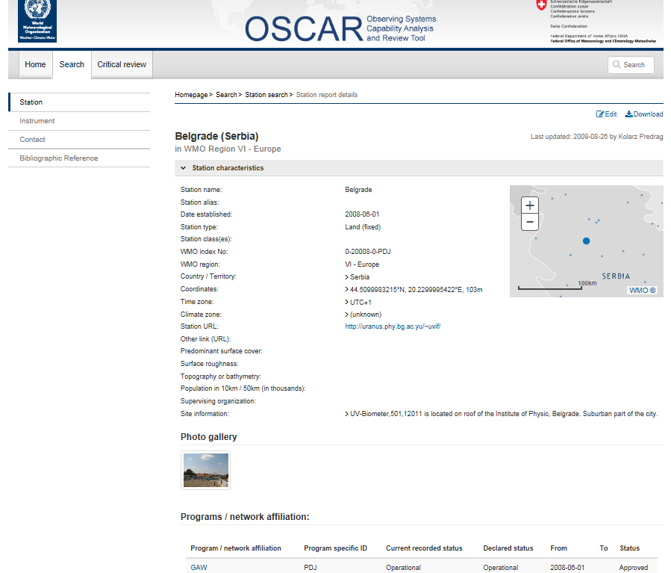

Slide 10
WIGOS Data Quality Monitoring System (WDQMS) (“How well is WIGOS working?”)
Real-time monitoring of performance (data availability and data quality) of all WIGOS components, searchable by region, country, station type, period, etc.
Monitor regional and national performance of all WIGOS components
Pilot projects involving ECMWF, NCEP, DWD and others underway
Delayed mode monitoring of data quality as measured against reference sources of information.
Incident management system for tracking and mitigation of performance issues.
Demonstration project in RA I, started operations 4 July 2016 with Kenya and Tanzania

Slide 11
WIGOS Data Quality Monitoring System (WDQMS) (“How well is WIGOS working?”)
Key priority:
development of a modern and efficient performance monitoring and reporting system for observational data availability and quality.
essential for measuring the effectiveness and impact of WIGOS, and for developing robust incident management practices that will lead to improved WIGOS data quality and availability.
A Task Team on WDQMS has been established by ICG-WIGOS, with initially experts from CBS, particularly focusing on modernizing the NWP-based monitoring of the surface-based component of the WIGOS.
Substantial resources will be needed in order to develop the initial ideas into an actual system, to bring in the space-based component of the GOS, and to broaden the concept to the other WIGOS component systems.
Incremental IT resources will be required to support the generation, exchange, storage and analysis of WIGOS-specific monitoring and incident management outputs/reports.

Slide 12
WIGOS Data Quality Monitoring System (WDQMS) Functional description of the 3 main components
The WIGOS Quality Monitoring Function:
- essentially provided by Global NWP Centres, who have been working on monitoring reports, as a by-product of the data assimilation process;
- Three additional NWP Centres, Canada, Germany and Japan, expressed their interest in joining ECMWF and NCEP the efforts.
WIGOS Evaluation (and reporting) Function:
Takes the QM outputs from contributing centres, extracts metadata from OSCAR, and generates routine reports based on performance indicators (e.g. compared with the status in OSCAR).
It will determine if the issues identified justify to formalize them as Incidents with the data provider. A semi-automated Global Centre is planned to provide routine reports and make available specific info to regional/thematic centres.
WIGOS Incident Management Function:
If the issues considered by the Evaluation function merit being raised as Incidents, this will be undertaken by the Incident Management Function.
Key to the success of this function will be the clear communication of incidents with the data providers and with data users to ensure they take suitable precautions regarding the affected data.

Slide 13
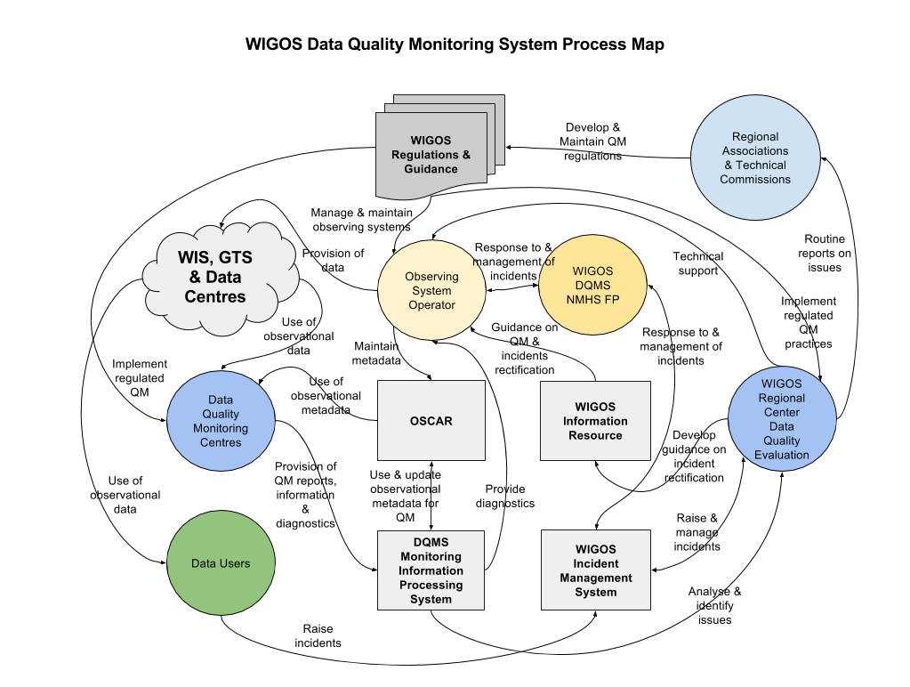
Structure and Process Diagram of the WDQMS
Possible RWC role

Slide 14
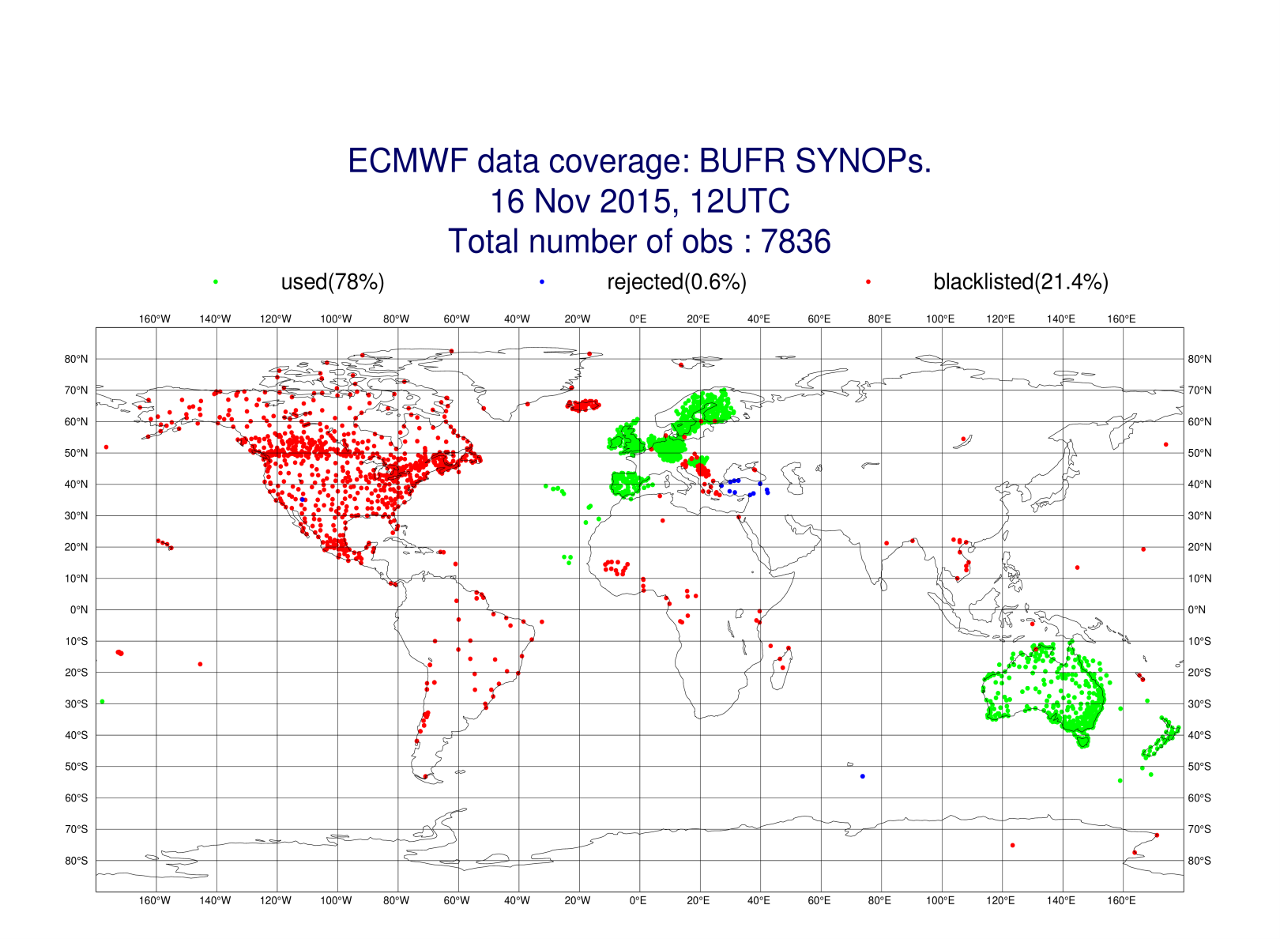
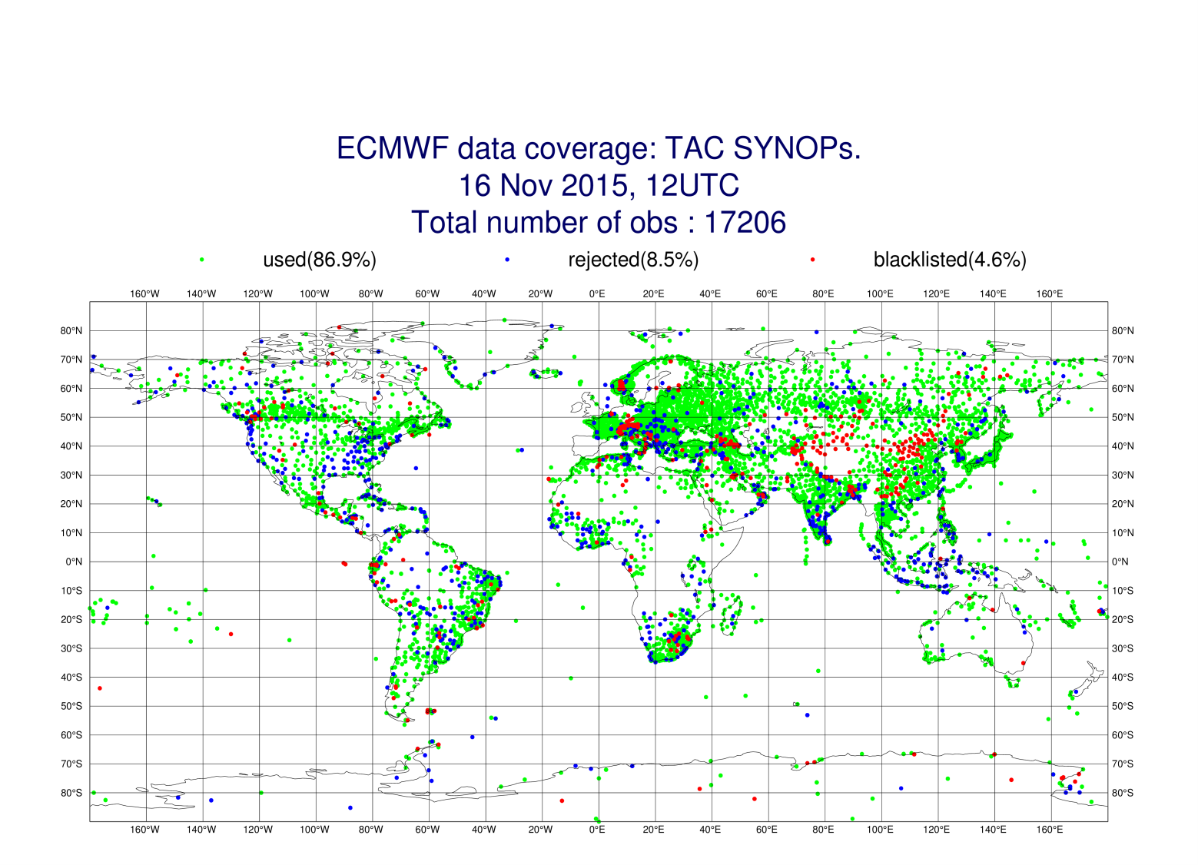
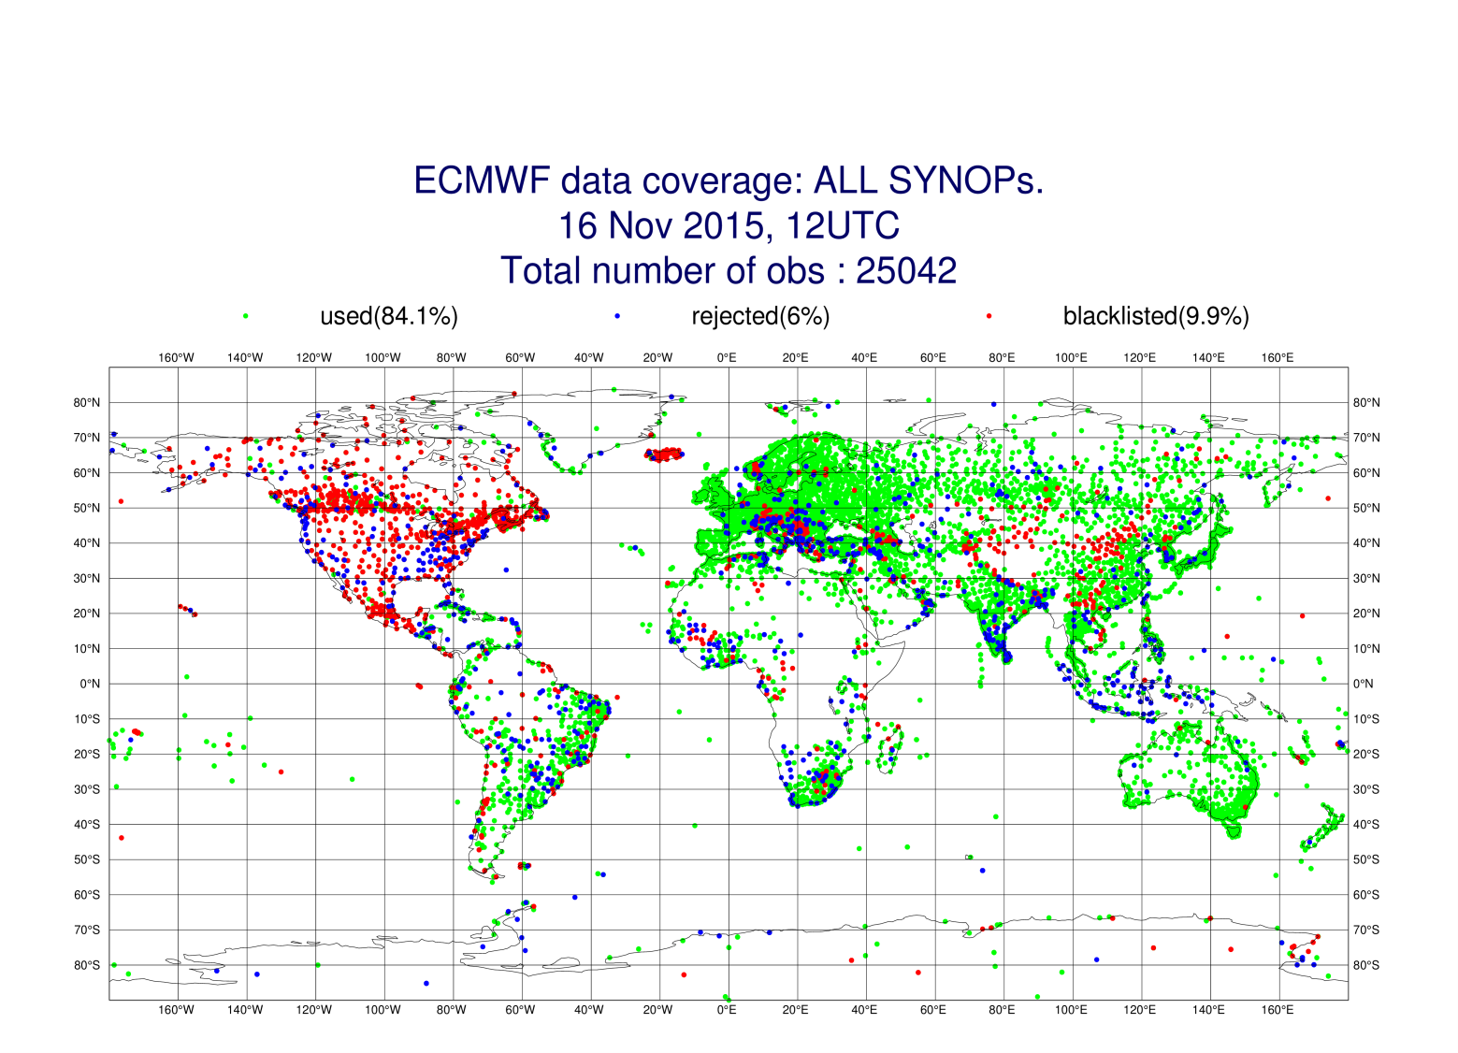
WDQMS – ECMWF Images - snapshot

Slide 15
Regional WIGOS Centers (RWC)
Why?
Many WMO Members requesting support from Secretariat for national implementation efforts
This can be addressed more efficiently and effectively at regional level
What?
Initial role or RWC will be to support national WIGOS Implementation efforts, in particular as concerns
OSCAR/Surface; ensuring metadata input and QC
WDQMS; especially fault management component
How?
This is for the individual WMO Regions to decide
Initial discussions in RA-VI point to EUMETNET having a role

Slide 16
Regional WIGOS Centers
Discussions within RA-VI
Unique characteristic of Region VI: EUMETNET, including more than half the WMO RA-VI Members, is already actively pursuing several elements of WIGOS implementation
RA-VI Workshop on WIGOS (Belgrade, Nov 2015)
WMO-DWD meeting (Offenbach, Jan 2016)
ICG-WIGOS-5 (Geneva, Jan 2016)
EUMETNET Executive Director, EUMETNET Observations Program Manager, President of RA-VI, WMO Regional Office of Europe, WIGOS Project Office,… (conference call Feb 2016)
EUMETNET STAC/PFAC (Bratislava, March 31 2016)

Slide 17
Regional WIGOS Centers
Concept adopted by EC-68
Mandatory functions
The proposed mandatory functions are directly linked with two of the priority areas of the WIGOS Pre-operational Phase (2016-2019):
1. Regional WIGOS metadata management (work with data providers to facilitate collecting, updating and providing quality control of WIGOS metadata in OSCAR/Surface);
2. Regional WIGOS performance monitoring and incident management (WIGOS Data Quality Monitoring System) and follow-up with data providers in case of data availability or data quality issues.

Slide 18
Regional WIGOS Centers
Concept adopted by EC-68
Links to other WMO entities:
The RWCs will ensure efficient and effective implementation of WIGOS by working closely with:
- WMO Secretariat (including Regional Offices),
- their respective regional working bodies.
The RWCs will liaise with relevant WMO Centres in particular with:
- the Regional Instrument Centres (RICs),
- Regional Climate Centres (RCCs),
- Regional Training Centres (RTCs)
Basic Functionalities:
- regional coordination, guidance, oversight and support of WIGOS implementation;
- operational activities at the regional and national levels (day-to-day level of activities).

Slide 19
Regional WIGOS Centers
Concept adopted by EC-68 (Cont.)
Optional functions
Depending on available resources and regional needs, one or more optional functions may be adopted, e.g.:
assistance with the coordination of regional/sub-regional and national WIGOS projects;
assistance with regional and national observing network management;
support for regional capacity development activities.

Slide 20
Regional WIGOS Centers
Concept adopted by EC-68 (Cont.)
Implementation options
Each Member should be covered by an RWC which will be responsible for providing WIGOS support;
- RWCs may be implemented either:
- centrally, at an overall regional level where a Member or a consortium of Members provide support for the entire Region,
- or at sub-regional level, e.g. aligned with the natural geographic or linguistic boundaries existing within the Region.
RWCs may be implemented either:
- as monolithic entities, with a single Member taking on the responsibility for the entire set of required functionalities,
- or as virtual Centres, in which a consortium of Members share these responsibilities between them under the overall coordination of a lead organization.

Slide 21
Next steps
RA-VI Working Group on Technology Development and Infrastructure, plus TT-WIGOS, Belgrade, June 2016
RA-VI Management Group Meeting in Madrid (June 2016)
Amendment to existing EUMETNET-WMO MoU (if agreed by both sides)
RA-VI RWC Implementation Meeting involving NMHSs interested in participating (Zagreb, September 2016; tentative)
Key milestones proposed in the Plan for the WIGOS Preoperational Phase:
(a) Establishment of one or more RWC in pilot mode from 2017,
(b) Operational phase of initial RWC beginning mid-2018,
(c) Establishment of RWC covering all WMO Regions by 2019.

Slide 22
Thank you for your attention
http://www.wmo.int/wigos
lfnunes@wmo.int

Slide 23
Proposed functionalities of RWC
From RA-VI Workshop (Belgrade), shown by Ivan Cacic, RA-VI President, at ICG-WIGOS-5
The main tasks for RWCs identified by the group include
coordination between Members and WMO bodies
improved communication through provision of contact points
education and training concerning WIGOS implementation
technical support
network design / management
data quality monitoring
meta data management
providing links to external entities and establishing of partnerships with different regional groupings
(oceanography, climate, hydrology, instrument calibration)
WMO

Slide 24
Proposed functionalities of RWC
Coordination, communication working packages
From RA-VI Workshop (Belgrade), shown by Ivan Cacic, RA-VI President, at ICG-WIGOS-5
Coordination (if implemented as Virtual Center involving more than one NMHSs)
Overarching coordination and communication with all RWCs in the Region, WMO Regional Office, relevant RA Working Groups and Task Teams RA, WMO Secretariat
Communication.
Act as Regional information resource for Members concerning various aspects of WIGOS implementation
Collect and document regional experience with WIGOS implementation and its benefits
Support for education & training in WIGOS implementation, especially concerning
Establishment of partnerships
WIGOS metadata management (OSCAR/Surface)
WMO

Slide 25
Implementation of Regional WIGOS Centers
From RA-VI Workshop (Belgrade), shown by Ivan Cacic, RA-VI President, at ICG-WIGOS-5
Difficult for most NMHSs to identify new resources for such entities
However, it is felt that it would be attractive for many Members to take on responsibility for one or more functionalities
RA-VI
RWCs could be implemented as virtual centers, where a group of NMHSs would share the relevant tasks between them under the overall coordination of one of them (illustrated in the next slide)
RWCs need not cover the Region as a whole; tasks could be shared between Regional WIGOS Centers covering subregions, with areas of responsibilty aligned with existing geographic or linguistic boundaries within the Region
In RA-VI, the existing EUMETNET activities could be strengthened and broadened to encompass several intended RWC functionalities at the WMO level
WMO

Slide 26
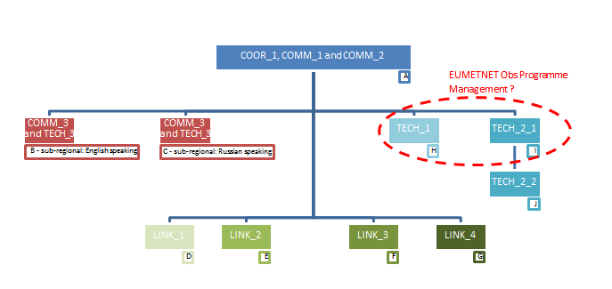
Structure of (virtual) RWC in RA VI
From RA-VI Workshop (Belgrade), shown by Ivan Cacic, RA-VI President, at ICG-WIGOS-5
WMO

