Slide 1
AMMC as DCPC WIS/WIGOS for the benefit of maritime services
Dijana Klarić
AMMC project manager
DHMZ
www.meteo.hr
dijana@cirus.dhz.hr

Slide 2
outline
Adriatic Marine Meteorological Center AMMC
DCPC WIS/WIGOS as cooperation of NMS
AMMC to fit at European actions
WIS-WIGOS learning curve
AMMC for RA VI WIGOS actions

Slide 3
DHMZ official duties
Meteorological and Hydrological Service of Croatia (DHMZ), is a state institution of Croatia, to provide support to economic development, environment protection, to act towards the preservation of life and material goods from natural hazards and disasters and to mitigate their consequences.
As part of Croatian national obligations and responsibilities as maritime country, DHMZ is authorized for the national operative marine services, provided by the Marine Meteorological Center in Split.
DHMZ represents Republic of Croatia at World Meteorological Organization (WMO) and Joint WMO-IOC Technical Commission for Oceanography and Marine Meteorology (JCOMM).
DHMZ operates several ranges of observation networks (meteorological, climatological, hydrological, marine), at more than 600 observation sites with automated and human operated programs.
DHMZ runs call centers dedicated to meteo, hydrological and marine information services.
DHMZ holds several ISO Accreditation Certificates for calibration of measurements

Slide 4
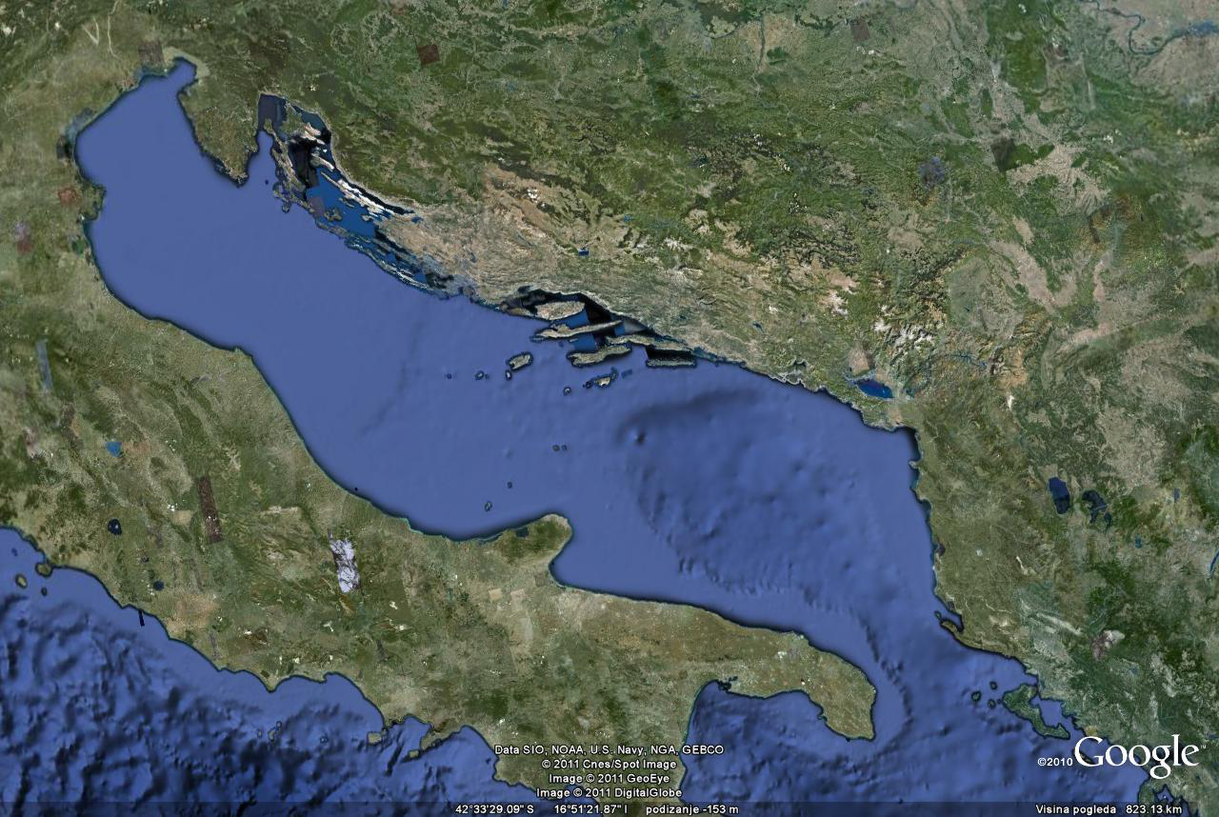
CROATIA - MARITIME COUNTRY
Total population 4,44 million / 30.000 seafarers
Lenght of coastline 6287 km
1246 islands of which 47 populated
Semi-closed sea basin
6 major ports, 98 ports with ship lines, 407 small ports and marines
Ship lines traffic: 11 mil. passengers, 2.8 mil. vehicles
Total number of passengers: 12 mil. maritime transport, ship cruisers, recreational ships
539 yachts and 103.945 boats registered
visit of 54.000 foreign yachts /year for recreational tourism
Search & rescue /year: ~800 rescued persons,~200 rescued vessels
35%more till
1st July 2016
Notes:
Traffic routes and maritime traffic intensity in the Adriatic Sea in 2008
Source: Policy Research Corporation based on Maglic, L., Simic Hlaca, M. & Zec, D., 2009, Maritime
Transport and Possible Accidents in the Adriatic Sea
The port of Split is the largest passenger port in with over 3,5 million passengers and more then half a million vehicles annually, which places the port as the third most important passenger port in the Mediterranean (after Naples and Piraeus)

Slide 5
Requirements for regional actions at Adriatic Sea
WMO Office for Europe - Initiative
Centres of excellences as a regional partnership activities of NMHSs, to respond to:
the specific country needs
country strategic goals in the sub-regional context
Regional inventory of core activities and candidates for leading centers:
WMO Informal Conference of Directors for South-East Europe (ICEED), Dubrovnik, 2006
Regional instrument centre – RIC (Ljubljana,Slovenia)
Sub-regional drought management centre for SE Europe (Slovenia, Romania, ...)
Sub-regional marine meteorological centre for Eastern Adriatic (Split, Croatia)
Sub-regional marine meteorological centre for Black Sea (Bulgaria, Romania)
Sub-regional climate centre (Belgrade, Serbia)
Regional education and training centre on NWP in SEE (Bucharest, Romania)
Sub-regional GCOS training centre for usage of satellite data in climate monitoring (Zagreb, Croatia)

Slide 6
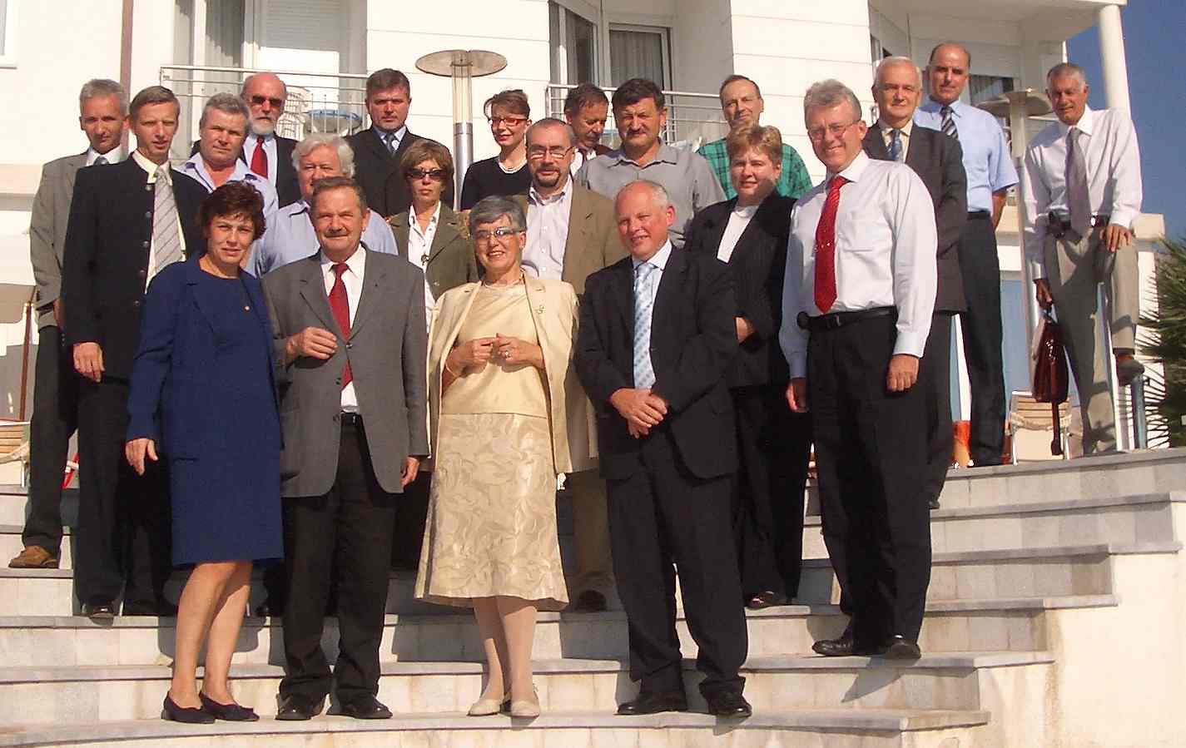
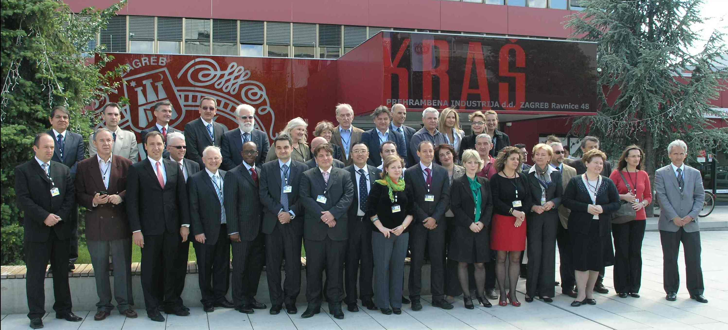
A long path from 2006
National Meteorological and Hydrological Service
Institute of Oceanography and Fisheries
Croatian Hydrographic Institute
Department of Geophysics, Faculty of Science, University of Zagreb
State Directorate on Resque and Protection
Ministry of Maritime Affairs, Transport and infrastructure
Croatian Navy
Plovput d.o.o. Split
Faculty of Maritime Studies, Universitiy of Split
Faculty of Maritime Studies, University of Rijeka
The First National Partnership Agreement on the Regional Marine Meteorological Center, Postrana, October, 2006
WIS DCPC - WIGOS AMMC Workshop, Zagreb, May 2012

Slide 7
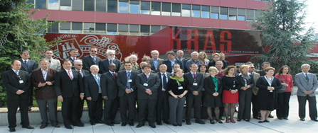
Adriatic Marine Meteorological Center (AMMC)
RA VI WIS/WIGOS Workshop on Enhanced Marine Services for Adriatic Sea Area,
17-18 May 2012, Zagreb, Croatia
- WMO secretariat, RA VI office, CBS, WIS, JCOMM, in collaboration with DHMZ
NHMSs:
Bosnia and
Herzegovina
Croatia
Italy
Montnegro
Romania - observer
Slovenia
Zagreb Initiative agreement ( BIH, CRO, IT, MNE, SLO)
to establish an Expert Team ,nominated by the WMO PRs of the countries in the sub-region, to conduct the follow-up activities including roadmap and action plan to implement the functionality as described in the Concept Document.
accept the offer of Croatia, to implement WIS-DCPC / WIGOS Center
Pilot Project for sub-regional cooperation in the provision of marine services
(WIGOS component) over Adriatic Sea area as a template for small / inner sea / gulf
( e.g. Black Sea, Baltic Sea, Arabian Gulf )
Notes:
7

Slide 8
WIS DCPC / WIGOS AMMC – Role
To follow up WMO and JCOMM objectives and priorities, search for cross cutting solutions and ensure marine meteorological and oceanographic information (data and products) and services for the Adriatic sea area by
Processing and quality management of marine meteorological and oceanographic
observations and products, including discovery metadata via WIS/DCPC System
Initiating WIGOS implementation at marine and oceanographic observations, taking into account the difference in practice and products (interoperability)
Contributing in common marine information system for wider user community (e.g. maritime, traffic and risk management authorities, navy, coastal and marine enterprises, media and tourism, public and private enterprises, interdisciplinary research community),
in particular for the
production of operational marine/oceanographic analyses and forecastes
provision of warning services according to WMO and JCOMM standards
delivery climate services related to marine atmosphere, coastal and deep sea
Notes:
8

Slide 9
WIS DCPC / WIGOS AMMC – Status
WIS DCPC CANDIDATES
Current status
Member or Organization and Centre | Associated Technical Commission or Constituent Body | Centre’s Principal Function | Proposed Principal Associated GISC | Congress Designation | Endorsed by CBS
Australia (Melbourne) | JCOMM | Tsunami Warning Service | Melbourne | Yes (Conditional) | Under Review with GISC Melbourne
Croatia (Zagreb) | JCOMM | Marine Meteorological Centre | WE-VGISC (Offenbach) | Yes (Conditional) | Under review by ET-GDDP
Germany (Hamburg) | JCOMM | Global Collection Centre | WE-VGISC (Offenbach) | Yes | Yes
Qatar | JCOMM | Qatar Meteorological Department DCPC and Gulf Marine Center |  | No | No
Russian Federation (Obninsk) | JCOMM | NODC and GDC | Moscow | Yes (Conditional) | Not submitted to ET-GDDP
United Kingdom of Great Britain and Northern Ireland (Exeter) | JCOMM | Marine Observations Centre | WE-VGISC Exeter | Yes | Yes
United Kingdom of Great Britain and Northern Ireland (Exeter) | JCOMM | Specialized Ocean and Wave Centre | WE-VGISC Exeter | Yes | Yes
United States of America (Ashville) | CCl | GOSIC | Washington | Yes (Conditional) | Not submitted to ET-GDDP
United States of America (Washington) | JCOMM | NODC | Washington | Yes (Conditional) | Not submitted to ET-GDDP
APPROVED during WMO CBS congres September 2014

Slide 10
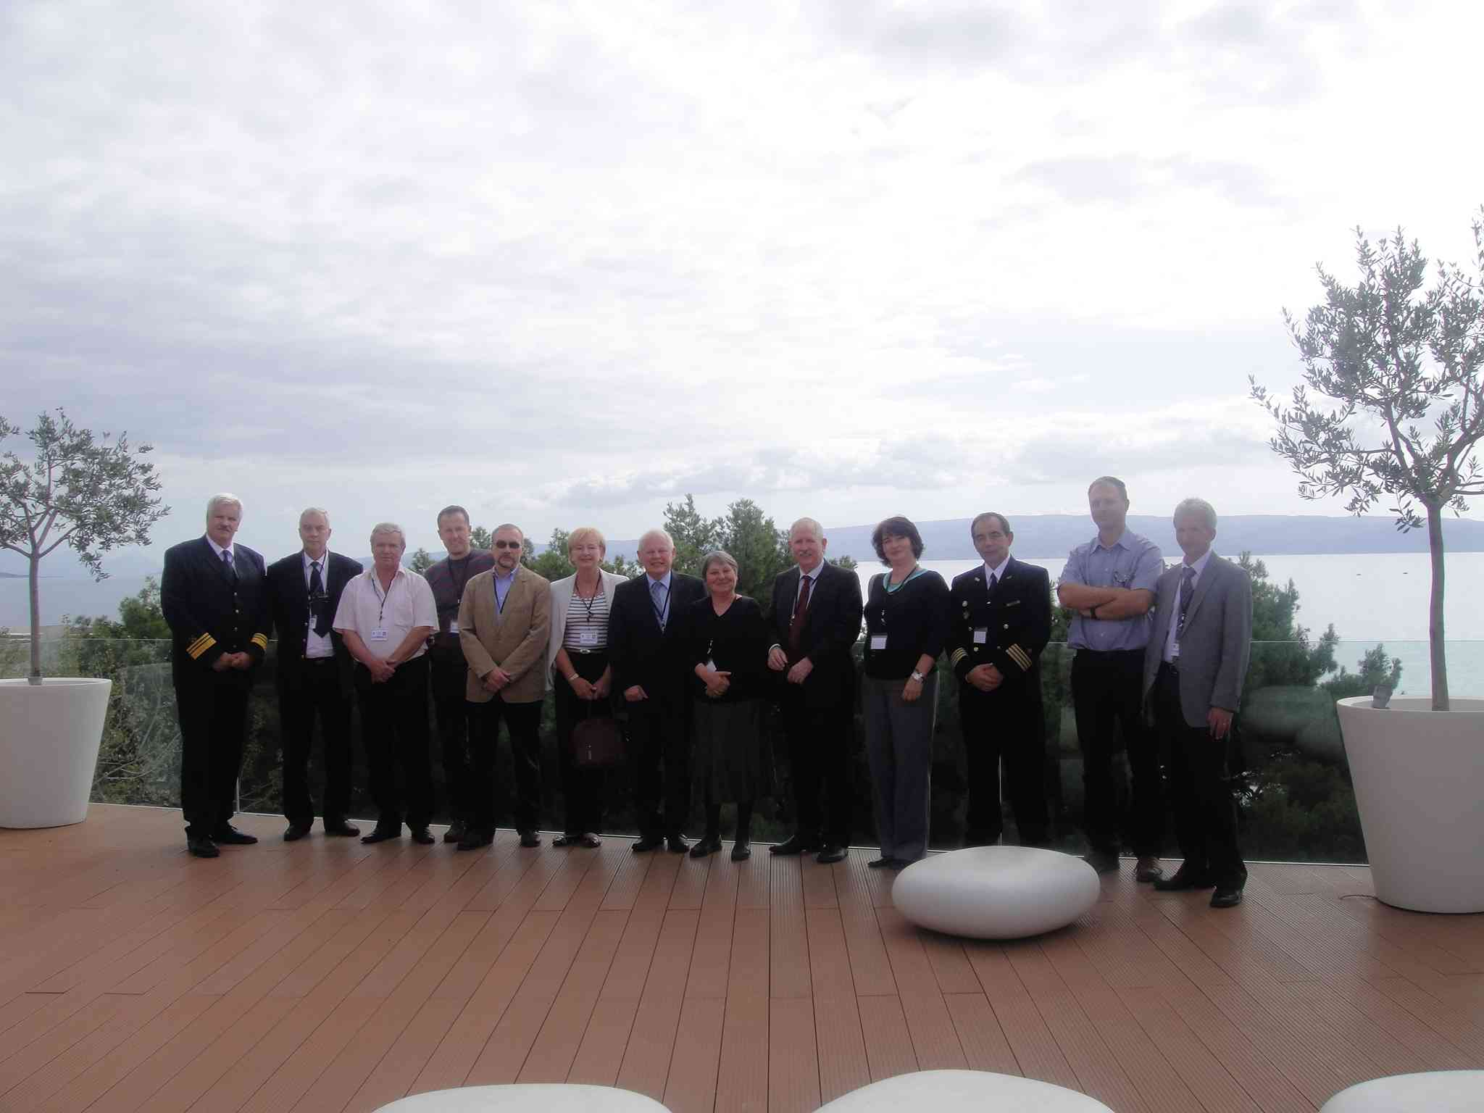
RA VI WIS/WIGOS Expert Team Meeting
RA VI WIS/WIGOS AMMC Expert Team meeting, Split, Croatia, 18-19 October 2012
Two meetings
Croatian Expert Team meeting with the national stakeholders / partners experts
Overview of marine and ocean operational and research potentials in a WIS and
WIGOS context
Hydrographic Institute, Oceanographic Institute, Geophysical Institute, Institute
Rudjer Boskovic, Croatian Navy, Harbour Masters
Gap and opportunity analysis (e.g. data, products, users *as partners)
Notes:
Suggested corresponding text:
Currently, activities on establishing of the Adriatic marine meteorological centre are concentrated in completing the administrative and technical procedures needed for the approval of the WIS center by the World Meteorological organization as well as the Joint Commission for Oceanography and Marine Meteorology. We have also organized two workshops for all interested national and international stakeholders where action plan for the period 2012-2014 is agreed.
Meteorological and Hydrological Service of Croatia has also implemented WEB portal www.ammc.hr which looks like this:::, but is still in the test phase.
Comments on WMO kick-off meeting:
First ever sub-regional meeting on operative Marine meteorological products
recognized and co-financed by WMO
It serves as Pilot project for future initiatives at Black sea area, Persian Gulf area
Comments ob WEB portal:
www.ammc.hr is alive portal, part of Croatian products, linked to meteorology are already there
Comment on Partners Expert Team meeting, Split, October 2012:
Primary goal is cooperation on Meteorology, Hydrology and Oceanography on Adriatic Sea Area
Data and product inventory, academic and operative products
sea tide, sea waves, sea currents and interaction of seal- atmosphere -rivers are primary goals
Oil split oceanographic models for sea pollution scenarios for Adriatic sea are also available but no 24/7/365 service exists,
link with sea-quality monitoring , part of EU regulatory activity could be established in future
Discussion:
- Future link to Marine Pollution Emergency Response Support System for the high seas (MPERSS) ????
AMMC Products should be at higher resolution then existing products at Global Maritime Distress & Safety System (GMDSS)
10

Slide 11
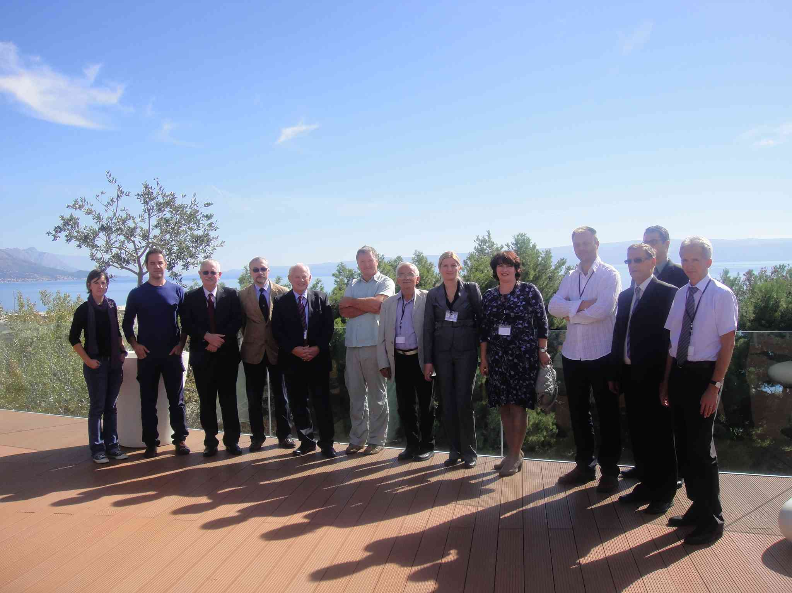
RA VI WIS/WIGOS Expert Team Meeting
RA VI WIS/WIGOS AMMC Expert Team meeting, Split, Croatia, 18-19 October 2012
Partners ET meeting: areas of cooperation in meteorology, hydrology, oceanography, hydrography with link to sea pollution simulations
Recapitulation of gap and opportunity analysis
Stakeholders Roles and Responsibilities
Development of the Action Plan / Road Map 2013-2014 including timelines,
deliverables and milestones
Expert Team Terms of Reference and Scope
Notes:
Suggested corresponding text:
Currently, activities on establishing of the Adriatic marine meteorological centre are concentrated in completing the administrative and technical procedures needed for the approval of the WIS center by the World Meteorological organization as well as the Joint Commission for Oceanography and Marine Meteorology. We have also organized two workshops for all interested national and international stakeholders where action plan for the period 2012-2014 is agreed.
Meteorological and Hydrological Service of Croatia has also implemented WEB portal www.ammc.hr which looks like this:::, but is still in the test phase.
Comments on WMO kick-off meeting:
First ever sub-regional meeting on operative Marine meteorological products
recognized and co-financed by WMO
It serves as Pilot project for future initiatives at Black sea area, Persian Gulf area
Comments ob WEB portal:
www.ammc.hr is alive portal, part of Croatian products, linked to meteorology are already there
Comment on Partners Expert Team meeting, Split, October 2012:
Primary goal is cooperation on Meteorology, Hydrology and Oceanography on Adriatic Sea Area
Data and product inventory, academic and operative products
sea tide, sea waves, sea currents and interaction of seal- atmosphere -rivers are primary goals
Oil split oceanographic models for sea pollution scenarios for Adriatic sea are also available but no 24/7/365 service exists,
link with sea-quality monitoring , part of EU regulatory activity could be established in future
Discussion:
- Future link to Marine Pollution Emergency Response Support System for the high seas (MPERSS) ????
AMMC Products should be at higher resolution then existing products at Global Maritime Distress & Safety System (GMDSS)
11

Slide 12
Marine meteorology – what we learned
- No coordinated as integrated met-ocean system in general
- Marine meteorology is the complex and integrated and has
opportunity to gain from WIGOS
- Integrated data and products:
Meteorological (in-situ, satellite),
Hydrological ( rivers and water power plant discharges )
Oceanographic (physics and chemistry)
Lack of the met- ocean observation at Adriatic Sea (east coast)
No proper treatment of non SOLAS traffic and recreation vessels
no standards for small crafts warnings,
no standards for traffic management due to sea state conditions
SOLUTION : Regional marine meteorological coordination

Slide 13
AMMC scheme and link to WIS
AMMC Members focal points (WIS NC)
Define AMMC plans, legislation issues
Coordinate national Expert Team
Coordinate national Services, Institutes, Academia for Adriatic Sea products (priorities: meteorological, hydro, oceanographic products )
Coordinate national distribution and retrieval actions toward AMMC DCPC (WIS DAR)
Provide meta data, products to AMMC
WMO WIS
AMMC DCPC virtual center
Provide DCPC Portal and functionality INSPIRE
(DAR procedures, products, users, network, archive)
Provide link between AMMC and GISC Offenbach for WIS/WIGOS marine , oceanographic services
Provide operative Adriatic Sea area products to WIS/WIGOS systems
- Maintain operative and near-real time Adriatic Sea area products for public and scientific purposes
www.ammc.hr

Slide 14
WIS DCPC / WIGOS AMMC – Tasks for DHMZ
DCPC-AMMC as Virtual international center, hosted by DHMZ
- operative retrieval and distribution of observations and products with WIS/WIGOS responsibility and functionality
- GEOPORTAL
Inventory of data and products for Adriatic Sea Area
- permanent Expert Team actions
- products provided by Partners (complementary system)
Operative Center at National Level for:
Catalogue of methods, observations, products
- synthesized national measurements for Adriatic Sea Area as part of National WIGOS Implementation Plan (N-WIP)
- ensuring the operative products and procedures for atmospheric and oceanographic services
in particular, for monitor and warning marine-related hazards
- “quality monitoring” of national products
- Support in sharing of IT and high performance computing resources for operative and efficient daily marine products

Slide 15
To fit AMMC at European Actions
DHMZ experts presented AMMC and DHMZ activities at the EMODnet Physics Adriatic session, 3-4 December 2013, Split, Croatia.
DHMZ has participated at 3rd Annual SeaDataNet meeting, September 24-26, 2014 in Split, Croatia, hosted by the Institute of Oceanography and Fisheries.
DHMZ is a new member of MonGOOS/EuroGOOS from the 3rd Annual meeting, held 26-28 2014. November Lecce, Italy.
DHMZ experts have participated at 7th EuroGOOS Conference: Operational Oceanography for Sustainable Blue Growth, Lisbon 28/10/2014 - 30/10/2014
DHMZ become member of EuroGOOS at 30th May 2015, Brusseels

Slide 16
WIGOS „learning curve”
How to add Croatian met.-ocean measurements in
WIGOS & WIS?
JCOMM programs compliance (to enter OSCAR, WIS)
- stations IDs, WIGOS metadata, formats, WIS metadata
„Data harvesting” via geoportals (DAR)
AMMC WIS/WIGOS geoportal (INSPIRE, OGC standards)
JCOMMOPS system
EuroGOOS - EMODNet system
WIS-WIGOS partership in data exchange
AMMC
WIS
JCOMMOPS
EMODNet

Slide 17
AMMC for RA VI WIGOS actions
OPTIONS
test-bed for WIS-WIGOS ocean in Mediterranean
to spread WIGOS standards and procedures at sub-region
test two-way communication between met-ocean obs. providers (formats, WIGOS ID, metadata standards, WIS access and harvesting )

Slide 18
Thank you

