Slide 1
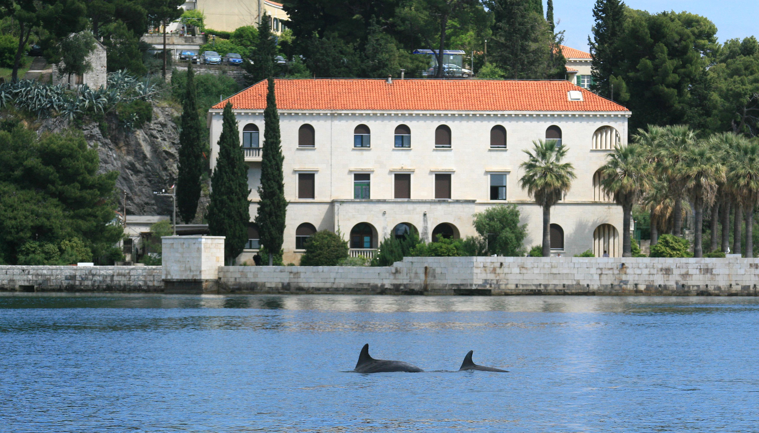
Institute of Oceanography and Fisheries (IOF)

Slide 2
By the decision of the Croatian Government the IOF in 2012 became National Reference Center for the Sea.
With 100 employees (out of which 54 scientists) and valuable modern equipment the IOF scientific, professional, educational and counseling activities are focused:
to study and preservation of marine environment
interpretation of spatial and temporal changes in oceanographic processes in the sea including the forecast of possible process
development and contribution to the creation of measures for preserving the Adriatic ecosystem and its biological resources.

Slide 3
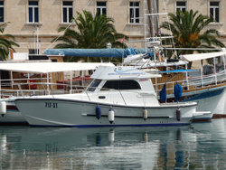
The boat length 10.8m (Calafuria Italia). This boat carried out a smaller coastal research and service activities with the operational oceanographic equipment
The research vessel length of 36.60 m. It is designed according to the specific needs of research Institute of Oceanography carried out. It can accommodate up to 18 members of researchers.
3.80m long inflatable boat, type Mistral. Serves for mapping the coast, transporting divers or collecting samples in the shallow areas of difficult access.

Slide 7
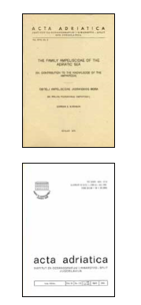
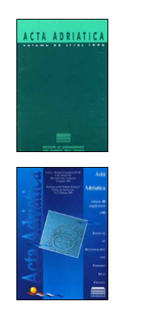
“Acta Adriatica” is the primary scientific publication with an
international review, a long tradition, which the Institute of
Oceanography and Fisheries in Split continuously published since
1932.

